Slide 1


Little Acts of Love for Len
Introduction
Faith
Hope
Justice (Kindness)
Love of Neighbor
Wisdom
Charity
Reflection
Mary’s Meals Prayer
Notes:
Teacher Notes
Encourage the students to notice details about the building and guess how old it is.
Teacher Narration
Take your best guess! How old do you think the remains of this building are?
Attribution
Photo by Rachel Claire: https://www.pexels.com/photo/ancient-concrete-temple-4819325/

Slide 2
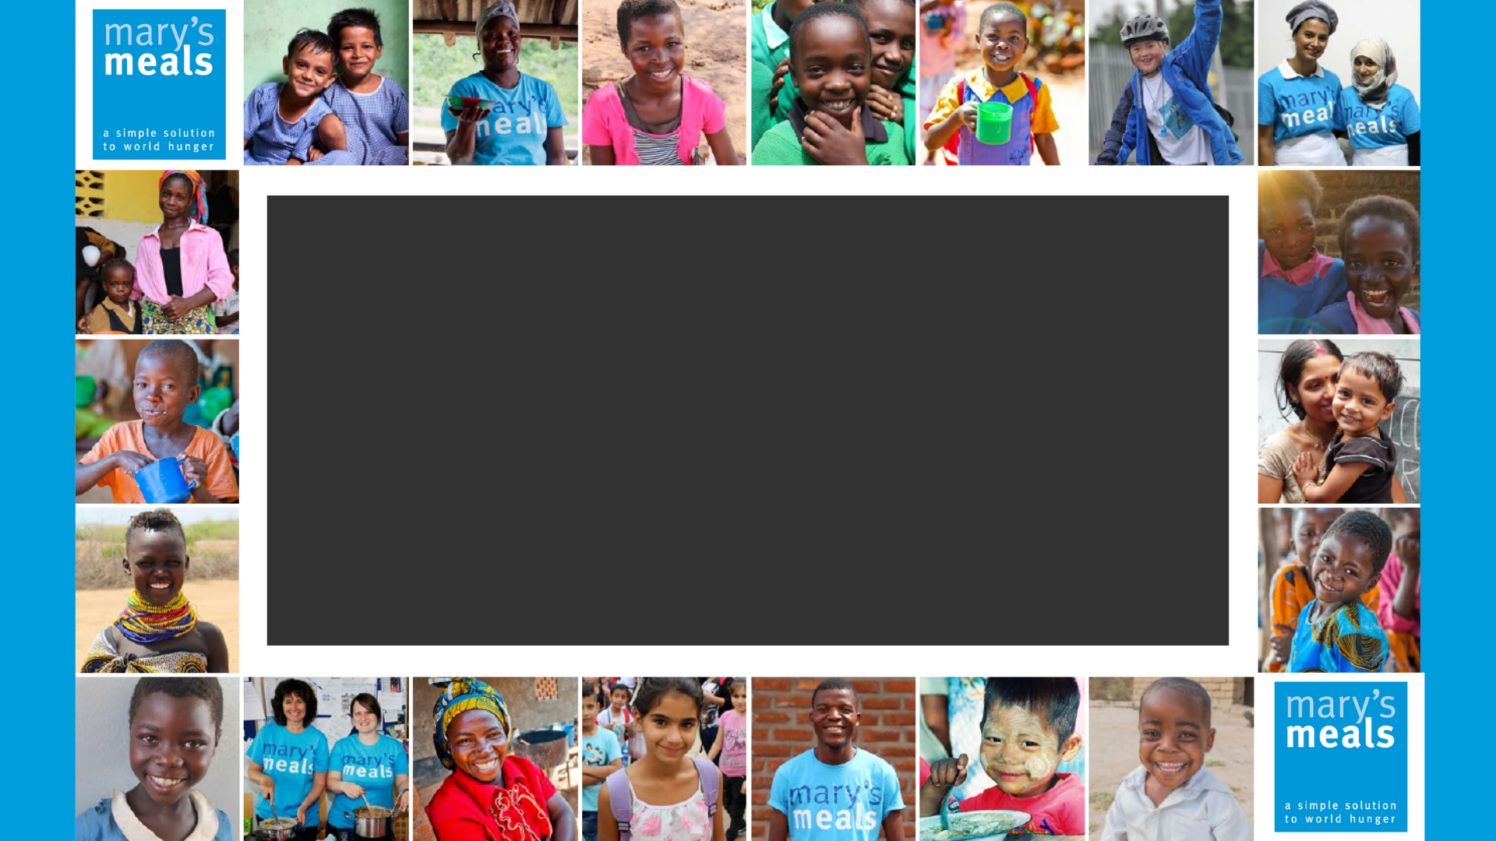
Little Acts of _Love for Len__
Notes:
Teacher Notes
Introduce “Little Acts of Love for Lent” as a six-week experience that will start next week. This lesson is introducing the students to what the experience will be like.
Teacher Narration
Welcome, everyone! Over the next six weeks, we’re going to embark on a special journey together called Little Acts of Love for Lent. Lent is a time for us to grow closer to God and reflect on how we can live out our faith in meaningful ways. It’s not just about making big changes—it’s about doing small, thoughtful things every day that show our love for God and for others.
Each week, we’ll focus on one important virtue, such as faith, hope, or kindness. These virtues are like building blocks that help us live a life full of love and purpose. Together, we’ll explore how these virtues connect to the three pillars of Lent: prayer, fasting, and almsgiving.
Here’s the exciting part: every week, we’ll practice little acts of love. These are simple but powerful things we can do to bring more love and goodness into our school, our community, and your own homes. Whether it’s helping someone in need, praying for a friend, or giving up something to focus on what matters most, these small acts of love can make a big difference.
By the end of Lent, we’ll have built something amazing—a stronger relationship with God and a heart that’s more open to loving others. So let’s get started! Together, we’ll discover how little acts of love can lead to great things.
Attribution
Image 1: Mary’s Meals Brand Book, page 4
Image 2: Mary’s Meals Logo

Slide 3
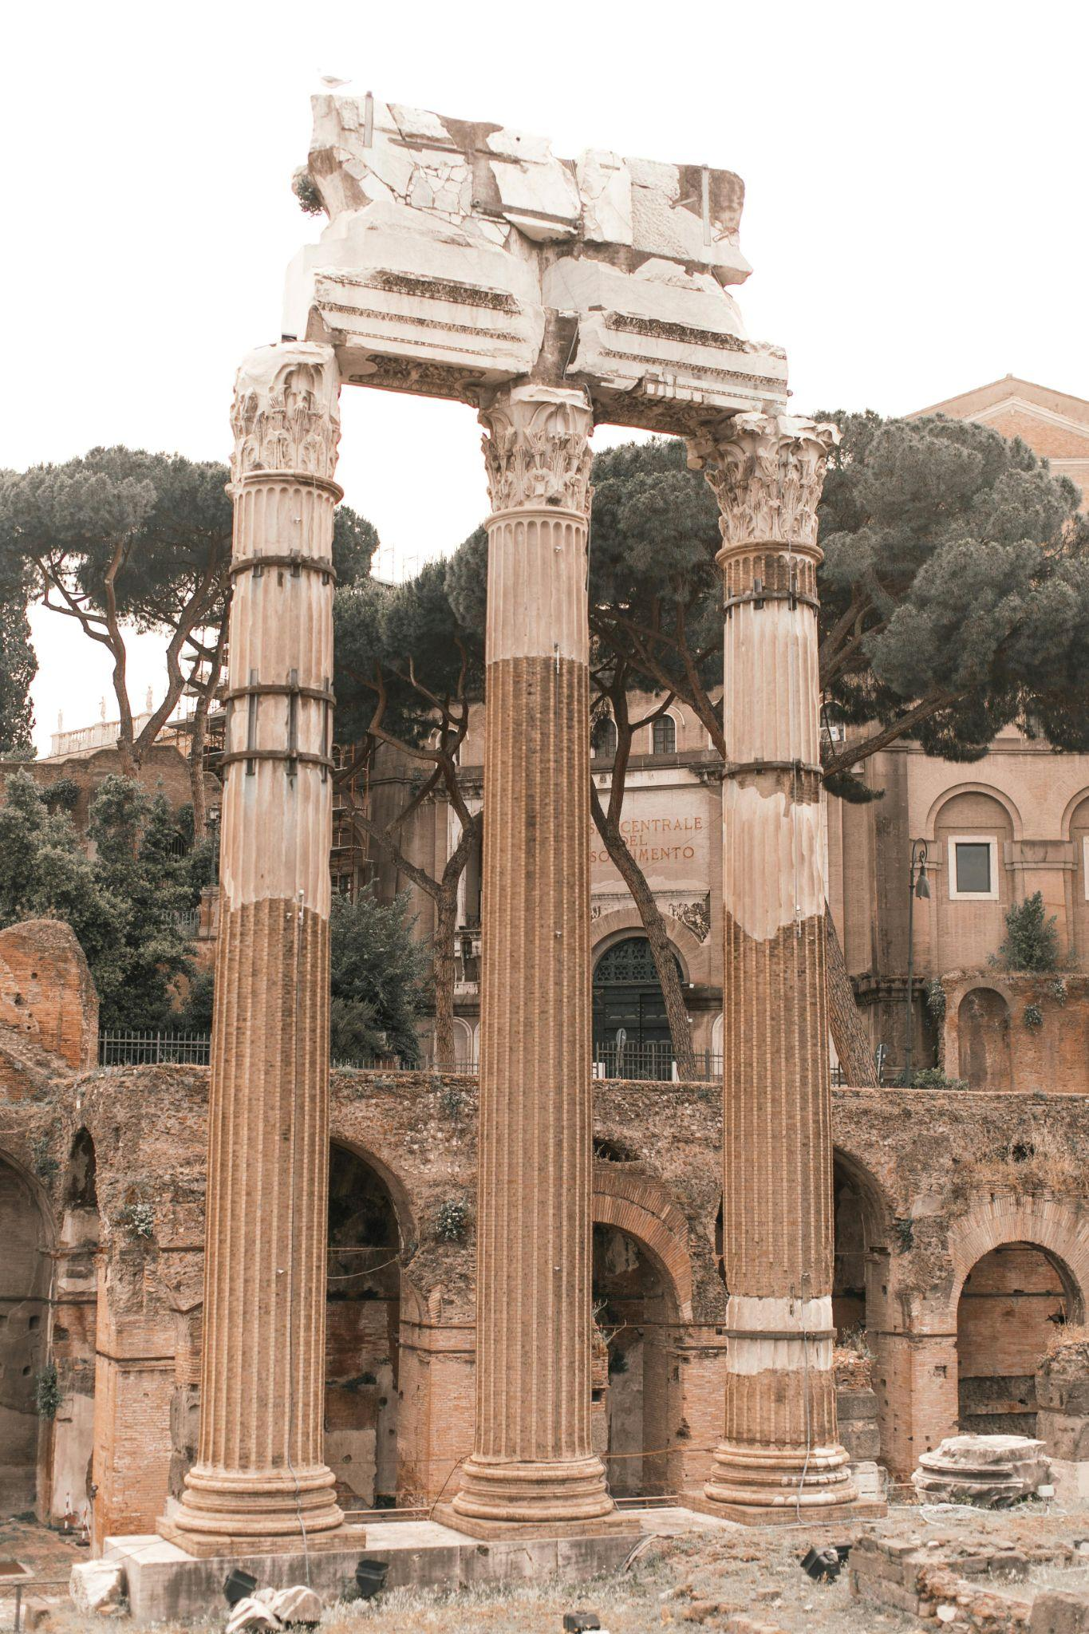
Take your best guess!
How old do you think the remains of this building are?
Notes:
Teacher Notes
Encourage the students to notice details about the building and guess how old it is.
Teacher Narration
Take your best guess! How old do you think the remains of this building are?
Attribution
Photo by Rachel Claire: https://www.pexels.com/photo/ancient-concrete-temple-4819325/

Slide 4
Take your best guess!
How old do you think the remains of this building are?
It was originally built in 46 BCE.
That is over 2050 years!
Discussion:
Why hasn’t it fallen down?
Would the top stone stay there if one of the pillars fell?
What might happen to the structure if the foundation stones were not level or aligned properly?
Notes:
Teacher Notes
Engage students in a discussion about the strength of foundations and pillars as a metaphor for faith, virtues, and Lent.
Highlight the age and resilience of the building.
Connect the structure’s strength to the importance of a solid foundation and supportive pillars in life and faith.
Teacher Narration
This building was originally built in 46 BCE. That means it’s over 2,050 years old! Isn’t that amazing?
Now, let’s think about why it’s still standing. Look closely at the structure. Why do you think it hasn’t fallen down after all these years?
Pause for responses, guiding students to mention strong foundations and pillars.
What do you think would happen if one of the pillars fell? Or if the foundation stones weren’t level or aligned properly?
Allow discussion and connect answers to the metaphor.
This building reminds us of our lives and faith. Just like this structure needs strong pillars and a solid foundation, we need virtues and practices like prayer, fasting, and almsgiving to support our relationship with God. Everything works together to make us strong!
Attribution
Photo by Rachel Claire: https://www.pexels.com/photo/ancient-concrete-temple-4819325/

Slide 5

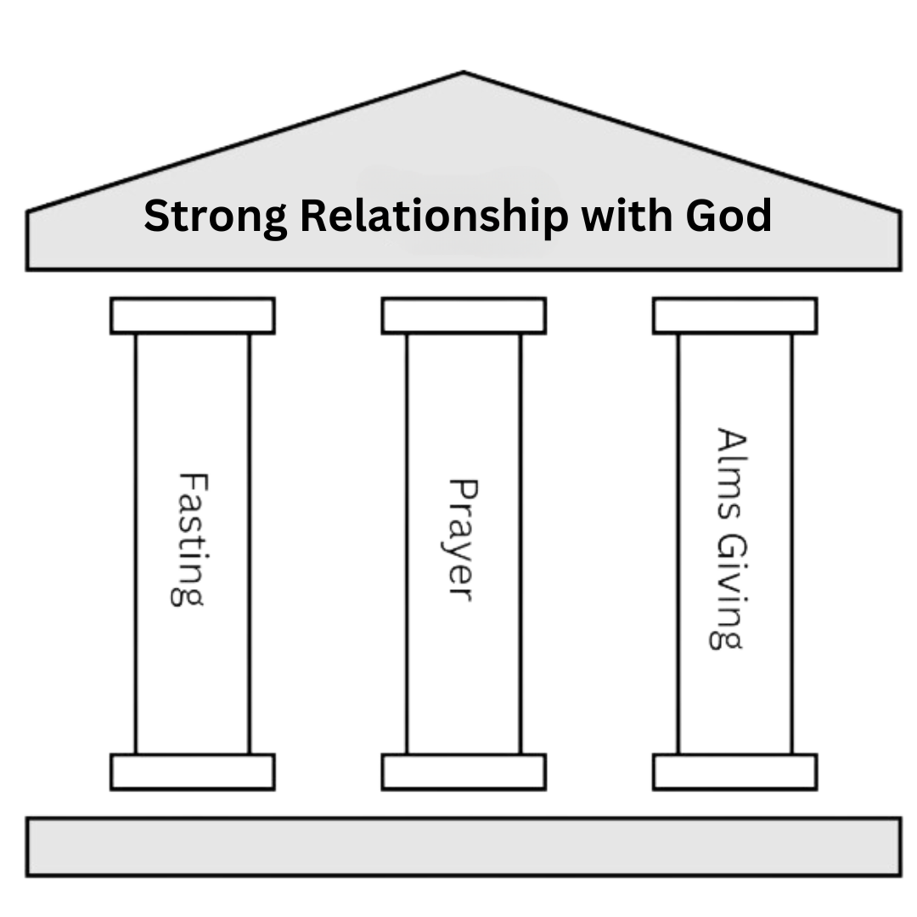
The 3 Pillars of Lent
The 3 Pillars of Lent — fasting, prayer, and almsgiving — serve to deepen our relationship with God.
Notes:
Teacher Notes
Briefly introduce the pillars of Lent: prayer, fasting, and almsgiving.
Emphasize their role in strengthening our relationship with God.
Teacher Narration
During Lent, we focus on three important practices—prayer, fasting, and almsgiving. These are called the 3 Pillars of Lent because they support and strengthen our connection with God. Think of them like strong columns that hold up a building. Each pillar has a unique role, but together they help us grow in faith and love. Let’s talk about how these pillars work in our lives.
Attribution
Image of 3 pillars: Found on Canva, edited to add in “Strong Relationship with God”

Slide 6

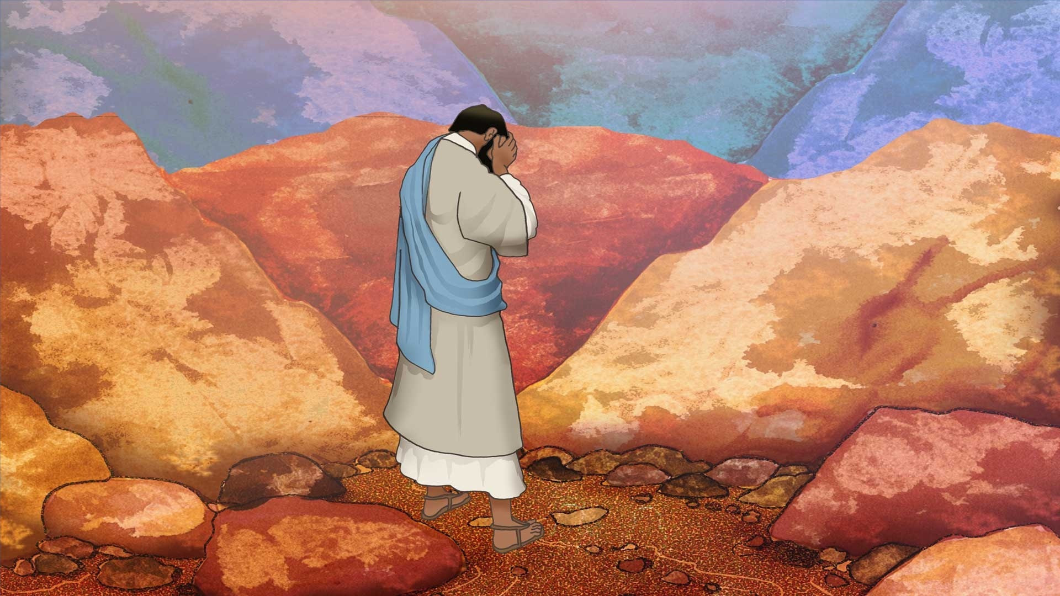
Strength in Fasting
Fasting helps us focus on God and turn away from sin, showing we trust Him more than anything else.
Fasting prepares us for special moments with God, like receiving the Eucharist or other sacraments.
Fasting teaches self-control and lets us share what we save with those in need.
Notes:
Teacher Notes
Explain fasting as a spiritual discipline, not just about food but about self-control, avoiding distractions and focus on God.
Connect fasting to acts of kindness or generosity.
Teacher Narration
Fasting is about more than just giving up food or treats—it’s a way to grow closer to God. When we fast, we let go of distractions and remind ourselves to trust God above all else. It also teaches us to share what we have with those in need. For example, by giving up a snack, you could use that time or money to help someone else. How might fasting help us prepare for special moments with God?
Attribution
Jesus is tempted by the devil in the wilderness. © 2019 by Paul Stanley is licensed under CC BY-NC-ND 4.0

Slide 7
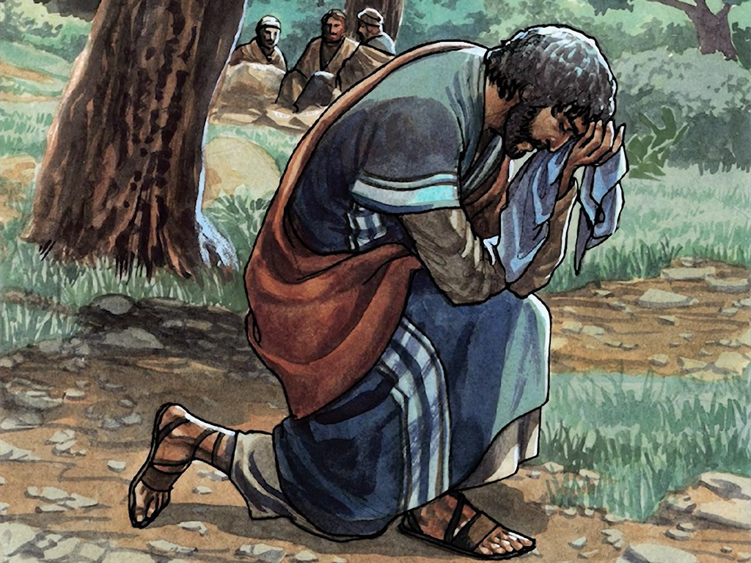
Strength in Prayer
God invites us into a personal and shared relationship with Him, speaking to us through Jesus, His Son.
Prayer is how we respond to God, who is already reaching out to us and revealing Himself.
Prayer is more than words; it’s about connecting with God fully—Father, Son, and Holy Spirit.
Notes:
Teacher Notes
Highlight prayer as a conversation with God.
Encourage students to think about how prayer helps them feel connected to God.
Teacher Narration
Prayer is like talking with God—it’s how we respond to His love and care for us. It’s not just about saying words; it’s about opening our hearts to Him and building a relationship. When we pray, we can ask for guidance, share our struggles, or simply thank Him. How does prayer help you feel closer to God?
Attribution
Prayer in the Garden © 2019 by Paul Stanley is licensed under CC BY-NC-ND 4.0

Slide 8
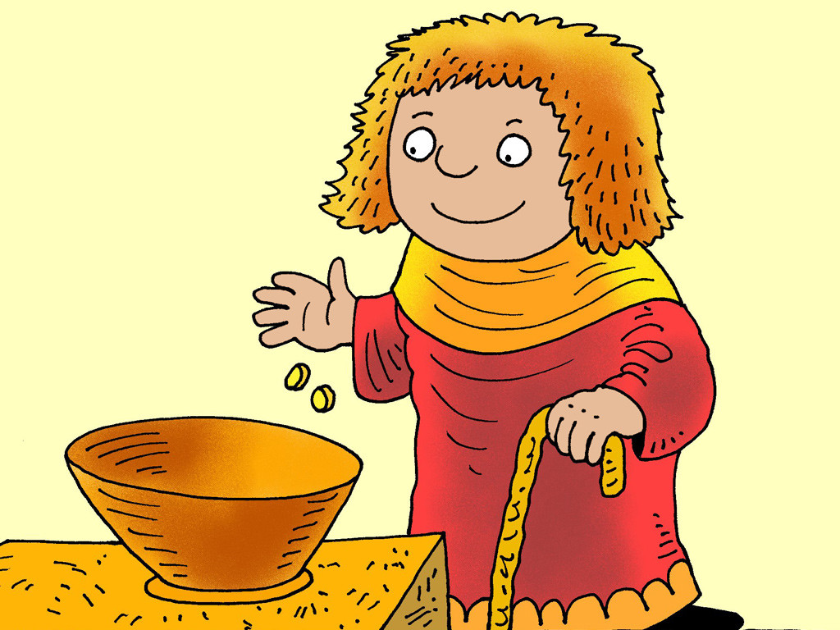
Strength in Almsgiving
Giving to others expresses love and compassion for those in need, fulfilling Jesus' call to care for one another.
When we give to others, we are demonstrating justice that pleases God.
There is enough in this world for everyone to have what they need. We promote fairness and kindness by sharing what we have to meet the needs of others.
Notes:
Teacher Notes
Explain almsgiving as a way to share blessings and practice justice.
Teacher Narration
Almsgiving means giving to those in need, whether it’s our time, money, or talents. It’s a way to show love and fairness, just as Jesus taught us.
Attribution
The Widow With Just Two Coins by Richard Gunther is licensed under CC BY-NC-ND 4.0

Slide 9
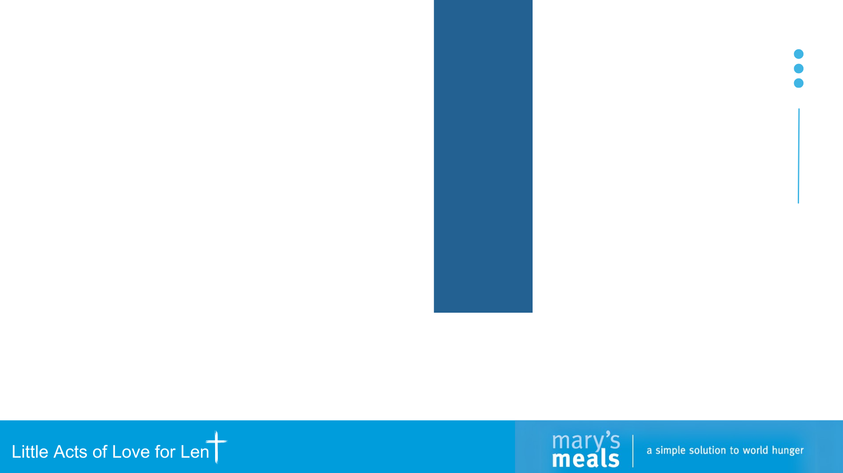
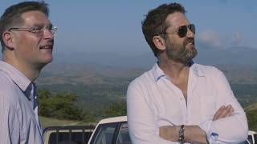
Almsgiving:
Mary’s Meals
Did you know?
Mary’s Meals feeds over 2.4 million children daily at school, changing lives.
Just $25.20 can feed a child for a whole year, helping them learn and thrive.
Notes:
Teacher Notes
Use Mary’s Meals as an example of an organization making a big impact through small acts.
Ask questions after the video is played..
Teacher Narration
Organizations like Mary’s Meals remind us that even small acts can make a huge difference. Did you know that donating $25.20 to Mary’s Meals can feed a child for an entire year? How can we practice almsgiving in our daily lives? How is the boy in the video showing a little act of love or almsgiving? (by carrying his sister and bringing her to school with him each day)
Attribution
Video: https://youtu.be/dZPyYprEago?feature=shared

Slide 10
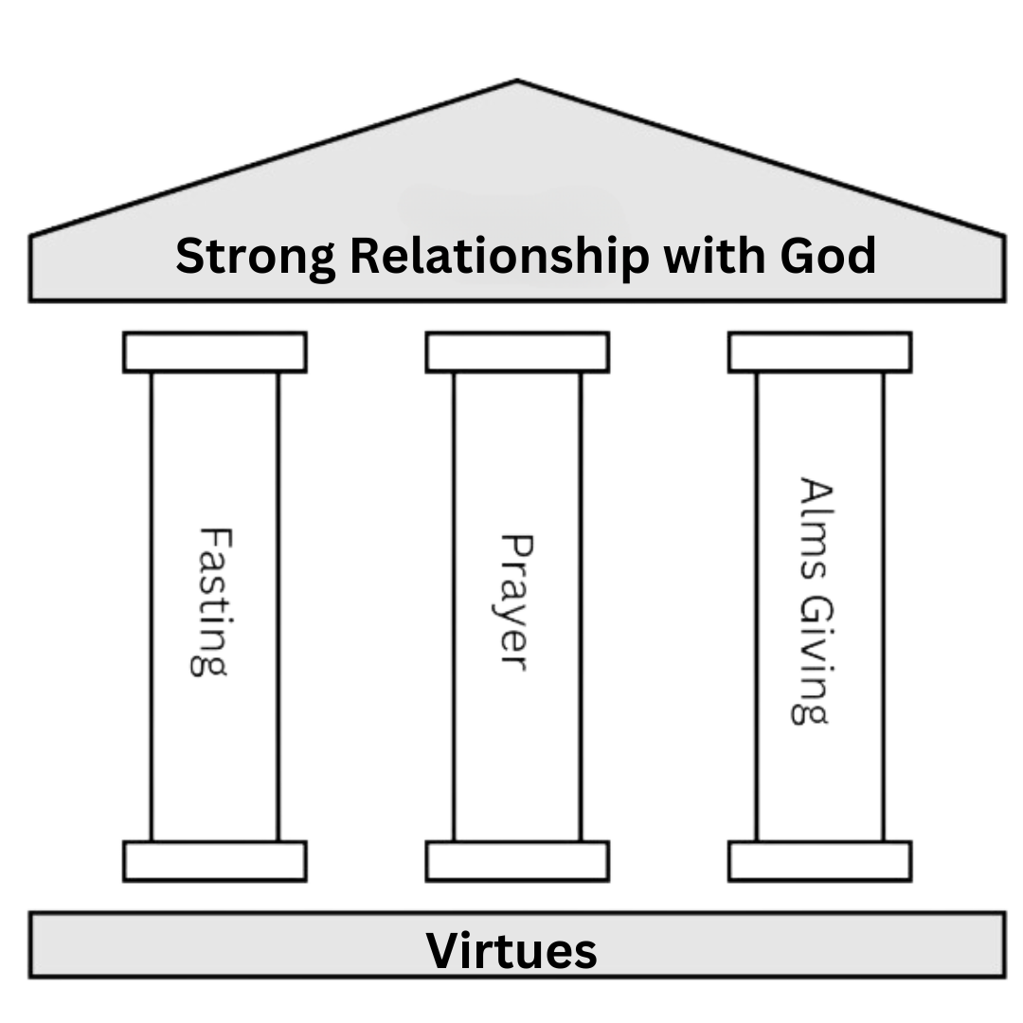
The Foundation of Virtues
Fasting, prayer, and almsgiving are grounded in living a virtuous life. The foundation is stronger through consistent, little acts of love.
Notes:
Teacher Notes
Connect the virtues to the pillars, emphasizing that the virtues are the foundation of a strong faith life.
Teacher Narration
Think of the virtues as the foundation of a strong and meaningful life. Each virtue, like faith, hope, and kindness, supports the 3 Pillars of Lent. When we live out these virtues, we make the pillars of prayer, fasting, and almsgiving even stronger. Together, they help us build a closer relationship with God.
Attribution
Image of 3 pillars: Found on Canva, edited to add in “Strong Relationship with God” and “Virtues”

Slide 11
Little Acts of Love for Len_
During Lent, we will focus on one virtue each week.
Each virtue acts as a foundational block that makes the pillars stable and effective:
Faith: Grounds prayer in trust and belief in God.
Hope: Gives purpose to fasting, reminding us of God’s promises.
Justice (Kindness): Directs almsgiving toward fairness and care for others.
Love of Neighbor: Motivates all three pillars by focusing on serving others.
Wisdom: Guides how we pray, fast, and give in ways that honor God.
Charity: Infuses every act of prayer, fasting, and giving with selfless love.
Notes:
Teacher Notes
Introduce the connection between virtues and the 3 pillars of Lent
Emphasize that virtues are the foundation of our faith and actions.
Help students understand that each virtue supports the pillars of prayer, fasting and almsgiving, making them more meaningful and effective.
Teacher Narration
During Lent, we’re going to focus on one virtue each week. Think of virtues like the foundation of a building—they make everything stable and strong. Each virtue helps us live out the pillars of Lent: prayer, fasting, and almsgiving.
For example, faith grounds prayer in trusting God and believing His teachings. Hope gives purpose to fasting, reminding us of God’s promises. Justice, or kindness, directs our almsgiving so we treat others fairly and help those in need. Love of neighbor motivates us to serve others and think beyond ourselves. Wisdom helps us make thoughtful choices about how we pray, fast, and give. And finally, charity infuses everything we do with love, making our actions selfless and meaningful.
This Lent, as we build a stronger relationship with God, let’s think about how we can live out these virtues in our daily lives. Which one do you think might be easiest for you? Which one might be the hardest?
Attribution
Image of 3 pillars: Found on Canva, edited to add in “Strong Relationship with God” and “Virtues”

Slide 12
Mary’s Meals Prayer
When questioned about which commandment was the greatest, Jesus replied, “Love the Lord your God with all your heart and with all your soul and with all your mind and with all your strength. The second is this: Love your neighbor as yourself. There is no commandment greater than these.” Mark 12:30-31
As we reflect on the words of Jesus, may we consider how our prayers and actions show our love for the neighbors that we know and for our global neighbors that we’ve not had the opportunity to meet – especially the children. Let us pray together.
Lord, we are thankful for all of your blessings.
We are thankful for all those who labor every day to feed the children
who are in such great need.
May the work of our volunteers be an expression of your love for the children.
May each and every child feel your loving embrace as they eat their meals
and enjoy a respite from the daily challenges of their lives.
May the meals these children receive provide them the energy to learn and the nutrition to grow. May these children have hope for the future despite their suffering today.
Lord, may our prayers for these children be little acts of love that reflect your love for them. Amen.
Notes:
Teacher Notes
Please feel free to refer to this Mary’s Meals prayers if the students ever need to have a prayer to
Teacher Narration
Charity is something that we feel in our hearts that leads us to do something to act on that feeling. Let’s create a list of words that have the same, or a similar, meaning as the word charity (synonyms).

Slide 13

Teacher Only (Prep for Faith Lesson)
All the teacher notes and scripts are in the speaker notes of each slide.
Items you will need for the activity:
Mustard Seed (optional)
Blindfolds
Print for each student:
Lent Advent Calendar
Take-Home Flyer

Slide 14
Little Acts of _Love for Len__

Slide 15
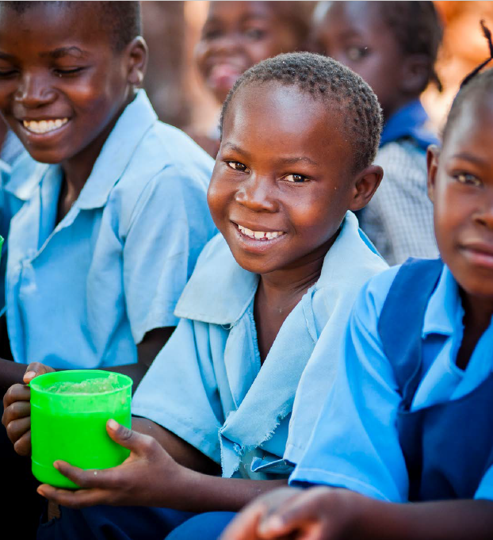
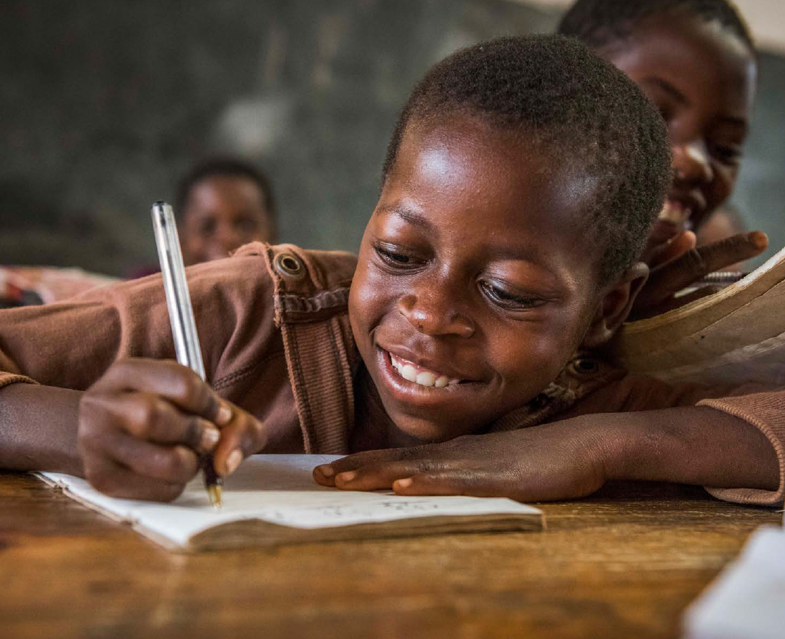
Week 1: Faith
Faith means trusting that God loves us and has a plan, believing what He teaches, and showing it by how we pray, act, and make good choices.
Notes:
Teacher Notes
Define faith simply as trusting God and showing it through actions.
Introduce the idea of small acts of faith.
Teacher Narration
Faith means trusting God loves us and has a plan for us. We show our faith by how we pray, act, and make choices every day. During Lent, we can strengthen our faith through little acts of love that help us grow closer to Him. Let’s talk about how faith can guide us through even the toughest challenges.
Attribution
Image 1: Mary’s Meals Brand Book, page 14

Slide 16
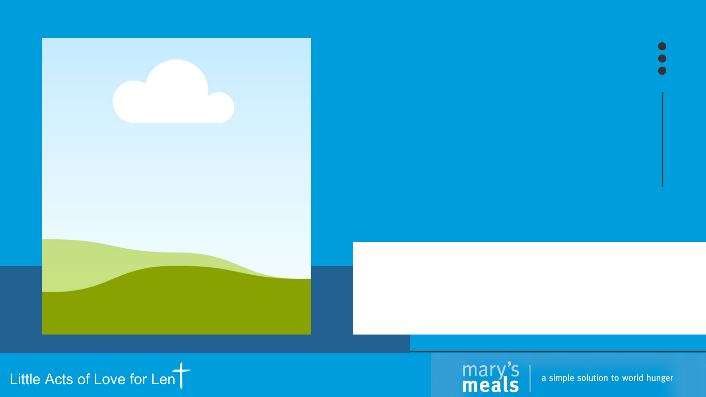
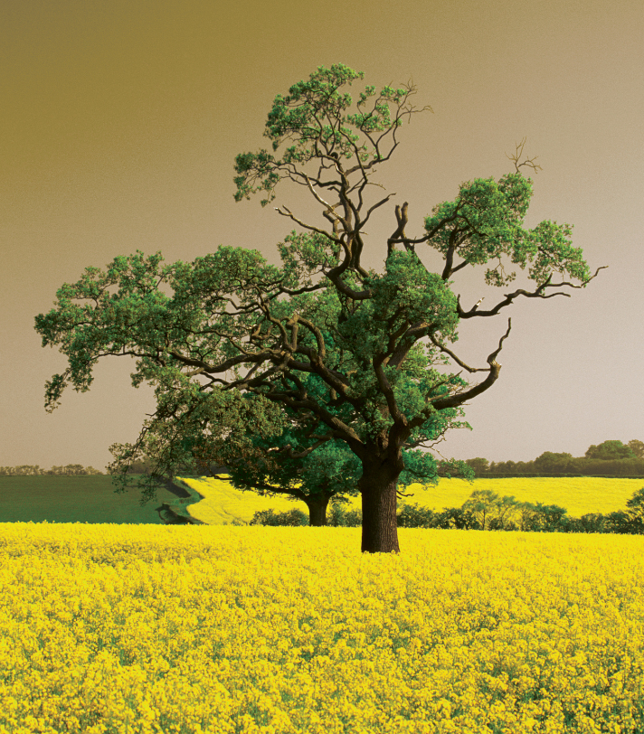
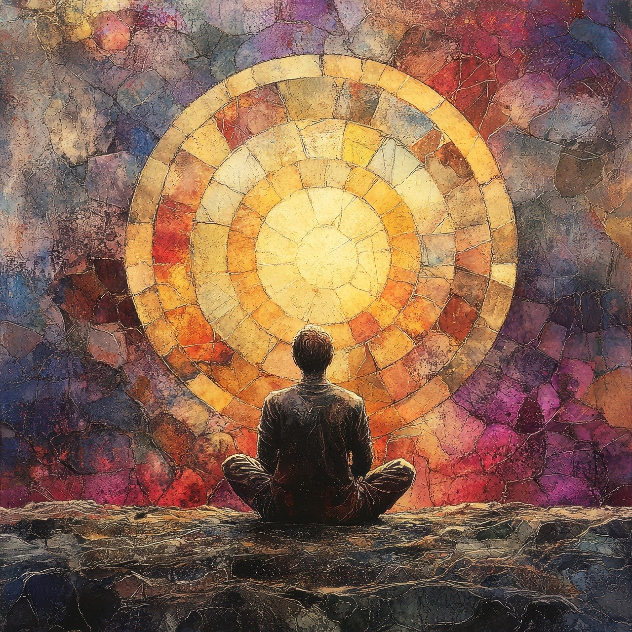
What kind of tree is this?
It is mentioned in the Bible.
It’s roots grow deep and can survive in the desert.
It produces small berries that contain lots of seeds that are often turned into a paste.
Notes:
Teacher Notes
Engage students in an interactive guessing activity while introducing the mustard tree, a symbol of faith in the Bible.
Encourage observation and critical thinking to guess the tree type.
Teacher Narration
Take a look at this picture. What kind of tree do you think this is? I’ll give you a few hints:
This tree is mentioned in the Bible.
Its roots grow deep, helping it survive even in the desert.
It produces small berries that have lots of seeds, which are often turned into a paste.
Take a moment to think, and if you have a guess, raise your hand!
Attribution
Image from Canva?

Slide 17
What kind of tree is this?
It is a mustard tree!
It is mentioned in the Bible.
It’s roots grow deep and can survive in the desert.
It produces small berries that contain lots of seeds that are often turned into a paste.
Notes:
Teacher Notes
Highlight the mustard tree’s resilience and connection to faith.
Teacher Narration
This is a mustard tree! It might look small, but it’s incredibly strong and resilient, just like our faith. In the Bible, Jesus uses the mustard seed as an example of how even a tiny amount of faith can grow into something powerful. We’ll explore that idea more in the next few slides.
Attribution
Image from Canva?

Slide 18
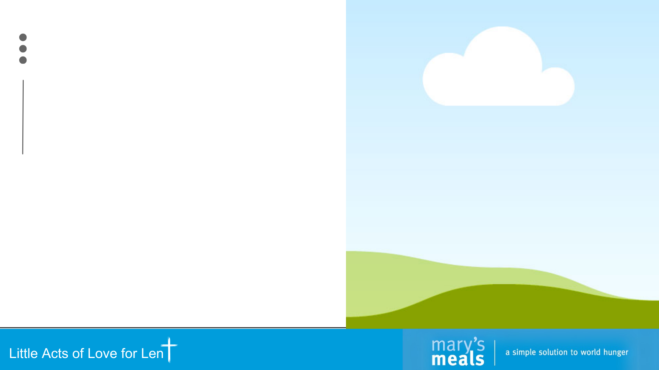
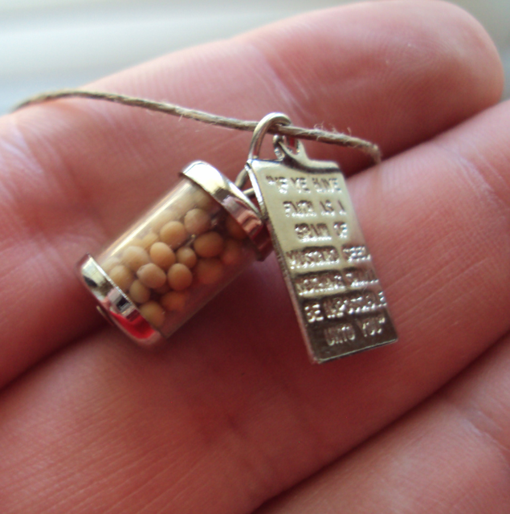
Faith in the Scriptures:
A Mustard Seed
Matthew 17:20
Truly I tell you, if you have faith the size of a mustard seed, you will say to this mountain, “Move from here to there,” and it will move; and nothing will be impossible for you.
Notes:
Teacher Notes
Use the mustard seed as a visual example of how small faith can grow into something powerful.
Focus on encouragement and potential.
You may bring a mustard seed for each children to have or see.
Teacher Narration
Jesus compared faith to a mustard seed—small, but able to grow into something great. Even if our faith feels tiny, God can do amazing things through us. What do you think Jesus meant when He said, 'Nothing will be impossible for you'? What are some challenges, or 'mountains,' that faith can help us overcome?
Attribution
Image from Canva

Slide 19
Faith in the Scriptures:
A Mustard Seed
Matthew 17:20
Truly I tell you, if you have faith the size of a mustard seed, you will say to this mountain, “Move from here to there,” and it will move; and nothing will be impossible for you.
Notes:
Teacher Notes
Facilitate a discussion that deepens understanding of faith using the mustard seed analogy from Matthew 17:20.
Emphasize that faith, even when small, has great potential to grow and overcome challenges.
Emphasize Jesus uses everyday examples to make His teachings relatable and meaningful.
Emphasize faith helps us approach difficulties with trust in God’s power.
Teacher Narration
Let’s reflect on the passage we just read from Matthew 17:20. Jesus says that even faith as small as a mustard seed can move mountains. Why do you think He compares faith to something so small?
Pause for responses, guide them toward understanding how small things, like faith, can grow into something powerful.
Faith isn’t about how big it starts—it’s about how much we trust God to help it grow. Think about your own life. How does faith help you see challenges or 'mountains' differently?
Allow responses and connect them to the idea of relying on God’s strength.
Finally, what are some 'mountains' in your life that faith can help you move? It could be something you’re worried about, a goal you want to achieve, or a problem you’re trying to solve. Let’s share a few examples so we can encourage each other to trust God to help us face these mountains.
Attribution
Image from Canva

Slide 20
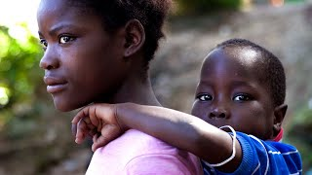
Finding Faith: Lette
Discussion:
What challenges did Lette face, and how might her faith have helped her overcome them?
How does having faith in God help us find strength to make positive changes in our lives?
Notes:
Teacher Notes
Introduce Lette’s story as an example of how faith can guide us through hard times.
Encourage students to think about how faith impacts their own lives.
Teacher Narration
Lette’s story shows how faith can help us find strength to keep going, even when life is really hard. She faced many challenges but kept moving forward. How might her faith have helped her? Can you think of a time when faith gave you strength to make a positive change?
Attribution
https://www.youtube.com/watch?v=F4kq8NWKmnM - 0:00 to 2:33 (story of Lette and her older brother Saidi)

Slide 21

Faith in Action:
Trust Walk Activity
Work in pairs: One of you will be blindfolded, and the other will guide.
Navigate the path: The blindfolded person listens carefully to their guide's voice to move safely through the obstacle course.
Take turns: Switch roles so everyone has a chance to lead and follow.
Remember: Trust your guide, and give clear, calm instructions!
Notes:
Teacher Notes
Explain the activity clearly and set expectations for safe and respectful participation.
Emphasize the role of trust in both God and each other.
Teacher Narration
In this activity, you’ll work in pairs to guide each other through a path while one of you is blindfolded. The blindfolded person will have to trust their partner completely, just like we trust God to guide us in life. Remember to give clear instructions and be calm and supportive. Let’s see how trust helps us feel safe and confident!
Attribution
Image from Canva

Slide 22
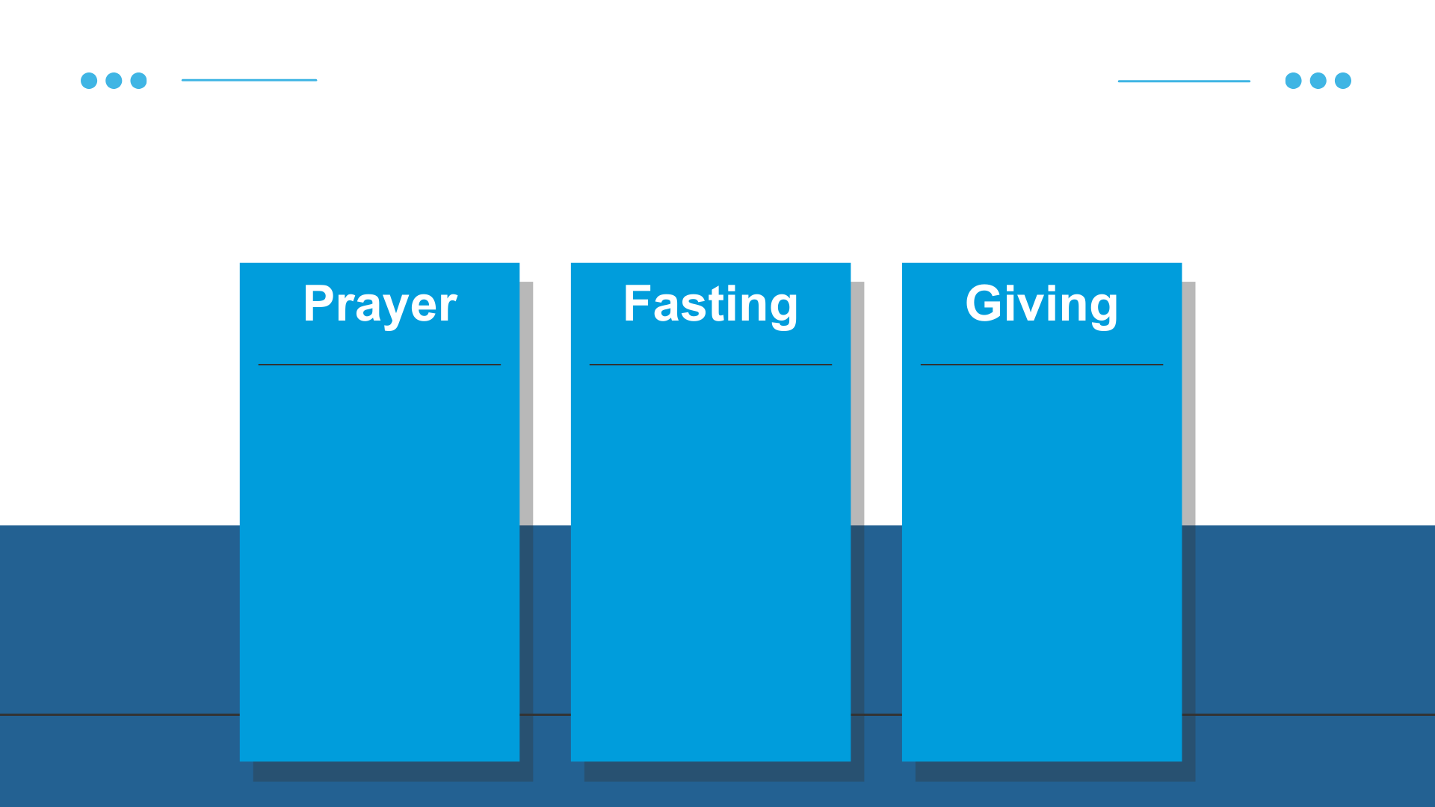
Little Acts of Love
Each week of Lent, we are focusing on building a stronger relationship with God through virtues. Here are some little acts of love you can do this week to strengthen your faith.
Write a letter to God about something you're trusting Him for.
Create a personal motto about faith
Memorize a short Bible verse about faith
Fast from negative thoughts
Pause and say a short prayer when you are tempted to complain.
Give up a comfort or distraction (e.g., excessive screen time) for a day,
Write or draw about faith to inspire others.
Create a gratitude jar for family and charity.
Read a Bible story about faith and discuss.
Notes:
Teacher Notes
Suggest practical and relatable actions students can take to grow in faith.
Encourage creativity in creating a personal faith motto.
Teacher Narration
What little acts of love can you do this week to demonstrate faith? These are three examples of what you can do this week. More ideas are on the back of your Lent Calendar. Remember to track the little acts of love you do by filling out your Lent Calendar and journaling! That way you can see the good you are doing and remember what little acts of love to add to our display here in class next week.
I will send 5 post-it notes home with each of you to write down your prayer, fasting, or giving examples when you do them. Your family can make a cross at home as well to post your little acts of love. You can also bring the post-it notes back to add to our crosses in class.
Attribution
N/A

Slide 24
Teacher Only (Prep for Hope Lesson)
All the teacher notes and scripts are in the speaker notes of each slide.
Items you will need for the activity:
Sticky notes
Blank piece of paper and pencil for each student
Meditation/calming music (optional)
Print:
Finding Hope Activity (You do not need to print this for each student. See activity slide)

Slide 25
Little Acts of _Love for Len__

Slide 26
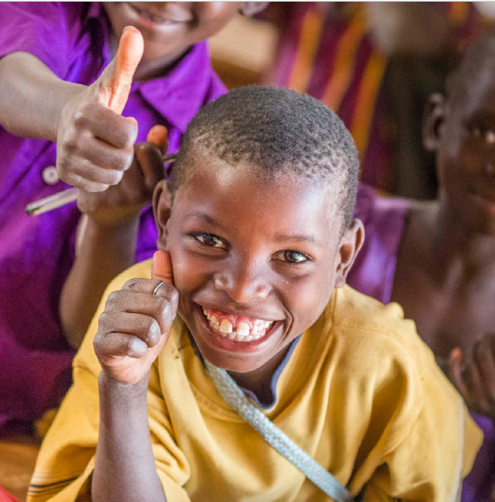

Reflection on Last Week:
Little Acts of Love
Reflect on a small act of faith you demonstrated last week that made you feel proud,
and write it down.
Notes:
Teacher Notes
Guide students to reflect on their personal experiences.
Encourage them to celebrate small successes in faith.
Teacher Narration
Take a moment to think about a small act of faith you did last week that made you feel proud. Maybe it was trusting God during a tough moment or showing kindness to someone in need. Write it down to remind yourself how faith is growing in your life.
Attribution
Image 1: Mary’s Meals Brand Book, page 18
Image 2: hanahal/stock.adobe.com, Multicolor post it notes (Adobe Stock Education License).

Slide 27
Week 2: Hope
Hope is trusting God’s promises even when we don’t see the outcome.
Notes:
Teacher Notes
Define hope as trusting in God’s promises, even when outcomes aren’t clear.
Introduce Lent as a time to focus on hope.
Teacher Narration
Hope means trusting in God’s promises, even when we can’t see how things will turn out. During Lent, we can focus on hope by remembering that Jesus brings peace and strength, even in the hardest times. Let’s explore how hope can guide us.
Attribution
Image 1: Mary’s Meals Brand Book, page 10

Slide 28
Imagining Hope
Close your eyes for a moment of imagination while I guide you through thoughts of hope.
Notes:
Teacher Notes
Set a calming tone for this reflection activity.
Lead students through a one-minute guided imagination of hope.
Encourage students to share their hopeful thoughts.
Teacher Narration
Close your eyes and take a deep breath in... and slowly let it out. Let your body relax, and let your mind settle into this moment.
Now, picture yourself standing in a quiet, peaceful place. Maybe it’s a sunny meadow, a soft sandy beach, or a cozy room where you feel safe and warm. In this place, you feel completely calm, completely at peace.
Imagine a soft, glowing light appearing in front of you. This light represents the love and hope of Jesus Christ. It is warm, gentle, and full of His promises.
As you watch the light, feel its warmth entering your heart. Remember that Christ’s love for you is perfect, endless, and unchanging. Think about His invitation to come unto Him and to find rest, no matter your worries or struggles.
Now, imagine this light growing and filling your entire being. Picture it spreading outward into your life, guiding your steps and comforting your soul. See yourself walking with Christ beside you, holding your hand and showing you the way to a brighter, more peaceful future.
Take a moment to think about His promises—that through Him, all things are possible. That through His Atonement, we can be forgiven, healed, and strengthened. Feel the deep, abiding hope that only He can bring.
When you’re ready, take a deep breath in... and let it out. Open your eyes, carrying this hope in Christ with you as a light to guide you and to share with others.
Attribution
Image by <a href="https://pixabay.com/users/ridderhof-3351731/?utm_source=link-attribution&utm_medium=referral&utm_campaign=image&utm_content=9155482">Anne-marie Ridderhof</a> from <a href="https://pixabay.com//?utm_source=link-attribution&utm_medium=referral&utm_campaign=image&utm_content=9155482">Pixabay</a>

Slide 29
Imagining Hope
What promises of Christ bring you the most hope? How can we, as a class, help each other hold onto the hope that Christ gives?
Notes:
Teacher Notes
Lead a discussion to allow students to share their hopeful thoughts.
Teacher Narration
What promises of Christ bring you the most hope?
How can we, as a class, help each other hold onto the hope that Christ gives?
Attribution
Image by <a href="https://pixabay.com/users/ridderhof-3351731/?utm_source=link-attribution&utm_medium=referral&utm_campaign=image&utm_content=9155482">Anne-marie Ridderhof</a> from <a href="https://pixabay.com//?utm_source=link-attribution&utm_medium=referral&utm_campaign=image&utm_content=9155482">Pixabay</a>

Slide 30
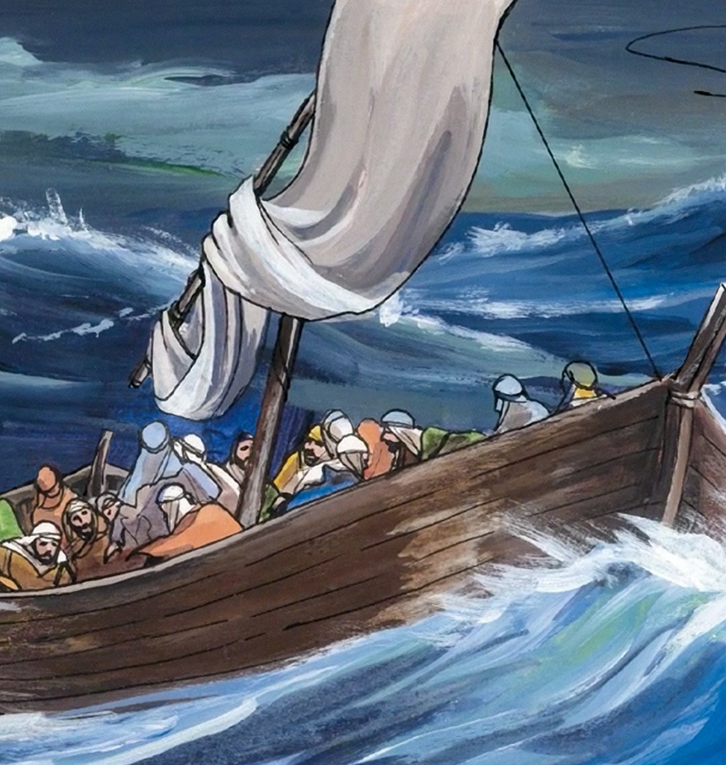
Hope in the Scriptures: Jesus Calms the Sea
Matthew 8: 24, 26, 27
24: And behold, a violent storm developed on the sea, so that the boat was being covered by the waves;
26: He got up and rebuked the winds and the sea, and it became perfectly calm.
27: The men were amazed, and said, “What kind of a man is this, that even the winds and the sea obey Him?”
Notes:
Teacher Notes
Use this story to highlight Jesus’ power to bring peace in life’s storms.
Teacher Narration
Let’s read about hope in the scriptures. Who would like to read the verses on the board?
Attribution
This work by Good News Productions International and College Press Publishing Artist:Paula Nash Giltner is licensed under CC BY-NC-ND 4.0
Image: https://freebibleimages.org/illustrations/gnpi-043-jesus-storm/

Slide 31
Hope in the Scriptures: Jesus Calms the Sea
Matthew 8: 24, 26, 27
24: And behold, a violent storm developed on the sea, so that the boat was being covered by the waves;
26: He got up and rebuked the winds and the sea, and it became perfectly calm.
27: The men were amazed, and said, “What kind of a man is this, that even the winds and the sea obey Him?”
Notes:
Teacher Notes
Relate the story to real-life struggles.
Teacher Narration
Jesus calmed a storm with just His words, reminding us that He has power over all our fears. What storms in your life can you bring to Jesus? How does remembering His power give you hope when things feel out of control?
Attribution
This work by Good News Productions International and College Press Publishing Artist:Paula Nash Giltner is licensed under CC BY-NC-ND 4.0
Image: https://freebibleimages.org/illustrations/gnpi-043-jesus-storm/

Slide 32
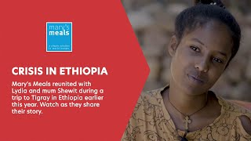
Bringing Hope: Lydia
Discussion:
How does Mary’s Meals bring hope to Lydia?
What does this story teach us about how small actions can reflect God’s love?"
Notes:
Teacher Notes
Use Lydia’s story to show how hope can inspire action and change lives.
Encourage students’ to connection Lydia’s story to their own actions.
Teacher Narration
Mary’s Meals brings hope to children like Lydia by giving them food and the chance to learn. How do you think this gives them hope for the future? What does this story teach us about how small actions can reflect God’s love?
Attribution
Video: https://www.youtube.com/watch?v=qxic0aMKAv0&t=95s show from 1:35-2:54 and 4:07-4:57

Slide 33

Finding Hope Activity
Choose a paper.
Read the situation that a student your age is going through.
Read the corresponding scripture.
Write a note of hope to this student.
Notes:
Teacher Notes
Guide students to reflect on a scripture passage and write encouraging notes.
Encourage empathy and creativity in their messages.
Teacher Narration
Choose a situation a student like you might face. Read the corresponding scripture and write a note of hope to that student. Your words can make a big difference and show how hope connects us to God and to each other.
Attribution
Image from Canva, edited to say “Dear friend”

Slide 34
Little Acts of Love
Each week of Lent, we are focusing on building a stronger relationship with God through virtues. Here are some little acts of love you can do this week to strengthen your hope.
Share something good daily and include a gratitude prayer.
Find and share a Scripture or saint quote about hope.
Write and read a prayer about your hopes and dreams.
Write a goal to grow closer to God and act.
On hard days, fast from negativity and focus on hope.
Reflect daily on fasting and how it brought hope.
Create a hope jar with notes and coins for charity.
Share a story about kindness helping someone overcome challenges.
Write a letter of hope to someone who needs encouragement.
Notes:
Teacher Notes
Highlight practical ways to bring hope into their lives and others’.
Encourage thoughtfulness in daily actions.
Teacher Narration
These little acts of love can bring hope to others. For example, write a letter of encouragement to someone in need or find a Bible quote about hope to share during family prayer. What little acts of love can you do this week to strengthen your hope? More ideas are on the back of your Lent Calendar. Remember to track the little acts of love you do by filling out your Lent Calendar and journaling! That way you can see the good you are doing and remember what little acts of love to add to our display here in class next week.
Attribution
N/A

Slide 36
Teacher Only (Prep for Justice Lesson)
All the teacher notes and scripts are in the speaker notes of each slide.
Items you will need for the activity:
Sticky notes
A blank space on the board or a large poster to tally the acts of kindness.
Print:
none

Slide 37
Little Acts of _Love for Len__

Slide 38
Reflection on Last Week:
Little Acts of Love
Reflect on a small act of faith you demonstrated last week that made you feel proud,
and write it down.
Notes:
Teacher Notes
Ask students to share one of their sacrifices and how they felt about it. As the students come into class, invite them to take a sticky note/piece of paper write a small act of love of neighbors they demonstrated last week that made them feel proud, and write it down. Have the students place it on the wall chart and look to see what other students are doing.
You can ask students to share one of their little acts of love and how they felt about it.
Teacher Narration
(See notes above)
Attribution
Image from Mary’s Meals
hanahal/stock.adobe.com, Multicolor post it notes (Adobe Stock Education License).

Slide 39
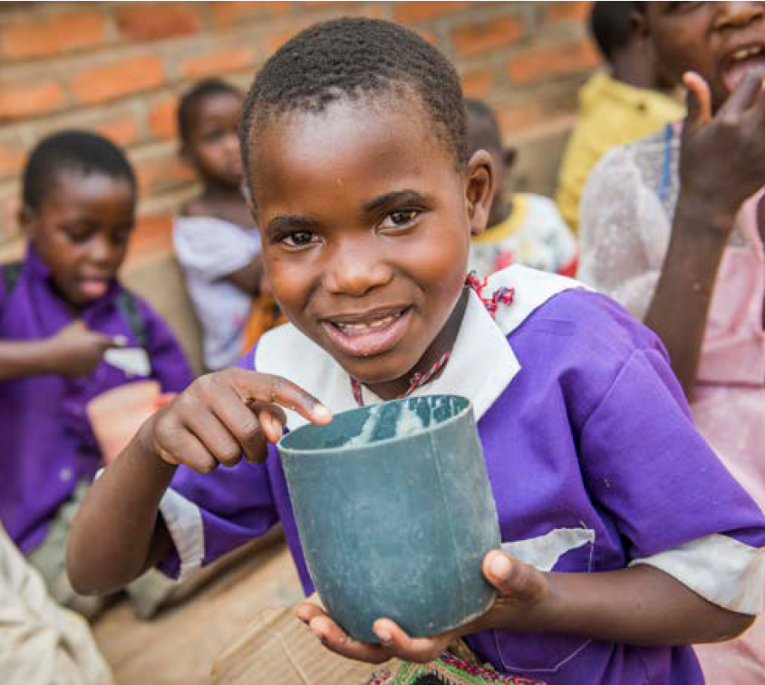
Week 3: Justice or
Kindness
Justice means treating everyone fairly and with respect, making sure we share what we have so that everyone gets what they need, because there is enough for everyone if we all do our part.
Notes:
Teacher Notes
Talk about the definition of the virtue of Justice/Kindness. Help the students understand that Justice is a cardinal virtue and it means that people are treated with the dignity proper to them.
Teacher Narration
Justice means treating everyone fairly and with respect, making sure we share what we have so that everyone gets what they need, because there is enough for everyone if we all do our part.
Attribution

Slide 40
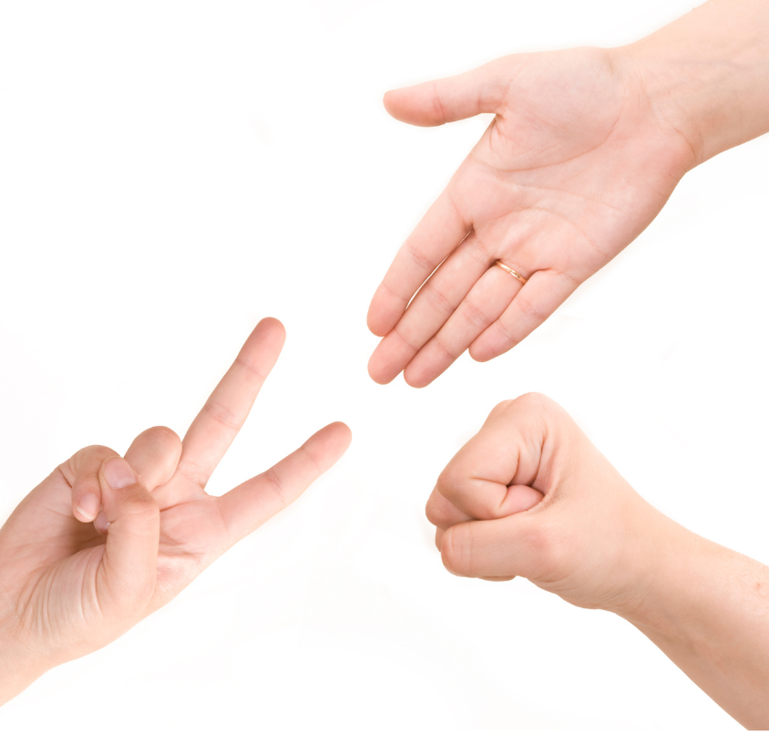
Rock, Paper, Scissors:
Justice Edition
Pair up with a partner to play Rock, Paper, Scissors for 5 rounds.
If you win a round, you get to play twice the next round while the other plays once.
Notes:
Teacher Notes
This activity introduces the concept of fairness and justice by allowing students to experience an unfair situation and reflect on how to make it right.
Prior to class, familiarize yourself with how Rock, Paper, Scissors is played in case some students need to be reminded how it works.
Explain the Rules of the Rock, Paper, Scissors game to your students.
Pair up students randomly or allow them to choose partners.
Have pairs play 5 rounds of Rock, Paper, Scissors with the unfair rule in place.
Observe how the students react—some may start discussing fairness naturally.
Teacher Narration
"We’re going to play Rock, Paper, Scissors, but with a twist to help us think about fairness and justice."
"In this version, one player in each pair will have an unfair advantage: If they win a round, they get to play twice in the next round, while their partner only gets one turn. For example, if you both are rock, the winner of the last round gets to change."
Attribution
Image from Canva

Slide 41
Rock, Paper, Scissors: Justice Edition
How did it feel to have an unfair advantage or disadvantage?"
"Was the game fair? Why or why not?"
"What could we change to make it fair for everyone?"
Notes:
Teacher Notes
After playing, explain the injustice and ask the students the reflection questions.
Teacher Narration
This game shows us how unfair rules can make people feel left out or powerless. Justice is about creating fairness so everyone has the same chance, whether in a game, in our classroom, or in the world.
"How did it feel to have an unfair advantage or disadvantage?"
"Was the game fair? Why or why not?"
"What could we change to make it fair for everyone?"
Attribution
Image from Canva

Slide 42
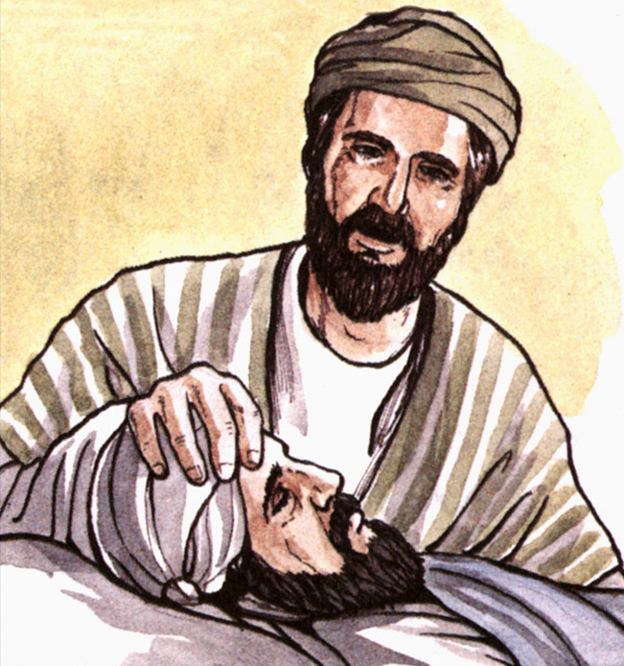
Justice in the Scriptures: Serving Others, Serving Christ
Matthew 25:35-40
For I was hungry and you gave me food, I was thirsty and you gave me drink, a stranger and you welcomed me,
Then the righteous will answer him and say, ‘Lord, when did we see you hungry and feed you, or thirsty and give you drink? When did we see you a stranger and welcome you, or naked and clothe you? When did we see you ill or in prison, and visit you?’
And the king will say to them in reply, ‘Amen, I say to you, whatever you did for one of these least brothers of mine, you did for me.
Notes:
Teacher Notes
Have the students read the verses from Matthew 25:-40.
Teacher Narration
These verses emphasizes how acts of kindness and justice toward others are, in essence, acts of love toward God. [Student name], could you please read these verses out loud?
Attribution
This work byGood News Productions International and College Press Publishing Artist:Paula Nash Giltner is licensed under CC BY-NC-ND 4.0
https://freebibleimages.org/illustrations/gnpi-acts-sharing/

Slide 43
Justice in the Scriptures: Serving Others, Serving Christ
Matthew 25:35-40
For I was hungry and you gave me food, I was thirsty and you gave me drink, a stranger and you welcomed me,
Then the righteous will answer him and say, ‘Lord, when did we see you hungry and feed you, or thirsty and give you drink? When did we see you a stranger and welcome you, or naked and clothe you? When did we see you ill or in prison, and visit you?’
And the king will say to them in reply, ‘Amen, I say to you, whatever you did for one of these least brothers of mine, you did for me.
Notes:
Teacher Notes
Ask these questions of your students and talk about their answers.
Teacher Narration
Why do you think Jesus said, “Whatever you did for one of these least brothers of mine, you did for me”?
What are some ways we can practice justice in our daily lives to make sure everyone gets what they need?
How can small acts of kindness, like giving food or visiting someone, help make the world a more just place?
Attribution
This work by Good News Productions International and College Press Publishing Artist:Paula Nash Giltner is licensed under CC BY-NC-ND 4.0
https://freebibleimages.org/illustrations/gnpi-acts-sharing/

Slide 44
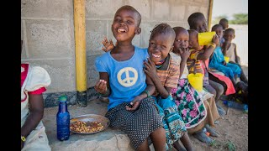
Justice for Every Child: A World of Hope & Fairness
Discussion:
What message do you think the video is trying to share about justice for children around the world?
If there is enough in the world for everyone, why do some people still go without? How can we work together to change that?
Notes:
Teacher Notes
Introduce the video and ask the children to look for how people strive to show kindness and make the world a more just place.
Teacher Narration
As we watch this video, think about ways that people help children who are hungry. Through their kindness, they make the world a more just place.
Attribution
Universal Child video: https://www.youtube.com/watch?v=DGv2LGGvfQ4
0:20-1:33 (or through the end of the video if the voice over can be removed for the last 20 seconds)

Slide 45

Kindness Ripple Challenge
Start the Ripple: Writes down one kind act you can perform today (e.g., helping a friend, holding the door, saying a kind word).
Perform the Act: Carry out your kind act during the day.
Pass it On: When you experience kindness from a classmate, “pass it on” by performing a kind act for someone else.
Track the Ripples: how many acts of kindness were completed throughout the day.
Notes:
Teacher Notes
Set up a classroom board or chart to track the students’ kindness ripple.
Ask the students the reflection questions.
Teacher Narration
How did performing a kind act make you feel?
How do small acts of kindness contribute to creating a just and fair community?
What can you do to keep the “ripple” of kindness going beyond today?
Attribution
Image from ChatGPT

Slide 46
Little Acts of Love
Each week of Lent, we are focusing on building a stronger relationship with God through virtues. Here are some little acts of love you can do this week to strengthen your kindness.
Pray for those treated unfairly or lacking basic needs.
Reflect on showing kindness and pray for strength to act.
Write a prayer for someone struggling or treated unfairly.
Fast from interrupting by practicing active listening to others.
Fast from judgment by learning something positive about others.
Give up something you enjoy and donate the savings to charity.
Do something kind anonymously, like cleaning or leaving a note.
Invite someone lonely to join your group or activity.
Help someone struggling with a task or responsibility.
Notes:
Teacher Notes
N/A
Teacher Narration
What little acts of love can you do this week to increase your kindness? These are three examples of what you can do this week. More ideas are on the back of your Lent Calendar. Remember to track the little acts of love you do by filling out your Lent Calendar and journaling! That way you can see the good you are doing and remember what little acts of love to add to our display here in class next week.
Attribution
N/A

Slide 48
Teacher Only (Prep for Love of Neighbor Lesson)
All the teacher notes and scripts are in the speaker notes of each slide.
Items you will need for the activity:
Sticky notes
A piece of blank paper for each pair of students and something to write with.
Print:
none

Slide 49
Little Acts of _Love for Len__

Slide 50
Reflection on Last Week:
Little Acts of Love
Reflect on a small act of justice you demonstrated last week that made you feel proud, and write it down.
Notes:
Teacher Notes
Ask students to share one of their sacrifices and how they felt about it. As the students come into class, invite them to take a sticky note/piece of paper write a small act of love of neighbors they demonstrated last week that made them feel proud, and write it down. Have the students place it on the wall chart and look to see what other students are doing.
You can ask students to share one of their little acts of love and how they felt about it.
Teacher Narration
(See notes above)
Attribution
Image from Mary’s Meals
hanahal/stock.adobe.com, Multicolor post it notes (Adobe Stock Education License)

Slide 51
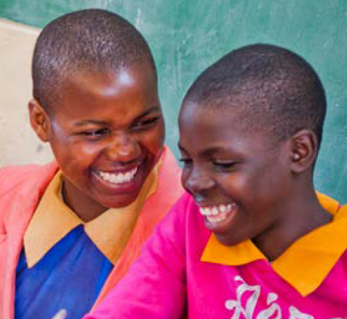
Week 4: Love of Neighbor
Love of neighbor means you see all people as your neighbors or as members of your family connected together. You look out for them and try to help them. You treat them as your friends.
Notes:
Teacher Notes
Help students understand what “love of neighbor” means in everyday life.
Teacher Narration
The virtue we are focused on today is love of neighbor. Love of neighbor means that you see all people as your neighbors - connected together. You look out for all people and try to help them. You treat them as your friends. You treat them with respect. You look for ways you can help them. You watch out for them.
Attribution
Image from Mary’s Meals

Slide 52
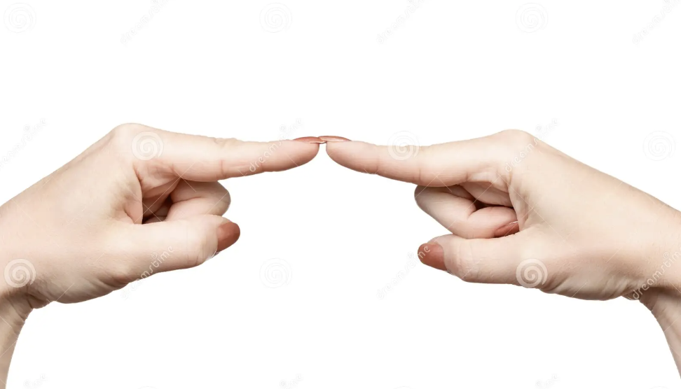
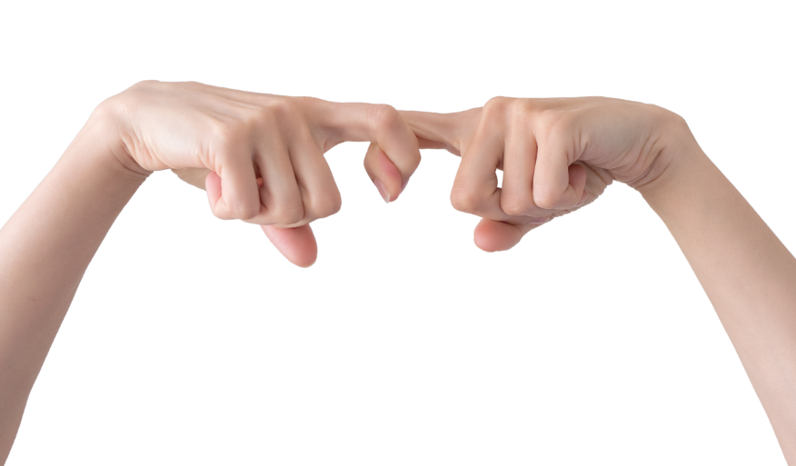
Unbreakable Bonds: Love of Neighbor
Hold up one finger from each hand and touch them together.
Try to pull them apart.
Is it easy to pull them apart? Yes or No?
Now lock one finger from one hand to a finger on your other hand.
Try to pull them apart again.
Is it easy to pull them apart? Yes or No?
Notes:
Teacher Notes
Invite the students to touch their pointer fingers together.
Then invite the students to hook their pointer fingers together.
Ask them the questions in the narration.
Teacher Narration
Touch your two pointer fingers together. Can you pull them apart? Is it easy to pull them apart?
Now, connect or hook your two pointer fingers together? Can you pull them apart?
Why is it easy to pull your fingers apart when they are touching, but not when they are hooked?
When they are connected, they are strong.
Attribution
Picture of fingers touching: https://www.dreamstime.com/stock-photo-two-index-fingers-each-other-gesture-female-hand-showing-isolated-white-background-image71065519
ID 71065519
© Oleksandr Grybanov
Dreamstime.com
Picture of fingers hooked: https://www.dreamstime.com/finger-finger-together-finger-lock-two-hands-held-together-fingers-people-harmony-concept-finger-finger-together-image186957682
D 186957682
© Sablin Stanislav
Dreamstime.com

Slide 53
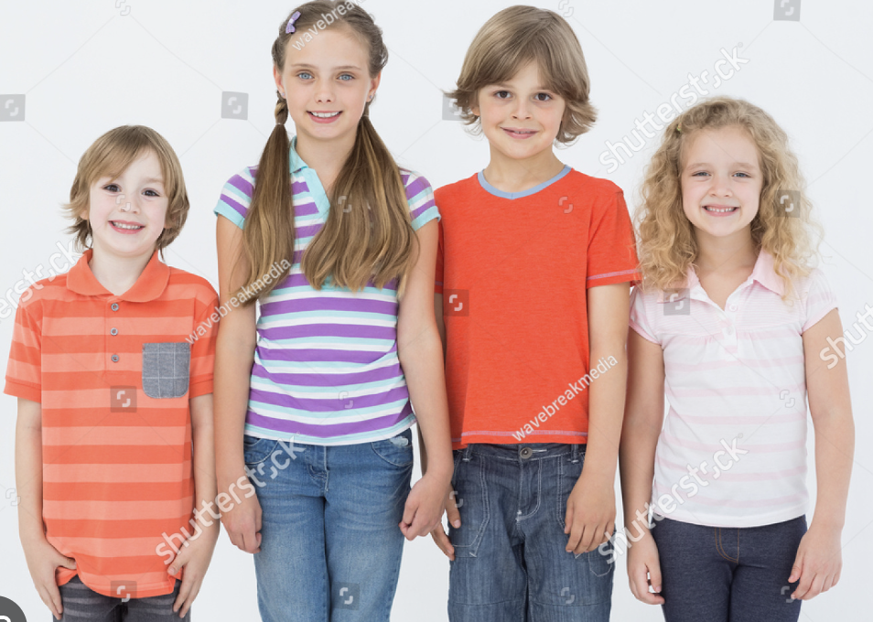
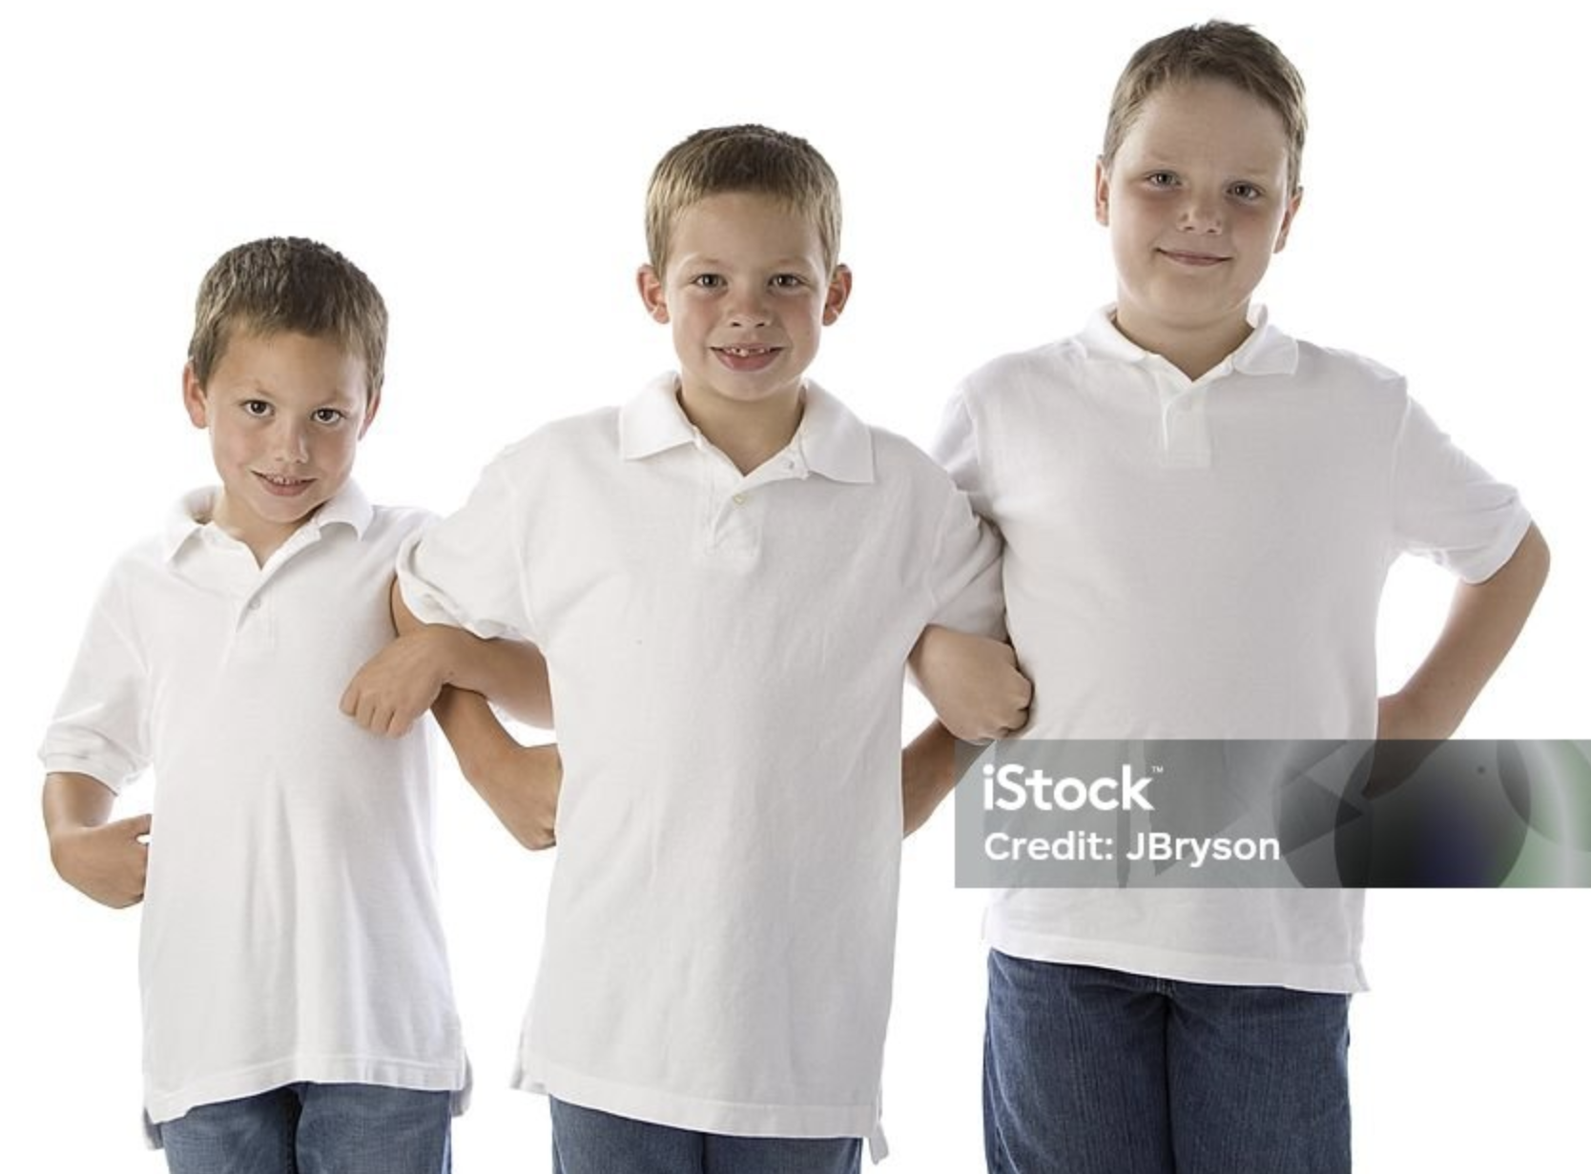
Unbreakable Bonds: Love of Neighbor
Love of neighbor means that you see all people as your neighbors - connected together.
What can you do to treat everyone you meet like they
are your neighbor?
Notes:
Teacher Notes
Invite the students to stand side by side and see how easy it is to step apart.
Have the students stand side by side and link arms and see how easy it is to step apart.
Explain the Love of Neighbor virtue.
Teacher Narration
It’s the same with people too. When you aren’t connected to other people, like when you stand side by side but don’t touch, it’s easy to move away from each other.
You stand alone and are weak and vulnerable. When you are connected to other people, for example, when you link arms, it’s really hard to pull apart. You are stronger and solid together. You have greater ability to do big things.
Attribution
Children standing side by side: https://www.shutterstock.com/image-photo/portrait-happy-children-standing-side-by-258018014
Children linking arms: https://www.istockphoto.com/photo/three-little-boys-standing-with-arms-hooked-gm176768809-10735487

Slide 54
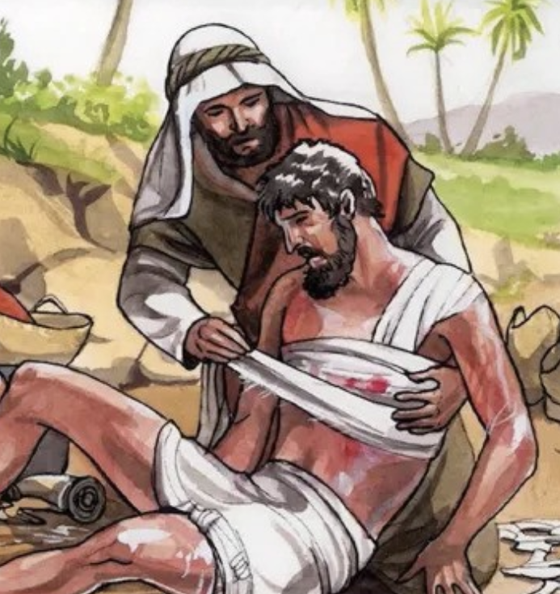
Love in the Scriptures: The Good Samaritan
Luke 10:25-37
A man fell victim to robbers as he went down from Jerusalem to Jericho. They stripped and beat him and went off leaving him half-dead.
A Samaritan traveler who came upon him was moved with compassion at the sight. He approached the victim, poured oil and wine over his wounds and bandaged them. Then he lifted him up on his own animal, took him to an inn and cared for him.
35 The next day he took out two silver coins and gave them to the innkeeper with the instruction, ‘Take care of him. If you spend more than what I have given you, I shall repay you on my way back.’
Notes:
Teacher Notes
Read the scripture verses themselves or summarize the story. A possible story summary is in the narration.
Teacher Narration
When Jesus was on earth, someone asked Him, “Who is my neighbor?” Jesus answered that question by telling the person who asked the question a story called the parable of the Good Samaritan (Luke 10:25-37).
In the story, a man was hurt by thieves and was left on the side of the road with no help.
A priest and a Levite passed by the man without helping him. Then a Samaritan, who was from a group that people didn’t like, stopped to help the hurt man. He cleaned the man’s wounds, took him to a place to recover, and paid for his care.
Attribution
https://www.linkedin.com/pulse/why-good-samaritan-alvin-ognimod/

Slide 55
Love in the Scriptures: The Good Samaritan
Luke 10:25-37
Did the Samaritan already know the hurt man?
Why is it important to help others, even if they are different from us or if we don’t know them?
What can we learn from the Samaritan about being kind and generous, even when it might be inconvenient or hard?
Notes:
Teacher Notes
Read the scripture verses themselves or finalize the story summary.
Teacher Narration
(See notes above)
Attribution
https://www.linkedin.com/pulse/why-good-samaritan-alvin-ognimod/

Slide 56
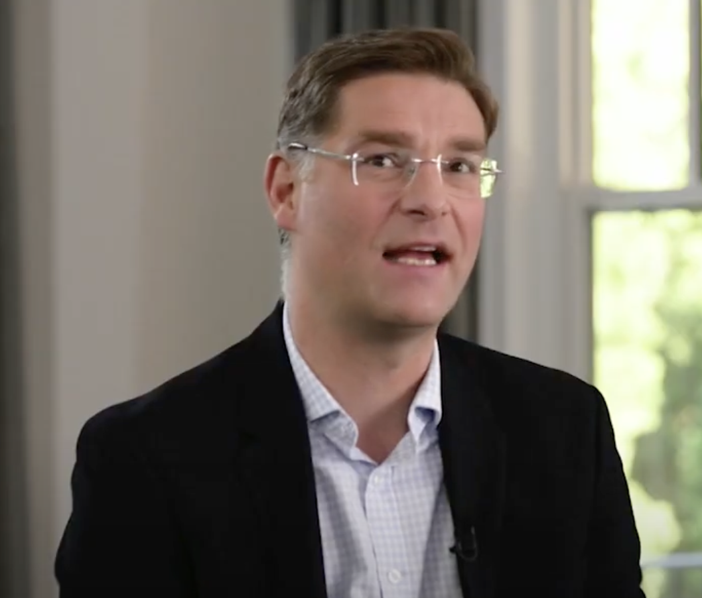
Love of Neighbor: The Example of Magnus
Discussion:
How does Magnus show neighborly love?
Who is someone you have never considered to be your neighbor?
What could you do to change the world for the better?
Notes:
Teacher Notes
Show the video and ask your students the discussion questions.
Teacher Narration
We are going to watch a video about the man who started Mary’s Meals. His name is Magnus Macfarlane-Barrow. As you watch this video, look for ways that Magnus sees and treats people around the whole world as his neighbors.
Attribution
Mary's Meals / MAGNUS MACFARLANE BARROW 1 video: https://www.youtube.com/watch?v=SLgnWwvaWJo&t=306s
3:53-5:03 or 3:53-6:30

Slide 57
Love of Neighbor: Small Acts, Big Impact
A classmate forgets their lunch.
How can you help them feel cared for?
Someone gets a wrong answer in class and looks embarrassed.
What can you do to make them feel better?
A new student doesn’t know where their next class is located.
How can you help them feel welcome?
A friend drops all their art supplies on the floor.
What can you do to show kindness?
Pair up with a partner and decide who will be the reader and who will be the writer.
The reader will read a scenario about someone in need.
Work together to think of a small act of love to show kindness to that person.
The writer will write down your idea for the act of love.
Notes:
Teacher Notes
Invite the children to talk through difficult scenarios and determine how a little acts of love can help people in need.
Teacher Narration
Pair up with a partner and decide who will be the reader and who will be the writer.
The reader will read a scenario about someone in need.
After reading the scenario, work together to think of a little act of love you could do to show kindness to that person.
The writer will write down your little act of love idea.
Switch roles and repeat this activity until you have identified little acts of love you can do for each scenario.
Attribution
N/A

Slide 58
Little Acts of Love
Each week of Lent, we are focusing on building a stronger relationship with God through virtues. Here are some little acts of love you can do this week to strengthen your love of neighbors.
Pray for someone sad or struggling, asking God to comfort them.
Spend time daily praying for your community and neighbors.
Write a prayer thanking God for people. Ask for how you can help comfort them.
Fast from gossip by choosing to only speak kind words.
Give up free time to help a classmate or neighbor.
Fast from distractions during family time by listening well.
Make a card to cheer someone up and show love.
Invite someone alone to join your group or activity.
Do something kind daily to make someone smile.
Notes:
Teacher Notes
N/A
Teacher Narration
What little acts of love can you do this week to show neighborly love? These are three examples of what you can do this week. More ideas are on the back of your Lent Calendar. Remember to track the little acts of love you do by filling out your Lent Calendar and journaling! That way you can see the good you are doing and remember what little acts of love to add to our display here in class next week.
Attribution
N/A

Slide 60
Teacher Only (Prep for Wisdom Lesson)
All the teacher notes and scripts are in the speaker notes of each slide.
Items you will need for the activity:
Sticky notes
Print:
none

Slide 61
Little Acts of _Love for Len__

Slide 62
Reflection on Last Week:
Little Acts of Love
Reflect on a small act of love of neighbors you demonstrated last week that made you feel proud, and write it down.
Notes:
Teacher Notes
Ask students to share one of their sacrifices and how they felt about it. As the students come into class, invite them to take a sticky note/piece of paper write a small act of love of neighbors they demonstrated last week that made them feel proud, and write it down. Have the students place it on the wall chart and look to see what other students are doing.
You can ask students to share one of their little acts of love and how they felt about it.
Teacher Narration
(See notes above)
Attribution
Image from Mary’s Meals
hanahal/stock.adobe.com, Multicolor post it notes (Adobe Stock Education License).

Slide 63
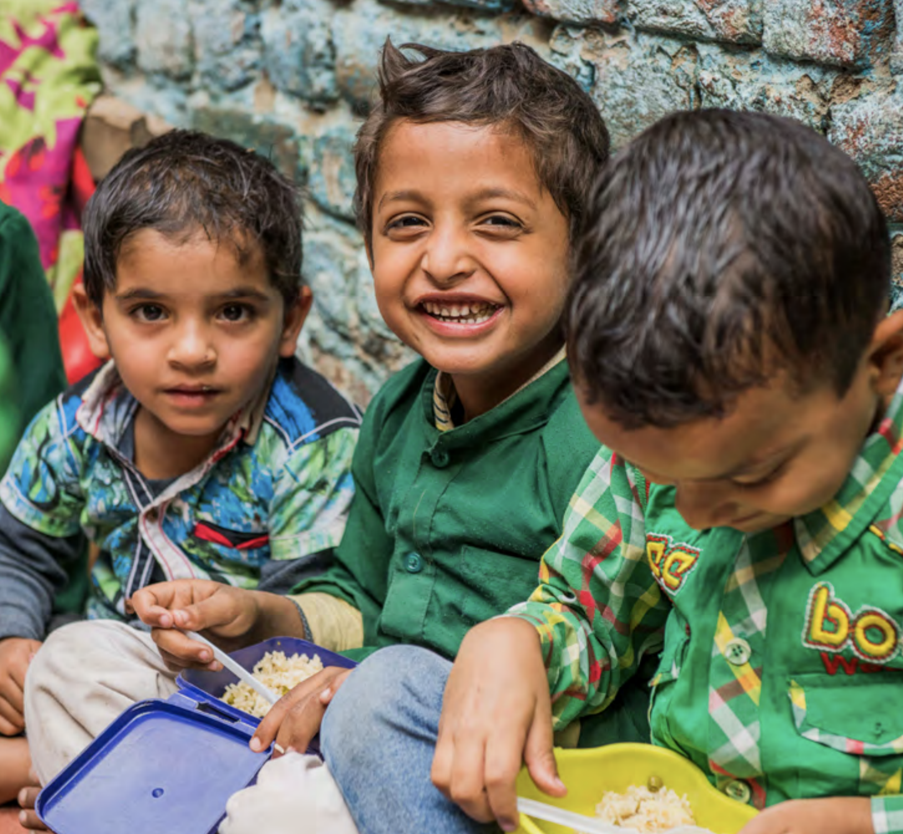
Week 5: Wisdom
Wisdom means using what you know and have learned from God and His teachings to make good choices and decisions.
Notes:
Teacher Notes
Consider explaining the difference between knowledge and wisdom. If you don’t feel like you need to go into that detail for your class, you can take it out of the narration below.
Teacher Narration
This week, we will be learning about the virtue of wisdom. Wisdom means using what we know and have learned from God and His Teachings to make good choices and decisions Wisdom is like having a “superpower” for making good choices. It’s when someone knows what the right thing to do is, even in tricky situations, because they’ve learned from their own experiences or listened carefully to advice from others. Wisdom helps people think things through and consider the effects of their actions, so they’re more likely to make decisions that help themselves and others. It’s a skill that grows over time as people learn, make mistakes, and understand more about the world.
Knowledge is knowing what to say; wisdom is knowing whether or not to say it. Knowledge gives answers; wisdom asks questions. Knowledge can be taught, wisdom grows from experience.
Attribution
Image from Mary’s Meals

Slide 64
Exploring the Qualities of Wisdom
Who is someone you think is wise? This could be a family member, teacher, friend, or someone you’ve read or learned about.
It could be someone who gives good advice, makes thoughtful decisions, or shows patience and understanding.
Notes:
Teacher Notes
Have students think for about 20 seconds of someone they know (or know about) who is wise.
Teacher Narration
Who is someone you think is wise? This could be a family member, teacher, friend, or someone you’ve read or learned about.
It could be someone who gives good advice, makes thoughtful decisions, or shows patience and understanding. Think quietly about that person for 20 seconds.
Attribution
N/A

Slide 65
Exploring the Qualities of Wisdom
In pairs, share with each other about who you think is wise. Use the questions below to guide your discussion.
“What do they do or say that shows they are wise?”
“How does their wisdom help others?”
“What do you admire most about them?”
Notes:
Teacher Notes
Split the class into pairs and after having them share a bit about who their wise person is, have them discuss the questions on the board. You can determine the length of this discussion, but consider having it be at least 90 seconds.
Teacher Narration
Now turn to your neighbor and tell them who you think is wise and why you think so. You can use the questions on the slide to guide your conversation.
Attribution
N/A

Slide 66
Exploring the Qualities of Wisdom
What attributes did both of your wise people have in common?
Notes:
Teacher Notes
Using your preferred strategy, bring the class’s attention back to you. Have a few students answer the question on the board.
Teacher Narration
What attributes did both of your wise people have in common?
Attribution
N/A

Slide 67
Exploring the Qualities of Wisdom
Understanding: They listen carefully and try to see things from different perspectives.
Patience: They take time to think before acting.
Good Judgment: They know how to make fair and thoughtful decisions.
Kindness: They use their knowledge to help others.
Experience: They’ve learned from life and use that experience to guide others.
Humility: They are willing to admit when they don’t know something.
Notes:
Teacher Notes
Highlight any qualities from the slide that students may not have mentioned.
Teacher Narration
You all shared great qualities. A few others include these attributes…
Attribution
N/A

Slide 68
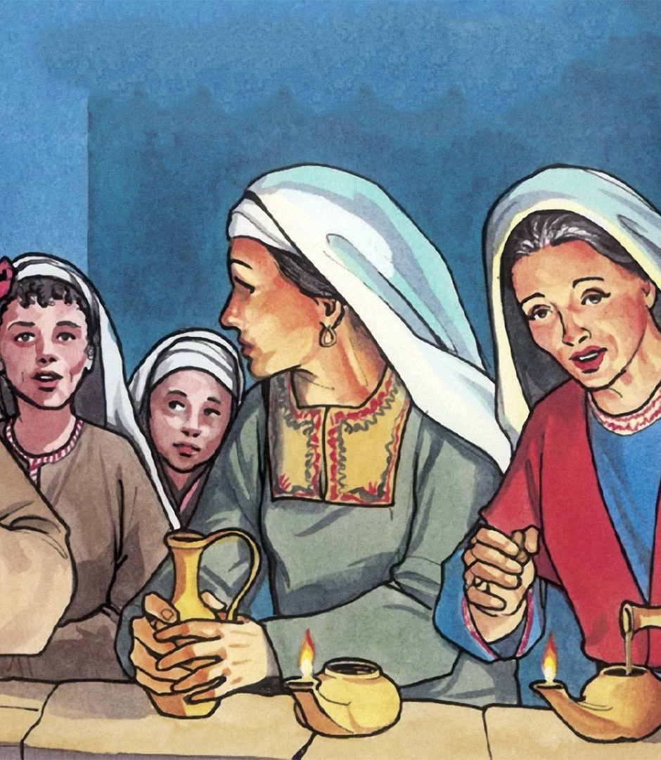
Wisdom in the Scriptures: The Ten Bridesmaids
Matthew 25:1-10
1 Then the kingdom of heaven will be like this. Ten bridesmaids took their lamps and went to meet the bridegroom.
3 When the foolish took their lamps, they took no oil with them;
4 but the wise took flasks of oil with their lamps.
6 But at midnight there was a shout, "Look! Here is the bridegroom! Come out to meet him.”
Notes:
Teacher Notes
Summarize the story of The Ten Virgins or have a student succinctly summarize it.
Teacher Narration
The Parable of the Ten Virgins is a story told by Jesus about ten women who were waiting for a bridegroom to arrive for a wedding. Five of them were wise and brought extra oil for their lamps, while the other five were foolish and only brought enough oil for a short time. When the bridegroom was delayed, the foolish virgins ran out of oil and went to buy more. While they were gone, the bridegroom arrived, and the wise virgins went in with him to the wedding feast. When the foolish virgins returned, the door was shut, and they were not allowed in.
Attribution
Good News Productions Int., Then all the virgins woke up and trimmed their lamps. Free Bible Images (CC BY-NC-ND).

Slide 69
Wisdom in the Scriptures: The Ten Bridesmaids
Matthew 25:1-10
8 The foolish said to the wise, "Give us some of your oil, for our lamps are going out.”
9 But the wise replied, "No! there will not be enough for you and for us; you had better go to the dealers and buy some for yourselves.”
10 And while they went to buy it, the bridegroom came, and those who were ready went with him into the wedding banquet; and the door was shut.
Notes:
Teacher Notes
Summarize the story of The Ten Virgins or have a student succinctly summarize it.
Teacher Narration
The Parable of the Ten Virgins is a story told by Jesus about ten women who were waiting for a bridegroom to arrive for a wedding. Five of them were wise and brought extra oil for their lamps, while the other five were foolish and only brought enough oil for a short time. When the bridegroom was delayed, the foolish virgins ran out of oil and went to buy more. While they were gone, the bridegroom arrived, and the wise virgins went in with him to the wedding feast. When the foolish virgins returned, the door was shut, and they were not allowed in.
Attribution
Good News Productions Int., Then all the virgins woke up and trimmed their lamps. Free Bible Images (CC BY-NC-ND).

Slide 70
Wisdom in the Scriptures: The Ten Bridesmaids
Matthew 25:1-13
Discussion:
Why do you think the wise virgins brought extra oil for their lamps?
Can you think of a time when you were prepared for something important? How did it help you?
How does this story remind us to be ready for God’s timing, even when it’s unexpected?
Notes:
Teacher Notes
Either lead a group discussion covering the questions on the slide, or have students get into small groups to discuss the questions.
Teacher Narration
Attribution
Good News Productions Int., Then all the virgins woke up and trimmed their lamps. Free Bible Images (CC BY-NC-ND).

Slide 71
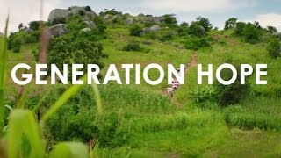
Wisdom:
The Example of Jimmy
Discussion:
How did Jimmy show wisdom?
Why did he pick the harder path?
What happened because he made wise choices?
Notes:
Teacher Notes
Watch the video.
After the video, either lead a group discussion covering the questions on the slide, or have students get into small groups to discuss the questions.
Teacher Narration
We will now watch a video of a young man, Jimmy, who shares his story about growing up and how Mary’s Meals helped him. As we watch the video, consider how Jimmy showed wisdom, why he picked the harder path, and what happened because he made a wise choice.
How did Jimmy show wisdom?
Why did he pick the harder path?
What happened because he made wise choices?
Attribution
Generation Hope video https://www.youtube.com/watch?v=LMIkrC09NpI&t=1237s
Timestamp: 17:00-20:00

Slide 72

Practicing Wisdom in Decisions
Imagine this:
You just got your first quiz back in a class you really like, and… oh no! You didn’t do well. You feel upset, but you really want to do better next time.
What do you feel like doing right away?
What could you do instead to be wise and make things better?
Notes:
Teacher Notes
Lead a group discussion covering the questions on the slide.
Teacher Narration
“Wisdom is about thinking before you act. It’s learning from mistakes and making good choices, even when it’s hard. Remember, being wise isn’t always easy, but it’s the smart path that helps you in the long run! Let’s practice being wise together!
You just got your first quiz back in a class you really like, and… oh no! You didn’t do well. You feel upset, but you really want to do better next time. What do you feel like doing right away? What could you do instead to be wise and make things better? Take the next 30 seconds to ponder what you would do. When the timer goes off, turn to your neighbor and share your thoughts.”
Attribution
N/A

Slide 73
Little Acts of Love
Each week of Lent, we are focusing on building a stronger relationship with God through virtues. Here are some little acts of love you can do this week to strengthen your love of neighbors..
Pray before tough choices: 'God, help me decide wisely.'
Start your day praying for guidance and wise decisions.
Reflect on Bible stories about wisdom and God’s guidance.
Fast from impulsive actions by asking, 'What would Jesus do?'
Fast from wasting time by choosing growth-focused activities.
Fast from frustration by focusing on lessons from challenges.
Write or draw a wise choice daily and share it.
Spend time with someone who helps you make wise choices.
Teach a Bible verse about wisdom and discuss its meaning.
Notes:
Teacher Notes
Help students think about what they can do to fill out their cross that week and help them practice wisdom by doing little acts of love.
Teacher Narration
What little acts of love can you do this week to demonstrate wisdom? These are three examples of what you can do this week. More ideas are on the back of your Lent Calendar. Remember to track the little acts of love you do by filling out your Lent Calendar and journaling! That way you can see the good you are doing and remember what little acts of love to add to our display here in class next week.
Attribution
N/A

Slide 75
Teacher Only (Prep for Charity Lesson)
All the teacher notes and scripts are in the speaker notes of each slide.
Items you will need for the activity:
Sticky notes
Food for the class (see slide on Charity in Action for details)
Blank paper for each student and something to write with
Print:
Charity Cross Activity

Slide 76
Little Acts of _Love for Len__

Slide 77
Reflection on Last Week:
Little Acts of Love
Reflect on a small act of wisdom you demonstrated last week that made you feel proud, and write it down.
Notes:
Teacher Notes
Ask students to share one of their sacrifices and how they felt about it. As the students come into class, invite them to take a sticky note/piece of paper write a small act of wisdom they demonstrated last week that made them feel proud, and write it down. Have the students place it on the wall chart and look to see what other students are doing.
You can ask students to share one of their little acts of love and how they felt about it.
Teacher Narration
(See notes above)
Attribution
Image from Mary’s Meals
hanahal/stock.adobe.com, Multicolor post it notes (Adobe Stock Education License).

Slide 78
Faith
Hope
Justice
Love of Neighbor
Wisdom
CHARITY
Notes:
Teacher Notes
If there is time, you can read and discuss 1 Corinthians 13:13 as a class.
Teacher Narration
During Lent, we have practiced living all these virtues. This week we are talking about one final virtue before Easter: charity. All of the other virtues we have learned about will help us to practice charity.
Attribution
Mary’s Meals image

Slide 79
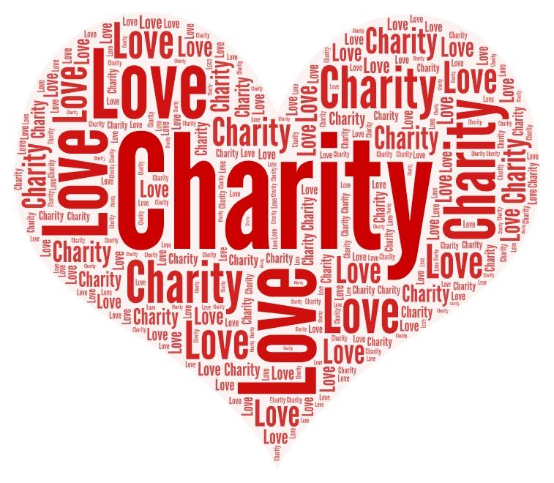
Charity
Notes:
Teacher Notes
Ask your class to brainstorm what we do when we feel charity. The students could write down words individually, you could create a list together, or you can use Mentimeter https://www.mentimeter.com to create a word cloud.
While you are leading this reflection, you should be serving the food for this activity. Make sure the students see you dividing up the food so they are anticipating receiving some. You can choose what type of food to use. It could be simple like pretzels or pizza or a treat like brownies that you cut into different-sized portions. Divide the food so ⅓ of the students receive multiple portions, ⅓ of the students receive a single portion, and ⅓ of the students receive none.
Teacher Narration
Charity is something that we feel in our hearts that leads us to do something to act on that feeling. Let’s create a list of words that have the same, or a similar, meaning as the word charity (synonyms).
Attribution
Image from Canva?

Slide 80
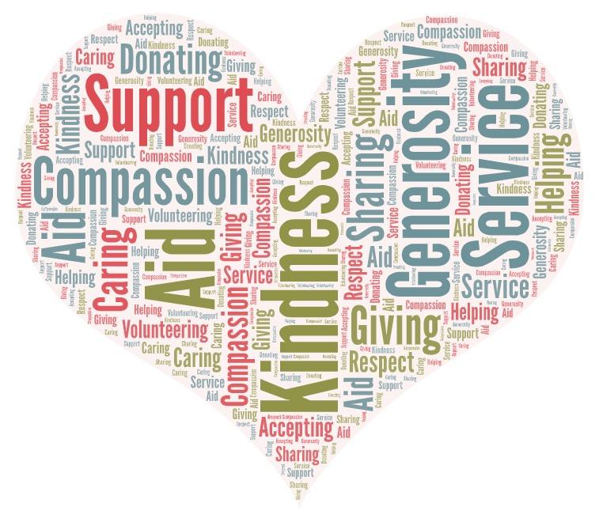
Charity
Notes:
Teacher Notes
Compare the list or word cloud the students created with the words in the second word cloud. Talk about the differences or similarities.
Teacher Narration
How do the words we chose compare to this word cloud?
Did you notice that most of the words that are similar to charity describe an action? When we feel charity in our hearts, it is important to do something to share that love with other people.
Attribution
Image from Canva?

Slide 81

Putting Charity into Action
How does it feel to get nothing?
How does it feel to get extra when others have none?
Is there a charitable solution to our problem?
There is enough when people are willing to share!
Notes:
Teacher Notes
Pass out the food you prepared. Give multiple portions of the food to ⅓ of the students. Give single portions of food to ⅓ of the students. Give none to ⅓ of the students.
Ask reflection questions.
Let the students decide how they might be able to redistribute the food.
Teacher Narration
Is there enough food here for everyone to eat?
How does it feel to get nothing?
How does it feel to get extra when you know others don’t have any?
Is there a charitable solution to our problem here today?
We have enough in our world as long as those of us who have more than we need are willing to share.
Attribution
Image from Canva?

Slide 82

Charity: The Example
of Charlie
Discussion:
How did Charlie show charity?
What sacrifices did Charlie make?
Why did Charlie feel like it was important to help?
Notes:
Teacher Notes
Show the video and then ask the discussion questions.
Teacher Narration
Let’s watch this video about a boy named Charlie Doherty. He has acted on the charity he felt in his heart and has done lots of little acts of love.
How did Charlie show charity?
What sacrifices did Charlie make?
Why did Charlie feel like it was important to help?
Attribution
Child 31 video https://www.youtube.com/watch?v=aFU8cU-cICs&t=802s
12:18-13:45

Slide 83
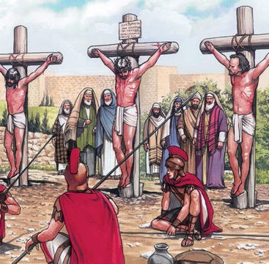
Christ teaches us about Charity: The Crucifixion
Luke 23:33-34
When they came to the place called the Skull, they crucified him and the criminals there, one on his right, the other on his left.
[Then Jesus said, “Father, forgive them, they know not what they do.”] They divided his garments by casting lots.
Notes:
Teacher Notes
Talk about Jesus’s crucifixion.
Have the students write a prayer or a letter to Jesus thanking Him for His sacrifice and asking for guidance in living out the virtues in their daily lives as an additional optional reflection activity.
Teacher Narration
Jesus was the best example of charity. He showed great love for each of us when he died on the cross.
Holy Week is the culmination of our Lenten journey. It’s a time to reflect on Jesus’ ultimate sacrifice and His love for us.
As we approach Easter, ask yourself these questions:
How has your journey through the virtues prepared you to follow Jesus more closely?
How can you carry these lessons forward beyond Lent?
Attribution
Jesus' Crucifixion © 2019 by Paula Nash Giltner is licensed under CC BY-NC-ND 4.0

Slide 84
Mary’s Meals Prayer
When questioned about which commandment was the greatest, Jesus replied, “Love the Lord your God with all your heart and with all your soul and with all your mind and with all your strength. The second is this: Love your neighbor as yourself. There is no commandment greater than these.” Mark 12:30-31
As we reflect on the words of Jesus, may we consider how our prayers and actions show our love for the neighbors that we know and for our global neighbors that we’ve not had the opportunity to meet – especially the children. Let us pray together.
Lord, we are thankful for all of your blessings.
We are thankful for all those who labor every day to feed the children
who are in such great need.
May the work of our volunteers be an expression of your love for the children.
May each and every child feel your loving embrace as they eat their meals
and enjoy a respite from the daily challenges of their lives.
May the meals these children receive provide them the energy to learn and the nutrition to grow. May these children have hope for the future despite their suffering today.
Lord, may our prayers for these children be little acts of love that reflect your love for them. Amen.
Notes:
Teacher Notes
Please feel free to refer to this Mary’s Meals prayers if the students ever need to have a prayer to
Teacher Narration
Charity is something that we feel in our hearts that leads us to do something to act on that feeling. Let’s create a list of words that have the same, or a similar, meaning as the word charity (synonyms).

Slide 85
Little Acts of _Love for Len__

Slide 86
Reflection on our Little Acts of Love for Lent
Look at the crosses you have filled with the small acts of faith, hope, justice, love for neighbor, and wisdom during Lent.
Notes:
Teacher Notes
Ask students to look at the crosses filled with post-it notes and reflect on what they did during Lent.
Ask some or all of the reflection questions.
Attribution
Image from Mary’s Meals
hanahal/stock.adobe.com, Multicolor post it notes (Adobe Stock Education License).

Slide 87
Little Acts of Love for Len_
During Lent, we focused on one virtue each week.
Faith: Grounds prayer in trust and belief in God.
Hope: Gives purpose to fasting, reminding us of God’s promises.
Justice (Kindness): Directs almsgiving toward fairness and care for others.
Love of Neighbor: Motivates all three pillars by focusing on serving others.
Wisdom: Guides how we pray, fast, and give in ways that honor God.
Charity: Infuses every act of prayer, fasting, and giving with selfless love.
These virtues guide us to live as Jesus taught, helping us grow closer to God and serve others.
Notes:
Teacher Notes
Introduce the connection between virtues and the 3 pillars of Lent
Emphasize that virtues are the foundation of our faith and actions.
Help students understand that each virtue supports the pillars of prayer, fasting and almsgiving, making them more meaningful and effective.
Teacher Narration
During Lent, we explored the virtues of Hope, Faith, Justice/Kindness, Love of Neighbor, Wisdom, and Charity.
These virtues guide us to live as Jesus taught, helping us grow closer to God and serve others.
Each virtue strengthens the three pillars of Lent:
Prayer: Builds our relationship with God.
Fasting: Helps us let go of distractions and grow spiritually.
Almsgiving: Encourages us to share our blessings with others.
As you think over the last six weeks,
Which virtue has been the most meaningful to you during Lent? How has it brought you closer to God?
What sacrifices did you make that you will remember for a long time?
What sacrifice was the hardest for you?
What meant the most to you?
Why did you choose the sacrifices you chose?
Were there some that didn’t work well? Why?
Attribution
Image of 3 pillars: Found on Canva, edited to add in “Strong Relationship with God” and “Virtues”

Slide 88
Little Acts of Love Don’t End with Lent
What are ways that you can continue to show charity through little acts of love at home, in our school, at church, in our community, or in our world?
Notes:
Teacher Notes
Give each student a new copy of the cross and encourage students to write down ideas of how they can continue to perform little acts of love even now that Lent is over.
Show the video from Mary’s Meals. Discuss ways that students can participate in Little Acts of Love through Mary’s Meals organization in the future.
Teacher Narration
You have filled your crosses during Lent with little acts of love. Doing little acts of love doesn’t have to end at Easter. Write some ways that you can continue to show charity through little acts of love at home, in our school, at church, in our community, or in our world.
Attribution
Video clip: Child 31 https://www.youtube.com/watch?v=aFU8cU-cICs&t=802s
27:58-30:39

Slide 89
You can do
Little Acts of Love
all year.

