Slide 1

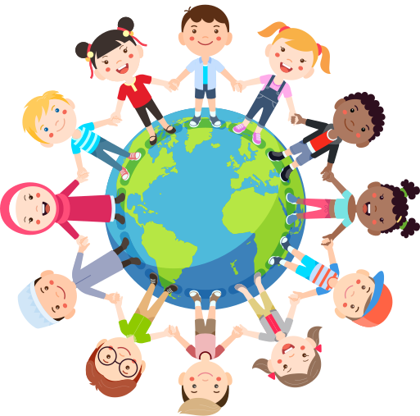


LITTLE ACTS OF LOVE FOR LENT
K-2 Slides

Slide 2
Notes for the Teacher
Each lesson follows this outline:
  Kindness chain
  Introduction to the virtue
  Bible story to teach the virtue
  Connection to Mary’s Meals
  Attention activity to practice the virtue
  Take-home invitation
The slide notes include an outline of discussion points for each slide, along with projected time estimates.
The lessons (with the exclusion of the introduction and reflection lessons) can be taught as a single session or spread out over the week as "daily lessons." You can choose the format that best fits your classroom needs.
Note that some of the lessons have options of Bible stories and activities you can do. Please adapt the lessons in ways that best fit your class.
Notes:
Kindness Chain:
Each student gets their own chain. Each day of lent (or each lesson) they will write or draw a little act of love they did and add it to their chain.
Take-Home Invitations:
Printable versions of the invitations can be found on this link: https://docs.google.com/document/d/1tZmNbN_LDMYb1SRc5MXOMGO7Qy-K8JRTx0F5rVa8NLk/edit?usp=sharing

Slide 3
Virtue Lessons - Table of Contents
  Introduction Lesson
  Faith
  Hope
  Justice
  Loving Others
  Wisdom
  Charity
  Reflection Lesson

Slide 4
LITTLE ACTS OF LOVE FOR LENT
Introduction to Mary’s Meals

Slide 5

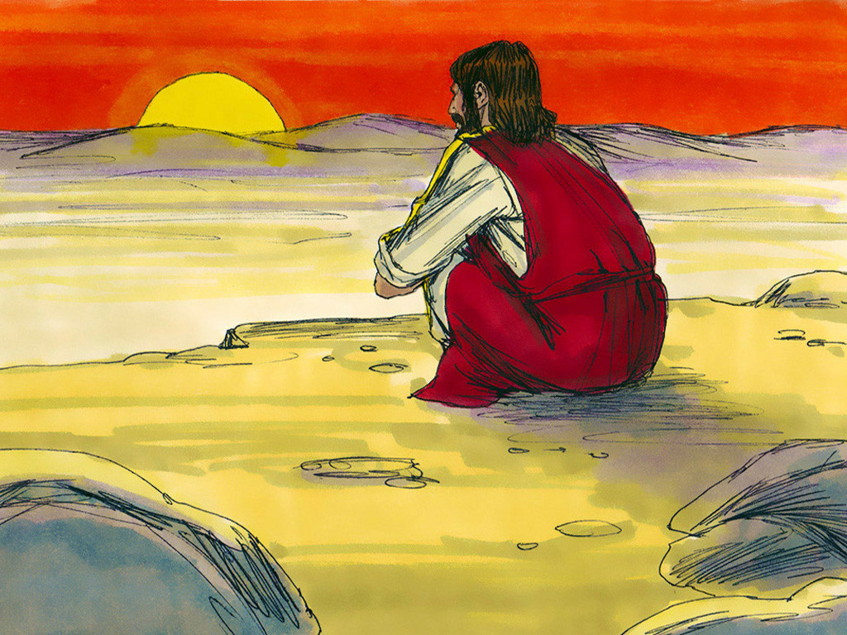


How long can you go without food before feeling hungry?
Little Acts of Love for Len
Notes:
Time: 3-5 minutes
1. Ask the class:
“How often do you drink water?”
“How long can you go without food before you start feeling hungry?”
2. Share the story of Jesus' 40 days of fasting (see Matthew 4:1-11). Ask the class to consider why Jesus would go without food and water for so long.
3. Explain that Jesus' fasting helped Him grow closer to God. We celebrate Lent so we can grow closer to God too.
Image copyright of Sweet Publishing.
Artist: Jim Padgett
They are licensed to FreeBibleimages for free distribution under a Creative Commons Attribution-ShareAlike 4.0 International license.
https://www.freebibleimages.org/illustrations/jesus-tempted/

Slide 6

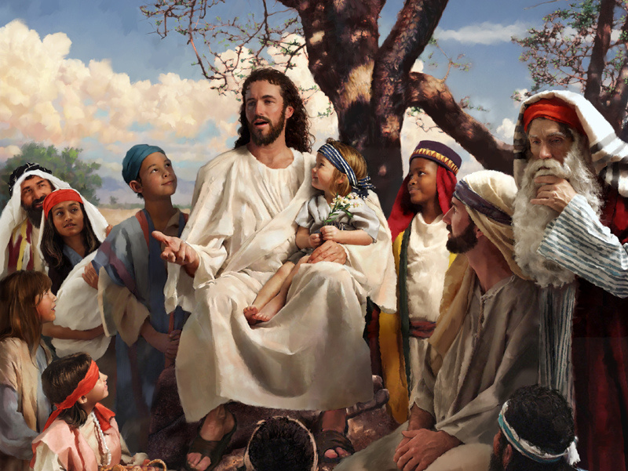
You can be like Jesus
Little Acts of Love for Len
Notes:
Time: 3-5 minutes
1. Ask the class:
“How often do you drink water?”
“How long can you go without food before you start feeling hungry?”
2. Share the story of Jesus' 40 days of fasting (see Matthew 4:1-11). Ask the class to consider why Jesus would go without food and water for so long.
3. Explain that Jesus' fasting helped Him grow closer to God. We celebrate Lent so we can grow closer to God too.
Image copyright of Sweet Publishing.
Artist: Jim Padgett
They are licensed to FreeBibleimages for free distribution under a Creative Commons Attribution-ShareAlike 4.0 International license.
https://www.freebibleimages.org/illustrations/jesus-tempted/

Slide 7

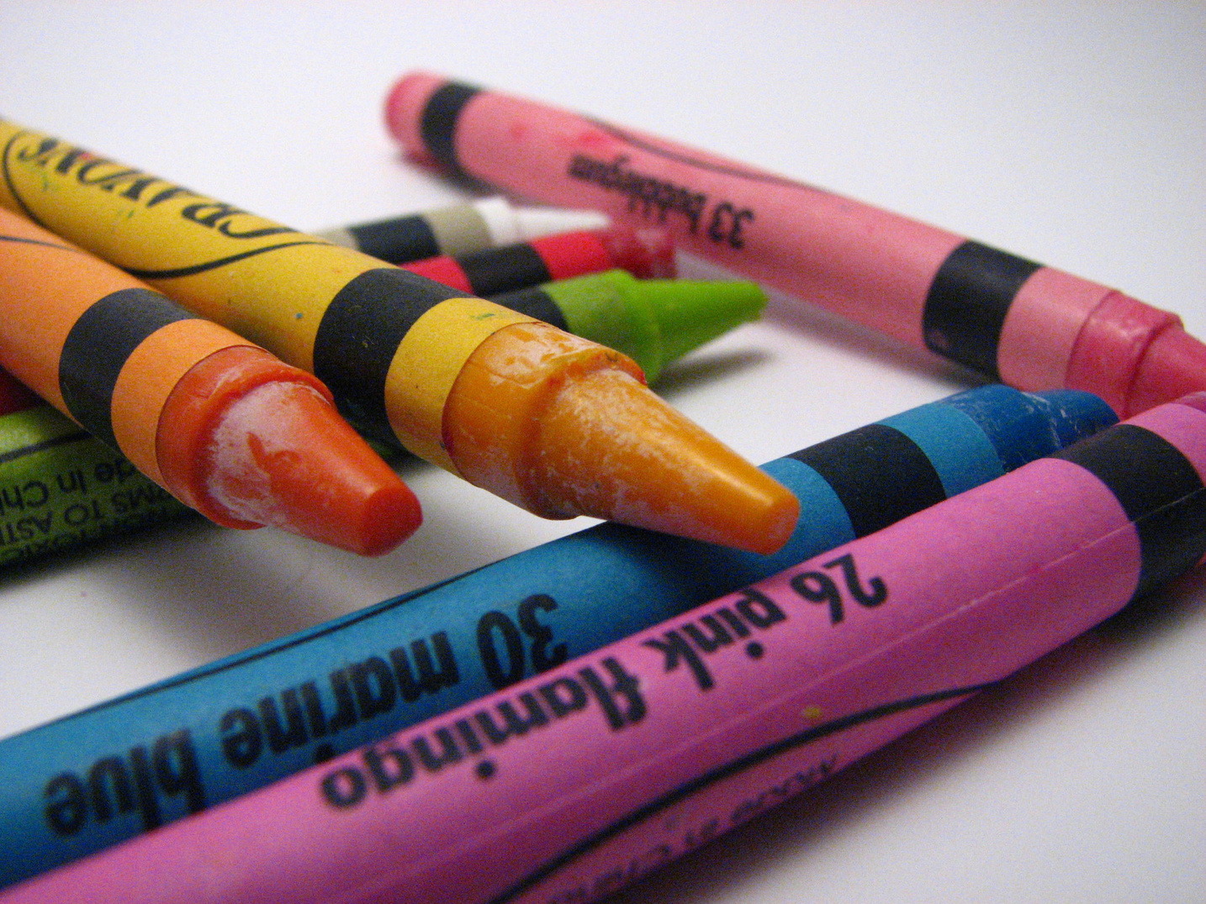
How can you be like Jesus?
Little Acts of Love for Len
Notes:
Time: 3-5 minutes
1. Distribute drawing supplies to the class.
2. Instruct the class to draw what it looks like to be like Jesus.
As needed, you might share suggestions such as:
- Helping a friend.
- Giving a gift.
- Saying a prayer.
"colors and crayons" by albastrica mititica is licensed under CC BY 2.0. To view a copy of this license, visit https://creativecommons.org/licenses/by/2.0/?ref=openverse.

Slide 8



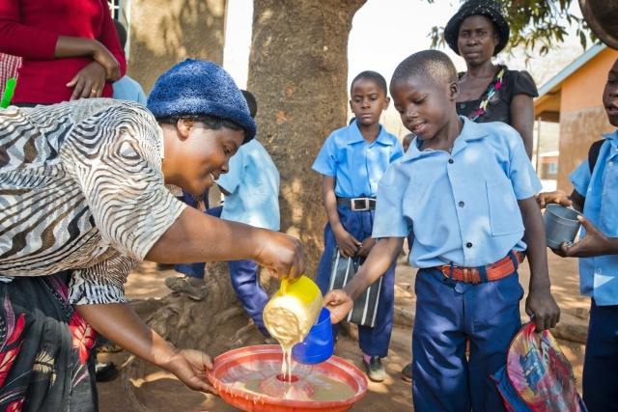
Mary’s Meals tries to be like Jesus by helping give food to kids in need.
Little Acts of Love for Len
Notes:
Time: 2-4 minutes
Teacher: This is Magnus! He wanted to help people! He started Mary’s Meals, a program that gives food to kids in school. So that they can learn and grow!
Ask: Why is school important? Why is food important?
Magnus’ story shows how one person can try to be like Jesus. It all started with him doing something kind to help someone else.
Image Attribution: Mary's Meals UK
https://www.marysmeals.org.uk/news/a-message-magnus-macfarlane-barrow-founder-of-marys-meals

Slide 9
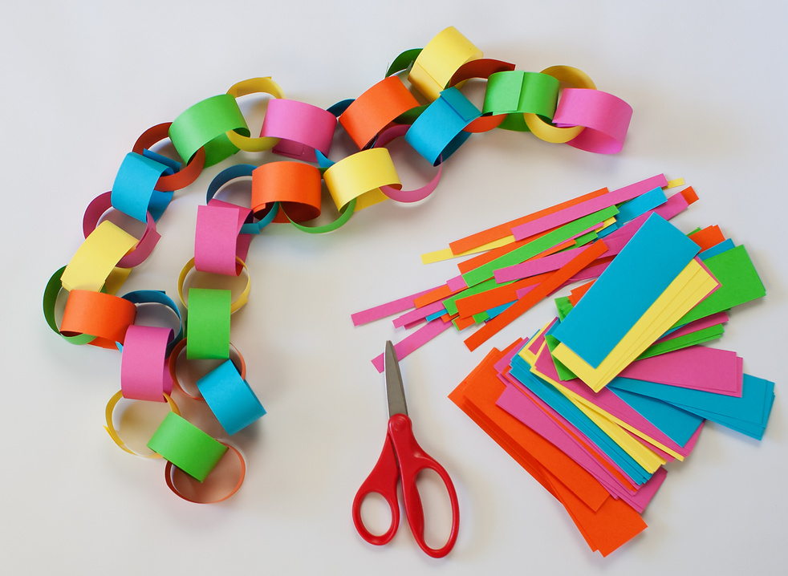
Do small acts of kindness to build your chain!
Notes:
Introduce the paper chain activity.
During lent each student will build their own kindness chain. On each link they will write or draw a small act of kindness they have done.
Teacher note: This activity may be done a number of ways.
1. Daily activity where students add one link
2. Weekly activity where students add multiple links
3. Any variation that fits the schedule of the classroom
Materials:
* 1 to 1 1/2 inch by 8 inch strips of paper
* Drawing/ writing materials
* Tape or Stapler
After lent emphasize how little acts of love can make a big difference.
You can use this template for making chain strips, if desired: https://drive.google.com/file/d/1y2ajEgSXB-ykR1pgdSQVEeJrlXZuyVzj/view?usp=drive_link

Slide 10
LITTLE ACTS OF LOVE FOR LENT
Faith

Slide 11




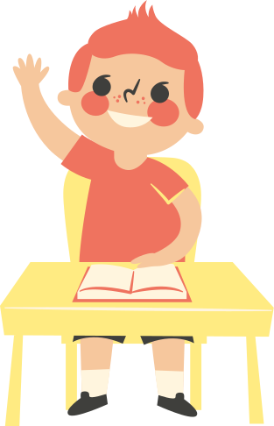

Kindness Chain
What are some small acts of love you have done this week?
Little Acts of Love for Len
Notes:
Time: 3-5 min
Students write or draw a small act of love they’ve done and add it to their paper chain.
Ideas for students:
* Say a prayer for someone
* Help at home
* Say something kind to someone
* Be extra patient
* Smile at others
* Make a card for someone
* Share a toy
If daily lesson:
Give the class a few minutes to share what they did.
Optional template for paper chain strips: https://drive.google.com/file/d/1y2ajEgSXB-ykR1pgdSQVEeJrlXZuyVzj/view?usp=drive_link
Attribution: Canva Images

Slide 12

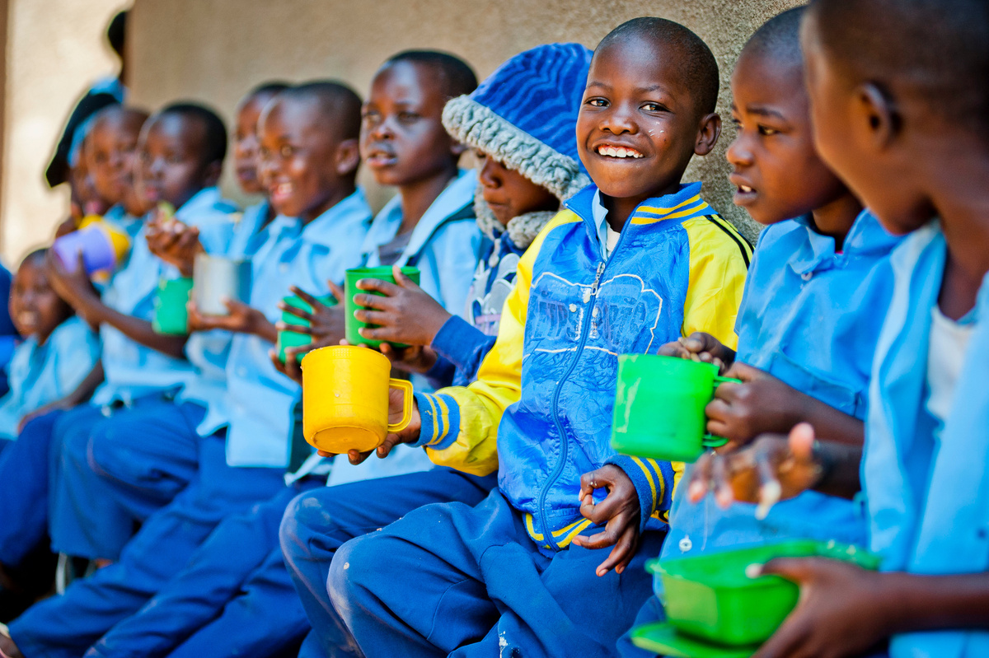
What is Faith?
Faith is trusting God, loving Him, and doing what makes Him happy.
Little Acts of Love for Len
Notes:
Time: 1-2 min
If daily lesson: Use this slide combined with the Bible story to fill the lesson time.
7-10 minutes.

Slide 13

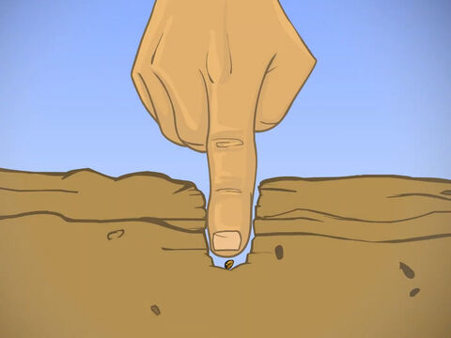
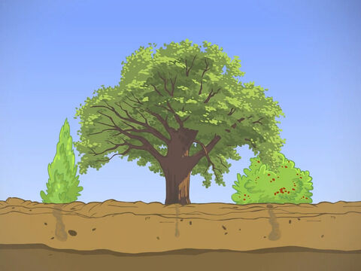
Bible Story: Faith is Like a Seed
Even though it’s super small, it can grow into a big, strong tree!
Faith is like a tiny seed.
Little Acts of Love for Len
Notes:
Time: 3-5 min
Matthew 17:20
Show the images of the mustard seed and the tree.
Explain that even if you have just a little bit of faith—like a tiny seed—it can still help you do big things. When you trust God, your faith grows, just like the seed grows into a tree.
Point out how small the mustard seed is and then how big the tree becomes, especially when compared to the trees around it and the seed it came from. Emphasize that even if faith feels small, it is still powerful!
Ask: “Can you think of a time when your faith helped you do something big? What happened when you trusted God?”
If a daily lesson:
Ask:
"What does believing mean?"
"What does the story of the tiny seed teach you about faith?"
Image Attribution: Free Bible Images https://freebibleimages.org/illustrations/wb-mustard-seed/

Slide 14



How can we show faith?
Click to View Video
Little Acts of Love for Len
Notes:
Time: 5-10 min
Before watching the video, explain that the students will see three children who have faith. Encourage them to look for the small act of faith in the video.
[Watch Video]
Ask what the “small act of faith” was.
While the children only asked for a one-dollar donation, those small donations added up to $300—enough to feed 12 children school lunches for a year! (Remind them it is similar the mustard seed!) Just like those children, their small acts of love can help people in big ways.
Consider sharing examples like being kind to a friend on the playground, praying for someone, or sharing with someone who is lonely.
If a daily lesson:
Discuss the following questions:
"How does faith lead to action?"
"How can I do good because of my belief in God?"
Consider splitting the students up in groups or sharing all together as a class.

Slide 15

Faith Walk
Little Acts of Love for Len
Notes:
time: 10-15 minutes
Faith Trust Walk
Materials: Blindfolds
Setup: Go to a playground or create an obstacle course with classroom furniture.
Instructions:
1. Work in pairs: One student is blindfolded while the other guides.
2. The guide's goal is to direct their partner safely through the obstacles.
3. The blindfolded student follows their guide's directions to move through the obstacle course.
4. Switch roles
5. Remind students to trust their guide, and give clear, calm instructions.
Discussion:
Talk about how we have to trust God always, even when we can’t see what’s ahead. Just as the students trusted their partner to guide them, we can trust God (have faith) to lead us in the right direction.
If daily lesson:
Before doing the activity briefly review what faith is.
Image Attribution: Bing Image Creator

Slide 16





Take-home invitation
Be brave
Talk about faith
Talk to God
Try something new. Trust that God will help you.
Share something you learned about God with your family.
Say a prayer to thank God for something in your life.
Little Acts of Love for Len
Notes:
time: 2-3 minutes
Encourage the students to show their faith by praying or trying something new and trusting God.
(if part of a daily thought)
You can expand this by doing the following activity with the students.
Materials: Slips of paper for students to write or draw on. Students can take their ideas home to share with their parents.
Review what faith means with the students, and encourage them to think of things they can do over the next few days to practice. Have them write down (or draw) their idea and take it home to share with their parents.
Here are some ideas to inspire them:
*Think before you speak: Pause for a moment to think if what you're going to say is kind or helpful.
*Ask good questions: Ask your teacher or parent how you can learn more about something you’re curious about.
*Listen carefully: Pay attention when someone is talking, so you can understand and learn from them.
*Make a wise choice: Choose to help, even when it’s hard, like picking up toys when you don’t feel like it.
*Learn from mistakes: If you make a mistake, say sorry and learn how to do better next time.
*Ask questions to help students reflect on the previous scripture story and activity.

Slide 17


What did you learn today?
Little Acts of Love for Len
Notes:
Time: 3-5 minutes
Invite the students to tell their parents something they learned about God or faith today.
Optional - You can expand this by doing the following activity with the students.
Materials: Provide slips of paper for the students to write the acts they want to do on. The students can then take home their ideas to share with their parents.
Start by reviewing what faith means with the students, and encourage them to think of one small act they can do over the next few days to show their faith. Have them write down (or draw) their idea and take it home to share with their parents. Here are some ideas to inspire them:
Write a letter to God, sharing how you plan to show your faith.
Tell your parents something you’ve learned about God.
Say a prayer to thank God for something special in your life.
Share your toys or help a friend in need.

Slide 18
LITTLE ACTS OF LOVE FOR LENT
HOPE

Slide 19
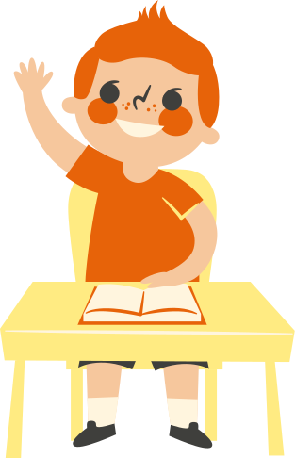
Kindness Chain
What are some small acts of love you have done this week?
Little Acts of Love for Len
Notes:
Time: 3-5 min
Students write or draw a small act of love they’ve done and add it to their paper chain.
Ideas for students:
* Say a prayer for someone
* Help at home
* Say something kind to someone
* Be extra patient
* Smile at others
* Make a card for someone
* Share a toy
If daily lesson:
Give the class a few minutes to share what they did.
Optional template for paper chain strips: https://drive.google.com/file/d/1y2ajEgSXB-ykR1pgdSQVEeJrlXZuyVzj/view?usp=drive_link
Attribution: Canva Images

Slide 20
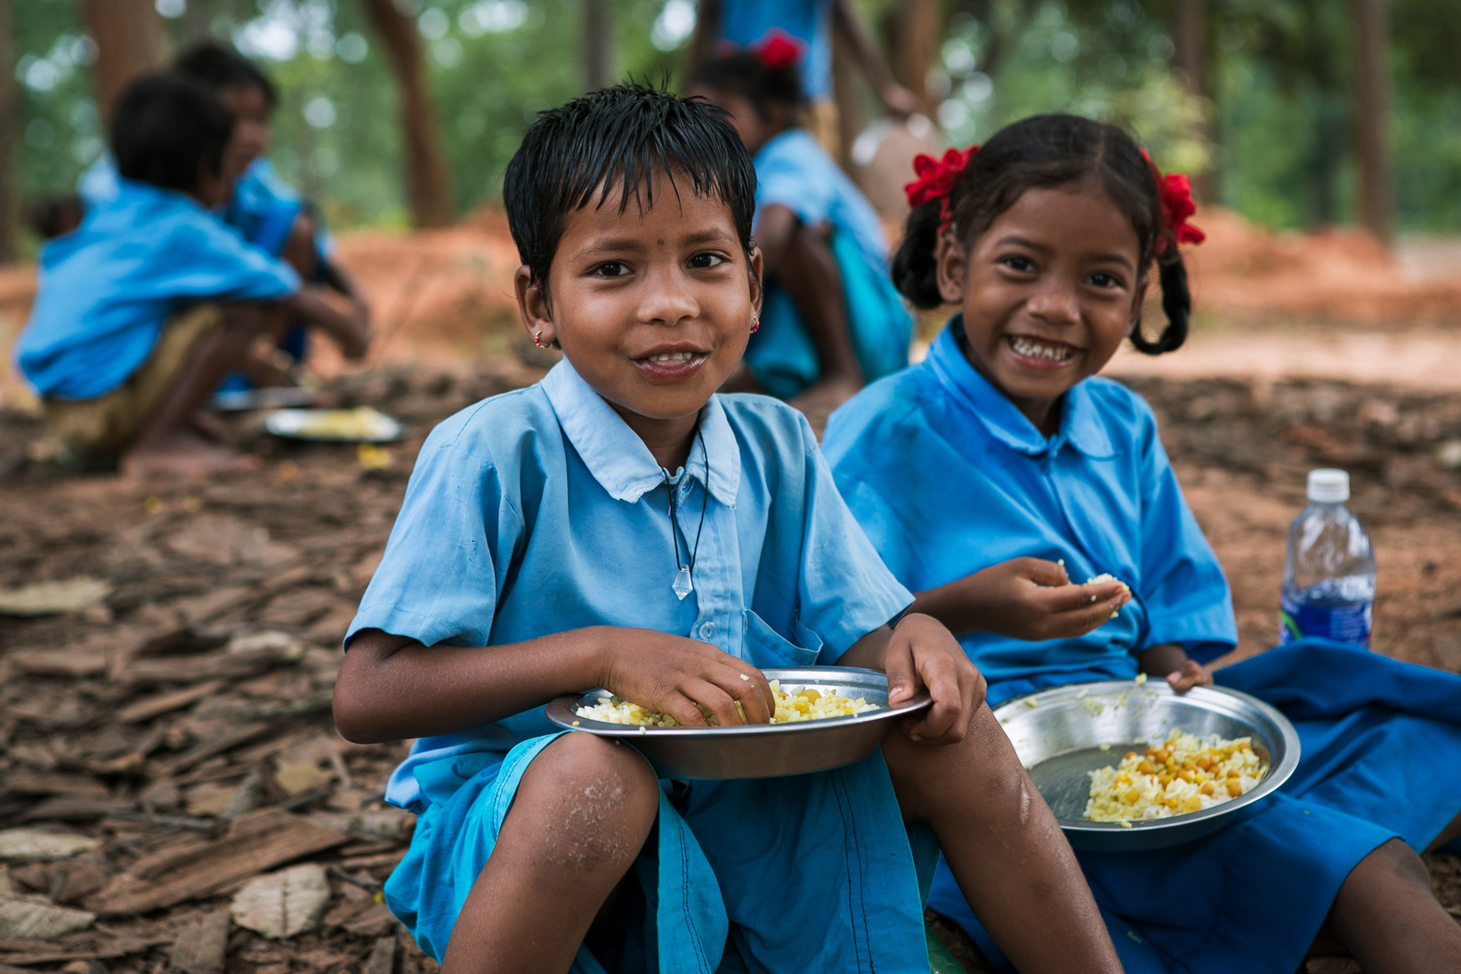
What is Hope?
Hope means trusting God and believing things will get better
Little Acts of Love for Len
Notes:
Time: 1-2 minutes
If daily lesson: Use this slide and the next with the bible story to fill the lesson time. Combined, they should take about 7-10 minutes.

Slide 21

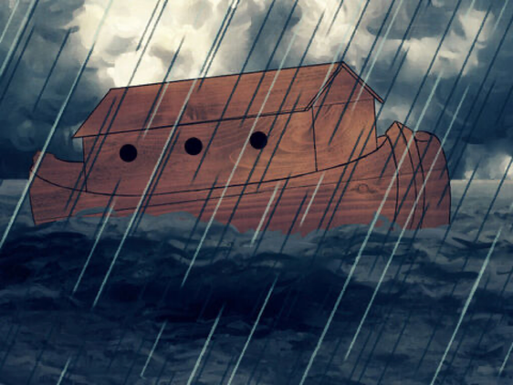
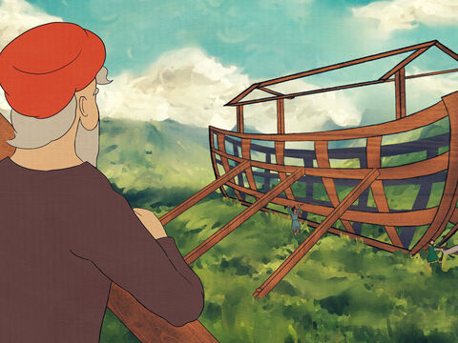
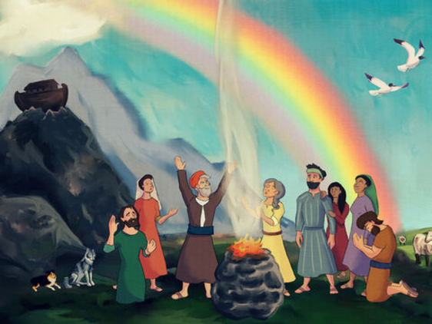
Bible Story: Noah’s Ark
A story about how Noah trusted that God would keep them safe in the flood.
Noah obeyed God and built the Ark.
Noah and his family trusted God when the floods came.
They saw a rainbow which gave them hope.
Little Acts of Love for Len
Notes:
time: ~10 minutes
Share the story of Noah’s Ark with the students. If they are familiar with it, invite them to help tell the story. Emphasize how Noah and his family trusted God to keep them safe and had hope in His promises.
"Noah was a good man who listened to God. One day, God told Noah to build a big boat to keep his family and the animals safe from a big storm. Noah trusted God and worked hard to build the ark.
Soon, the rain came, and it rained for 40 days. But inside the ark, Noah, his family, and the animals were safe and dry. When the water finally went away, they found land again.
Noah saw a beautiful rainbow in the sky. It was a sign of God’s promise to always take care of them. Noah and his family felt happy and full of hope!"
If daily lesson: Ask students the following questions:
"How would you have felt if you were Noah?
How does being with your family give you hope?
What does Noah and the flood teach you about hope?"
Image Attribution: Free Bible Images https://freebibleimages.org/illustrations/fn-noah-3/

Slide 22
Click to View Video
Linda’s Story of Hope
Little Acts of Love for Len
Notes:
time: 5 min
Explain that the video shows a girl in Zambia who doesn’t have much food at home, but Mary’s Meals provides a meal for her and her classmates every school day.
[Show the video]
After the video, discuss with the students:
“How does Mary’s Meals give this girl hope?”
“What are some things that are hard in your life?”
“What gives you hope?”
Emphasize that we can have hope when we trust in God. He knows when we are sad, lonely, or hungry. When we help others, we grow closer to God, and when we are close to Him, we can have hope that He will help us
(if part of a daily thought) Provide more time for discussion of the questions above. Consider splitting the students up in groups or sharing as a class.
Also combine with the next slide ("What gives you hope?"). Both should be about 10 minutes total.
Video Segment: Feeding Zambia's Future
(1:16-1:49)
https://www.youtube.com/watch?v=nC8UPYX8Mu4
Video attribution: Mary's Meals

Slide 23


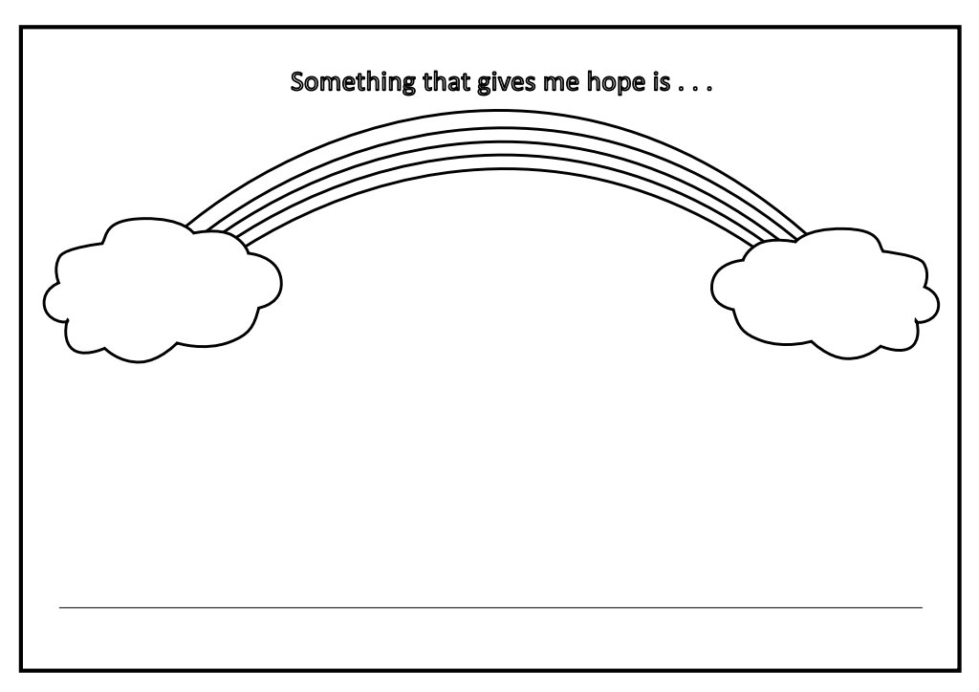
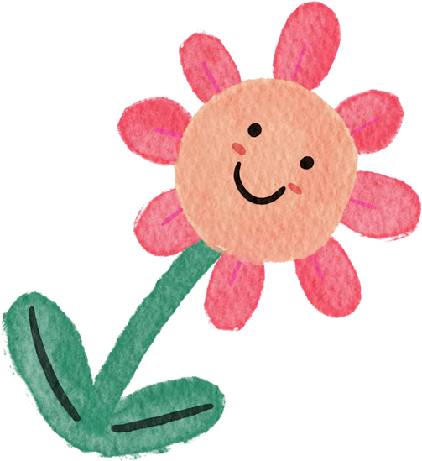

What gives you hope?
Little Acts of Love for Len
Notes:
time: ~5 minutes
Rainbow of Hope
Give each student a picture of a rainbow (see Rainbow of Hope PDF).
Have them write or draw something that gives them hope or that they hope for.
Display the rainbows as a reminder of hope throughout the week.
If daily lesson:
Before the activity show pictures of Noah’s Ark again. Remind students how Noah and his family found hope in God’s promise.
Rainbow of Hope PDF: https://drive.google.com/file/d/1Dv6sKEPYUbmANWlMu1om26EO8EIItBmN/view?usp=drive_link

Slide 24

Take-Home Invitation
Look for the Good
Be Encouraging
Write it down
Name 3 happy things from your day.
Write or draw something you are excited for.
Cheer your friends and classmates on!
Little Acts of Love for Len
Notes:
time: 2-3 minutes
Encourage the students to think about what gives them hope and how they can help others have hope.
(if part of a daily thought)
You can expand this by doing the following activity with the students.
Materials: Slips of paper for students to write or draw on. Students can take their ideas home to share with their parents.
Review the meaning of hope—trusting God and believing things will get better.
Ask questions to help students reflect on the previous scripture story and activity.
Encourage students to think of one small act they can do over the next few days to show hope. Have them write or draw their idea and take it home to share with their parents.
Here are some ideas to inspire them:
*Share something good that happened today.
*If you see someone feeling sad, be kind and give them a hug.
*Cheer on your classmates and friends.
*Look around and draw things that give you hope or make you happy.

Slide 25
What did you learn today?
Little Acts of Love for Len
Notes:
time: 3-5 minutes
Invite the students to tell their parents something they learned about God or faith today.
Optional - You can expand this by doing the following activity with the students.
Materials: Provide slips of paper for the students to write the acts they want to do on. The students can then take home their ideas to share with their parents.
Start by reviewing what faith means with the students, and encourage them to think of one small act they can do over the next few days to show their faith. Have them write down (or draw) their idea and take it home to share with their parents. Here are some ideas to inspire them:
Write a letter to God, sharing how you plan to show your faith.
Tell your parents something you’ve learned about God.
Say a prayer to thank God for something special in your life.
Share your toys or help a friend in need.

Slide 26
LITTLE ACTS OF LOVE FOR LENT
JUSTICE

Slide 27
Kindness Chain
What are some small acts of love you have done this week?
Little Acts of Love for Len
Notes:
Time: 3-5 min
Students write or draw a small act of love they’ve done and add it to their paper chain.
Ideas for students:
* Say a prayer for someone
* Help at home
* Say something kind to someone
* Be extra patient
* Smile at others
* Make a card for someone
* Share a toy
If daily lesson:
Give the class a few minutes to share what they did.
Optional template for paper chain strips: https://drive.google.com/file/d/1y2ajEgSXB-ykR1pgdSQVEeJrlXZuyVzj/view?usp=drive_link
Attribution: Canva Images

Slide 28
What is Justice?
Justice means treating everyone fairly and with kindness.
Little Acts of Love for Len
Notes:
Time: 1-2 minutes
If daily lesson, combine this slide with the next to introduce the virtue.

Slide 29
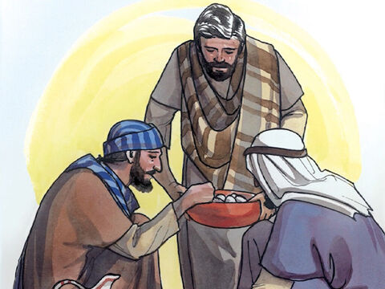
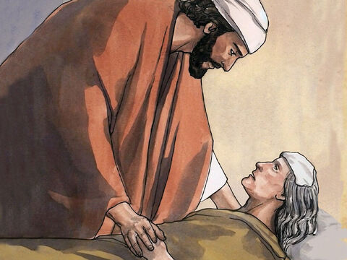
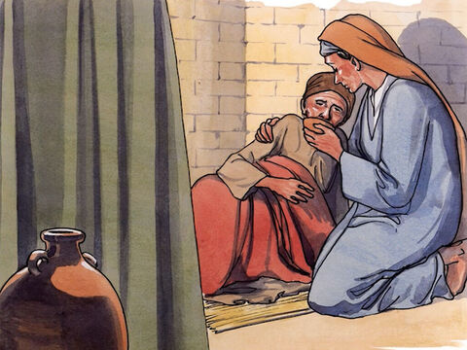
Bible Story: Jesus Teaches us to be Kind
Matthew 25:35-40
Feed the Hungry
Be Kind
Serve the sick
Little Acts of Love for Len
Notes:
Time: 5-10 minutes
Read Matthew 25:35-40 with the students. Or summarize what Jesus taught:
"In these verses, Jesus teaches us to be kind and help others. He says that when we give food to someone who is hungry, water to someone who is thirsty, or take care of those in need, it’s like we are doing those kind things for Him. Jesus wants us to show love by helping people around us."
Discuss how we all can show love and kindness to everyone.
If daily lesson: Ask the following questions:
"How do you feel when you help someone? When someone helps you?"
What are some things you can do today to help someone?"
Image Attribution: Free Bible Images

Slide 30
How can you show kindness?
Click to View Video
Little Acts of Love for Len
Notes:
Time: 3-5 minutes
Introduce the video. Explain that it is about a person who saw that kids in some places needed kindness. Ask the students to look for what this man (Magnus) decided to do.
[watch video]
Discuss with students how Magnus decided to help children who didn’t have enough food by making sure they could get meals at school.
Optional - Continue the discussion with some of these questions:
Why do you think Magnus wanted to help?
How do you feel when you’re hungry?
What are some ways we can help others who might not have enough food?
Connect this discussion to the lesson’s theme of kindness and serving others, reinforcing how helping those in need is a way to show love, just as Jesus taught.
(If part of single lesson)
Share that this video shows a good example of a person realizing that people don't have a lot of food but he can do something about it. He can be kind to those who need kindness.
(If part of daily thought)
Share that this video shows a good example of a person realizing that people don't have a lot of food but he can do something about it. He can be kind to those who need kindness. After the video, ask students to share with a partner how they can show kindness.

Slide 31

Ripples of Kindness
Small actions can create a big impact in the community, just like a small object creates ripples in water.
Little Acts of Love for Len
Notes:
time: 10-15 minutes
Ripples of Kindness
Help students understand how small actions can create a big impact in the community, just like a small object creates ripples in water.
Materials:
*A large, shallow baking sheet or tray
*Water
*Small tiles or objects (e.g. Pebbles, marbles, buttons)
Set Up: Fill the tray with water, just enough to cover the bottom.
Let the students take turns dropping a tile or object into the water and watch how it creates ripples.
Discussion: Just like when they dropped their stone in water and it created ripples, small acts of kindness can ripple out too.
Ask how they think their actions affect others.
Ask them to think about a kind action they could do for someone else. For example, “How could you help a friend who is feeling sad?” or “What could you do if you see someone alone?”
Remind them that small acts of kindness can spread, just like ripples in water.
If daily lesson: Before the activity briefly review what justice means.
After the activity students may draw or write examples of kind actions they can do.

Slide 32

TAKE-HOME INVITATION
Help someone younger
Be Honest
Include Everyone
Tell the truth, even when it is hard.
Make sure you don’t leave anyone out of games.
Be nice to a younger sibling or friend.
Little Acts of Love for Len
Notes:
time: 2-3 minutes
As you go home, think about how you can treat everyone fairly.
(if part of a daily thought)
You can expand this by doing the following activity with the students.
Materials: Slips of paper for students to write or draw on. Students can take their ideas home to share with their parents.
Review the meaning of justice, and encourage them to think of things they can do over the next few days to practice. Have them write down (or draw) their idea and take it home to share with their parents.
Here are some ideas to inspire them:
*Help someone younger – Show kindness to a younger sibling or classmate by helping them.
*Donate a toy or clothes – Give to kids who don’t have as much.
*Share fairly – Let a friend take a turn first in a game.
*Stand up for someone – If a friend is being left out, invite them to join.
*Clean up without being asked – Help make things right when there’s a mess.
*Give everyone a chance – If choosing teams, make sure no one is left out.
*Speak kindly to everyone – Treat all people with respect, no matter who they are.

Slide 33
What did you learn today?
Little Acts of Love for Len
Notes:
time: 3-5 minutes
Invite the students to tell their parents something they learned about God or faith today.
Optional - You can expand this by doing the following activity with the students.
Materials: Provide slips of paper for the students to write the acts they want to do on. The students can then take home their ideas to share with their parents.
Start by reviewing what faith means with the students, and encourage them to think of one small act they can do over the next few days to show their faith. Have them write down (or draw) their idea and take it home to share with their parents. Here are some ideas to inspire them:
Write a letter to God, sharing how you plan to show your faith.
Tell your parents something you’ve learned about God.
Say a prayer to thank God for something special in your life.
Share your toys or help a friend in need.

Slide 34
LITTLE ACTS OF LOVE FOR LENT
LOVING OTHERS

Slide 35
Kindness Chain
What are some small acts of love you have done this week?
Little Acts of Love for Len
Notes:
Time: 3-5 min
Students write or draw a small act of love they’ve done and add it to their paper chain.
Ideas for students:
* Say a prayer for someone
* Help at home
* Say something kind to someone
* Be extra patient
* Smile at others
* Make a card for someone
* Share a toy
If daily lesson:
Give the class a few minutes to share what they did.
Optional template for paper chain strips: https://drive.google.com/file/d/1y2ajEgSXB-ykR1pgdSQVEeJrlXZuyVzj/view?usp=drive_link
Attribution: Canva Images

Slide 36
How can I love others?
Loving your neighbor means seeing everyone as a friend and treating them like family.
Little Acts of Love for Len
Notes:
Time: 3-5 minutes
Explain to the students that loving their neighbor means seeing everyone as a friend and treating them like family. Encourage them to think about ways they can be kind and caring to others, just like they would with their own family.
If daily lesson: combine this slide with the next to introduce the virtue.
image attribution: Adobe Stock Photo, "Big Happy Smiling Family Together.Young Adult Couple Woman,Man,Mother,Father, Husband, Wife.Children Kids Daughter and Son.Caring and Loving Dad and Mom Spouses.Household Life.Flat Vector"
By Alina.Alina

Slide 37
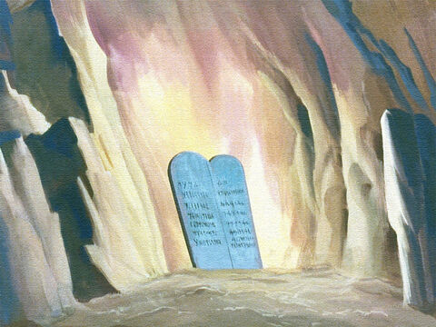
Bible Story:
The Two Great Commandments
God asks us to do these things every day!
Little Acts of Love for Len
Notes:
Time: 5-10 minutes
There are two bible stories (one here and one on the next slide) you can choose from to help the students understand loving others best.
Option 1: The Two Great Commandments Matthew 22:34-40
One day, some people were asking Jesus questions. One of them asked, “What is the most important commandment?”
Jesus answered, “The most important commandment is to love God with all your heart, soul, and mind. The second is just like it—love other people the way you love yourself.”
Then Jesus told them, “All of God’s rules are built on these two: love God and love others!"
If daily lesson: Ask ask students who in their lives they can show more love to.
image attribution: Free Bible images
https://freebibleimages.org/illustrations/moody-moses-commandments/

Slide 38
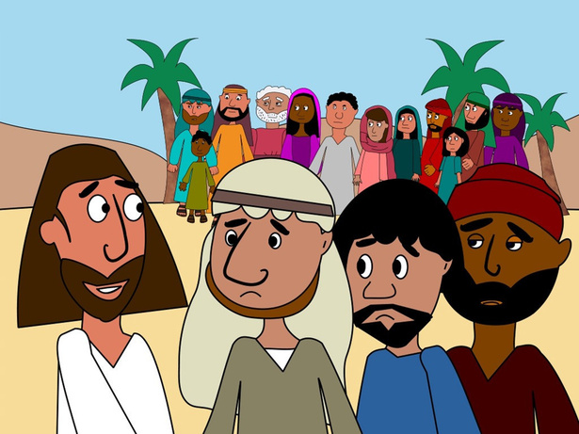
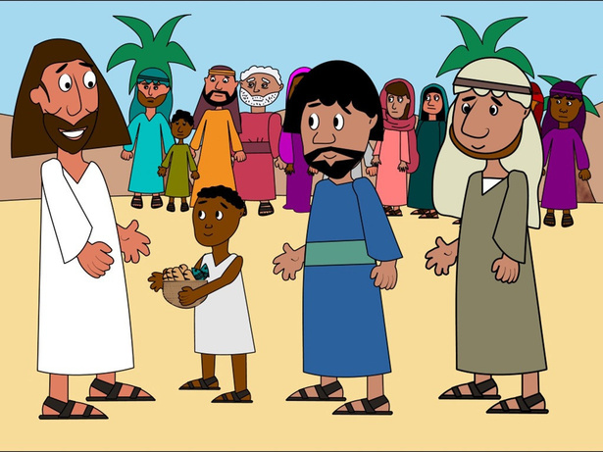
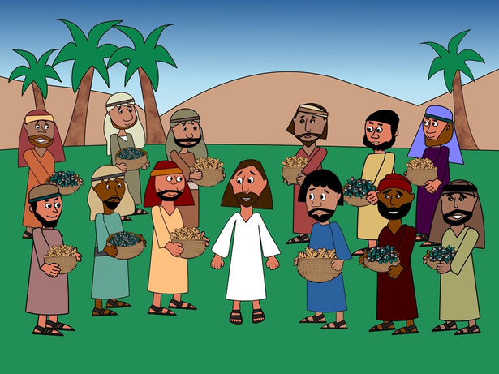
Bible Story: Feeding 5,000 People!
Jesus fed 5,000 people with 2 pieces of bread and 5 fish!
After teaching all day, Jesus needed to feed 5,000 people.
A little boy gave Jesus 2 pieces of bread and 5 fish.
Jesus prayed and there was enough food for everyone!
Little Acts of Love for Len
Notes:
time: 5-10 minutes
Option #2: Feeding of the 5,000 John 6:5-12
Tell the story of Jesus Feeding the 5,000.
"One day, there were many people who wanted to hear Jesus, but they got hungry. Jesus asked His disciples, “Where can we get food for all these people?” His disciple Philip said, “We don’t have enough money to buy food for them!”
But Andrew found a boy with five loaves of bread and two fish. The boy was willing to share his food, and Jesus took it, prayed, and started handing it out. Everyone ate until they were full, and there were leftovers! Jesus showed that even the smallest amount can be enough if we trust Him."
Emphasize to the students that the little boy didn't have much, but he wanted to help. Even though he only had five loaves of bread and two fish, he gave what he could. God used his small gift to make a big difference for many people. This shows us that when we share what we have, no matter how small it seems, God can use it to do amazing things!
If daily lesson: ask students who in their lives they can show more love to.
Image attribution: Free Bible Images, https://www.freebibleimages.org/illustrations/preschool-jesus-5000/

Slide 39
How can you care for people like the brother in this video did?
Click to View Video
Little Acts of Love for Len
Notes:
Time: 3-5 minutes
Introduce the video: Just like it’s important to care for our families, we should try and care for people around us too! There are so many ways you can make a difference, small or big! As we watch the video, think about how the brother was showing love to his sister by helping her get to school!
[watch video]
Discuss with students how the brother showed love to his sister by helping her get to school.
Optional - Continue the discussion with some of these questions:
Why do you think the brother wanted to help his sister?
How do you feel when someone helps you with something important?
What are some ways we can help our family and friends?
Connect this discussion to the lesson’s theme of kindness and serving others, reinforcing how helping those around us is a way to show love, just as Jesus taught.
(If part of single lesson) Share that this video shows a good example of a person realizing that people around them need help and they can do something about it. They can be kind to those who need kindness.
(If part of daily thought) Share that this video shows a good example of a person realizing that people around them need help and they can do something about it. They can be kind to those who need kindness. After the video, ask students to share with a partner how they can show kindness.
Video attribution: Mary's Meals

Slide 40
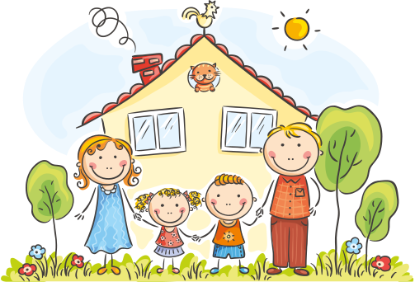
Our Family
Little Acts of Love for Len
Notes:
Time: 10-20 minutes
Family and Class Community Activity
Materials:
* Pictures of the students families
* OR paper and pencils for students to draw their families
Preparation: Ask parents to send a picture of their family with the student to class (or email it ahead of time).
Have each student share their family picture, naming who is in their family and what they love about them.
Display a picture of the class on the board
Discussion:
Talk about how the class is like a family
How is our class like a family?
What makes it special?
What can you do to treat each other more like family?
How does it feel to know you have a family both at home and at school?
If daily lesson:
Briefly review what it means to love others and to love our neighbor.
Image attribution: Adobe stock image "A lively stick figure family holding hands in the grass, with a bright sun overhead, capturing a joyful moment of togetherness."
By khonkangrua
Generated with AI

Slide 41

Take-home invitation
Bring others into your “family.”
Help others
Speak kindly
Smile!
Offer to do something for a brother, sister, or friend, just to make their day better.
Show your love to someone else by smiling at them when you see them!
Tell someone why you are happy they are in your life!
Little Acts of Love for Len
Notes:
time: 2-3 minutes
Encourage students to talk to someone new this week and make them feel included in the class "family." Invite them to be kind, share, or play with someone they don’t usually spend time with.
Remind students about the lent chain they are building.
(if part of a daily thought)
You can expand this by doing the following activity with the students.
Materials: Provide slips of paper for the students to write the acts they want to do on. The students can then take home their ideas to share with their parents.
Review what it means to love your neighbor. Encourage them to think of ways they can show their love. Have them write down (or draw) their idea and take it home to share with their parents.
Here are some ideas to inspire them:
*Hug your sibling or friend: Show love by giving a hug to someone who needs it.
*Help without being asked: Offer to do something for a brother, sister, or friend, just to make their day better.
*Say something kind: Tell someone they are important to you, like "I’m glad you’re my friend!"
*Share a smile: Brighten someone’s day by smiling at them when they look sad or lonely.
*Be patient with others: Wait your turn or help someone who is struggling, showing love

Slide 42
What did you learn today?
Little Acts of Love for Len
Notes:
time: 3-5 minutes
Invite the students to tell their parents something they learned about God or faith today.
Optional - You can expand this by doing the following activity with the students.
Materials: Provide slips of paper for the students to write the acts they want to do on. The students can then take home their ideas to share with their parents.
Start by reviewing what faith means with the students, and encourage them to think of one small act they can do over the next few days to show their faith. Have them write down (or draw) their idea and take it home to share with their parents. Here are some ideas to inspire them:
Write a letter to God, sharing how you plan to show your faith.
Tell your parents something you’ve learned about God.
Say a prayer to thank God for something special in your life.
Share your toys or help a friend in need.

Slide 43
LITTLE ACTS OF LOVE FOR LENT
WISDOM

Slide 44
Kindness Chain
What are some small acts of love you have done this week?
Little Acts of Love for Len
Notes:
Time: 3-5 min
Students write or draw a small act of love they’ve done and add it to their paper chain.
Ideas for students:
* Say a prayer for someone
* Help at home
* Say something kind to someone
* Be extra patient
* Smile at others
* Make a card for someone
* Share a toy
If daily lesson:
Give the class a few minutes to share what they did.
Optional template for paper chain strips: https://drive.google.com/file/d/1y2ajEgSXB-ykR1pgdSQVEeJrlXZuyVzj/view?usp=drive_link
Attribution: Canva Images

Slide 45
What is Wisdom?
Wisdom is using what you know about God to make good choices.
It is listening to God and thinking carefully before you act.
Little Acts of Love for Len
Notes:
Time: 2-3 minutes
Wisdom is: -using what you know about God to make good choices
-listening to God
-thinking carefully before you act
If daily lesson: combine this slide with the next to introduce the virtue

Slide 46
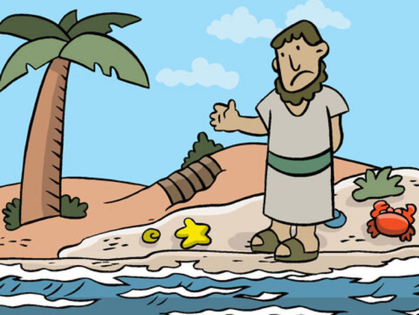
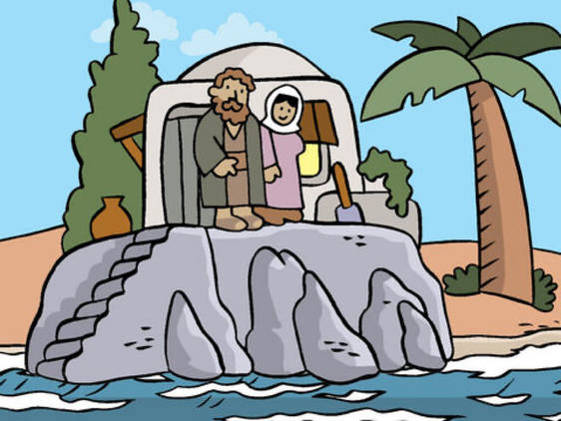
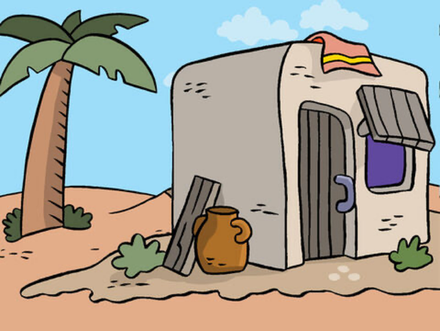
The Wise and Foolish Builders
Think about how the people in this story were making good or bad choices:
The wise man built his house on a rock, and it stayed strong in the storm.
The foolish man built on sand.
The house on the sand fell down in the storm
Little Acts of Love for Len
Notes:
Time: 8-10 minutes
The Wise and Foolish Builders
Explain that Jesus taught people how to follow Him through stories.
Share the story of the wise and foolish builders and encourage the students to think about how the people in this story were making good or bad choices.
Matthew 7:24-27
"Jesus told a story about two builders. One builder was very wise, and the other was foolish. The wise builder built his house on strong, solid rock. When the rain came and the wind blew, his house stayed safe and didn't fall down.
But the foolish builder built his house on soft sand. When the rain came and the wind blew, his house fell down because it wasn't built on something strong.
Jesus taught us that when we listen to His words and follow them, we are like the wise builder. Our lives will be strong, just like the house built on rock."
If daily lesson, ask:
"Why did the house fall down?"
"What can you do to be more like the wise man?"
Image Attribution: Free Bible Images https://freebibleimages.org/illustrations/dm-wise-foolish-builders/

Slide 47
Click to View Video
Wisdom
Little Acts of Love for Len
Notes:
Time: 3-5 minutes
Introduce the Video: Tell students they will watch a video about a girl named Veronica, who values school very much. Ask them to think about why school is important to her as they watch.
[Watch Video]
Discuss with Students: Explain that learning makes us happy and helps us make good choices. God wants us to learn about the world and about Him. Just like Veronica, we can feel joy when we discover new things!
(If Part of Daily Thought):
Review that wisdom is making good choices.
Talk about how going to school can help you learn.
Show the excerpt from Generation Hope.
(If Part of Single Lesson):
Explain that the class will watch a video about a girl named Veronica. School is very important to her. Invite the students to consider, as they watch the video, why school is important to Veronica.
Ask the students to share what they noticed–why is school important to Veronica?
Explain that learning helps us to be happy now and make wise decisions in the future. God wants us to learn about all kinds of things, both at school and also about Him. Just like Veronica, we can be happy when we learn and seek wisdom.

Slide 48
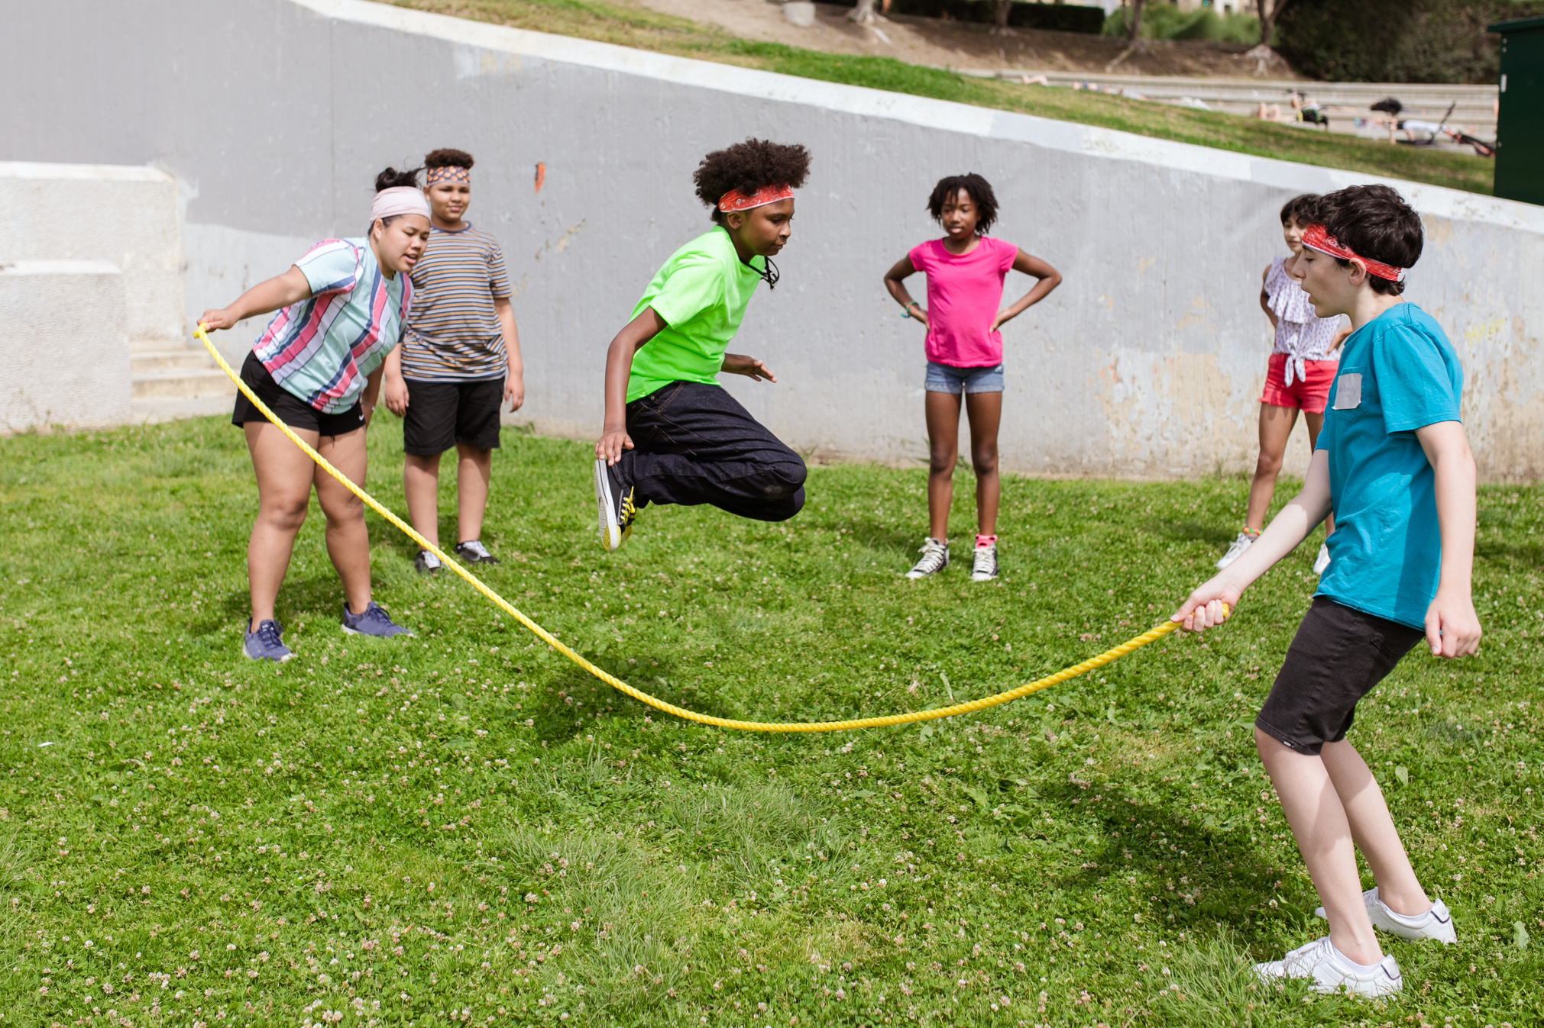
Jumping the line
Choose between right and wrong!
Little Acts of Love for Len
Notes:
Time: ~10 min
Jumping the Line
Help the students learn wisdom as they choose between right and wrong.
Materials:
* Tape
* Signs labeled “right” and “wrong”
* Place a long line of tape on the floor.
* Tell brief scenarios in which students make a decision (examples below)
* Students stand on the line and jump to the “right” or “wrong” side depending on the scenario
If daily lesson:
Before the activity briefly review what wisdom means.
Examples
* Scenario 1:
A friend drops their lunchbox and it spills everywhere. You
see them looking sad.
Right: Help them pick it up.
Wrong: Ignore them and walk away.
* Scenario 2:
You’re playing a game with friends, and you win.
Right: You say, "Good job everyone! That was fun."
Wrong: You brag about how good you are and say, "I’m the best! I won!"
* Scenario 3:
Your little brother is crying because he can’t find his toy.
Right: You help him look for it.
Wrong: You tell him you don’t have time and keep playing.
* Scenario 4:
You see a friend sitting alone at lunch.
Right: You invite them to sit with you.
Wrong: You leave them alone and sit with others.
*Scenario 5:
You see a piece of trash on the playground.
Right: You pick it up and throw it away.
Wrong: You leave it there and keep walking.

Slide 49
Take-home invitation
Think before you speak
Ask good questions
Learn from mistakes
Pause for a moment to think if what you're going to say is kind or helpful.
Ask your teacher or parent how you can learn more about something you’re curious about
If you make a mistake, say sorry and learn how to do better next time.
Little Acts of Love for Len
Notes:
time: 2-3 minutes
As you go home, try to think about what good choices you can make.
(if part of a daily thought)
You can expand this by doing the following activity with the students.
Materials: Provide slips of paper for the students to write the acts they want to do on. The students can then take home their ideas to share with their parents.
Ask questions to help students reflect on the previous scripture story and activity. Review what wisdom means with the students, and encourage them to think of things they can do over the next few days to practice. Have them write down (or draw) their idea and take it home to share with their parents.
Here are some ideas to inspire them:
*Think before you speak: Pause for a moment to think if what you're going to say is kind or helpful.
*Ask good questions: Ask your teacher or parent how you can learn more about something you’re curious about.
*Listen carefully: Pay attention when someone is talking, so you can understand and learn from them.
*Make a wise choice: Choose to help, even when it’s hard, like picking up toys when you don’t feel like it.
*Learn from mistakes: If you make a mistake, say sorry and learn how to do better next time.

Slide 50
What did you learn today?
Little Acts of Love for Len
Notes:
time: 3-5 minutes
Invite the students to tell their parents something they learned about God or faith today.
Optional - You can expand this by doing the following activity with the students.
Materials: Provide slips of paper for the students to write the acts they want to do on. The students can then take home their ideas to share with their parents.
Start by reviewing what faith means with the students, and encourage them to think of one small act they can do over the next few days to show their faith. Have them write down (or draw) their idea and take it home to share with their parents. Here are some ideas to inspire them:
Write a letter to God, sharing how you plan to show your faith.
Tell your parents something you’ve learned about God.
Say a prayer to thank God for something special in your life.
Share your toys or help a friend in need.

Slide 51
LITTLE ACTS OF LOVE FOR LENT
CHARITY

Slide 52
Kindness Chain
What are some small acts of love you have done this week?
Little Acts of Love for Len
Notes:
Time: 3-5 min
Students write or draw a small act of love they’ve done and add it to their paper chain.
Ideas for students:
* Say a prayer for someone
* Help at home
* Say something kind to someone
* Be extra patient
* Smile at others
* Make a card for someone
* Share a toy
If daily lesson:
Give the class a few minutes to share what they did.
Optional template for paper chain strips: https://drive.google.com/file/d/1y2ajEgSXB-ykR1pgdSQVEeJrlXZuyVzj/view?usp=drive_link
Attribution: Canva Images

Slide 53
What is Charity
(God’s Love)?
Charity means loving God and others by being kind and helping them.
Little Acts of Love for Len
Notes:
time: 3-5 minutes
Explain to the students that charity means loving God and others. When we have charity, we want to be kind and help people because we love them, instead of being unkind or mean.
If daily lesson:
Expand on this definition by asking students questions about how they feel love from others. Also combine with the next slide to introduce the virtue.
For the younger kids, you may need to explain what love is, "good feelings" "how you feel when you get a hug from your best friend"

Slide 54
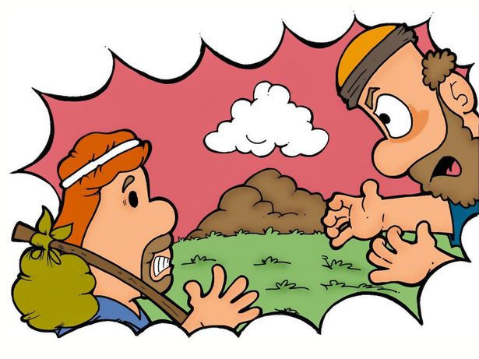
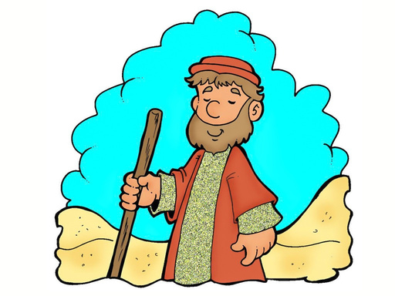
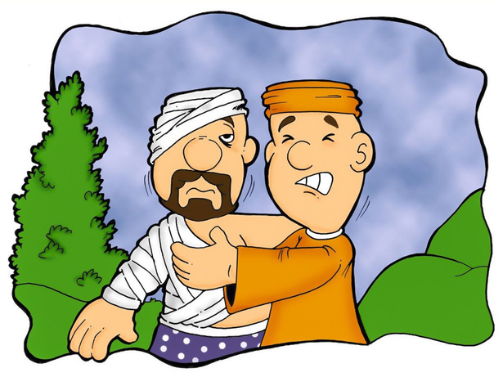
Bible Story: The Good Samaritan
A story about how one man showed love to someone who was having a bad day.
Others were mean to this man.
People kept passing him by without helping him.
The Samaritan helped him get better!
Little Acts of Love for Len
Notes:
Time: 5-10 minutes
Share the following Bible story with the class. Remind them that it's a story Jesus shared to teach about what it means to follow Him.
[Scripture story: good samaritan (Luke 10:25-29 NRSV)]
Modified version (from chatgpt): "One day a man asked Jesus, “But who is my neighbor?”
Jesus told a story: “A man was walking down the road when some robbers hurt him and left him. A priest walked by but didn’t help. Another man walked by but didn’t help either. Then a Samaritan man saw him, felt sorry for him, and helped him. He took care of the man and made sure he was safe.”
Jesus asked, “Who was a good neighbor to the hurt man?”
The man said, “The one who helped him.”
Jesus said, “Go and do the same!”
If daily lesson: Take more time to walk through the story, asking kids the following questions:
"How would you have felt if you were the man who was hurt?"
"How would you have felt if someone helped them after you had a bad day?"
Help them connect that just like they want to be helped, it is good to help other people, because that is what God wants us to do!
Image Attributions: https://www.freebibleimages.org/illustrations/rr-good-samaritan/

Slide 55
How can you be like Charlie and share your love with others?
Click to View Video
Little Acts of Love for Len
Notes:
Time: 3-5 minutes
Introduce the video: Explain that there are lots of ways we can show love. Tell the students they will learn about Charlie, who is a kid just like them. Encourage them to watch carefully and think about how Charlie shows love to the people around him.
[Watch Video]
Discuss with students: Ask the students what they noticed about how Charlie showed love. Explain that Charlie gave up some of his own presents, like birthday and Christmas gifts, so he could use that money to help kids who didn’t have enough food. He also worked with others to raise even more money to help.
Optional - Continue the discussion with some of these questions:
Why do you think Charlie decided to give up his presents to help others?
How do you feel when you give something to someone in need?
What are some ways we can show love and help others in our community?
(If part of daily lesson): Leave more room for the discussion of how students can be like Charlie and share love with others.
Video Attribution: Mary's Meals

Slide 56


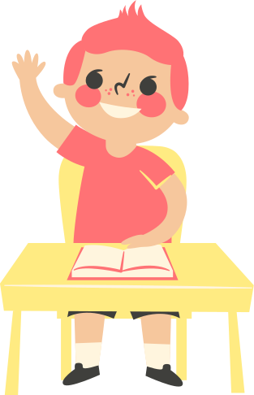
DRAW A PICTURE OR WRITE A THANK YOU CARD
Little Acts of Love for Len
Notes:
Time: 10-20 minutes
Thank You Cards
"One of the ways we can show love to other people is by telling them we love them! Think about someone you love a lot and draw a picture or write a thank you card to them!"
Materials:
* Letter writing materials (paper, markers, stickers, etc.)
Instructions:
Invite the students think about someone they love and are grateful for.
Give them time to make a card to that person.
Discussion:
How did it make you feel to write the card?
What can you do to show more love to the people around you?
If daily lesson:
Before writing cards remind the class about Charlie and review what charity means.

Slide 57
Take-home invitation
Give something away
Help a neighbor
Think about your chain!
Choose a toy or book you can give to someone who might enjoy it like you did!
Remember the good things you do this week so you can add them to your Lent chain next time!
Think about the people you live by. How can you help them more this week?
Little Acts of Love for Len
Notes:
time: 2-3 minutes
Remind students about the chain they are building and encourage them that the more acts of love they do the more links they can add to their lent chain!
(if part of a daily thought)
You can expand this by doing the following activity with the students.
Materials: Provide slips of paper for the students to write the acts they want to do on. The students can then take home their ideas to share with their parents.
Review what charity means with the students, and encourage them to think of things they can do over the next few days to show charity. Have them write down (or draw) their idea and take it home to share with their parents.
Here are some ideas to inspire them:
*Give something away: Choose a toy or book to donate to someone who needs it more.
*Help a neighbor: Offer to help carry groceries or do a small chore for someone.

Slide 58
What did you learn today?
Little Acts of Love for Len
Notes:
time: 3-5 minutes
Invite the students to tell their parents something they learned about God or faith today.
Optional - You can expand this by doing the following activity with the students.
Materials: Provide slips of paper for the students to write the acts they want to do on. The students can then take home their ideas to share with their parents.
Start by reviewing what faith means with the students, and encourage them to think of one small act they can do over the next few days to show their faith. Have them write down (or draw) their idea and take it home to share with their parents. Here are some ideas to inspire them:
Write a letter to God, sharing how you plan to show your faith.
Tell your parents something you’ve learned about God.
Say a prayer to thank God for something special in your life.
Share your toys or help a friend in need.

Slide 59
LITTLE ACTS OF LOVE FOR LENT
REFLECTION LESSON

Slide 60
Kindness Chain
What are some small acts of love you have done this week?
Little Acts of Love for Len
Notes:
Time: 3- 5 min
Last day to add links in class. Encourage students to keep looking for ways to be kind.
Students write or draw a small act of love they’ve done and add the final links to their paper chain.
Ideas for students:
* Say a prayer for someone
* Help at home
* Say something kind to someone
* Be extra patient
* Smile at others
* Make a card for someone
* Share a toy
Optional template for paper chain strips: https://drive.google.com/file/d/1y2ajEgSXB-ykR1pgdSQVEeJrlXZuyVzj/view?usp=drive_link
Attribution: Canva Images

Slide 61

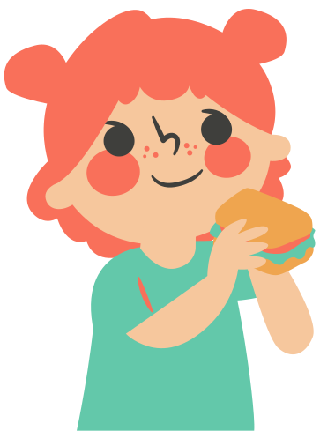
Let’s Share!
Little Acts of Love for Len
Notes:
time: 5-10 minutes
Give time for the students to reflect and share what they learned about the virtues during the past six weeks. It can be done in a few ways:
Option 1: Group sharing
Split the students into small groups. Have them bring their chains with them. After they are settled, ask them to share 1-2 of their favorite things they did from their chain.
Option 2: Class sharing
Have each of the students share one of the things they did during Lent. If time allows, prompt them to share why that was their favorite act.

Slide 62
Being kind is something you can do the whole year!
Click to View Video
Little Acts of Love for Len
Notes:
time: 3-5 minutes
Encourage the students to think about the feelings they had as they did these good works.
Say something like, “It feels good to do nice things, just like you’ve talked about! You’ve all worked so hard these last few weeks and have done so many good things! Wouldn’t it be great to keep feeling these nice things?
Being kind and doing good are things that we can do all year round.”
Video Attribution: Mary's Meals

