Slide 1
Overview for Teachers
The Little Acts of Love for Lent curriculum was made to help students strengthen their faith and develop a greater understanding of what Lent is and what it means to them individually. It is an eight-week curriculum with an introductory lesson, weekly lessons for the six weeks of Lent, and a follow-up reflection lesson. The weekly lessons can be completed in a single 45-min lesson or spread over a week in 5-15-minute segments. Please use the lessons in a way that works for you.
Each weekly lesson includes the following:
  Readiness activity: The lesson starts with a follow-up on the previous week’s virtue and preparation for the new virtue.
  Bible story: The Bible story introduces the virtue for the week and gives students a chance to immerse in the words of God.
  Virtues in the World: Students are given facts about the world and are invited to discuss how applying the virtue to these real-world problems could help resolve them.
  Video: Video clips from Mary’s Meals provide real-world application of the virtues and connect the lessons to the goals of Mary’s Meals.
  Engagement: These activities help students engage with and increase their understanding of the virtue.
  Application: The students are invited to apply what they have learned in their own lives.
Notes:
Teacher Instruction:
This slide is intended to help teachers understand the structure of the Little Acts of Love for Lent lesson structure so they can teach their students about the Christian virtues and make students aware of Mary's Meals' goal to combat child hunger around the world through little acts of love.

Slide 2

Introduction
High School Students
Notes:
Teacher Instruction:
You can choose to teach all the content in one class or break it up over several days.
Total lesson time: approximately 50 minutes

Slide 3


How would you describe Lent?
Little Acts of Love for Len
Notes:
Teacher Instruction:
1. Ask, “If you had to describe Lent in just one word, what would it be?”
2. Invite students to respond by either:
• Sharing their word aloud.
• Submitting their word to a word cloud (Mentimeter.com).
Time: 10 minutes
Image Source: ananaline / Adobe Stock

Slide 4
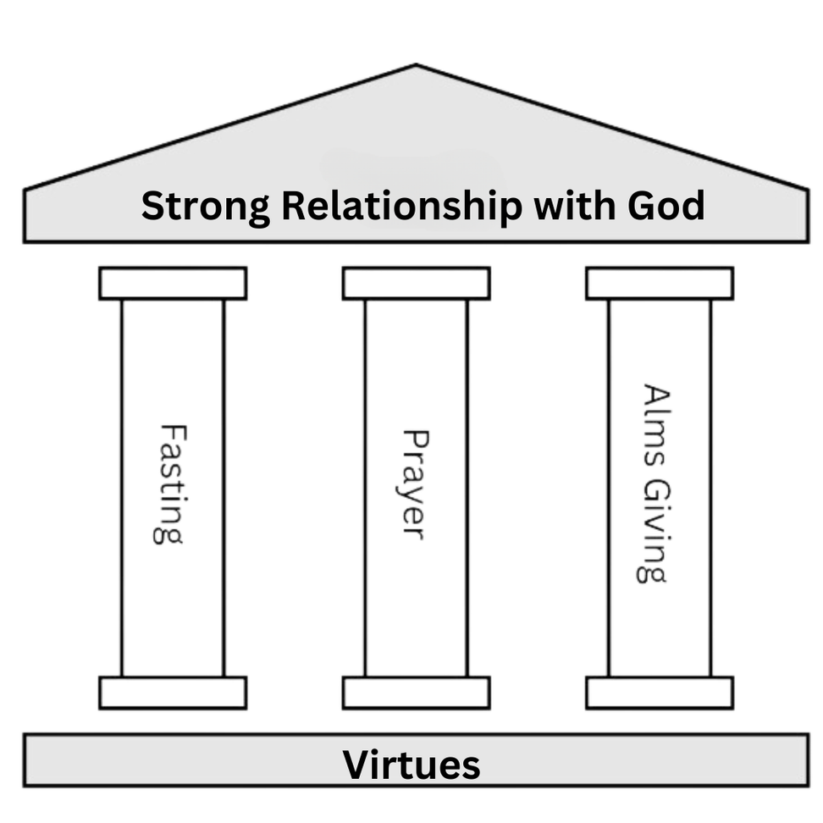
The Pillars of Lent
Prayer - Helps us talk to God and grow closer to Him.
Fasting - Helps us deepen our trust in God, builds discipline, and supports those in need.
Giving - Helps us share love by giving to those in need.
Notes:
Teacher Instruction:
1. Remind students that the three pillars of Lent–prayer, fasting, and almsgiving–reflect how Jesus prepared for His mission during His 40 days in the desert.
2. Review the purpose of Lent through one or more of the following activities:
- Reinforce the Three Pillars: Help students consider how prayer deepens our relationship with God, fasting helps us rely on Him, and almsgiving calls us to love and serve others.
- Read and Reflect on Bible Verses: Read Matthew 4:1-11 (Jesus’ temptation in the wilderness) and ask: “How does Jesus’ time in the desert reflect what we are called to do during Lent?”
- Personal Reflection and Sharing: Explain that Lent is a time to grow closer to God. Invite students to share (if comfortable):
• How has observing Lent helped you grow in faith?
• What is one thing you could do this Lent to strengthen your relationship with God?
Time: 15 minutes
Image Source: "York Minster Holy Light #dailyshoot #York" by Leshaines123 is licensed under CC BY 2.0. To view a copy of this license, visit https://creativecommons.org/licenses/by/2.0/?

Slide 5

How can my actions during Lent make a difference?
Notes:
Teacher Instruction:
1. Share the statement, “How might my actions in Lent make a difference?”
2. Invite the students to share what they do to make a difference during Lent.
3. Point out the image of the water droplet making ripples. Explain that, oftentimes, small and simple things can have big effects. Moses lifted his staff and God parted the Red Sea (Exodus 14:16, 21-22). Young David defeated Goliath with small, smooth stones (1 Samuel 17:40-50). Jesus taught that the faith the size of a mustard seed can move mountains (Matthew 17:20).
4. Emphasize that little acts of faith and love can make a big difference, both in our own lives and in the lives of others.
Time: 15 minutes
Image Source: "Water droplet" by Shan Sheehan is licensed under CC BY 2.0. To view a copy of this license, visit https://creativecommons.org/licenses/by/2.0/?ref=openverse.

Slide 6
Click to View Video
Watch Video 0:28-6:04
Notes:
Teacher Instruction:
1. Introduce Mary’s Meals. It is a nonprofit organization that provides one meal daily in schools for impoverished children around the world. Explain that it started simply with two brothers not much older than you having an idea.
2. Watch the video until 6:07
3. Share with students that the average cost of feeding a child for a whole school year with Mary’s Meals is just $25.20. This is something Mary’s Meals is able to provide with the help of those who donate. Each donation acts as a ripple itself, touching the lives of others.
Time: 15 minutes

Slide 7
What can you do starting today to make other people’s lives better?
Little Acts of Love for Len
Notes:
Teacher Instruction:
1. Ask the students to think about this question and then share their answer with another student.
Time: 2-3 minutes

Slide 8
Week 1: Faith
Notes:
Teacher Instruction:
1. This slide introduces the focus for the first week of "Little Acts of Love for Lent" lessons.
This week focuses on the virtue of faith.
Total lesson time: approximately 50 minutes

Slide 9
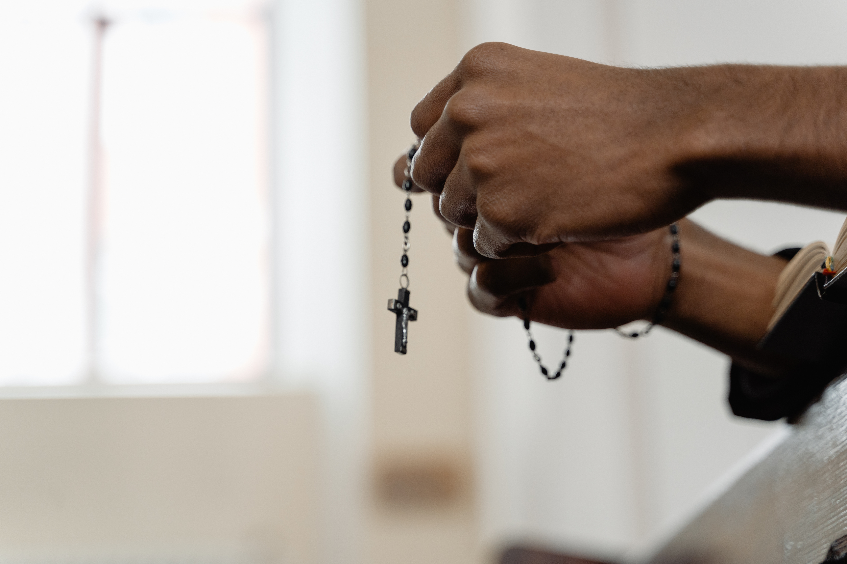
Faith
You believe that God loves you. He has a plan and teaches you truth. You show your faith by how you pray, act, and make good choices.
Notes:
Teacher Instruction:
1. Introduce this week's virtue of faith.
Time: 1 minute
Activity Description:
1. Provide a definition of faith, this week's virtue.
Image source: Canva Images

Slide 10
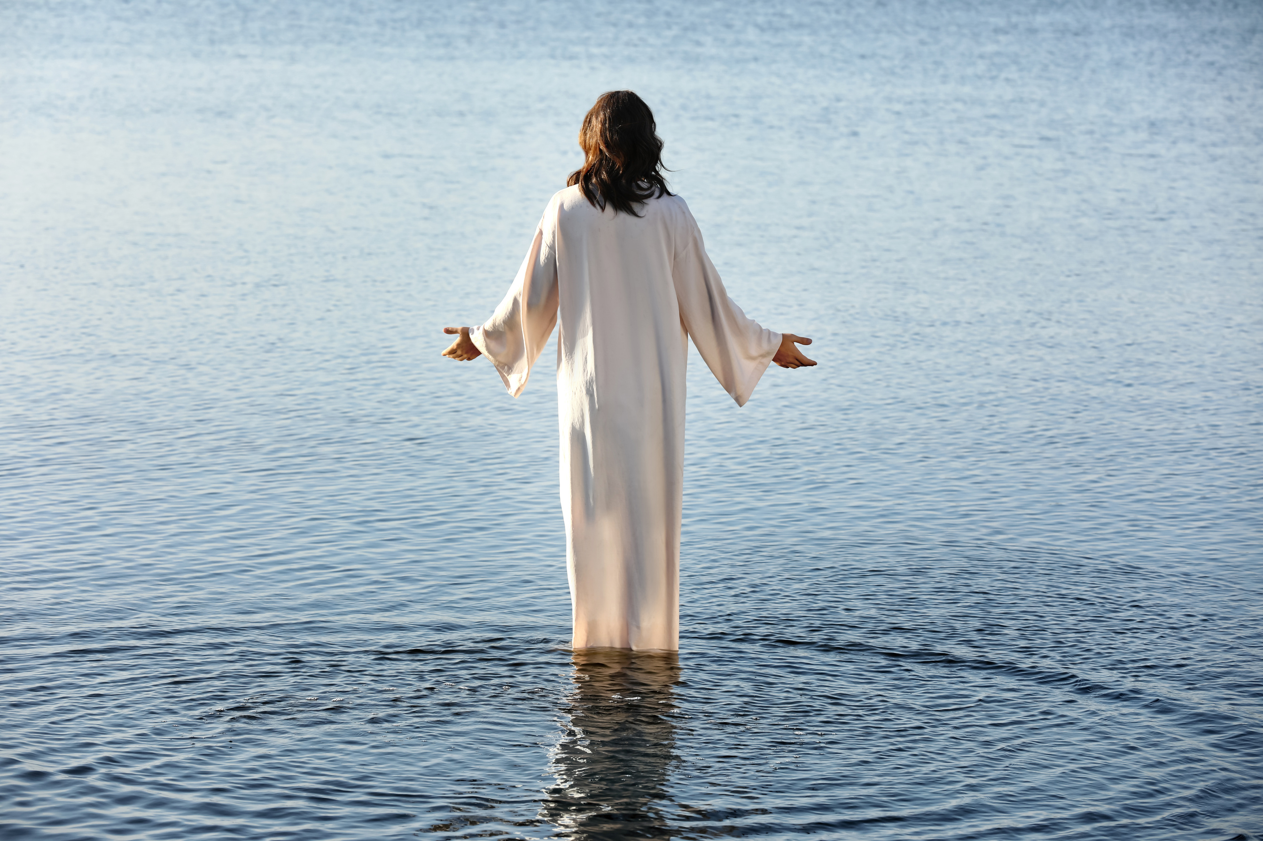
Matthew 14: 25-33
25 Shortly before dawn Jesus went out to them, walking on the lake.
26 When the disciples saw him walking on the lake, they were terrified. “It’s a ghost,” they said, and cried out in fear.
Notes:
Teacher Instruction:
1. Have a student read Matthew 14:25-33.
2. Explain the scripture's connection to faith.
3. Go through the questions and begin a discussion with the students as the questions are answered.
Time: 5 minutes for all verses
Activity Description:
Share Bible verses relate to the virtue of faith.
Image source: Canva Images

Slide 11

Matthew 14: 25-33
27 But Jesus immediately said to them: “Take courage! It is I. Don’t be afraid.”
28 “Lord, if it’s you,” Peter replied, “tell me to come to you on the water.”
Notes:
Teacher Instruction:
1. Have a student read Matthew 14:25-33.
2. Explain the scripture's connection to faith.
3. Go through the questions and begin a discussion with the students as the questions are answered.
Time: 5 minutes for all verses
Activity Description:
Share Bible verses relate to the virtue of faith.
Image source: Canva Images

Slide 12

Matthew 14: 25-33
29 “Come,” he said.
Then Peter got down out of the boat, walked on the water and came toward Jesus.
30 But when he saw the wind, he was afraid and, beginning to sink, cried out, “Lord, save me!”
Notes:
Teacher Instruction:
1. Have a student read Matthew 14:25-33.
2. Explain the scripture's connection to faith.
3. Go through the questions and begin a discussion with the students as the questions are answered.
Time: 5 minutes for all verses
Activity Description:
Share Bible verses relate to the virtue of faith.
Image source: Canva Images

Slide 13
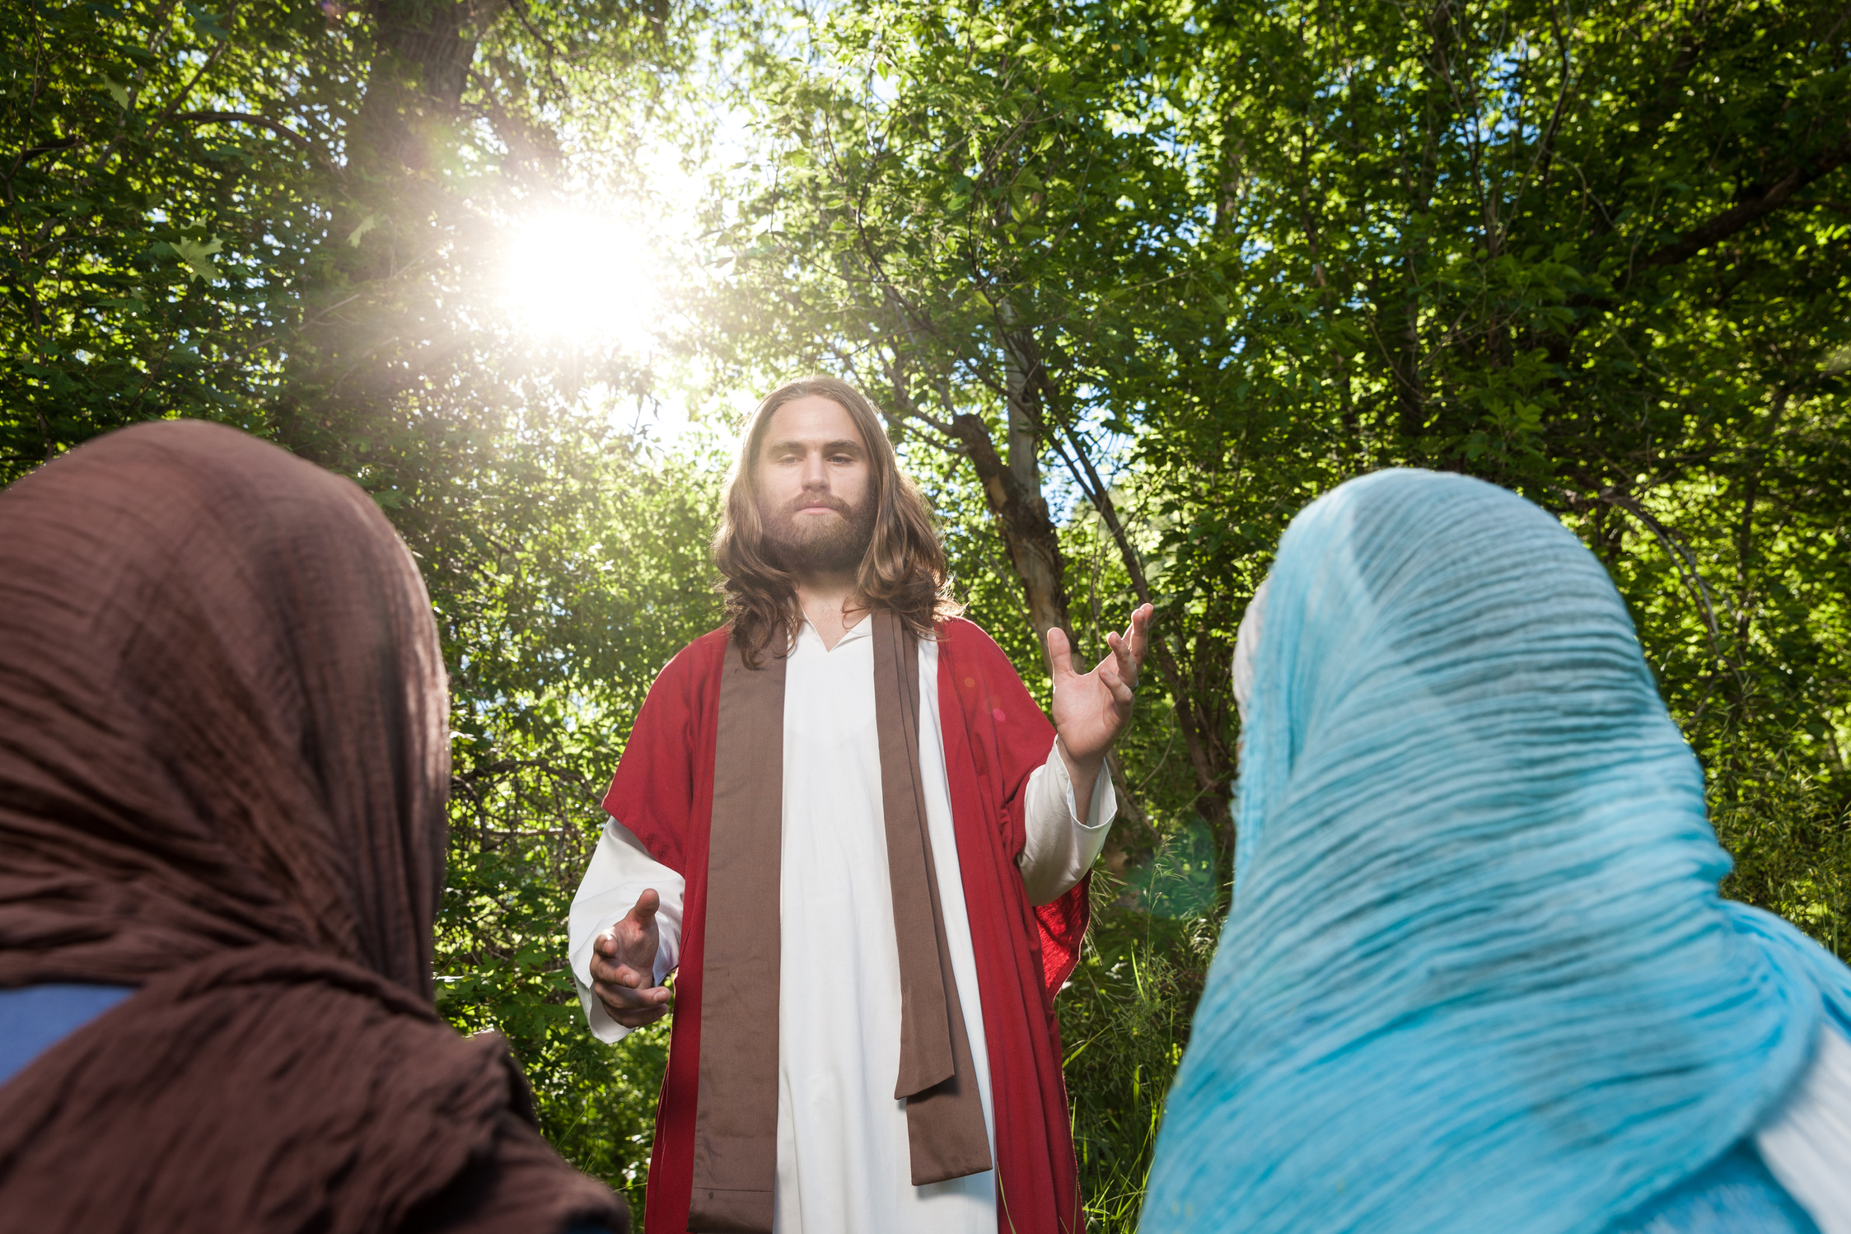
Discussion
  What does this story teach us about faith?
  How do you think following Jesus might look different in your life compared to someone else’s?
  What can we learn from this story about trusting God when things don’t go the way we planned?
  In what ways can you share your faith with others at school, at home, or in your community?
Notes:
Teacher Instruction:
1. Have a student read Matthew 14:25-33.
2. Explain the scripture's connection to faith.
3. Go through the questions and begin a discussion with the students as the questions are answered.
Time: 10-15 minutes
Activity Description:
Share Bible verses relate to the virtue of faith.
Image source: Canva Images

Slide 14
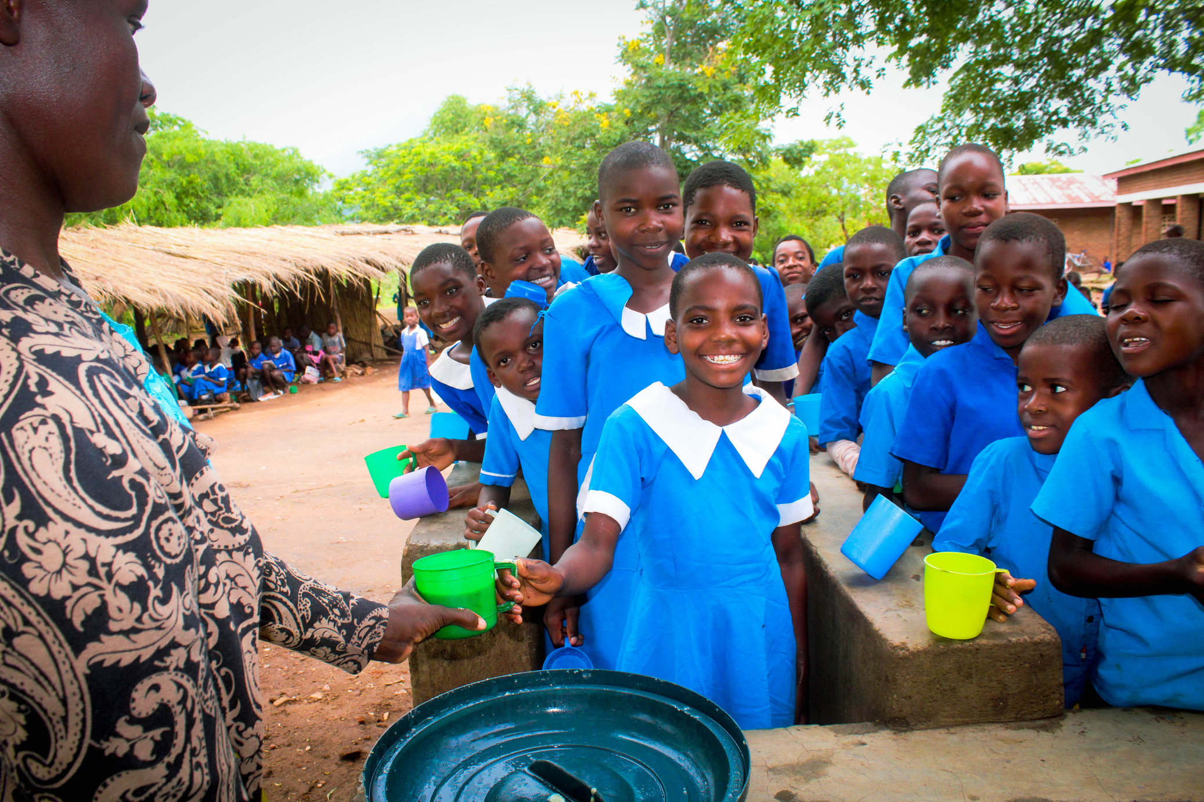
Need for Faith in the World
“Around 733 million people faced hunger in 2023, equivalent to one in eleven people globally and one in five in Africa...
If current trends continue, about 582 million people will be chronically undernourished in 2030 - half of them in Africa” (World Health Organization).
Notes:
Teacher Instruction:
1. The following three slides work together to present data on hunger in the world and how virtuous action can have an impact for good. Share data about food insecurity and hunger around the world with students.
Time: 5-10 minutes
Activity Description:
Allow the issue of hunger to become real to the student by applying “real life” data, information, and context.
Citation: https://www.who.int/news/item/24-07-2024-hunger-numbers-stubbornly-high-for-three-consecutive-years-as-global-crises-deepen--un-report
Photo courtesy of Mary's Meals

Slide 15
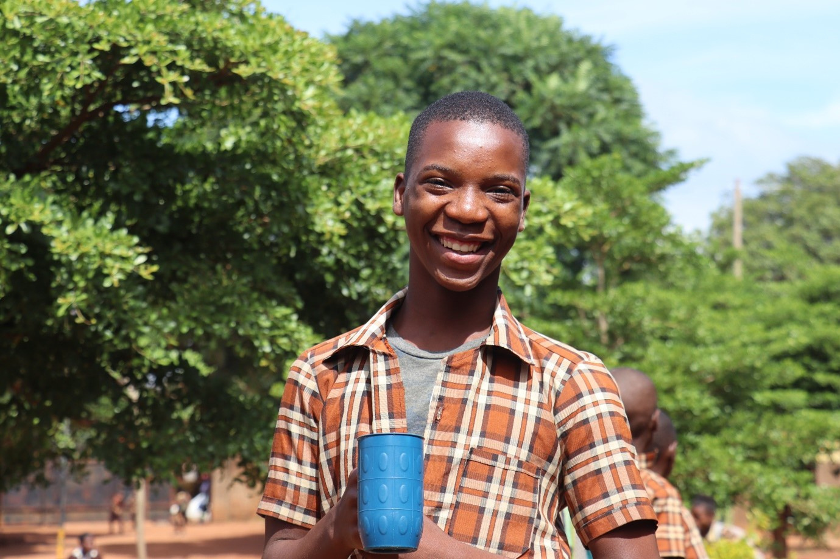
Need for Faith in the World
“We all want our families to have enough food to eat that is safe and nutritious. A world with zero hunger can positively impact our economies, health, education, equality and social development.
“It’s a key piece of building a better future for everyone. Additionally, with hunger limiting human development, we will not be able to achieve the other sustainable development goals such as education, health and gender equality” (United Nations).
Notes:
Teacher Instruction:
1. Share data about food insecurity and hunger around the world with students.
Time: 5-10 minutes
Activity Description:
Allow the issue of hunger to become real to the student by applying “real life” data, information, and context.
Citation: https://www.un.org/sustainabledevelopment/hunger/
Photo courtesy of Mary's Meals

Slide 16
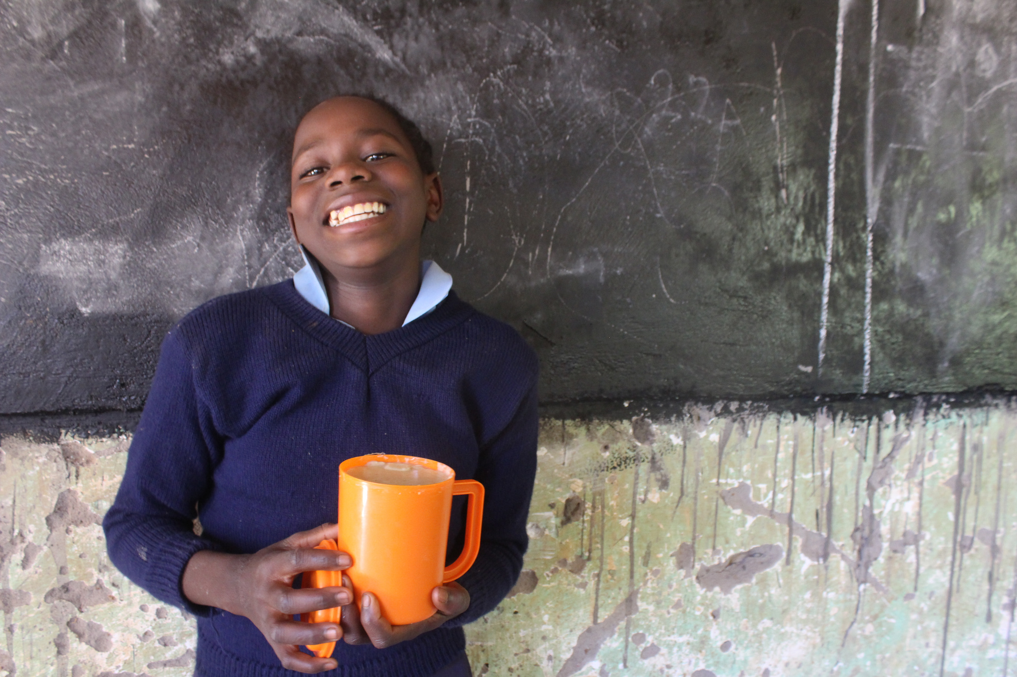
Need for Faith in the World
After reading the statistics from the World Health Organization and the statement from the United Nations:
  How can your acts of faith and the faith of others have an impact on the issue of world hunger?
  How can your acts of faith have an impact on the issue of hunger in your local community?
Notes:
Teacher Instruction:
1. Share data about food insecurity and hunger around the world with students.
Time: 5-10 minutes
Activity Description:
Allow the issue of hunger to become real to the student by applying “real life” data, information, and context.
Photo courtesy of Mary's Meals

Slide 17
Video: Love Reaches Everywhere
Click to View Video
Notes:
Teacher Instruction:
1. Explain that our acts of faith can bring hope and better lives to children around the world.
2. Show the video to students.
Time: 5 minutes
Activity Description:
Add context to the issue of world hunger for students.

Slide 18
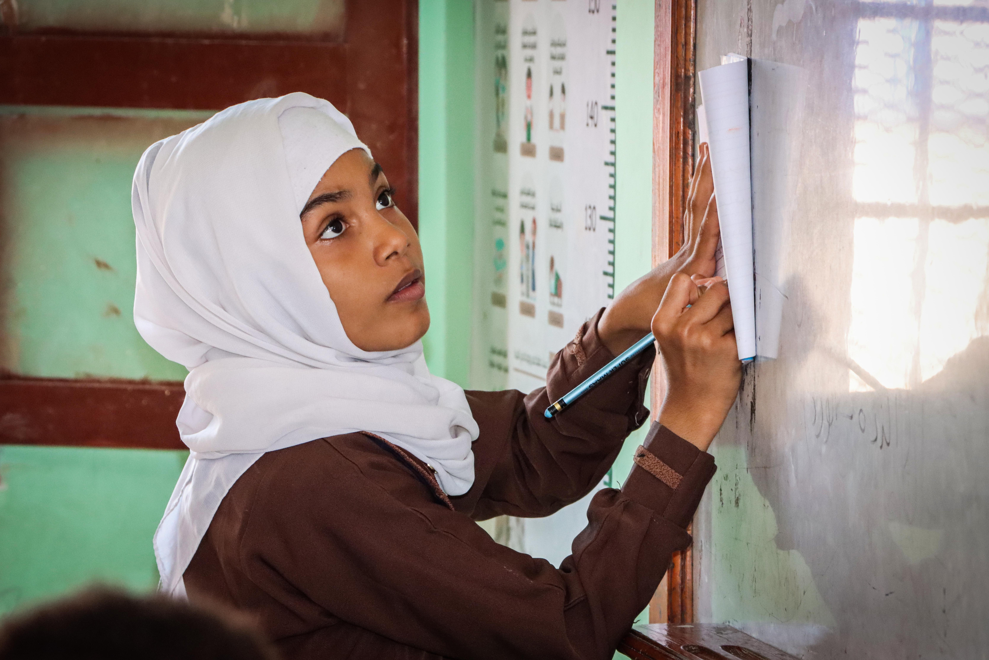
Video Discussion
  What are some obstacles you face with school?
  How do you feel after watching the video?
  How does the mother demonstrate her faith instead of fear?
Notes:
Teacher Instruction:
1. Invite students to reflect on the previous video by asking the on-screen questions.
Time: 5 minutes
Activity Description:
Add context to the issue of world hunger for students.
Photo courtesy of Mary's Meals

Slide 19

Circle of Trust
  Stand in a circle.
  One student will be blindfolded and stand in the middle.
  The students in the circle will catch the blindfolded student.
Notes:
Teacher Instruction:
1. Explain that this activity is to help students practice faith.
2. Students stand in a circle, with one blindfolded student in the center. (Depending on class size, you can split the students into 2-4 groups.)
3. Have students fall gently backward, trusting their peers to catch them.
4. Once caught, the blindfolded student is guided safely to the edge of the circle while receiving encouraging words from their classmates.
5. Repeat for any student who want to try the activity.
Time: 10 minutes
Activity Description:
Allow students to practice faith and build trust.
Image source: Canva Images

Slide 20

Circle of Trust
  Was it difficult or easy to trust your peers? Why?
  How does this compare to having faith in God?
Notes:
Teacher Instruction:
1. Discuss the on-screen questions with the students and allow them to reflect on the activity
Time: 5 minutes
Activity Description:
Reflect on the trust fall activity and connect it to the virtue of faith.
Image source: Canva Images

Slide 21
Little Act of Love for Faith
You are invited to choose one of these little acts of love or create your own little act of faith to offer up this week of Lent. You will report back to your classmates next week.
Prayer
Fasting
Almsgiving
  Start each day with prayer. Pray for more faith in your life or for someone in need.
  Keep a “Faith Journal”: Write down how you see God working in your life.
  Set reminders on your phone to pray or listen to faith-based podcasts.
  Take a break from music, TV, or video games for a day to focus on silence with God.
  Limit screen time and use extra time to pray or help others.
  Spend time with someone who may feel lonely (a classmate, elderly relative, or new student)
  Support a friend’s faith journey by inviting them to youth group, Mass, or a faith event.
Notes:
Teacher Instruction:
1. Allow the students to silently view the options and decide how they will exercise faith in their lives this week during this Lent.
2. At the beginning of the next lesson, students will report back to an accountability group what they did and what they learned from that experience.
Time: 5 minutes
Activity Description:
Provide options and choices for students to exercise faith in their lives and relate it back to Lent.

Slide 22
Week 2: Hope
Notes:
Teacher Instruction:
1. This slide introduces the focus for the second week of "Little Acts of Love." It will focus on the virtue of hope.
Total lesson time: approximately 50 minutes

Slide 23
Follow-up on Faith
  What was your little act of love to show faith?
  How did you feel when you did this?
  What do you think the impact was of your little act of love?
Little Acts of Love for Len
Notes:
Teacher Instruction:
1. Split students into small groups.
2. Have students go through each question and discuss with each other their experiences.
3. Give time for a few students to share with the whole class, if desired.
Time: 5 minutes
Activity Description:
Allow the students to have time to reflect on their previous week and how their little act of love was related to the previous virtue of faith.
Image source: Canva Images

Slide 24
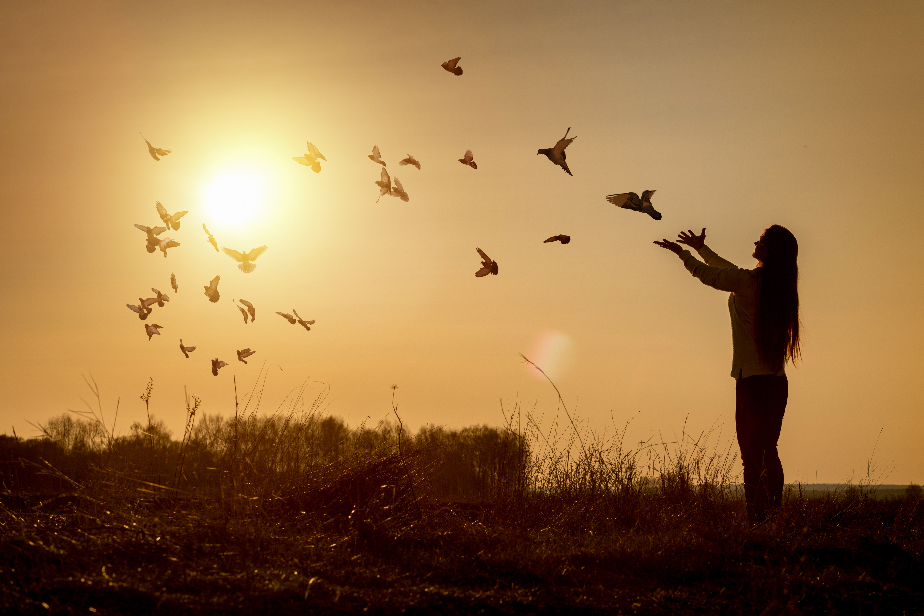
Hope
You endure with hope, serve others, and trust God’s good plan.
Notes:
Teacher Instruction:
1. Introduce this week's virtue of hope.
Time: 1 minute
Activity Description:
Introduce this week's virtue of hope.
Image source: Canva Images

Slide 25
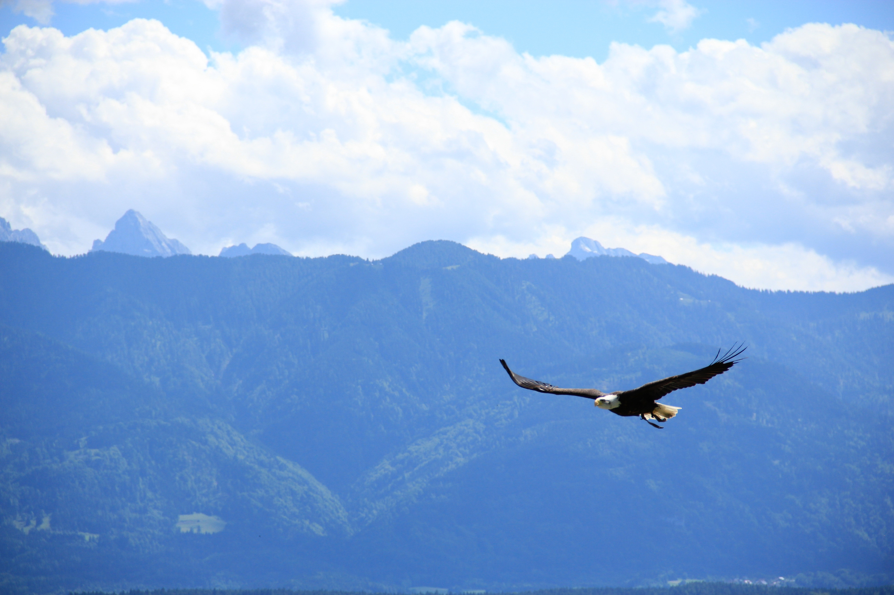
Isaiah 40:31
31 Those who hope in the LORD will renew their strength. They will soar on wings like eagles; they will run and not grow weary, they will walk and not be faint.
Notes:
Teacher Instruction:
1. Have a student read Isaiah 40:31.
2. Explain its relevance to hope.
Time: 1 minutes
Activity Description:
Read and discuss a Bible verse to relate to the virtue of hope.
Image source: Canva Images

Slide 26

Discussion
  What does it mean to "hope in the Lord"? How is that different from ordinary hope?
  How have you seen God renew someone’s strength—either in your life or someone else's?
  What are some things that can drain your strength, and how can faith help overcome them?
Notes:
Teacher Instruction:
1. Go through the questions and begin a discussion with the students.
Time: 5-10 minutes
Activity Description:
Read and discuss a Bible verse to relate to the virtue of hope.
Image source: Canva Images

Slide 27
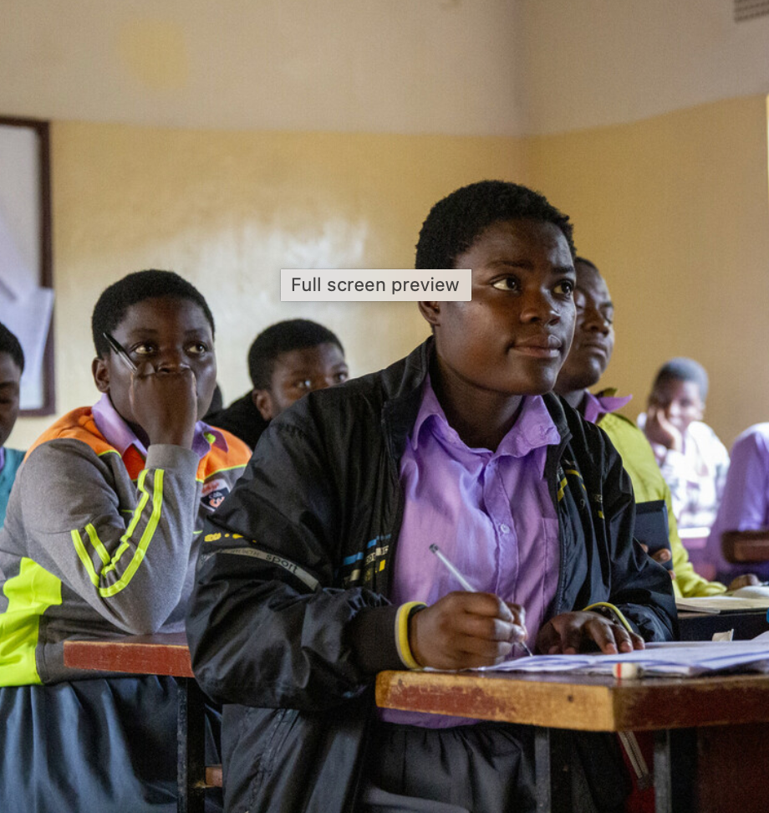
Need for Hope in the World
“According to the USDA , 1 in every 5 children (in the United States) is unsure where they will get their next meal.
Black and Latino children are nearly twice as likely to face hunger.
Many families, regardless of their race, have a hard time affording food. However, it happens more frequently to families of color because of discrimination based on race” (Feeding America).
Notes:
Teacher Instruction:
1. The following two slides work together to present data on hunger in the world and how virtuous action can have an impact for good.
2. Allow students to answer the questions on the following slide
3. Have the students discuss.
Time: 10 minutes
Activity Description:
Allow the issue of hunger to become real to the student by applying “real life” data, information, and context
Citation: https://www.feedingamerica.org/hunger-in-america/child-hunger-facts
Photo courtesy of Mary's Meals

Slide 28
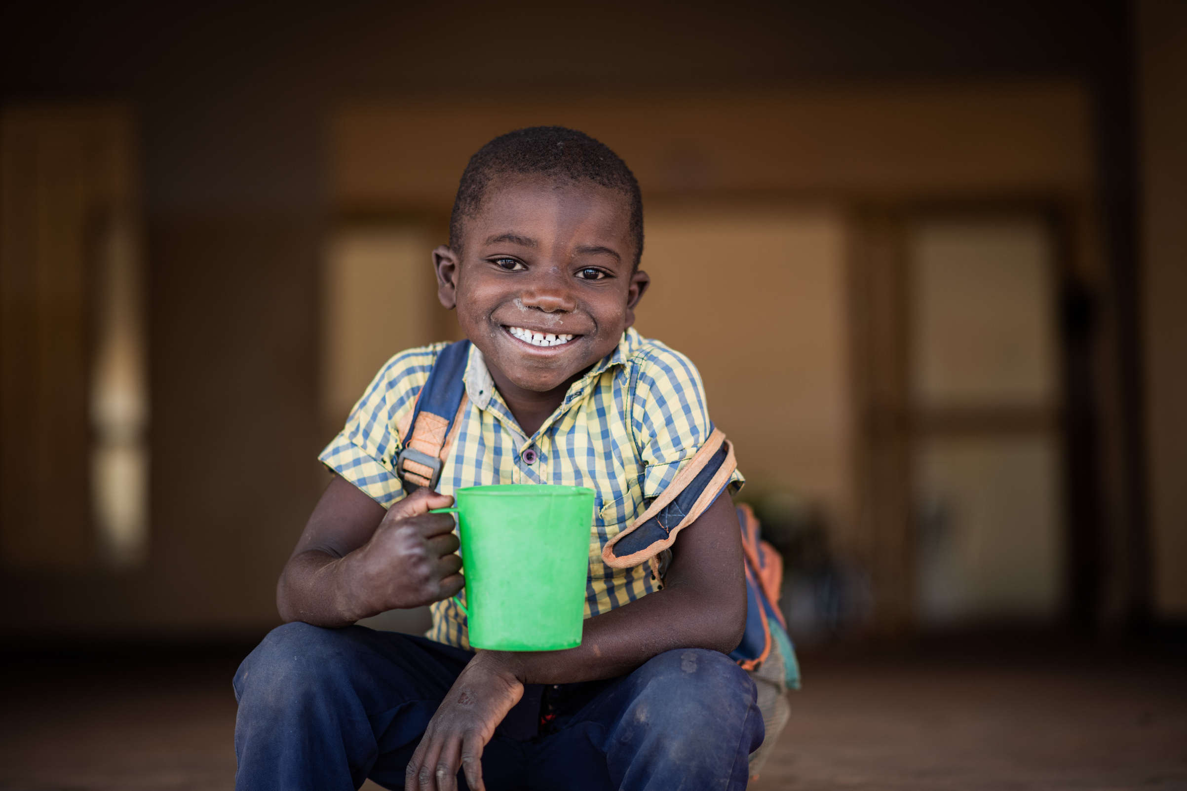
Need for Hope in the World
After reading the statistics from Feeding America, discuss the following questions:
  How can your acts of hope have an impact on the issue of world hunger?
  How can your acts of hope have an impact on the issue of hunger in your local community?
Notes:
Teacher Instruction:
1. Share data about food insecurity and hunger around the world with students.
Time: 5-10 minutes
Activity Description:
Allow the issue of hunger to become real to the student by applying “real life” data, information, and context.
Photo courtesy of Mary's Meals

Slide 29
Video: Crisis in Ethiopia | Voice from Tigray | Lydia and Shewit
Click to View Video
Notes:
Teacher Instruction:
1. Show Mary's Meals video to students.
Time: 5 minutes
Activity Description:
Add context to the world hunger issue for students.

Slide 30
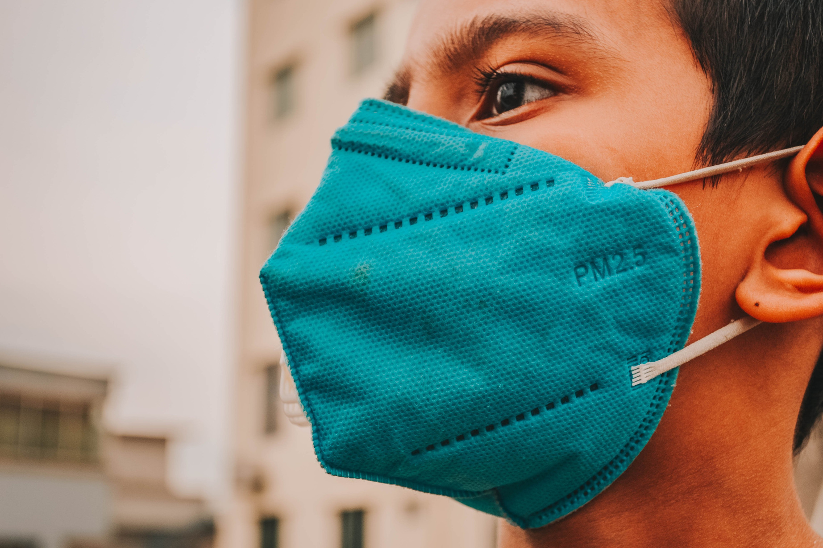
Video Discussion
  Lydia describes how her education was interrupted by the Covid-19 pandemic. In what ways was your experience similar or different?
  How does this video demonstrate hope?
  What can you do to become more hopeful?
Notes:
Teacher Instruction:
1. After watching the video, discuss the questions on the slide with the students.
Time: 5 minutes
Activity Description:
Add context to the issue of world hunger and hope for students.
Image source: Canva Images

Slide 31

Hope Word Cloud
  Write 2-4 words that you associate with “hope.”
  Watch as we create a word cloud with your hope-related words.
Notes:
Teacher Instruction:
1. Give students one minute to silently write 2-4 words down that they associate with “hope."
2. While they are writing, set up word cloud generator
(https://www.simplewordcloud.com) for them to share their words with the class.
3. After the minute is up, have each student share their words with each other.
4. As the students share their words, type their words into the word cloud generator.
5. As each student shares, project the word cloud for the class to see how it changes.
Alternate White Board/Chalk Board Version:
1. Instead of the word cloud generator, write each word on the whiteboard in a scattered, cloud-like formation
2. If multiple students say the same word, write it bigger or underline it
3. Once all students have shared, step back and review the board together.
Time: 10-15 minutes
Activity Description:
Encourage students to reflect on the meaning of hope and visualize their collective understanding through a word cloud.
Image source: Canva Images

Slide 32

Hope Word Cloud
  Which words appeared the most in our word cloud? Why do you think that is?
  Did any words surprise you?
  How does this word cloud compare to the way you personally think about hope?
  How do these words relate to the Bible verse we read about hope?
Notes:
Teacher Instruction:
1. Reflect on the previous activity by discussing these questions with the students.
Time: 5-10 minutes
Activity Description:
Encourage students to reflect on the meaning of hope and visualize their collective understanding through a word cloud.
Image source: Canva Images

Slide 33
Little Acts of Love for Hope
You are invited to choose one of these little acts of hope or create your own little act of hope to offer up this week of Lent. You will report back to your classmates next week.
Prayer
Fasting
Almsgiving
  Write a note of encouragement to someone who may need hope.
  Choose and memorize a Bible verse about hope
  Fast from complaining for a day. Instead pray for hope in difficult situations and replace complaints with gratitude.
  Eat only simple foods for one meal while reflecting on those who go without daily nourishment.
  Reflect and write down one way you can commit to giving regularly through time, money, or acts of kindness.
  Do one anonymous act of kindness and reflect on how giving without recognition strengthens your hope in God.
Notes:
Teacher Instruction:
1. Allow the students to silently view the options and decide how they will exercise hope in their lives this week during Lent.
2. At the beginning of the next lesson, students will report back to an accountability group what they did and what they learned from that experience.
Time: 5 minutes
Activity Description:
Provide options and choices for students to exercise hope in their lives and relate it back to Lent.

Slide 34
Week 3: Justice
Notes:
Teacher Instruction:
1. This slide introduces the focus for the third week of "Little Acts of Love." The focus will be on the virtue of justice.
Total lesson time: approximately 50 minutes

Slide 35

Follow-up on Hope
  What was your little act of love to show hope?
  How did you feel when you did this?
  What do you think the impact was of your act of love?
Little Acts of Love for Len
Notes:
Teacher Instruction:
1. Split students into small groups.
2. Have students go through each question and discuss with each other their experiences.
3. Give time for a few students to share with the whole class, if desired.
Time: 5 minutes
Activity Description:
Allow the students to have time to reflect on their previous week and how their little act of love was related to the previous virtue of hope.
Image source: Canva Images

Slide 36

Justice
You treat everyone fairly and with respect. You share what you have so that everyone gets what they need.
Notes:
Teacher Instruction:
1. Introduce this week's virtue of justice.
Time: 1 minute
Activity Description:
Introduction to this week's virtue.
Image source: Canva Images

Slide 37
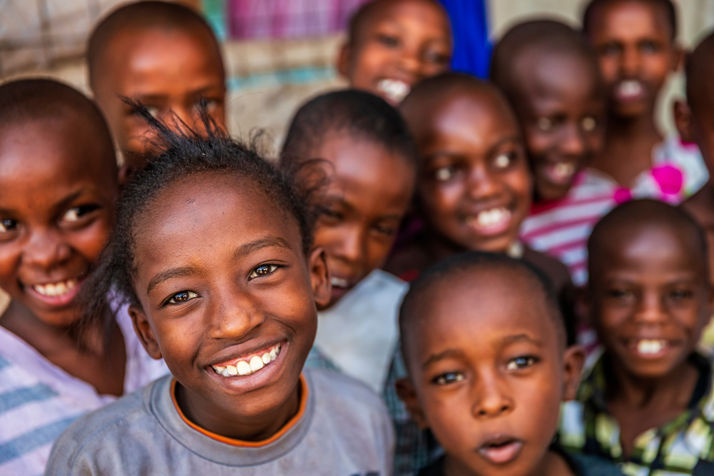
Isaiah 1:17
17 Learn to do right; seek justice. Defend the oppressed. Take up the cause of the orphan; plead
the case of the widow
Notes:
Teacher Instruction:
1. Have a student read Isaiah 1:17.
Time: 1 minutes
Activity Description:
Share a Bible verse to show how the virtue of justice is encouraged in the scriptures.
Image source: Canva Images

Slide 38
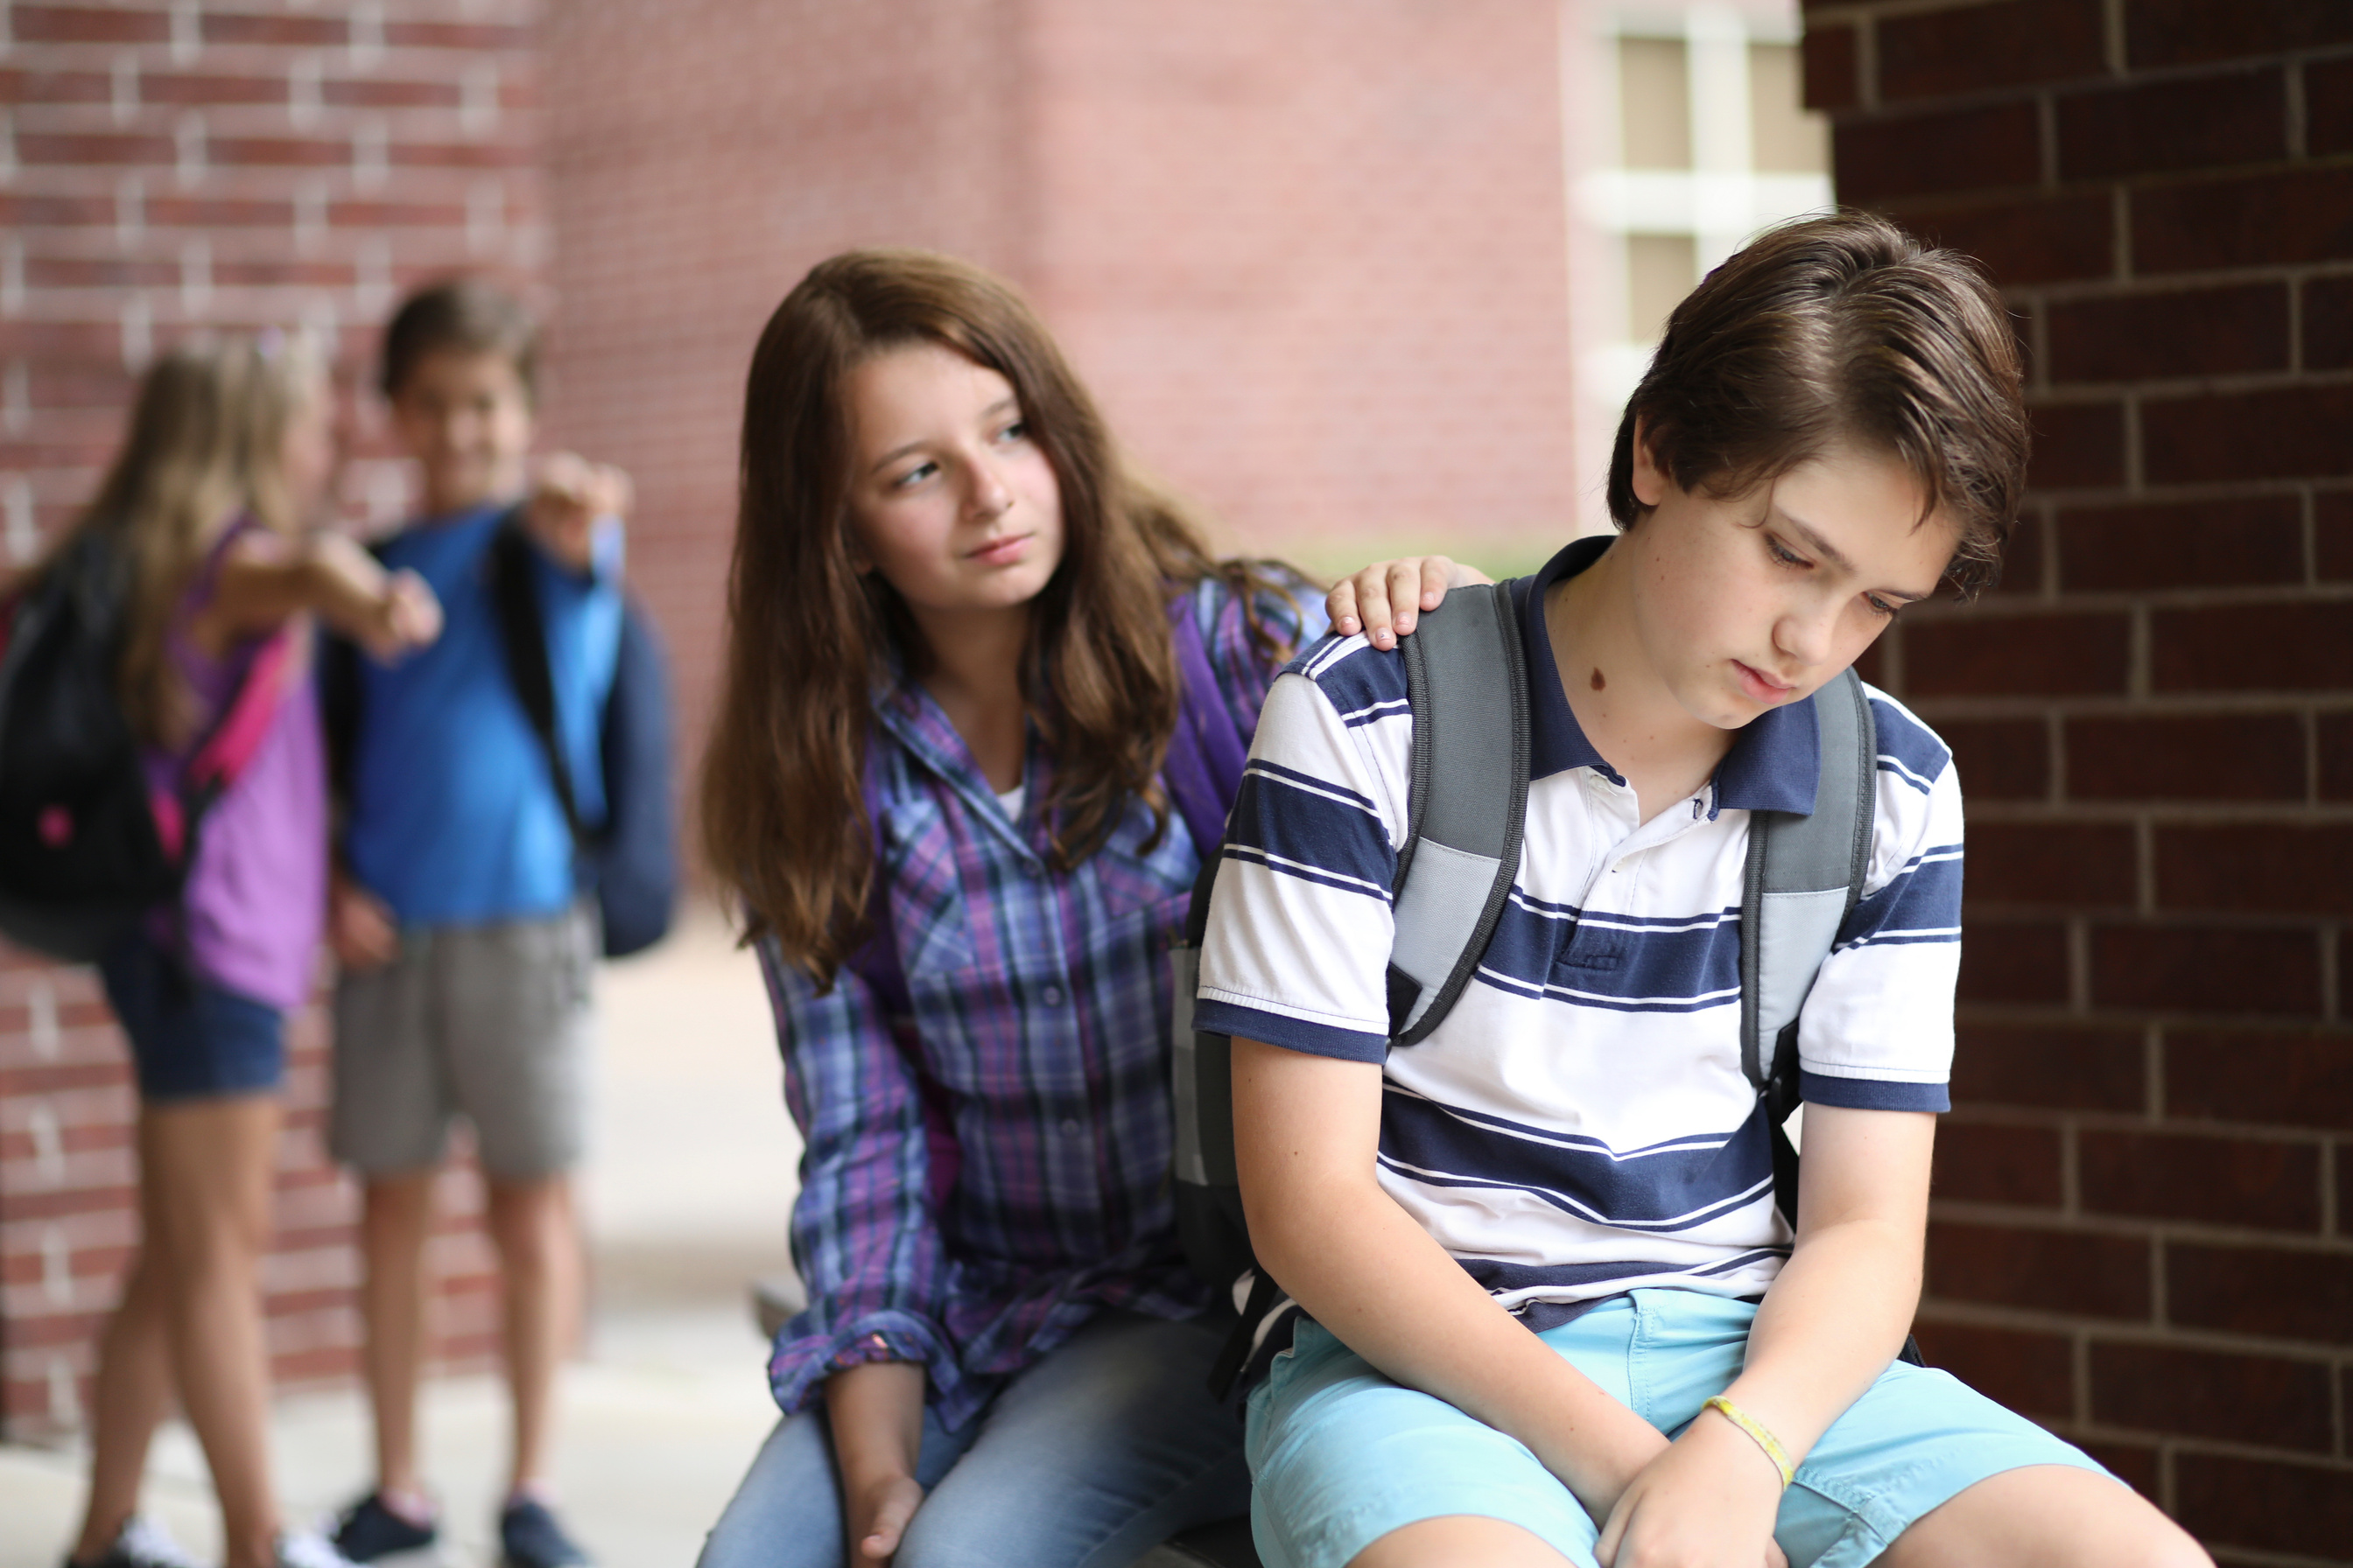
Discussion
  “What does it mean to "learn to do right"? How can we make learning to do right a habit in our daily lives?
  Can you think of a time when you stood up for someone who was being treated unfairly? How did it feel?
  What are some ways you can "seek justice" in your school or community?
Notes:
Teacher Instruction:
1. Ask the questions and begin a discussion with the students about justice.
Time: 5-10 minutes
Activity Description: Share a Bible verse to show how the virtue of justice is encouraged in the scriptures.
Image source: Canva Images

Slide 39
Need for Justice in the World
“Along with conflict, climate shocks, and rising cost of living, civil insecurity and declining food production have all contributed to food scarcity and high food prices.
Investment in the agriculture sector is critical for reducing hunger and poverty, improving food security, creating employment and building resilience to disasters and shocks” (United Nations).
Notes:
Teacher Instruction:
1. The following two slides work together to present data on hunger in the world and how virtuous action can have an impact for good. Share the data provided and discuss the injustice of food insecurity.
Time: 5-10 minutes
Activity Description:
Allow the issue of hunger to become real to the student by applying “real life” data, information, and context
Citation:
https://www.un.org/sustainabledevelopment/hunger/
Photo courtesy of Mary's Meals

Slide 40
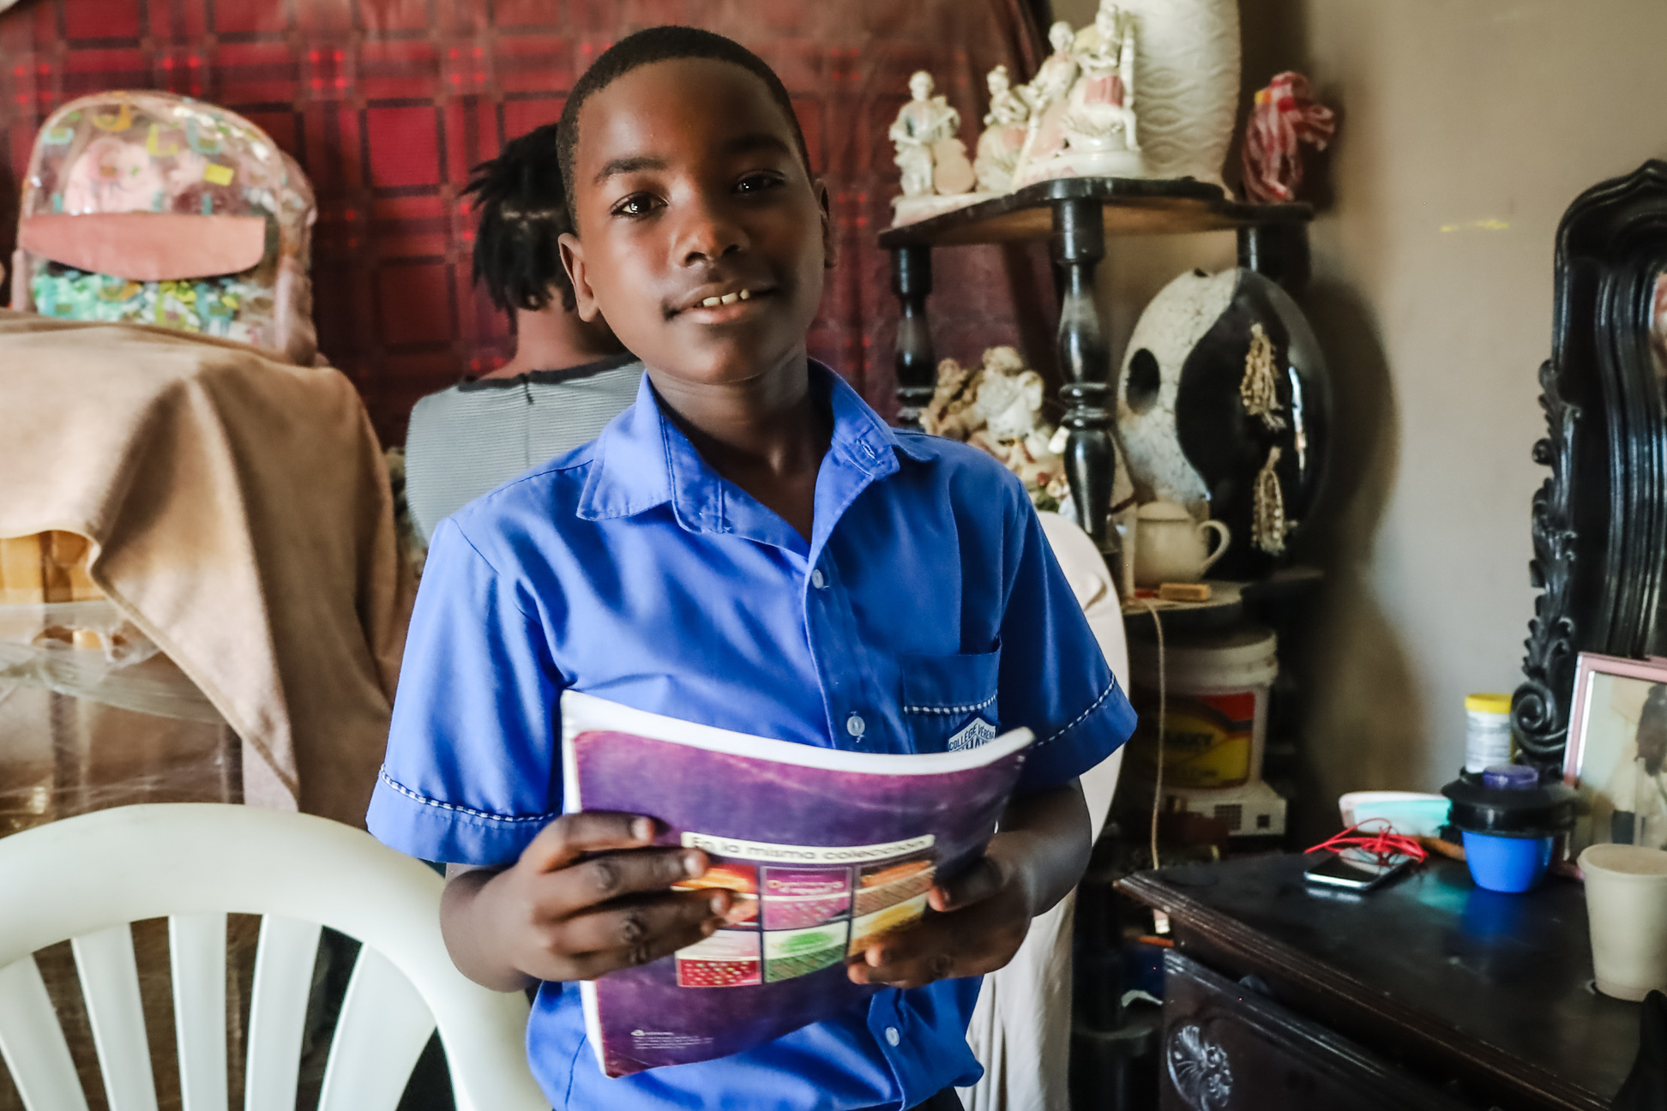
Need for Justice in the World
After reading the statement from the United Nations, discuss the following questions:
  How can your acts of justice have an impact on the issue of world hunger?
  How can your acts of justice have an impact on the issue of hunger in your local community?
Notes:
Teacher Instruction:
1. Share data about food insecurity and hunger around the world with students.
Time: 5-10 minutes
Activity Description:
Allow the issue of hunger to become real to the student by applying “real life” data, information, and context.
Photo courtesy of Mary's Meals

Slide 41
Video: Lette’s Story
Click to View Video
Notes:
Teacher Instruction:
1. Share the Mary's Meals video with students.
Time: 5 minutes
Activity Description:
Add context to the issue of food insecurity and justice for students.

Slide 42
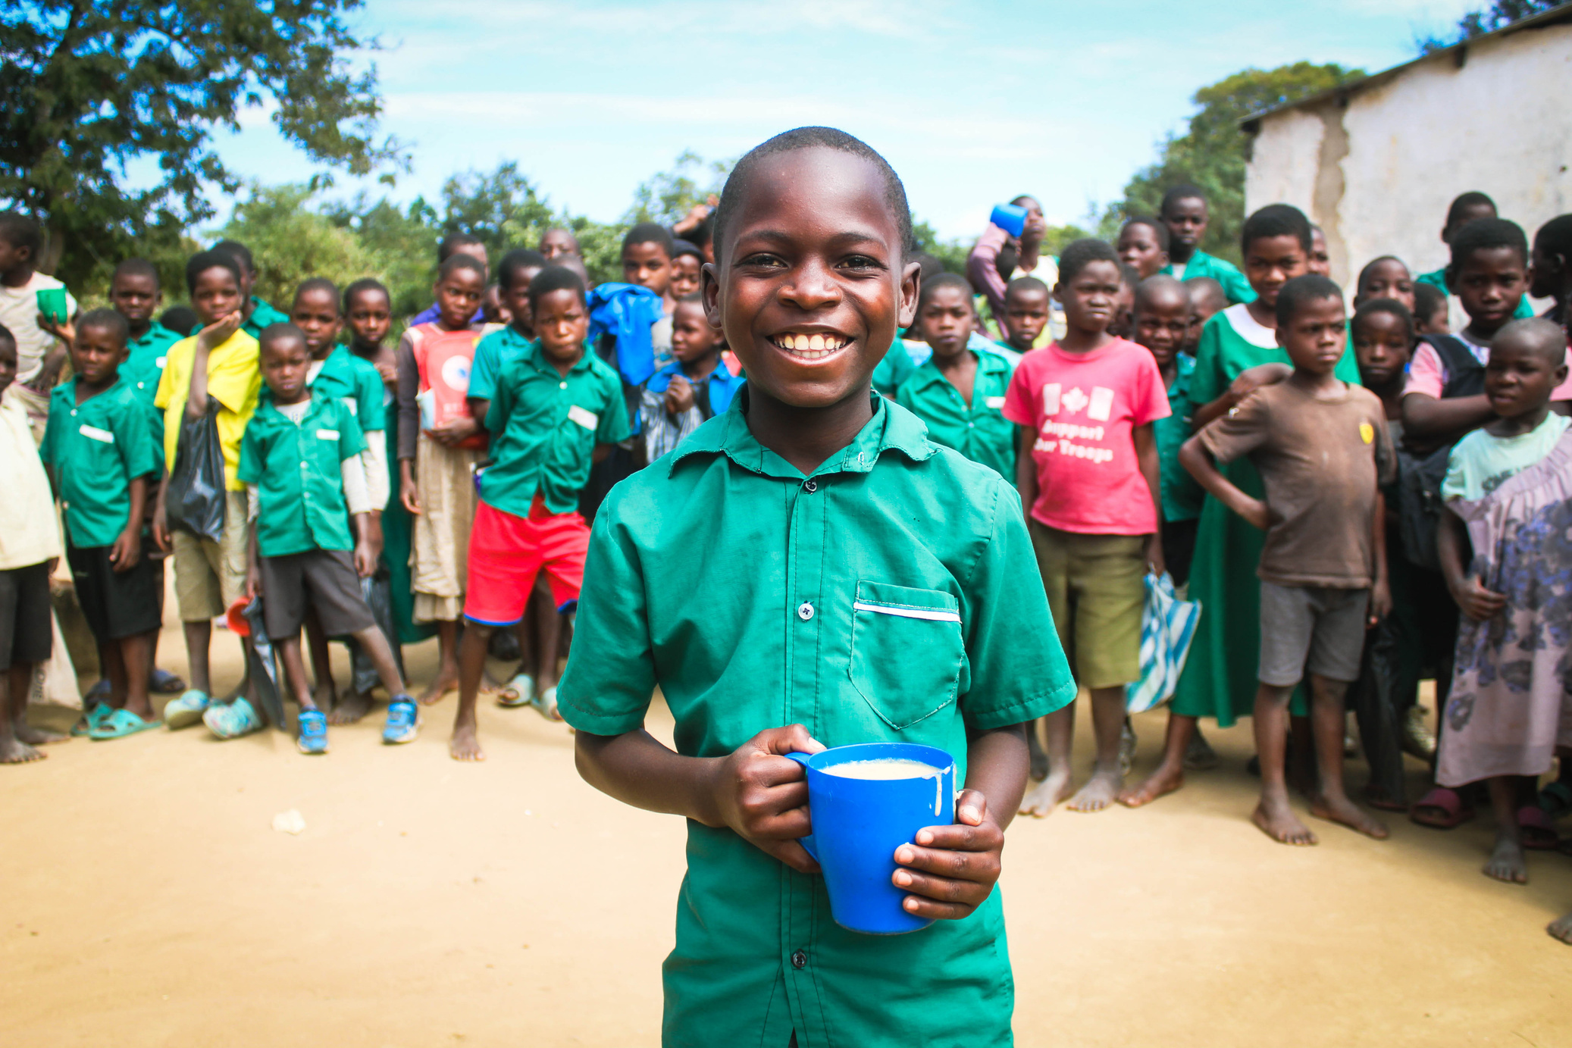
Video Discussion
  How is your life similar or different to Lette’s?
  How does Lette’s story demonstrate the virtue of justice?
  What does Lette’s story teach you about the importance of justice?
Notes:
Teacher Instruction:
1. After watching the video, discuss the questions on the slide with the students.
Time: 5 minutes
Activity Description:
Add context to the issue of food insecurity and justice for students.
Photo courtesy of Mary's Meals

Slide 43
Justice Scenarios: “What Would Jesus Do?”
  Sit in a small group.
  Review the real-world scenario related to food justice you receive and debate what Jesus would do.
  Use Bible stories, logic, and compassion in your responses.
---
  Present your scenario and tell your classmates what you think Jesus would do and why.
  After presenting your scenario, discuss it as a class and allow others to provide rebuttals.
  Reflect on how justice is not always black and white but requires wisdom, compassion, and action.
Notes:
Teacher Instructions:
1. Share the possible scenarios with students:
Wasting vs. Sharing Food:
A restaurant throws away tons of uneaten food at the end of the day. Should they be required to donate leftovers to shelters? What would Jesus say about food waste?
Fair Wages for Farmers:
Many farmers in developing countries are underpaid for their labor while grocery stores make huge profits. Should people be obligated to buy fair-trade food even if it costs more?
Feeding the Unhoused:
A city bans people from giving food to the homeless in public areas, saying it attracts too many people and causes problems. Would Jesus follow the law or still feed the hungry?
Fasting vs. Helping:
A student chooses to give up eating out for Lent. Another student suggests donating the money saved to a local food pantry. Which is the greater act of justice?
Time: 10 minutes
Activity Description:
Allow students to discuss ways to exercise the virtue of justice.

Slide 44
Justice Scenarios: “What Would Jesus Do?”
Wasting vs. Sharing Food
A restaurant throws away tons of uneaten food at the end of the day. Should they be required to donate leftovers to shelters? What would Jesus say about food waste?
Fair Wages for Farmers
Many farmers in developing countries are underpaid for their labor while grocery stores make huge profits. Should people be obligated to buy fair-trade food even if it costs more?
Feeding the Unhoused
A city bans people from giving food to the homeless in public areas, saying it attracts too many people and causes problems. Would Jesus follow the law or feed the hungry?
Fasting vs. Helping
A student chooses to give up eating out for Lent. Another student suggests donating the money saved to a local food pantry. Which is the greater act of justice?
Notes:
Teacher Instructions:
1. Share the possible scenarios with students:
Wasting vs. Sharing Food:
A restaurant throws away tons of uneaten food at the end of the day. Should they be required to donate leftovers to shelters? What would Jesus say about food waste?
Fair Wages for Farmers:
Many farmers in developing countries are underpaid for their labor while grocery stores make huge profits. Should people be obligated to buy fair-trade food even if it costs more?
Feeding the Unhoused:
A city bans people from giving food to the homeless in public areas, saying it attracts too many people and causes problems. Would Jesus follow the law or still feed the hungry?
Fasting vs. Helping:
A student chooses to give up eating out for Lent. Another student suggests donating the money saved to a local food pantry. Which is the greater act of justice?
Time: 10 minutes
Activity Description:
Allow students to discuss ways to exercise the virtue of justice.

Slide 45
Little Acts of Love for Justice
You are invited to choose one of these little acts of justice or create your own little act of justice to offer up this week of Lent. You will report back to your classmates next week.
Prayer
Fasting
Almsgiving
  Reflect on the connection between justice and the words in the Lord’s Prayer.
  Read Micah 6:8 and consider how you can be more just during the week.
  In conversations, especially debates, commit to truly listening before responding.
  During fasting, practice justice by being fair to yourself. Set realistic expectations and show compassion to yourself.
  As a family or class, collect spare change for a Mary’s Meal Giving jar.
  Gather and give away gently used clothes, books, or toys to those in need or a donation center
Notes:
Teacher Instruction:
1. Allow the students to silently view the options and decide how they will exercise justice in their lives this week during Lent.
2. At the beginning of the next lesson, students will report back to an accountability group what they did and what they learned from that experience.
Time: 5 minutes
Activity Description:
Provide options and choices for students to exercise justice in their lives and relate it back to Lent.

Slide 46
Week 4: Charity
Notes:
Teacher Instructions:
1. This slide introduces the focus for the fourth week of "Little Acts of Love." It will focus on the virtue of charity.
Total lesson time: approximately 50 minutes

Slide 47
Follow-up on Justice
  What was your little act of love to show justice?
  How did you feel when you did this?
  What do you think the impact was of your act of love?
Little Acts of Love for Len
Notes:
Teacher Instruction:
1. Split students into small groups.
2. Have students go through each question and discuss with each other their experiences.
3. Give time for a few students to share with the whole class, if desired.
Time: 5 minutes
Activity Description:
Allow the students to have time to reflect on their previous week and how their little act of love was related to the previous virtue of justice.
Image source: Canva Images

Slide 48

Charity
You feel the love of God above all things, and the love of others as yourself for the sake of God. Your actions help others in need, both spiritually and physically.
Notes:
Teacher Instruction:
1. Provide a definition of the virtue of charity.
Time: 1 minute
Activity Description:
Introduction to and definition of this week's virtue.
Image source: Canva Images

Slide 49
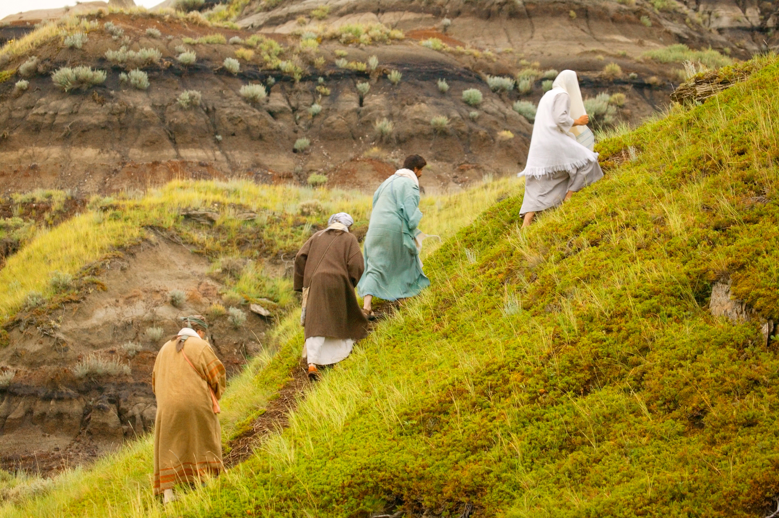
John 6:1-13
1 After this, Jesus went across the Sea of Galilee [of Tiberias].
2 A large crowd followed him, because they saw the signs he was performing on the sick.
3 Jesus went up on the mountain, and there he sat down with his disciples.
4 The Jewish feast of Passover was near.
Notes:
Teacher Instruction:
1. Have a student read John 6:1-13.
Time: 5-7 minutes
Activity Description:
Read Bible verses related to the virtue of charity.
Image source: Canva Images

Slide 50
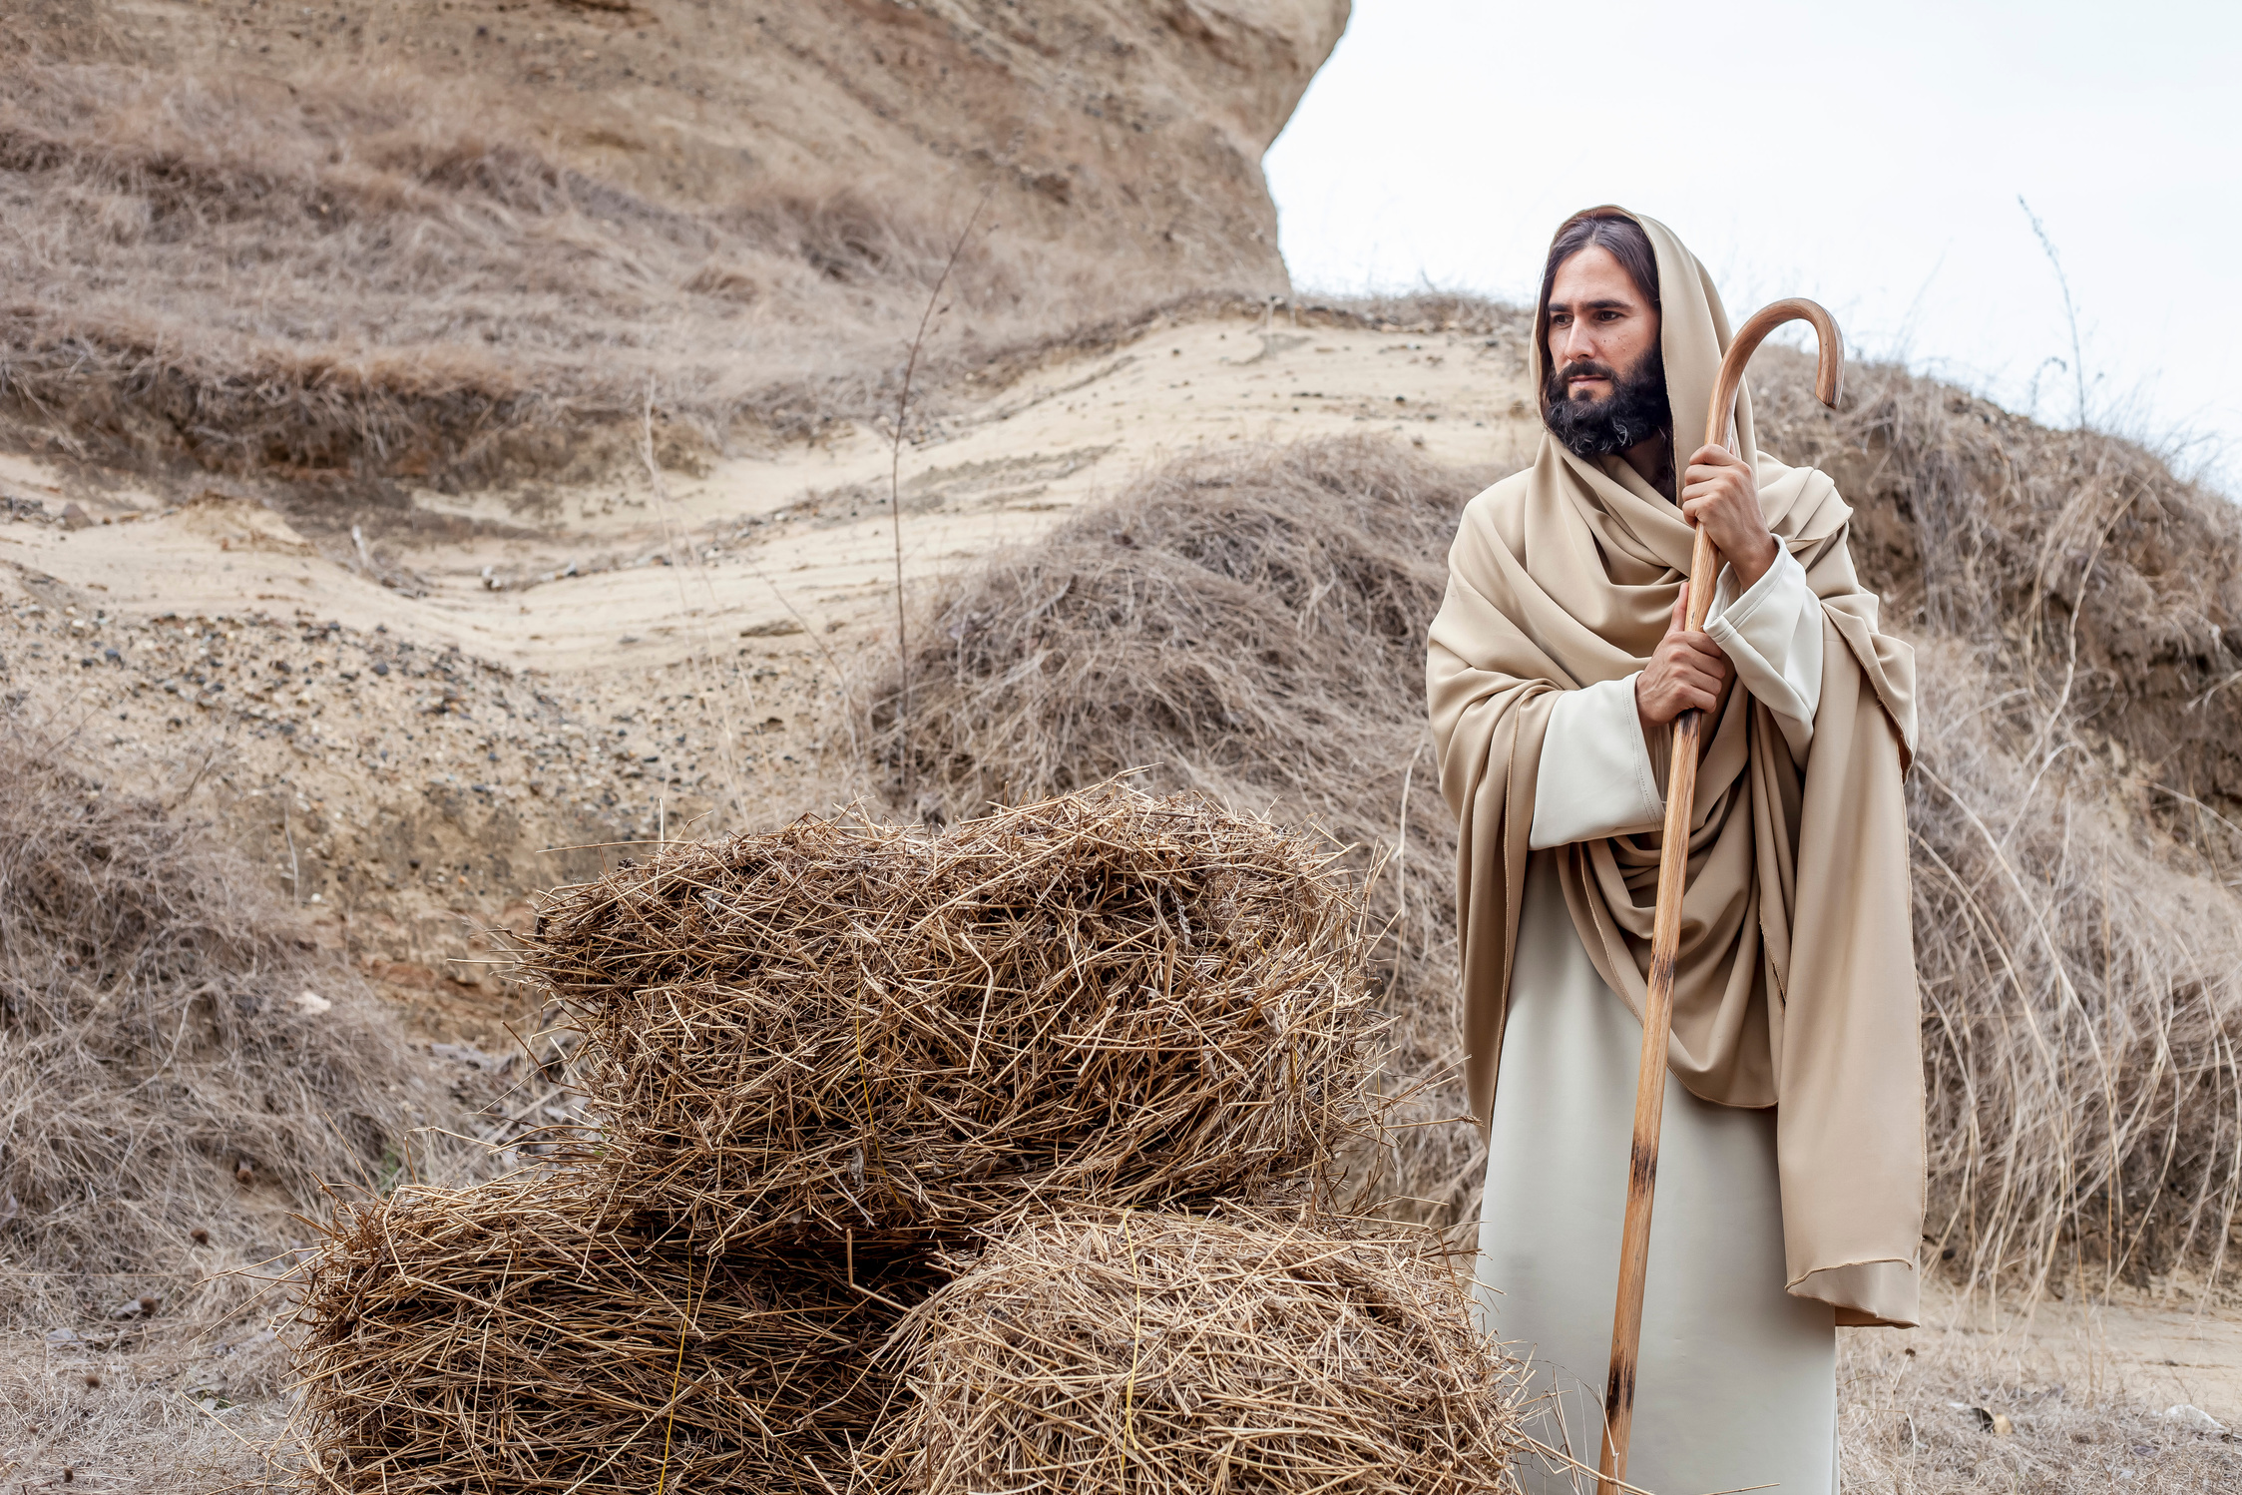
John 6:1-13
5 When Jesus raised his eyes and saw that a large crowd was coming to him, he said to Philip, “Where can we buy enough food for them to eat?”
6 He said this to test him, because he himself knew what he was going to do.
7 Philip answered him, “Two hundred days’ wages worth of food would not be enough for each of them to have a little [bit].”
Notes:
Teacher Instruction:
1. Have a student read John 6:1-13.
Time: 5-7 minutes
Activity Description:
Read Bible verses related to the virtue of charity.
Image source: Canva Images

Slide 51
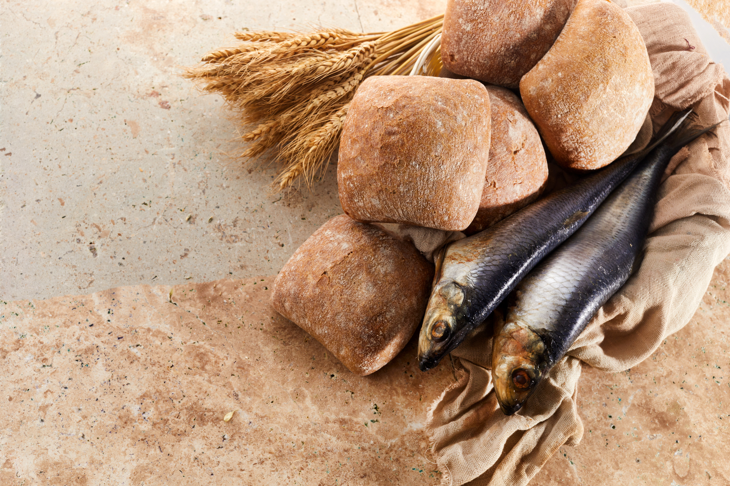
John 6:1-13
8 One of his disciples, Andrew, the brother of Simon Peter, said to him,
9 “There is a boy here who has five barley loaves and two fish; but what good are these for so many?”
10 Jesus said, “Have the people recline.” Now there was a great deal of grass in that place. So the men reclined, about five thousand in number.
Notes:
Teacher Instruction:
1. Have a student read John 6:1-13.
Time: 5-7 minutes
Activity Description:
Read Bible verses related to the virtue of charity.
Image source: Canva Images

Slide 52
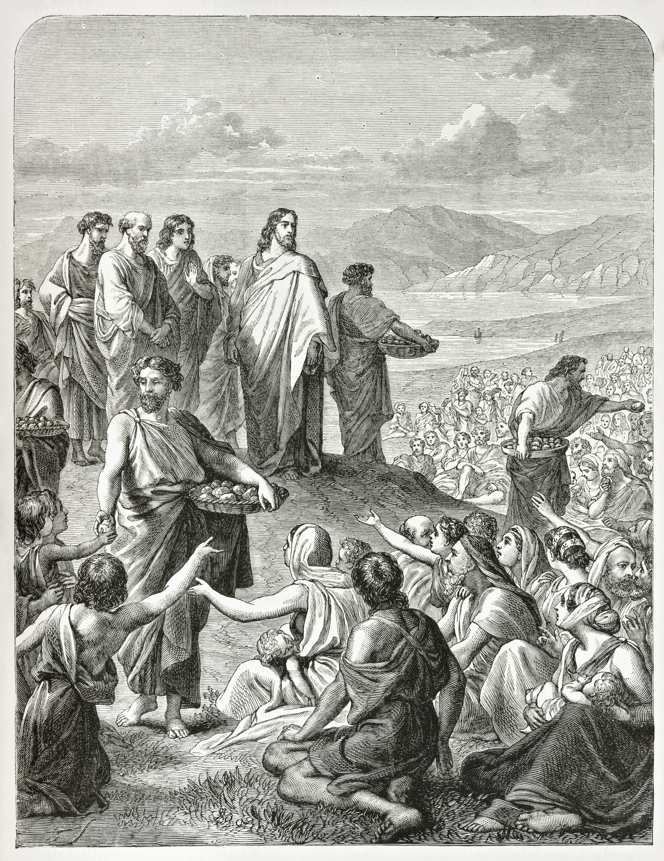
John 6:1-13
11 Then Jesus took the loaves, gave thanks, and distributed them to those who were reclining, and also as much of the fish as they wanted.
12 When they had had their fill, he said to his disciples, “Gather the fragments left over, so that nothing will be wasted.”
13 So they collected them, and filled twelve wicker baskets with fragments from the five barley loaves that had been more than they could eat.
Notes:
Teacher Instruction:
1. Have a student read John 6:1-13.
Time: 5-7 minutes
Activity Description:
Read Bible verses related to the virtue of charity.
Image source: Canva Images

Slide 53
Discussion
  Why do you think Jesus used the boy’s food instead of just creating food Himself?
  What does this teach us about our own efforts in serving and helping others?
  How do you think the disciples felt when Jesus told them to feed the crowd, and how did their perspective change?
Notes:
Teacher Instruction:
1. Go through the questions and begin a discussion with the students about charity.
Time: 5-10 minutes
Activity Description:
Discuss the Bible verses related to the virtue of charity.
Image source: Canva Images

Slide 54
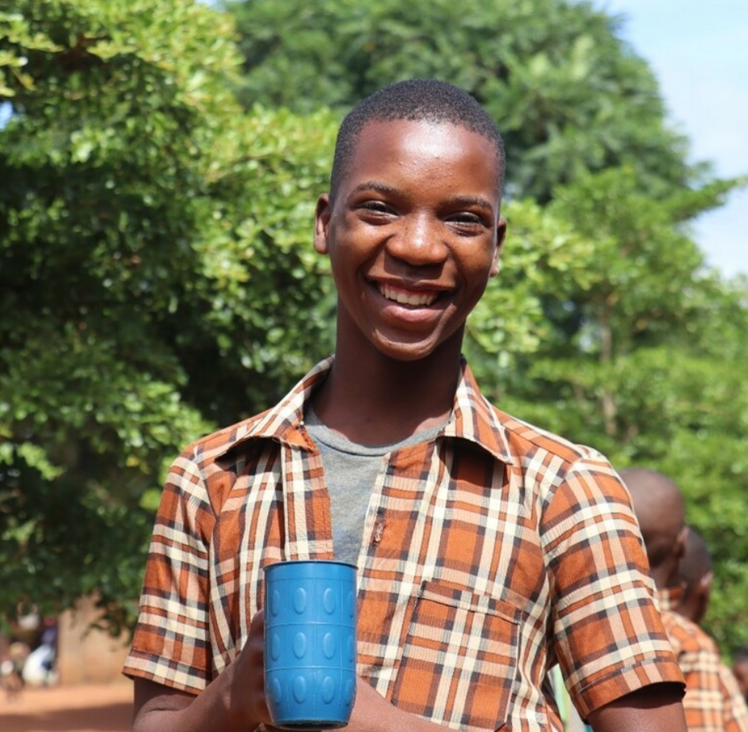
Charity in the World Through Mary’s Meals
Mary’s Meals is working to address this problem by serving one meal every school day to over 2.5 million children in 16 countries.
The founder of Mary’s Meals has said: “I believe that every child has a right to a daily meal in their place of education. And I believe that there is no good reason why we cannot make – and keep – this promise to the world’s poorest children. We have in the human family more than enough resources to do this. We in this room could make it happen.”
Notes:
Teacher Instruction:
1. Share the data provided.
Time: 5-10 minutes
Activity Description:
Allow the issue of hunger to become real to the student by applying “real life” data, information, and context
Citation:
https://www.marysmeals.org
https://www.marysmeals.org/news/articles/the-right-to-hope-for-every-child
Photo courtesy of Mary's Meals

Slide 55
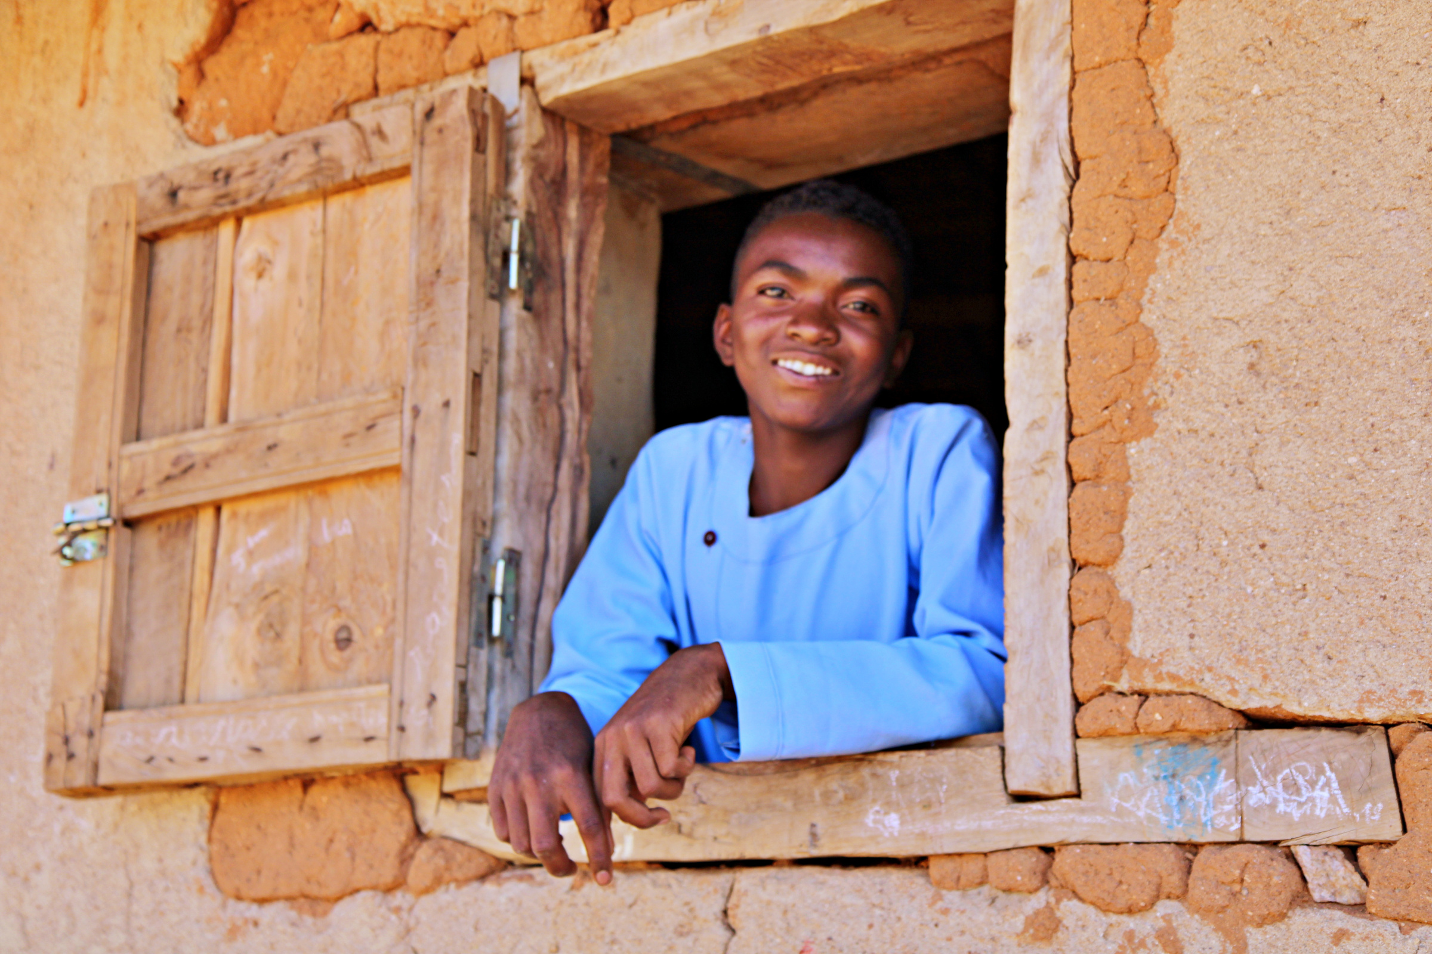
Need for Charity in the World
After reading the statement from Mary’s Meals:
  How can your acts of charity have an impact on the issue of world hunger?
Notes:
Teacher Instruction:
1. Share data about food insecurity and hunger around the world with students.
Time: 5-10 min
Activity Description:
Allow the issue of hunger to become real to the student by applying “real life” data, information, and context.
Photo courtesy of Mary's Meals

Slide 56
Video: Charlie’s Story
Click to View Video
Notes:
Teacher Instruction:
1. Share video with students
Time: 5 minutes
Activity Description:
Show how one child's actions are making a big difference for many children's health and wellbeing.

Slide 57
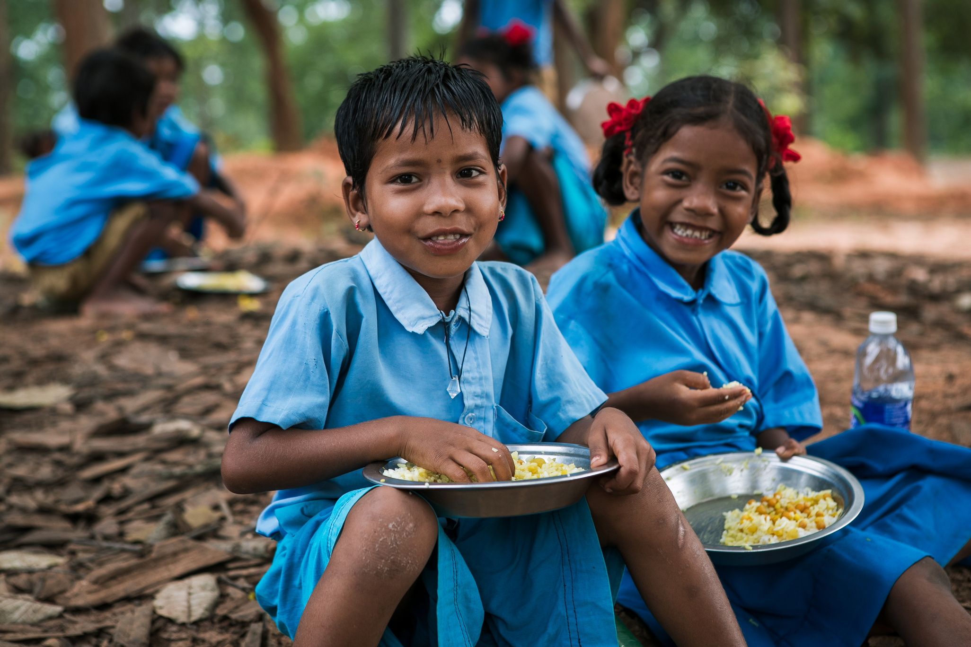
Video Discussion
  How does Charlie bring his “loaves and fishes” to help others in need?
  Charlie says “Even a 12-year-old like me can make a difference.” What are some needs in your local community that might need your “loaves and fishes”?
Notes:
Teacher Instruction:
1. After watching the video, discuss the questions on the slide with the students.
Time: 5 minutes
Activity Description:
Discuss how the students can make a difference in their local communities through little acts of love.
Photo courtesy of Mary's Meals

Slide 58
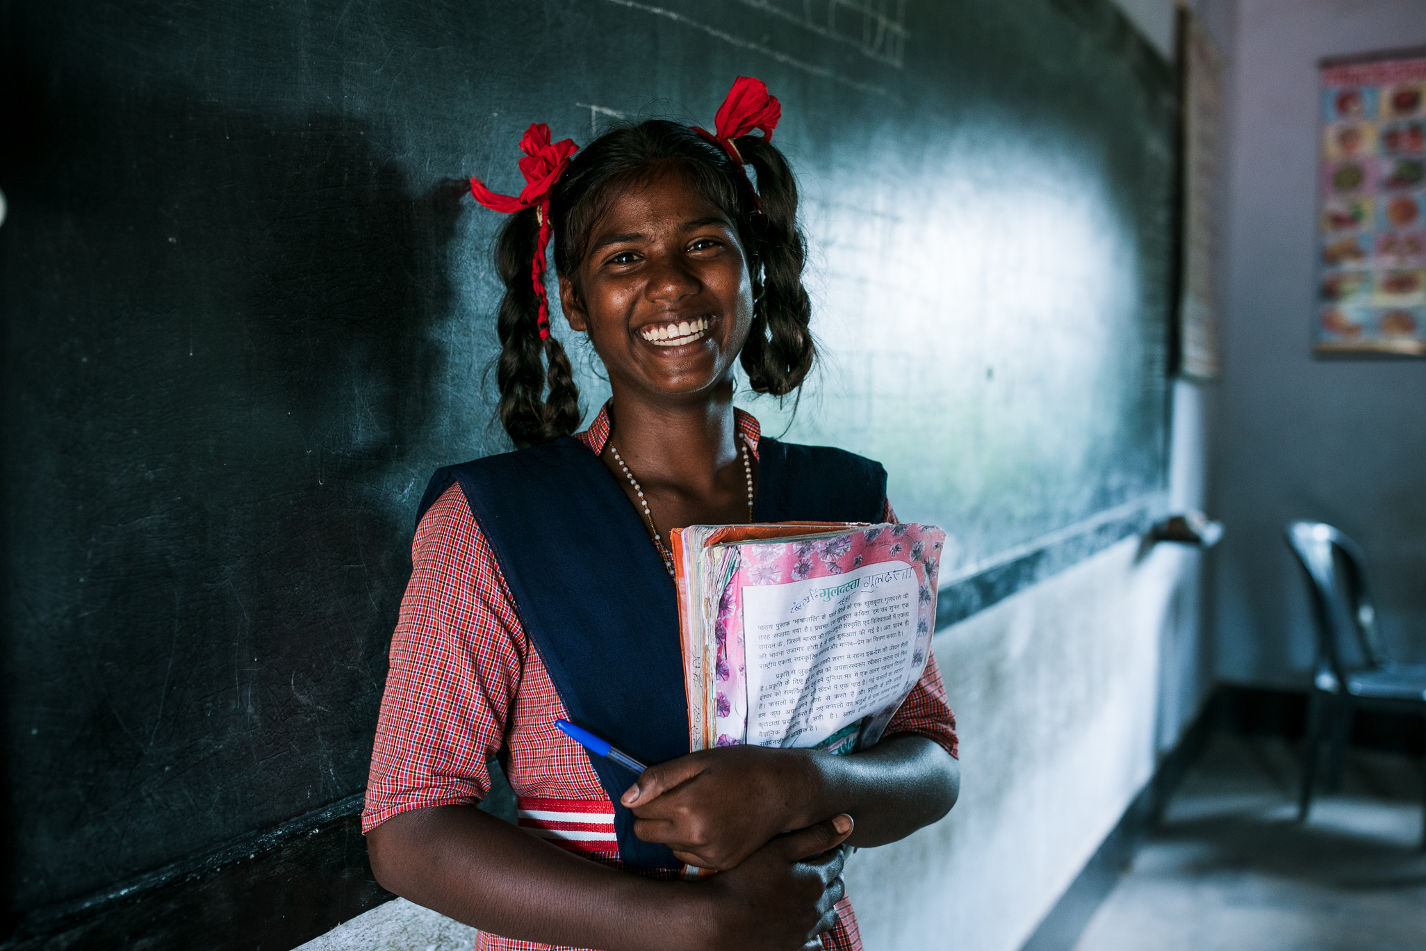
Charity Poster
  Brainstorm personal gifts and resources, write down on sticky note or paper.
  Brainstorm people who could benefit from your charity.
  Share in your groups.
  Create a poster for the sticky notes.
Notes:
Teacher Instruction:
1. Brainstorm Personal Gifts & Resources (5 minutes)
- Give each student two notecards or sticky notes—one for what they can offer and one for who they can help
- On the first card, ask them to write down a talent, skill, or resource they have that could bless others. Examples:
"I’m a good listener."
"I can bake/cook something for someone."
"I have time to send an uplifting message."
On the second card, ask them to think of someone specific who could use help or kindness—this could be an individual, a group, or even a cause. Examples:
"My mom – she’s been really stressed."
"A friend who seems lonely."
"Families in need at our local food bank."
"Kids in Haiti."
2. Group Sharing & Expansion (5 minutes)
- Have students pair up or form small groups to share their ideas
- Encourage them to discuss:
What small act could make a difference?
- How can their gifts/resources match the need they identified?
3. Commitment Board (5 minutes)
- On a large poster or whiteboard, write: "Our Loaves and Fishes – Small Acts, Big Impact"
- Have students place their two cards on the board—one under “What I Can Offer” and the other under “Who I Can Help”
- Discuss how, just like the boy who provided loaves and fishes in the Bible story, their small offerings can be multiplied when given with faith and love.
Time: 15 minutes
Activity Description:
Students brainstorm ideas of how to engage in charitable acts with people around them.
Photo courtesy of Mary's Meals

Slide 59
Little Acts of Love for Charity
You are invited to choose one of these little acts of charity or create your own little act of charity to offer up this week of Lent. You will report back to your classmates next week.
Prayer
Fasting
Almsgiving
  Pray for someone specifically each day.
  Pray for the strength and opportunity to complete your goal from the previous activity.
  Reflect on the charity you have received from others this week. Offer a prayer of gratitude.
  Give up a personal comfort to offer it to someone else (food, time, money).
  Fast from self-centered thoughts.
  Fast from comparison. Seek to express more gratitude to those around you.
  Write a heartfelt note or message to someone who might need encouragement.
  Do a small act of service anonymously.
  Donate something personally meaningful (clothes, money, service).
Notes:
Teacher Instruction:
Teacher Instruction:
1. Allow the students to silently view the options and decide how they will exercise charity in their lives this week during Lent.
2. At the beginning of the next lesson, students will report back to an accountability group what they did and what they learned from that experience.
Time: 5 minutes
Activity Description:
Provide options and choices for students to exercise charity in their lives and relate it back to Lent.

Slide 60
Week 5: Love of Neighbor
Notes:
Teacher Instruction:
This slide introduces the focus for the fifth week of "Little Acts of Love." It will focus on the virtue of love of neighbor.
Total lesson time: approximately 50 minutes

Slide 61
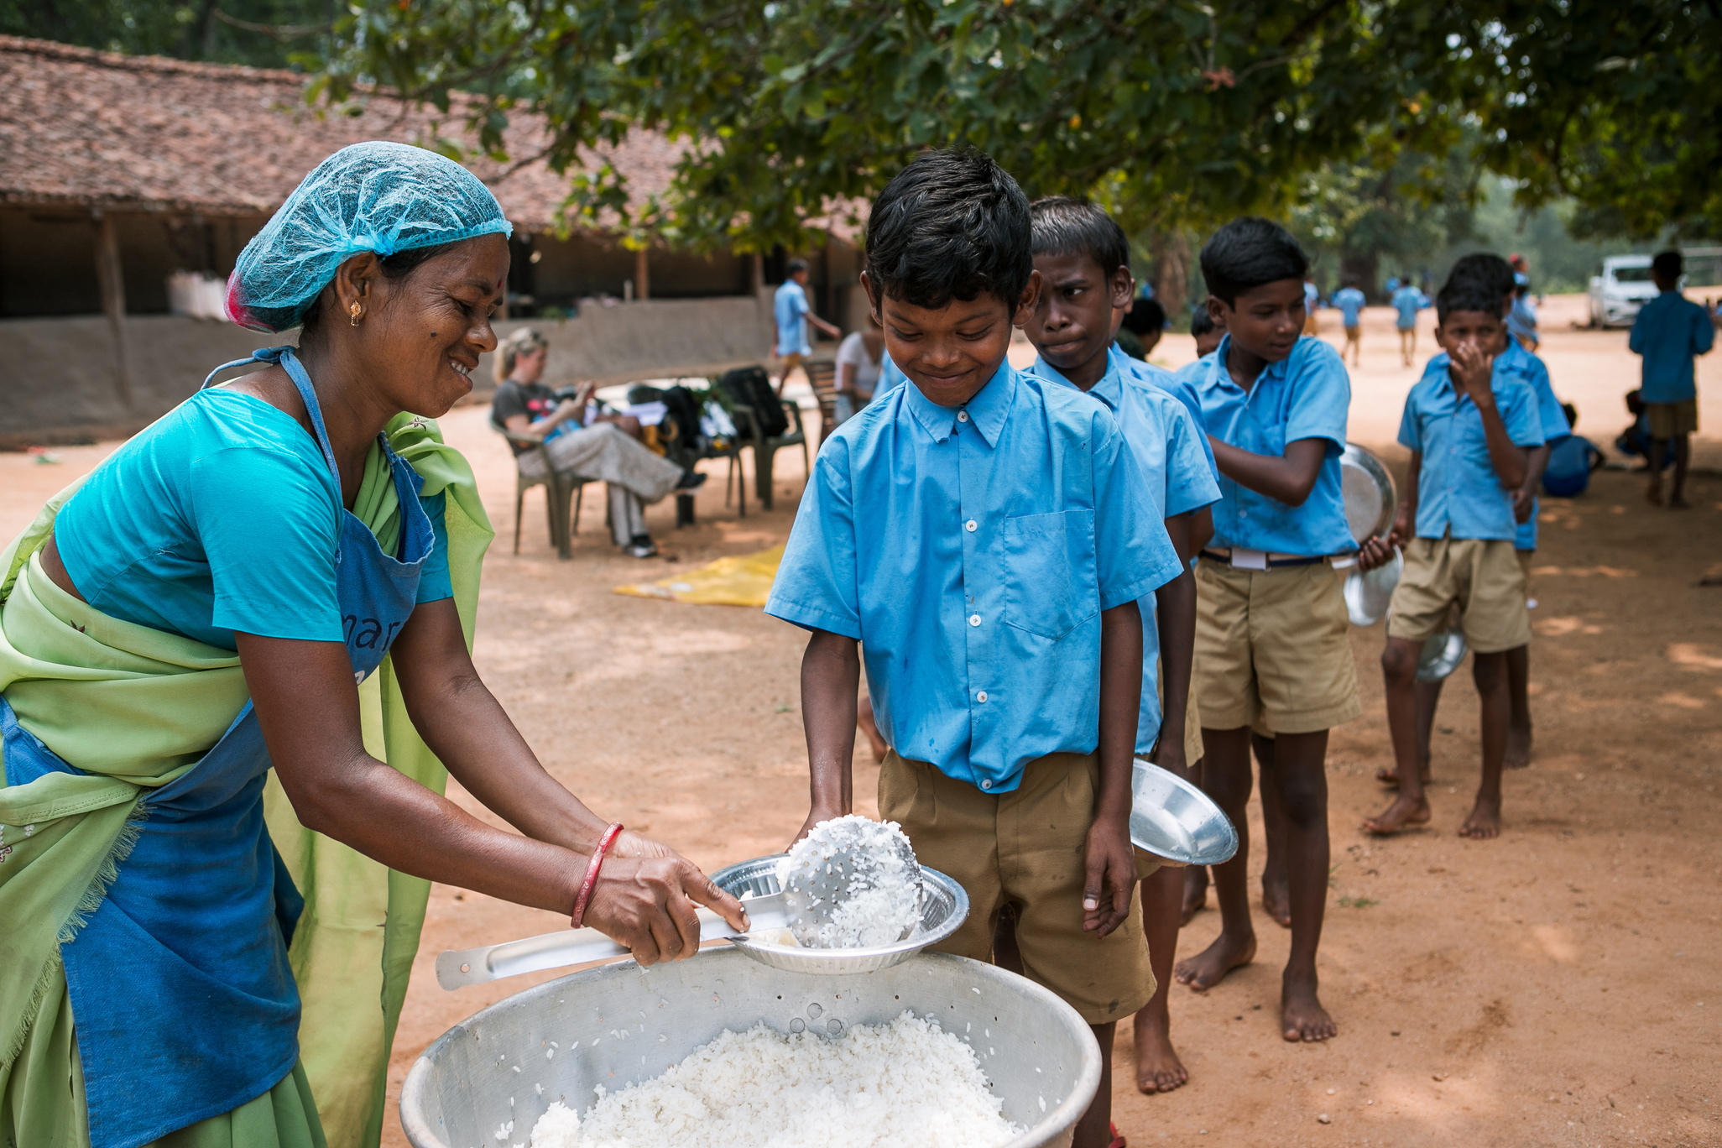
Follow-up on Charity
  What was your little act of love to show charity?
  How did you feel when you did this?
  What do you think the impact was of your act of love?
Little Acts of Love for Len
Notes:
Teacher Instruction:
1. Split students into small groups.
2. Have students go through each question and discuss with each other their experiences.
3. Give time for a few students to share with the whole class, if desired.
Time: 5 minutes
Activity Description:
Allow the students to have time to reflect on their previous week and how their little act of love was related to the previous virtue of charity.
Photo courtesy of Mary's Meals

Slide 62


Love of Neighbor
Jesus asks you to love everyone which is sometimes not easy, but if you practice love when it is easy to do, you will become, with God’s help, able to love even when it is difficult and when you are not loved in return.
Notes:
Teacher Instruction:
1. Provide a definition of the virtue of love of neighbor.
Time: 1 minute
Activity Description:
Introduction to and definition of this week's virtue.
Image source: Canva Images

Slide 63

Matthew 22:37-39
37 You shall love the Lord your God with all your heart and with all your soul and with all your mind.
38 This is the great and first
commandment.
39 And a second is: You shall love your neighbor as yourself.
Notes:
Teacher Instruction:
1. Have a student read the bible verse, Matthew 22:37-39.
Time: 5 minutes
Activity Description:
Include a Bible verse to relate to the virtue of love of neighbor.
Image source: Canva Images

Slide 64

Discussion
  How is loving your neighbor similar to loving God?
  Why do you think loving your neighbor is so important?
  What other examples from the Bible demonstrate love of neighbor?
Notes:
Teacher Instruction:
1. Go through the questions and begin a discussion with the students.
Time: 5-10 minutes
Activity Description:
Discuss a bible verse to relate to the virtue, love of neighbor
Image source: Canva Images

Slide 65
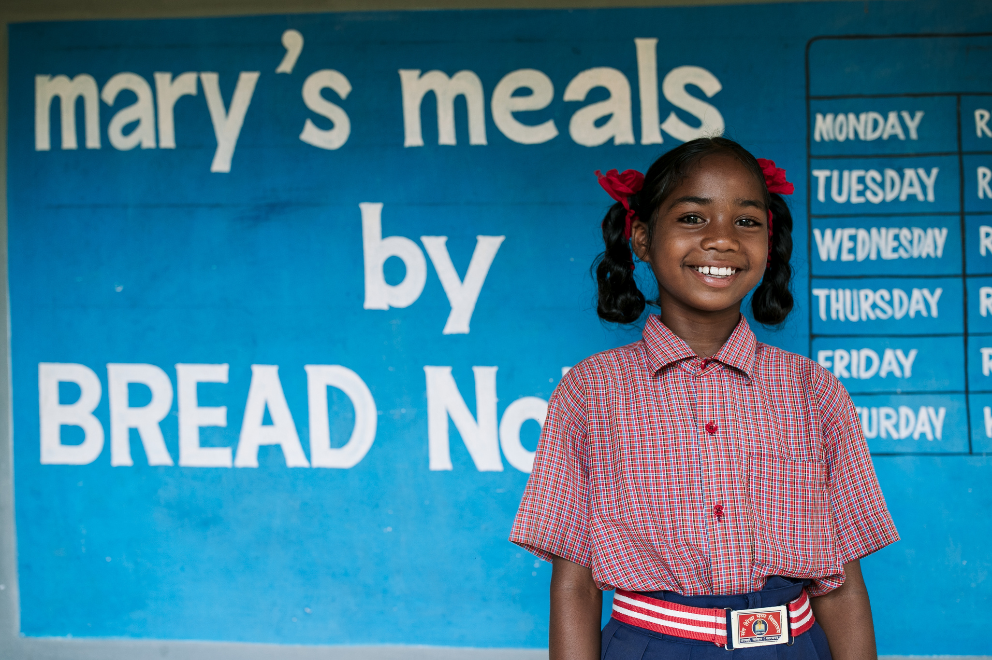
Need for Love of Neighbor in the World
Nearly 14 million children face hunger in the US and “one in every five children is unsure where they will get their next meal.” (Feeding America)
Notes:
Teacher Instruction:
1. Explain the need for love of neighbor in the world.
Time: 1-2 minutes
Activity Description:
Allow the issue of hunger to become real to the student by applying “real life” data, information, and context.
Sources:
https://www.wfpusa.org/articles/10-facts-child-hunger/#:~:text=Retoboha%20gets%20her%20arm%20measured,From%20Severe%20Malnutrition%20Every%20Year
https://www.feedingamerica.org/hunger-in-america/child-hunger-facts
Photo courtesy of Mary's Meals

Slide 66
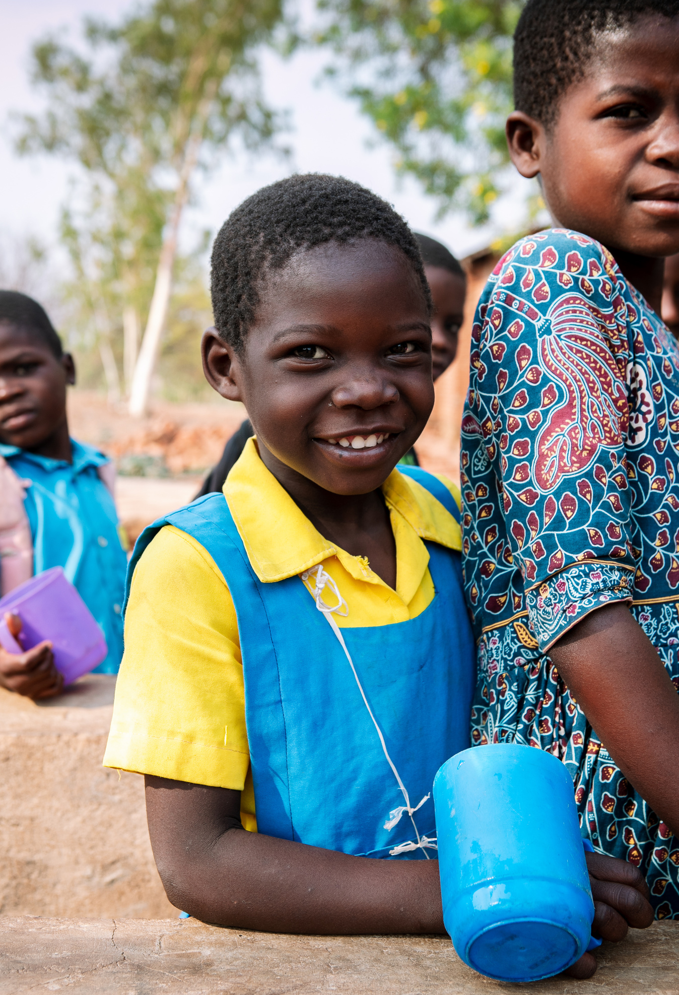
Need for Love of Neighbor in the World
After reading the statement from Feeding America:
  How can your acts of loving your neighbor have an impact on the issue of hunger in your local community?
Notes:
Teacher Instruction:
1. Share data about food insecurity and hunger around the world with students.
Time: 5-10 minutes
Activity Description:
Allow the issue of hunger to become real to the student by applying “real life” data, information, and context.
Photo courtesy of Mary's Meals

Slide 67
Video: Generation Hope
Click to View Video
Notes:
Teacher Instruction:
1. Share video with students.
Time: 2 minutes
Activity Description:
Add context to the issue for students through the video's content.

Slide 68
Video Discussion
  How do these volunteers demonstrate love of neighbor through their actions?
  How do these volunteers describe the feeling of being able to help their neighbors?
  Think about a time you have helped a neighbor. How did you feel?
Notes:
Teacher Instruction:
1. After watching the video, discuss the questions on the slide with the students.
Time: 5 minutes
Activity Description:
Discuss what the volunteers did and how they felt. Have the students explain how they feel when they show love of neighbor.
Photo courtesy of Mary's Meals

Slide 69

Secret Notes of Kindness
  Think of someone who you think could use some extra kindness this week.
  Write an anonymous note of encouragement and love.
  Secretly deliver the note. Try not to get caught.
Notes:
Teacher Instruction:
1. Instruct students to write an anonymous note of encouragement and love to someone who they think could use some extra kindness.
2. Encourage students to deliver their note to the person.
Time: 5-10 minutes
Activity Description:
Help students engage in an activity where they practice loving their neighbor.
Image source: Canva Images

Slide 70
Little Act of Love for Love of Neighbor
You are invited to choose one of these little acts of loving your neighbor or create your own little act of loving your neighbor to offer up this week of Lent. You will report back to your classmates next week.
Prayer
Fasting
Almsgiving
  Pray and listen to which “neighbor” Jesus wants you to help.
  Keep a daily journal of loving acts, challenges with difficult neighbors, and prayers for others.
  Use the fasting time to pray for people in need.
  Fast for eyes to see opportunities to love and serve those around you.
  Fast for someone who has been unkind to you.
  Host a “Fast A Meal” event and donate the savings to Mary’s Meals ($25.20 feeds a child for a year).
  Set up a booth and ring a bell to collect donations for Mary’s Meals at school, outside supermarkets, etc.
Notes:
Teacher Instruction:
Homework: Invite students to choose one of the listed activities to show their love of neighbor. Give them a deadline.
Time: 5-10 minutes
Activity Description:
Help students engage in an activity where they practice loving their neighbor.
Image source: Canva Images

Slide 71
Week 6: Wisdom
Notes:
Teacher Instruction:
This slide introduces the focus for the sixth week of "Little Acts of Love." It will focus on the virtue of wisdom.
Total lesson time: approximately 50 minutes

Slide 72
Follow-up on Love of Neighbor
  What was your little act of love to show love for your neighbor?
  How did you feel when you did this?
  What do you think the impact was of your act of love?
Little Acts of Love for Len
Notes:
Teacher Instruction:
1. Split students into small groups.
2. Have students go through each question and discuss with each other their experiences.
3. Give time for a few students to share with the whole class, if desired.
Time: 5 minutes
Activity Description:
Allow the students to have time to reflect on their previous week and how their little act of love was related to the previous virtue of love of neighbor.
Image source: Canva Images

Slide 73

Wisdom
You use what you know and have learned from God and His teachings to make good decisions.
Notes:
Teacher Instruction:
Introduce this weeks virtue of wisdom.
Time: 1 minute
Activity Description:
Introduction to this week's virtue.
Image source: Canva Images

Slide 74

Matthew 7:24-27
24 Everyone who listens to these words of mine and acts on them will be like a wise man who built his house on rock.
25 The rain fell, the floods came, and the winds blew and buffeted the house. But it did not collapse; it had been set solidly on rock.
Notes:
Teacher Instructions:
1. Have a student read Matthew 7:24-27.
Time: 3-4 minutes
Activity Description:
Read Bible verses related to the virtue of wisdom.
Image source: Canva Images

Slide 75

Matthew 7:24-27
26 And everyone who listens to these words of mine but does not act on them will be like a fool who built his house on sand.
27 The rain fell, the floods came, and the winds blew and buffeted the house. And it collapsed and was completely ruined.”
Notes:
Teacher Instruction:
1. Have a student read Matthew 7:24-27.
Time: 3-4 minutes
Activity Description:
Read Bible verses related to the virtue of wisdom.
Image source: Canva Images

Slide 76

Discussion
  What does it mean to "hope in the Lord"? How is that different from ordinary hope?
  How have you seen God renew someone’s strength—either in your life or someone else's?
  What are some things that can drain your strength, and how can faith help overcome them?
Notes:
Teacher Instruction:
1. Go through the questions and begin a discussion with the students.
Time: 5-10 minutes
Activity Description:
Include a Bible verse to relate to the virtue of wisdom.
Image Source: Canva Images

Slide 77
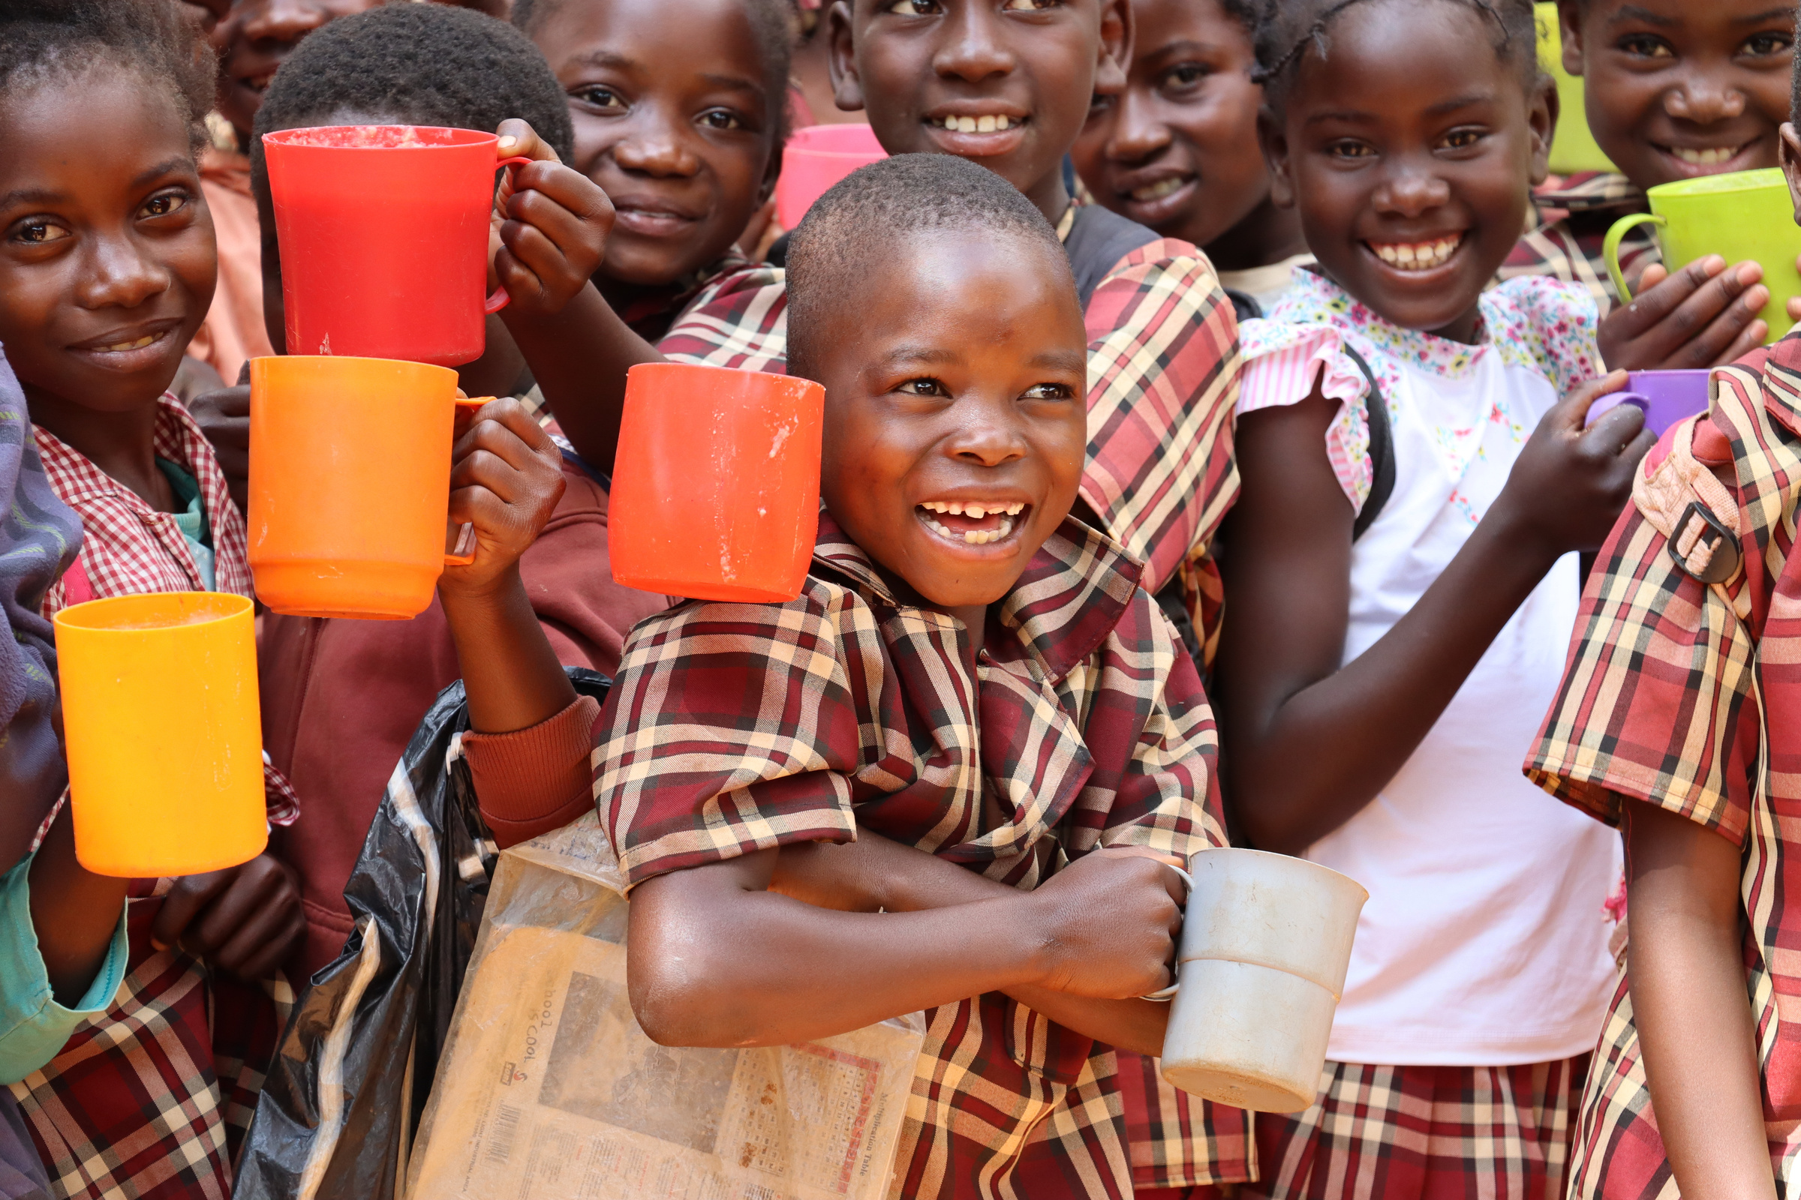
Need for Wisdom in the World
“Thousands of children are on the brink, while life-saving supplies are ready to be delivered if violence stops and roads and hospitals are opened. This malnutrition crisis is entirely human made. Basic security is urgently needed for the people of Haiti, for the life-saving services they rely on, and for humanitarian workers to reach children and families in desperate need” (UNICEF).
Notes:
Teacher Instruction:
1. Share the data provided.
Time: 5-10 minutes
Activity Description:
1. Allow the issue of hunger to become real to the student by applying “real life” data, information, and context
Source:
https://www.unicef.org/press-releases/armed-violence-deepening-malnutrition-crisis-children-haiti
Photo courtesy of Mary's Meals

Slide 78
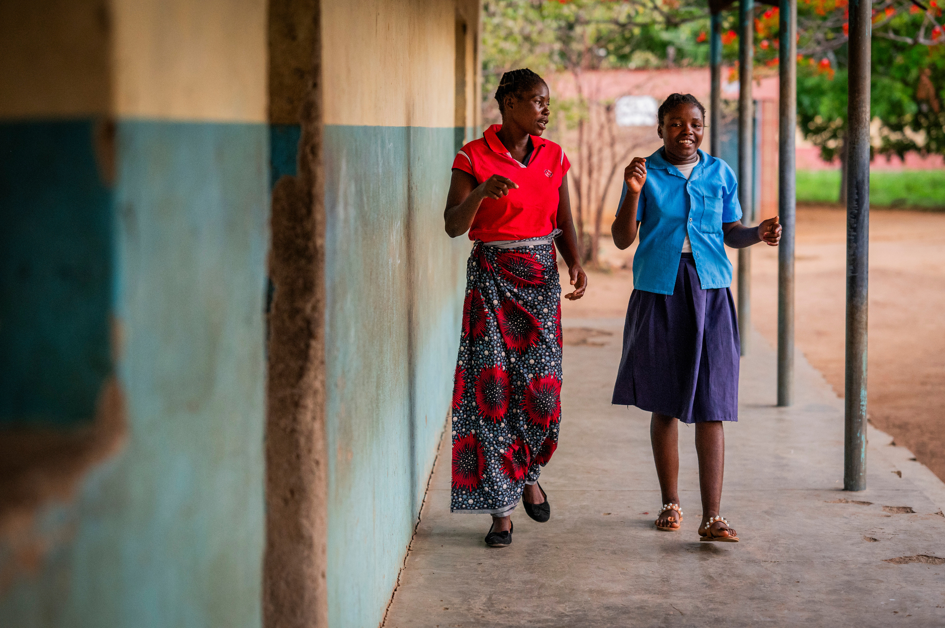
Need for Wisdom in the World
After reading the statement from UNICEF:
  How can your acts of wisdom have an impact on the issue of hunger in the world?
  In this specific example of Haiti, how can wisdom have an impact for good?
Notes:
Teacher Instruction:
1. Share data about food insecurity and hunger around the world with students.
Time: 5-10 minutes
Activity Description:
Allow the issue of hunger to become real to the student by applying “real life” data, information, and context.
Photo courtesy of Mary's Meals

Slide 79
Video: Generation Hope
Click to View Video
Notes:
Teacher Instruction:
1. Share Mary's Meals video that demonstrates wisdom with students.
Time: 3 minutes
Activity Description:
Add context to the issue of hunger in Haiti for students.

Slide 80
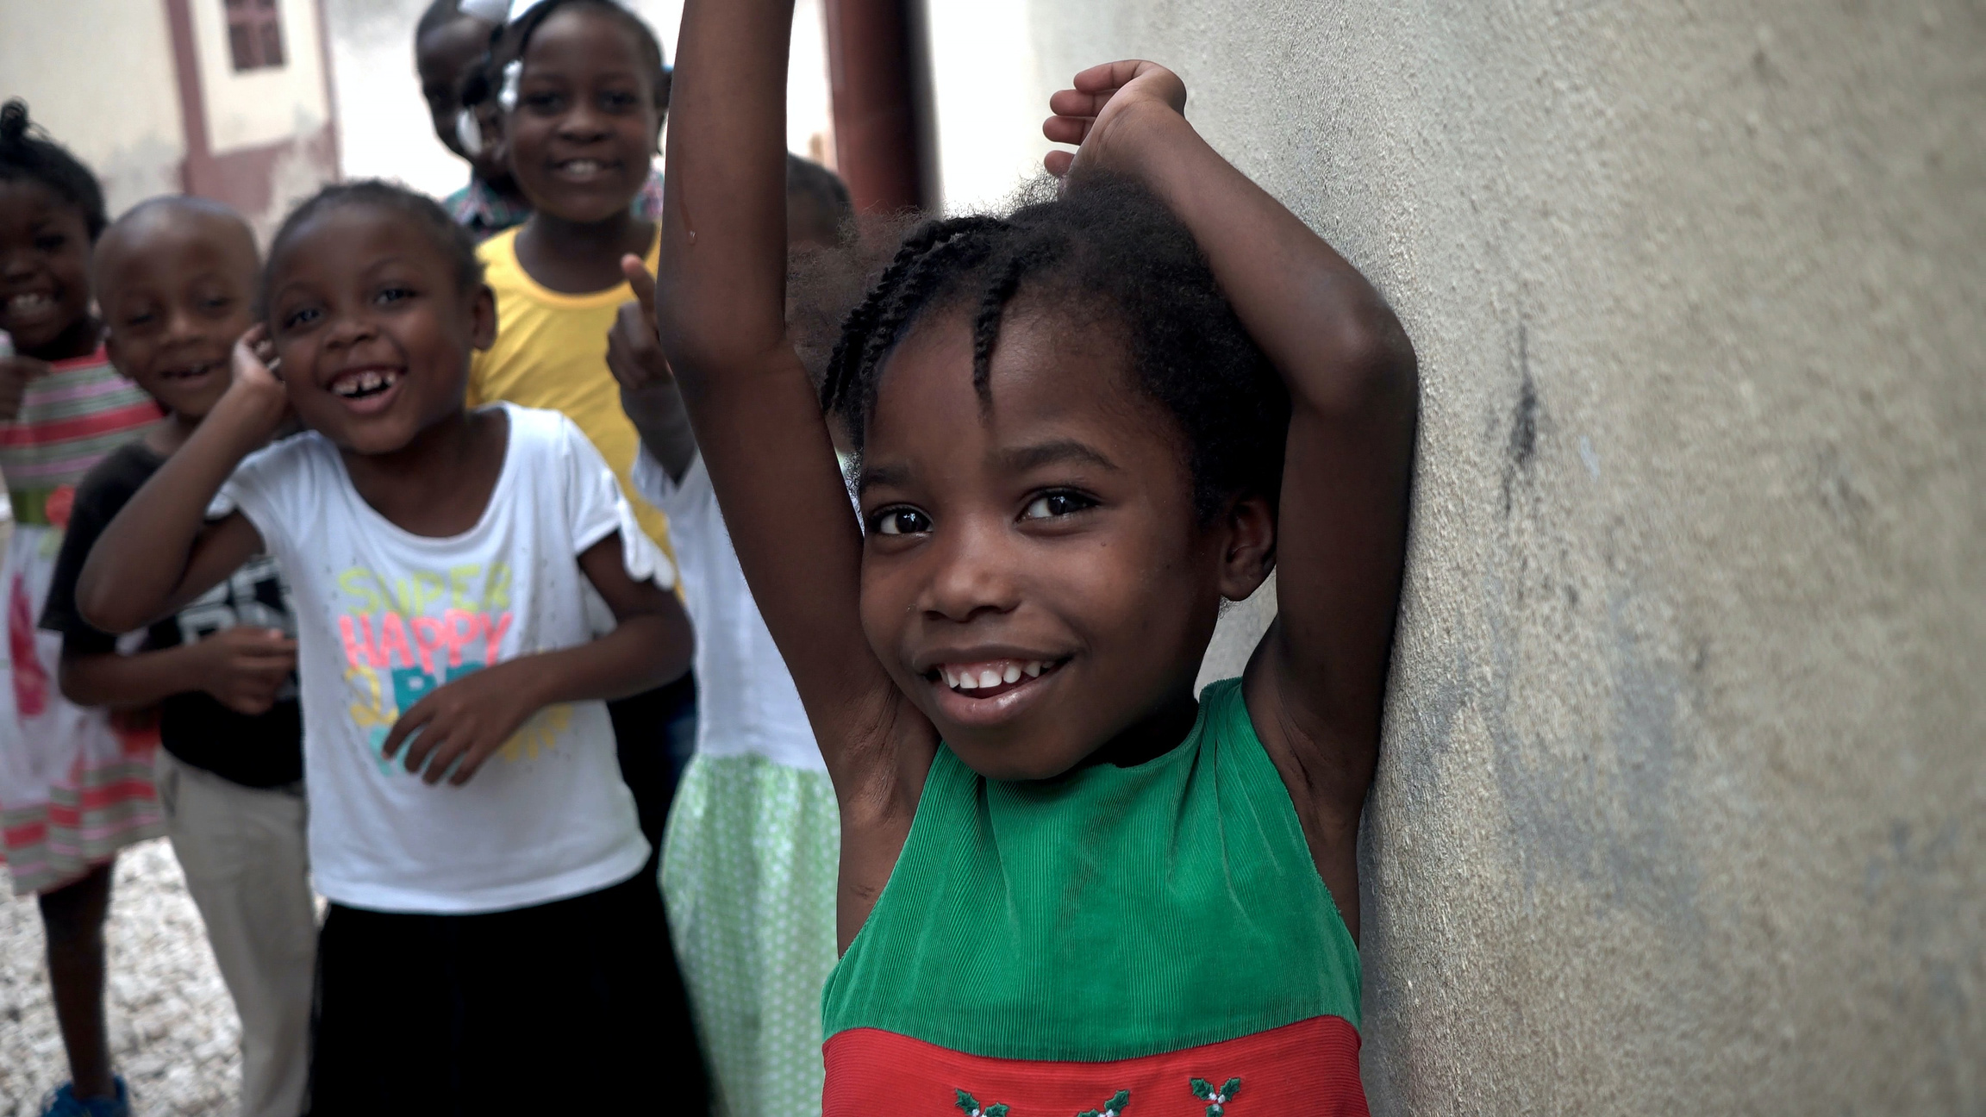
Video Discussion
  How does Jimmy demonstrate the virtue of wisdom?
  What does his story teach you about the importance of wisdom?
  Jimmy says there is a lot of “hunger and misery” in his city. In what ways do you see this in your own community?
Notes:
Teacher Instruction:
1. After watching the video, discuss the questions on the slide with the students.
Time: 5 minutes
Activity Description:
Add context to the value of demonstrating wisdom for the students and ask them about the need for wisdom to solve the problems in their own community.
Image source: Canva Images

Slide 81

Human Knot
  Stand in a circle.
  Grab the right hand of someone not standing next to you.
  Grab the left hand of someone not standing next to you.
  Work together to untangle the circle.
Notes:
Teacher Instruction:
1. Instruct students to stand in a circle for the activity. (If you have a large class, separate the students into groups of no more than 10.)
2. Help students get entangled by following the instructions below:
- Raise your right hand and grab the right hand of someone not standing next to you.
- Raise your left hand and grab the left hand of someone not standing next to you.
- Untangle your circle without letting go of each other's hands.
3. As students work to untangle themselves, give the students ideas about ways that they could untangle the circle.
Time: 10 minutes
Activity Description:
Allow students to practice the virtue of wisdom.
Image Source: Sincerely media on Unsplash
https://unsplash.com/photos/person-holding-hands-of-another-person-EtyBBUByPSQ?utm_content=creditShareLink&utm_medium=referral&utm_source=unsplash

Slide 82
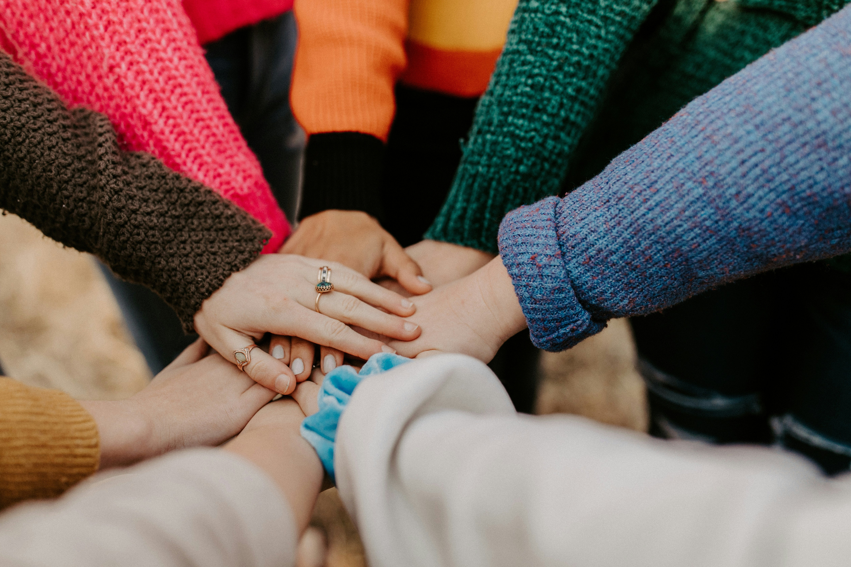
Human Knot
  What made this activity challenging?
  Making good choices often requires support from friends. How did your classmates support you in untangling the circle?
  Making good choices also requires the perspective of God. How did your teacher’s advice from outside the circle help you?
Notes:
Teacher Instruction:
1. After doing the activity, have the students reflect on the questions as a class to encourage a discussion.
Time: 5-10 minutes
Activity Description:
Allow students a chance to reflect on how the activity relates to the virtue of wisdom.
Image Source: Hannah Busing on Unsplash
https://unsplash.com/photos/person-in-red-sweater-holding-babys-hand-Zyx1bK9mqmA?utm_content=creditShareLink&utm_medium=referral&utm_source=unsplash

Slide 83
Little Acts of Love for Wisdom
You are invited to choose one of these little acts of wisdom or create your own little act of wisdom to offer up this week of Lent. You will report back to your classmates next week.
Prayer
Fasting
Almsgiving
  Write or find a prayer that invites God to help guide your choices this week.
  Think about a time when the word of God helped you make a decision. Write down that memory.
  Choose a bad habit that you can work to break this week or a good habit you would like to start.
  Do a 24-hour social media fast and dedicate more time to reading the Bible.
  Talk to your friends about goals they have or big decisions they need to make. Offer to support them in a specific way.
  Share your faith with someone by telling them how you have learned more about God.
Notes:
Teacher Instruction:
1. Allow the students to silently view the options and decide how they will exercise wisdom in their lives this week during Lent.
2. At the beginning of the next lesson, students will report back to an accountability group what they did and what they learned from that experience.
Time: 5 minutes
Activity Description:
Provide options and choices for students to exercise wisdom in their lives and relate it back to Lent.

Slide 84
Week 7: Reflection
Notes:
Teacher Instruction:
1. This slide introduces a reflection of the last 6 weeks of doing Little Acts of Love for Lent.
Total lesson time: approximately 50 minutes

Slide 85
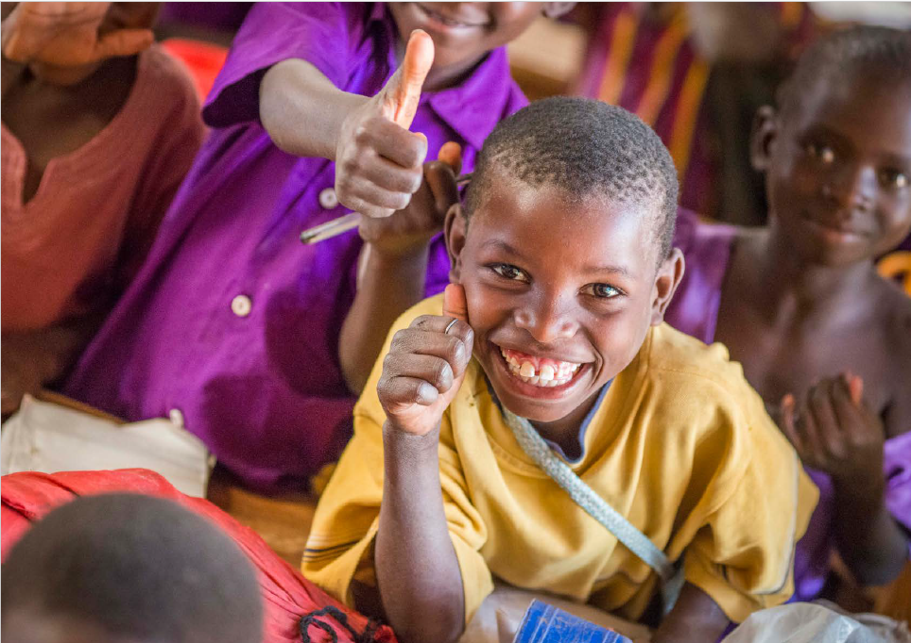
Reflection on our Little Acts of Love for Lent
Think back about each of the small acts for Lent that you have done over the past few weeks.
Reflect on how you acted to show faith, hope, justice, charity, love for neighbor, and wisdom during Lent.
Little Acts of Love for Len
Notes:
Teacher Notes
1. Ask students to reflect on what they did during Lent.
2. Invite students to share some of their reflections.
Time: 5-10 minutes
Photo courtesy of Mary’s Meals

Slide 86


Little Acts of Love for Len
During Lent, we focused on one virtue each week.
Each virtue acts as a foundational block that makes the pillars stable and effective:
  Faith: Grounds prayer in trust and belief in God.
  Hope: Gives purpose to fasting, reminding us of God’s promises.
  Justice (Kindness): Directs almsgiving toward fairness and care for others.
  Charity: Infuses every act of prayer, fasting, and giving with selfless love.
  These virtues guide us to live as Jesus taught, helping us grow closer to God and serve others.
  Love of Neighbor: Motivates all three pillars by focusing on serving others.
  Wisdom: Guides how we pray, fast, and give in ways that honor God.
Little Acts of Love for Len
Notes:
Teacher Notes
1. Introduce the connection between virtues and the 3 pillars of Lent
2. Emphasize that virtues are the foundation of our faith and actions.
3. Help students understand that each virtue supports the pillars of prayer, fasting and almsgiving, making them more meaningful and effective.
Teacher Narration
During Lent, we explored the virtues of Hope, Faith, Justice/Kindness, Love of Neighbor, Wisdom, and Charity.
These virtues guide us to live as Jesus taught, helping us grow closer to God and serve others.
Each virtue strengthens the three pillars of Lent:
Prayer: Builds our relationship with God.
Fasting: Helps us let go of distractions and grow spiritually.
Almsgiving: Encourages us to share our blessings with others.
As you think over the last six weeks,
Which virtue has been the most meaningful to you during Lent? How has it brought you closer to God?
What sacrifices did you make that you will remember for a long time?
What sacrifice was the hardest for you?
What meant the most to you?
Why did you choose the sacrifices you chose?
Were there some that didn’t work well? Why?
Attribution
Image of 3 pillars: Found on Canva, edited to add in “Strong Relationship with God” and “Virtues”
Time: 10 minutes
Activity Description: reflect on the virtues covered throughout the past 7 lessons.

Slide 87
Little Acts of Love Don’t End with Lent
What are ways that you can continue to live the virtue of charity through little acts of love at home, in our school, at church, in our community, or in our world?
This video shows how the people involved in Mary’s Meals make children’s lives better by giving them a meal at school every day.
Click to View Video
Little Acts of Love for Len
Notes:
Teacher Instruction:
- Give each student a new copy of the cross and encourage students to write down ideas of how they can continue to perform little acts of love even now that Lent is over.
- Show the video from Mary’s Meals. Discuss ways that students can participate in Little Acts of Love through Mary’s Meals organization in the future.
- Teacher Narration
You have filled your crosses during Lent with little acts of love. Doing little acts of love doesn’t have to end at Easter. Write some ways that you can continue to show charity through little acts of love at home, in our school, at church, in our community, or in our world.
Attribution
Video clip: Child 31 https://www.youtube.com/watch?v=aFU8cU-cICs&t=802s
27:58-30:39
Time: 5-10 minutes
Activity Description: Allow students to reflect on how they continue to practice little acts of love within their lives moving forward.

Slide 88
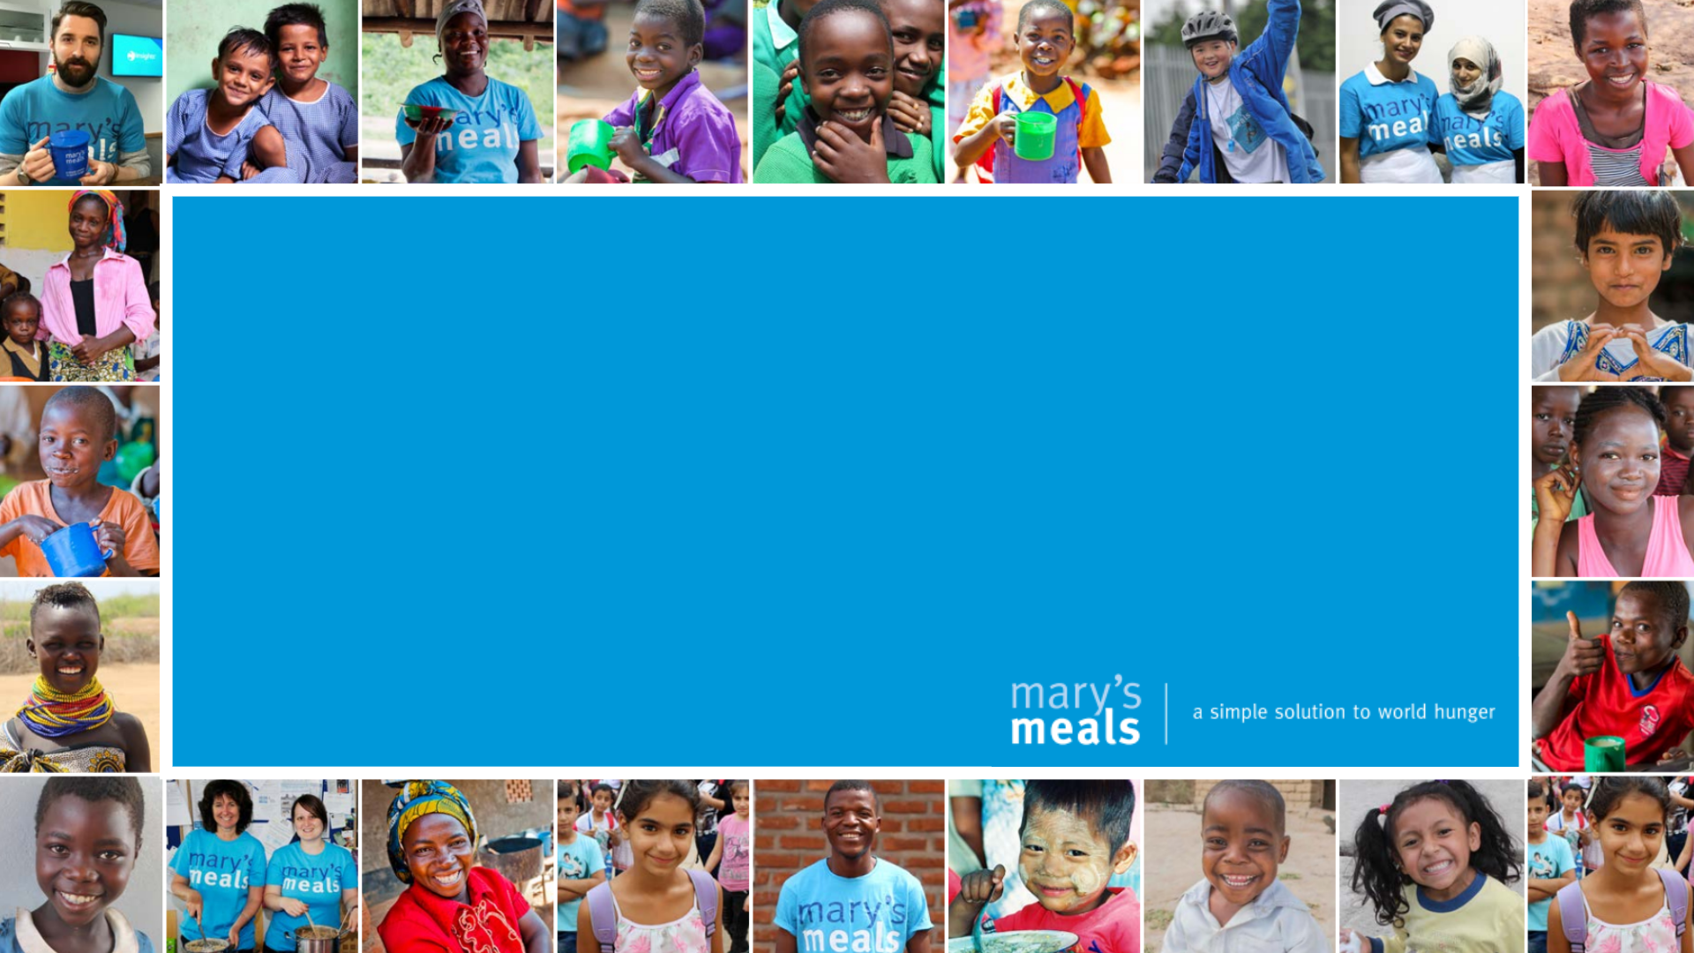
You Can Do Little Acts of Love All Year!
Notes:
Teachers Instruction:
This is the final slide closing the curriculum for Mary's Meals Little Acts of Love for Lent curriculum.

