Slide 1
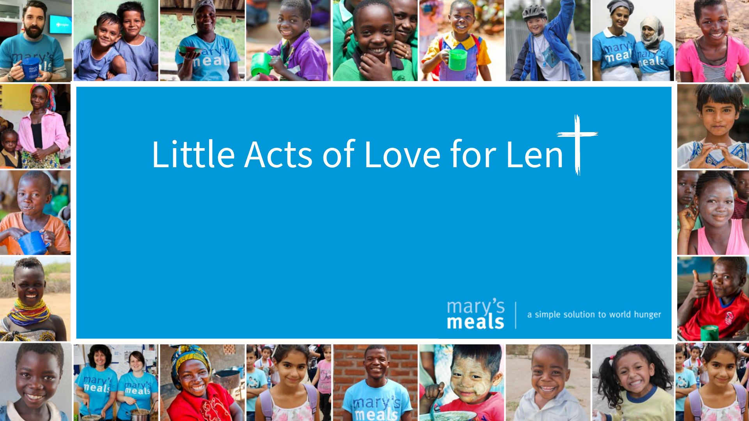
Introduction
3rd-5th Grade Students
Notes:
Notes:
You can choose to teach all the content in one class or break it up over several days.
Total lesson time: 45 min.
_____________________________
Script:
N/A
_____________________________
Citation:
N/A

Slide 2


Teacher Notes
This Little Acts of Love for Lent curriculum covers eight weeks: one introduction week six weekly lessons covering one of six Christian virtues, and short reflection after Lent to encourage students to reflect on the Little Acts of Love they did for Lent and Mary's Meals and invite them to continue performing acts of love.
Each lesson takes 45-50 minutes. You can choose to teach all the content for each weekly lesson in one class period or break it up over several days. Most activities within the lessons range from 5 to 12 minutes. The lesson instructions are found in the notes/comment section of each slide.
Little Acts of Love for Len

Slide 3
Little Acts of Love for Lent Lessons
  Introduction
  Faith
  Hope
  Justice (Kindness)
  Love Our Neighbor
  Wisdom
  Charity
  Reflection
Little Acts of Love for Len

Slide 4





How would you describe Lent?
Little Acts of Love for Len
Notes:
Notes:
N/A
_____________________________
Script:
Ask, “If you had to describe Lent in just one word, what would it be?”
Invite students to respond by either:
• Sharing their word aloud.
• Submitting their word to a word cloud (Mentimeter.com).
Encourage responses like: prayer, giving, love, Jesus, church, sacrifice, growth, and Easter.
_____________________________
Citation:
- ananaline / Adobe Stock

Slide 5
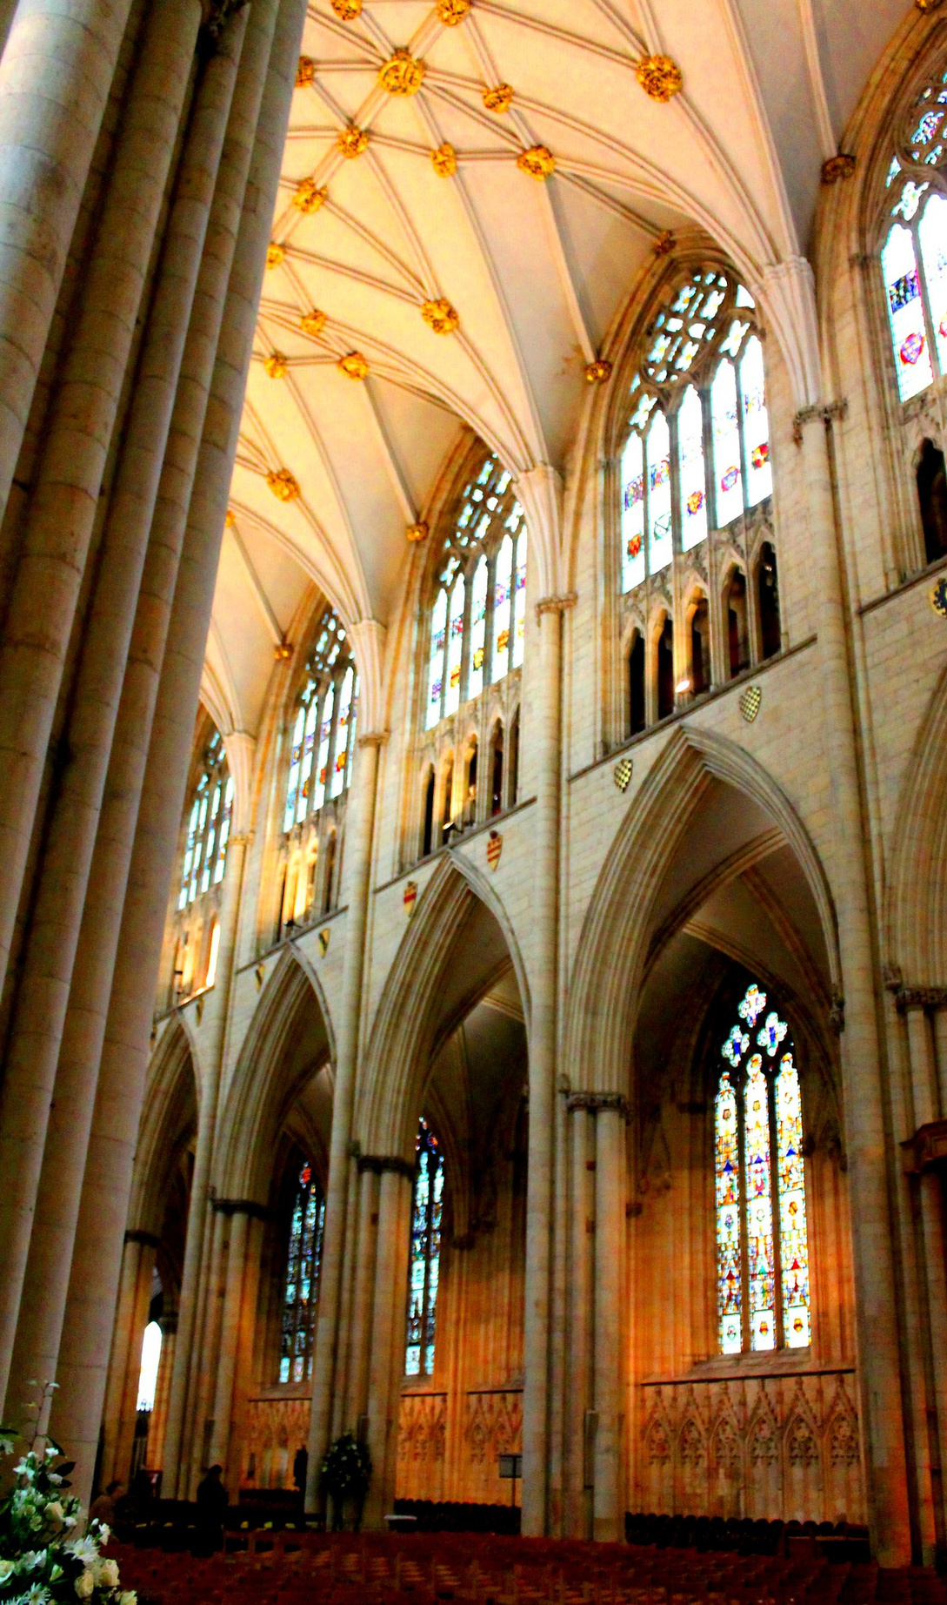
The Pillars of Lent
Prayer - Helps us talk to God and grow closer to Him.
Fasting - Helps us turn away from distractions and rely on God.
Giving - Helps us share love by giving to those in need.
Little Acts of Love for Len
Notes:
Notes:
Remind students that Lent helps us prepare for Easter, just as Jesus prepared for His mission during His 40 days in the desert. We do this by following the three pillars of Lent.
Review the Pillars of Lent on the slide.
You may also consider reading and helping students reflect on Matthew 4:1-11. Ask:
• How does Jesus’ time in the desert show us what Lent is about?
• What are some ways we can follow His example
_____________________________
Script:
N/A
_____________________________
Citation:
- "York Minster Holy Light #dailyshoot #York" by Leshaines123 is licensed under CC BY 2.0. To view a copy of this license, visit https://creativecommons.org/licenses/by/2.0/?

Slide 6
The Virtues of Lent
  Faith
  Hope
  Justice (Kindness)
  Love of Neighbor
  Wisdom
  Charity
Little Acts of Love for Len
Notes:
Notes:
N/A
_____________________________
Script:
This year, we will be learning more about lent and these six virtues:
- Faith
- Hope
- Justice (Kindness)
- Love of Neighbor
- Wisdom
- Charity
Everything will be framed within the context of the organization Mary’s Meals. We’ll learn more about Mary’s Meals in the following activity.
_____________________________
Citation:
- "York Minster Holy Light #dailyshoot #York" by Leshaines123 is licensed under CC BY 2.0. To view a copy of this license, visit https://creativecommons.org/licenses/by/2.0/?

Slide 7

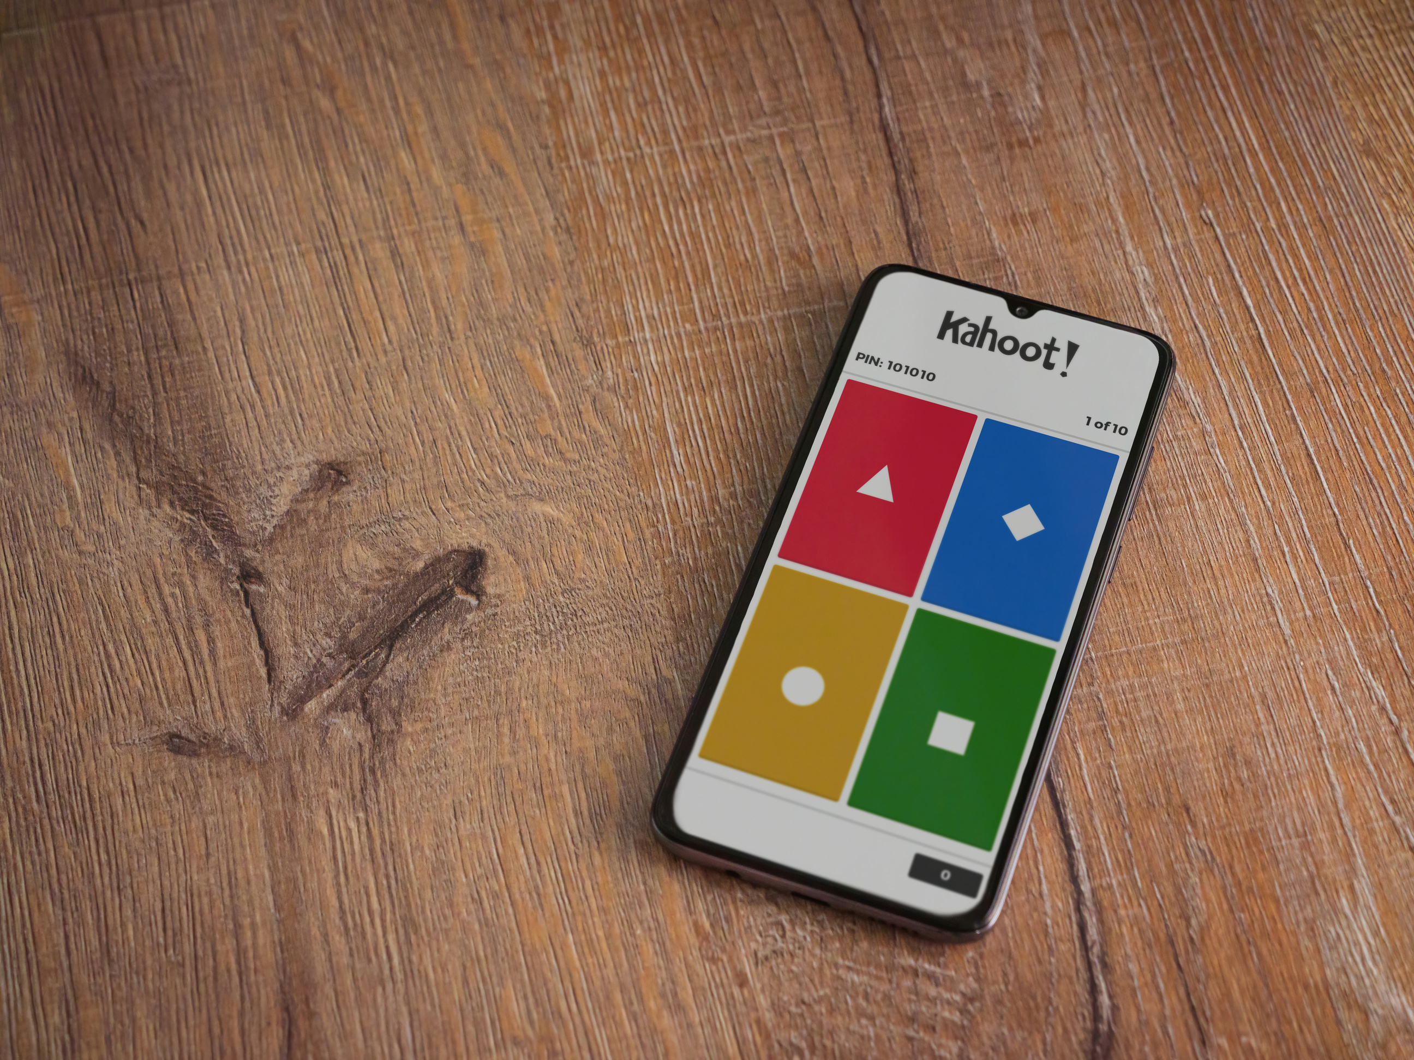
Let’s play Kahoot
Little Acts of Love for Len
Notes:
Notes:
Kahoot: https://create.kahoot.it/share/lent-grades-3-5/30a9d132-8f8d-4ba2-aaa2-351bd8c13736
Students could be divided into groups or play individually. Check options in Kahoot for group games.
At the end, review answers as a class.
If students don’t have a device to play, the teacher could show the questions and have the students raise their hand to answer.
_____________________________
Script:
We’re going to play a Kahoot game about Lent and Mary’s Meals.
[Game time]
Let’s review what we learned. Did you learn anything new about Lent? What is Mary’s Meals?
_____________________________
Citation:
- wavemovies / Adobe Stock

Slide 8

My actions make a difference
Little Acts of Love for Len
Notes:
Notes:
N/A
_____________________________
Script:
“My actions make a difference.”
-Small and simple actions can make big changes, just like ripples in water, even small acts like prayer, kindness, and giving.
-Have you ever done something special for Lent? How did it help you and others?
-Little acts of faith and love can make a big difference, both in our own lives and in the lives of others.
_____________________________
Citation: "Water droplet" by Shan Sheehan is licensed under CC BY 2.0. To view a copy of this license, visit https://creativecommons.org/licenses/by/2.0/?ref=openverse.

Slide 9
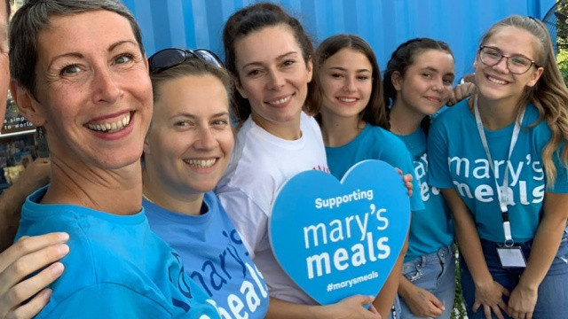
What is Mary’s Meals?
Little Acts of Love for Len
Notes:
Notes:
Share with students the story of Mary's Meals below.
_____________________________
Script:
Mary's Meals was started by a man named Magnus. Magnus met a boy named Edward in Malawi, Africa. Edward was 14 years old, (Ask: Does anyone have an older brother or sister that is 14?)
Edward was taking care of his younger brothers and sisters because his mother was very sick. Edward’s biggest wish was to have enough food to eat and go to school. (Ask: What is your biggest wish?)
Magnus started Mary's Meals to help provide meals in school for kids like Edward.
The story of Mary's Meals shows how one small act of kindness can grow into something big—just like ripples in water. What can you do to create ripples of kindness in your own life?
Over the next 40 days, we’ll talk about different virtues and how you can act upon them to make a difference. For now, brainstorm ways you can start making a difference today!
Give examples of ways they can help a mom, sister or brother, friend, grandparent, etc.
_____________________________
Citation:
- Image by Mary's Meals (https://www.marysmeals.org.uk)

Slide 10
Little Acts of Love can change people’s lives.
Click to View Video
Little Acts of Love for Len
Notes:
Notes:
After watching video, help students see how little acts of love turned into helping people all over the world.
_____________________________
Script:
Mary’s Meals is an organization that helps hungry children by providing meals in schools. As you watch this video, think about how we can make a difference in the lives of these children.
[Students watch clip]
What did you learn about Mary’s Meals?
_____________________________
Citation:
- Mary's Meals. (Nov 10, 2013). Child 31 - The Story of Mary's Meals [Video file].

Slide 11

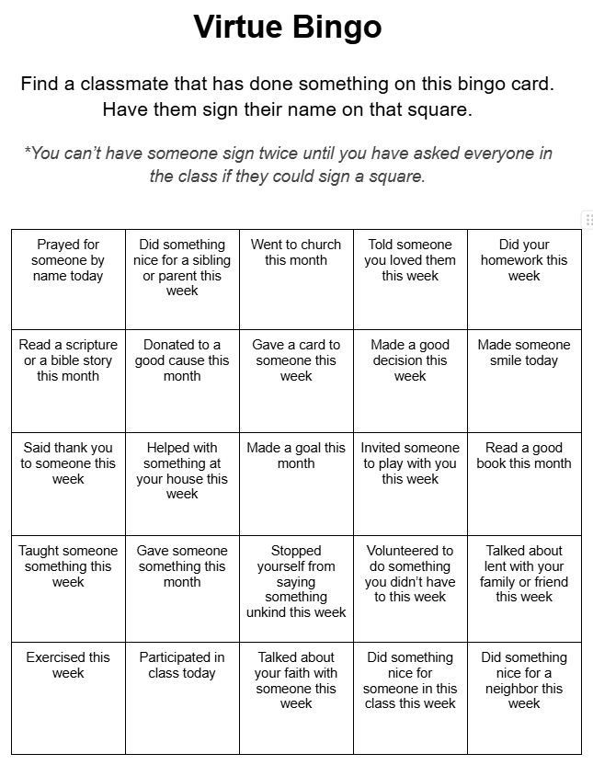
Virtue Bingo
Instructions:
  Find a classmate that has done something on this bingo card
  Have them sign their name on that square
*You can’t have someone sign two squares until you have asked everyone in the class if they could sign a square.
Little Acts of Love for Len
Notes:
Notes:
Print bingo cards- one for each student: https://docs.google.com/document/d/1GTcMSpLk7laXZy6MCe_giwT5zdQkPsuoriXdCT6duEc/edit?usp=sharing
*Read through the bingo ideas and think if they are all relevant for your students. Change ideas, if needed.
Recommended: Have a reward for the first student to either get bingo or get blackout.
___________________________
Script:
We are going to play bingo!
This game will show us how we already are doing small acts of love and how we can show kindness in little ways every day.
In the following 6 weeks, we’ll talk about virtues, which are just simple acts of love.
_____________________________
Citation:
- happy_author / Adobe Stock

Slide 12
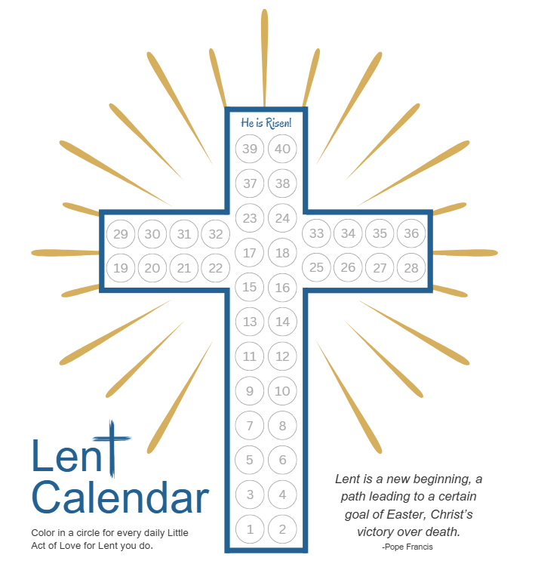
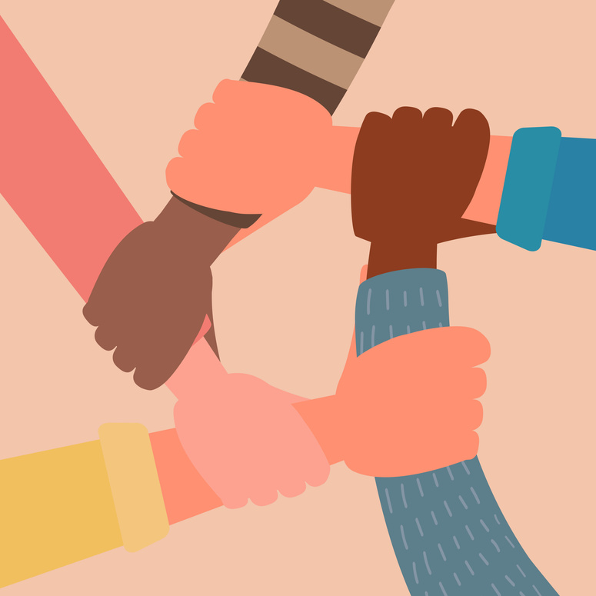

Lent Calendar
When your name is chosen, be ready to share your Little Acts of Love
Complete your Lent Calendar
Perform Little Acts of Love for people this week
Little Acts of Love for Len
Notes:
Notes:
- Lent Calendar link: https://drive.google.com/file/d/1jJUiWKjd6UOb_WA9IEHZjZ2vbPxvU7JQ/view?usp=sharing
Distribute the Lent Calendar handout.
Send a link to the calendar via email for parents with an explanation that the class will be focusing on virtues and acts of love during lent.
-Have them encourage their students to do an act of love each day and fill out a circle on the calendar.
-Explain that each week, three students will get to tell what they did on their cross handout.
Draw three students' names a week before they will share their little acts of love so they will be prepared when it is their turn to share. Remind the students as needed.
*Gamify it and make it a big deal that the students' names were drawn and they get to share!
_____________________________
Script:
[Distribute the cross handout]
Each day during lent, you get to do something that is an act of love or a sacrifice. It can be one of the ideas on the back of the handout, or you can come up with something on your own.
After you have done an act of love, fill in a circle on your Lent calendar.
I’ll draw the names of students now to see who will get to share their little acts of love next week.
_____________________________
Citation:
- ST.art / Adobe Stock
- tannikart / Adobe Stock

Slide 13
Faith
Notes:
Notes:
You can choose to teach all the content in one class or break it up over several days.
Total lesson time: 45 min.
_____________________________
Script:
N/A
_____________________________
Citation:
N/A

Slide 14
Acts of Love
Instructions:
Share what you did to show love and kindness during the week.
Little Acts of Love for Len
Notes:
Notes:
N/A
_____________________________
Script:
Okay, class! Let’s hear about some Acts of Love you did this week. [Student 1, Student 2, and Student 3], please share one of your experiences doing a little act of love.
* Student 1
* Student 2
* Student 3
Thank you for sharing!
_____________________________
Citation:
N/A

Slide 15
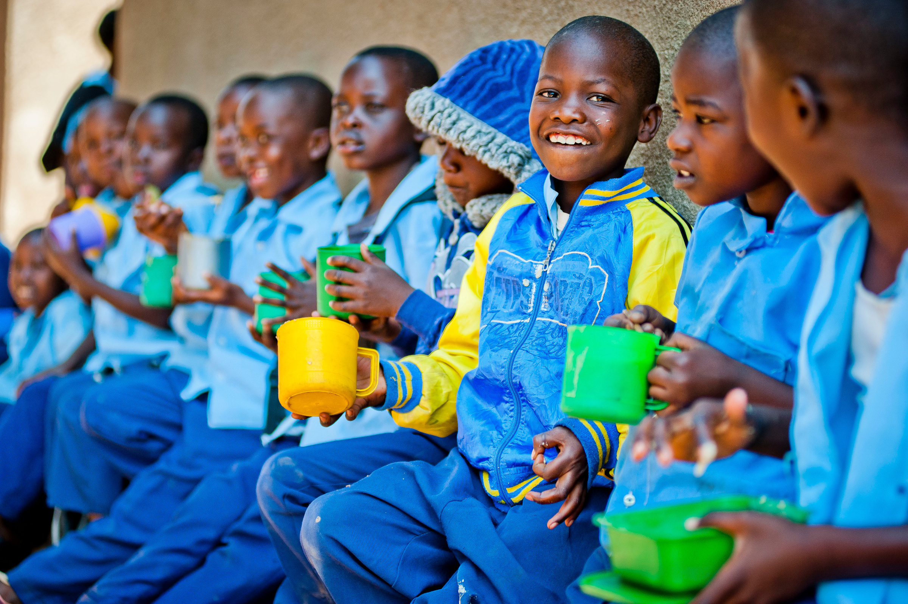
What should I do?
Little Acts of Love for Len
Notes:
Notes:
Encourage discussion. Change scenario if needed.
_____________________________
Script:
Class, I have a problem I’m hoping you can help me with.
I have a friend who just moved to a new city and is feeling super lonely. He said he wishes he felt more loved and not invisible.
What can I tell him?
_____________________________
Citation:
- Image by Mary's Meals.

Slide 16
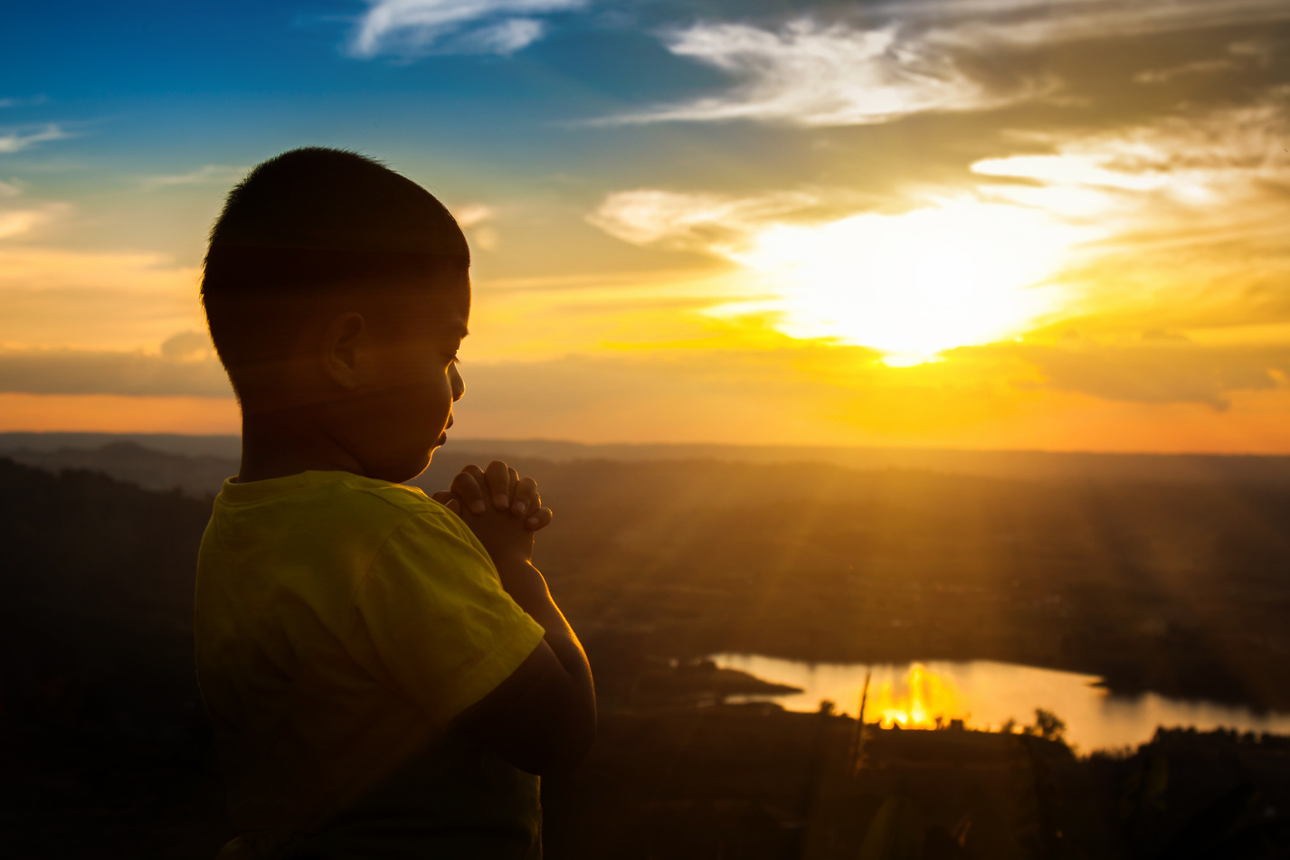
What is Faith?
Faith means trusting that God loves us and has a plan, believing what He teaches, and showing it by how we pray, act, and make good choices.
Little Acts of Love for Len
Notes:
Notes:
N/A
_____________________________
Script:
This week we will talk about Faith. Who can read this definition?
Faith means trusting that God loves us and has a plan, believing what He teaches, and showing it by how we pray, act, and make good choices.
How does the definition of faith relate to my friend who is lonely in a new city?
Would you change what you said to him after reading about faith? What else would you tell him?
_____________________________
Citation:
- Boy praying on the Mount, thank God. Image by beerphotographer / Adobe Stock

Slide 17

Listening to God activity
Blind person
  Close your eyes and pretend to be blind.
  You will be led to a different spot in the room.
  Listen carefully and follow the directions of your partner to get back to your desk.
Leader
  Lead your blind partner to a different spot in the room. It can be any spot, don’t go straight there so they can’t retrace their steps easily.
  Help your partner get back to their desk using only words.
You have 90 seconds, then switch roles!
Little Acts of Love for Len
Notes:
Notes:
In the following activity students will be blindfolded, taken to a new spot in the room, and then guided back to their desks by one of their classmates.
Help students realize that it's hard when they can't see what's ahead. They can learn that God sees what we cannot and helps us through challenges.
_____________________________
Script:
Each of you will partner with the person sitting next to you. One of you will close your eyes and be blind, one of you will lead.
Let’s go over the instructions (read instructions from slide).
[Activity time]
Was it easy or hard to listen to your partner?
How did other people’s voices affect you?
What techniques did you use to listen well?
How can we listen to God like we listened to our partner?
_______________________________
Citation:
- penyushkin / Adobe Stock

Slide 18

Faith like a mustard seed
(Matthew 17:5-6)
And the apostles said to the Lord, “Increase our faith.”
The Lord replied, “If you have faith the size of a mustard seed, you would say to [this] mulberry tree, ‘Be uprooted and planted in the sea,’ and it would obey you.
Click to View Video
Little Acts of Love for Len
Notes:
Notes:
If you don’t want to show the video, you could share a quick summary of the story or read the verses.
Bible resource: https://www.biblegateway.com/passage/?search=mathew%2017&version=NABRE
_____________________________
Script:
Let’s learn about a story in the Bible that shows the virtue of Faith.
[Students watch clip]
Or:
Can someone read this scripture out loud?
[Student reads]
How big is a mustard seed —it’s tiny! But even a tiny bit of faith can do big things.
Have you ever had someone smile or be nice to you on a day that you were having a hard time? Something so small to them was much bigger for you.
What small kind things can we do to make a big difference for others?
_____________________________
Citation:
- PursueGOD Kids. (April 5, 2016). Faith Like a Little Mustard Seed. YouTube. https://www.youtube.com/watch?v=8VF8lWZUJL4

Slide 19
Zebron’s Story
Click to View Video
As we learn more about what others in the world are going through,
how can we help?
Little Acts of Love for Len
Notes:
Notes:
Help the students have empathy toward other people in the world who are their same age and are struggling.
*If there is a challenge in your area that is happening right now, talk about how it can apply to faith.
_____________________________ Script:
We are going to watch a clip of a boy named Zebron. Look for how he is thinking about the future and having faith that the choices he is making now will help him in the future.
[Students watch clip]
Let’s talk about this. What does this video teach us about faith? How does Zebron have faith?
_____________________________
Citation:
- Mary's Meals. (Oct 25, 2024). Feeding Zambia's Future.

Slide 20

Match the Bible character
with a story of faith!
Instructions:
  You will get either a Bible character or their story. Walk around and ask your classmates questions to find your match.
  After you find your match, talk about how that character showed faith.
  How you can show faith like your character?
  Share your ideas with the class.
Little Acts of Love for Len
Notes:
Notes:
Print and cut out Bible characters and their faith stories. Mix and hand them out.
Bible character/faith printable:
https://docs.google.com/document/d/1bnljAbKiKwhTELCZ2cJE5W5Rad5HD72ggLMJMb1aDcg/edit?tab=t.0
_____________________________
Script:
I will give each of you either a person or a story about faith.
You will need to go around the classroom asking questions to each other to match your stories and people.
After everyone finds their match, you will need to tell about your person and their story of faith.
Then, tell us how their story can apply to your life.
_______________________________
Citation:
- surachat / Adobe Stock

Slide 21
Lent Calendar
When your name is chosen, be ready to share your Little Acts of Love
Complete your Lent Calendar
Perform Little Acts of Love for people this week
Little Acts of Love for Len
Notes:
Notes:
N/A
_____________________________
Script:
Remember to complete your Lent calendar and do Little Acts of Love for someone this week.
Let's draw the names to know which three of you will share your Little Acts of Love next week.
_______________________________
Citation:
- ST.art / Adobe Stock
- tannikart / Adobe Stock

Slide 22
Hope
Notes:
Notes:
You can choose to teach all the content in one class or break it up over several days.
Total lesson time: 45 min.
_____________________________
Script:
N/A
_____________________________
Citation:
N/A

Slide 23
Acts of Love
Instructions:
Share what you did to show love and kindness during the week.
Little Acts of Love for Len
Notes:
Notes:
N/A
_____________________________
Script:
Okay, class! Let’s hear about some Acts of Love you did this week. [Student 1, Student 2, and Student 3], please share one of your experiences doing a little act of love.
* Student 1
* Student 2
* Student 3
Thank you for sharing!
_____________________________
Citation:
N/A

Slide 24

What should I do?
Little Acts of Love for Len
Notes:
Notes:
N/A
_____________________________
Script:
I have a problem I hope you can help me with.
I have a friend who knows someone who is really sick and is in the hospital. She is worried about what will happen to them.
What can I say to her that would help her feel better?
_____________________________
Citation:
- merrimonc/ Adobe Stock

Slide 25
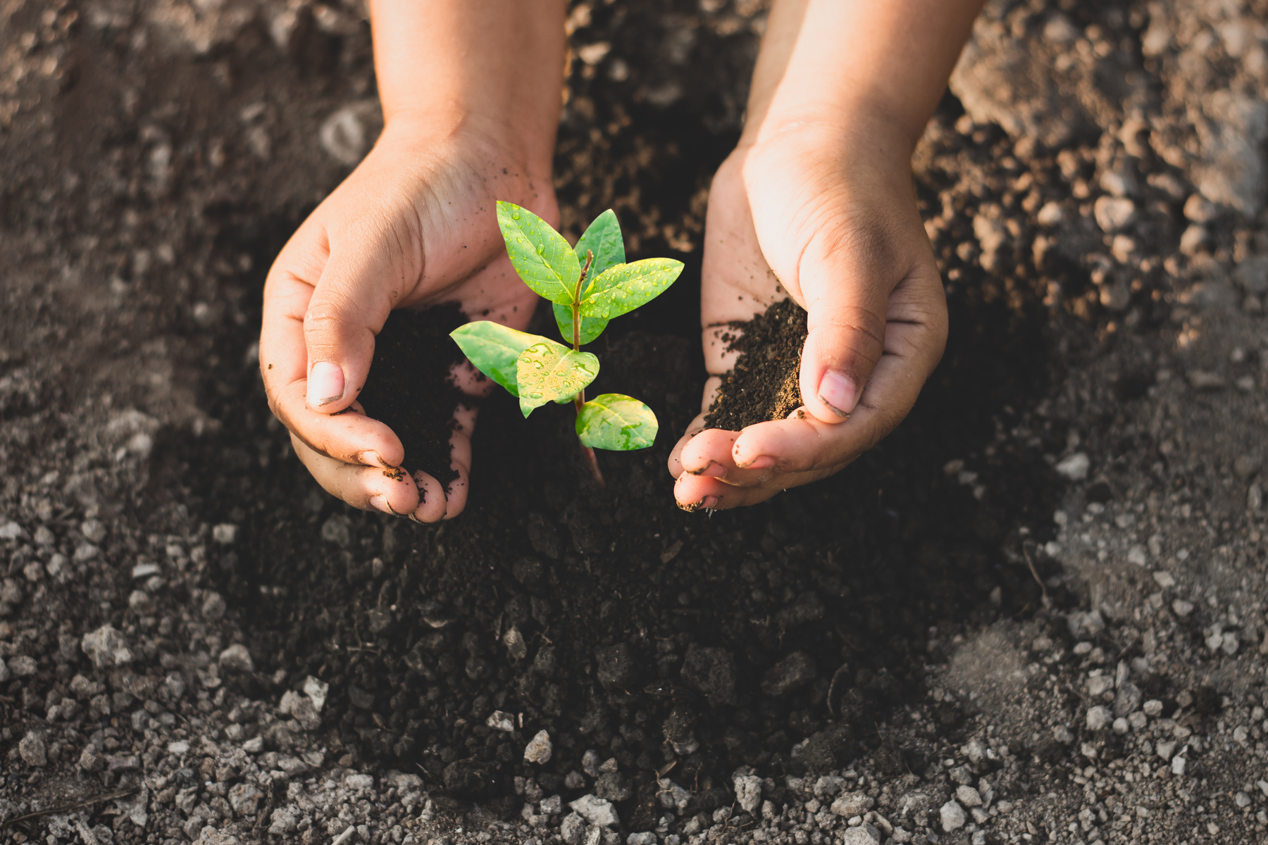
What is Hope?
Hope is trusting God’s promises even when we don’t see the outcome.
Little Acts of Love for Len
Notes:
Notes:
N/A
_____________________________
Script:
This week we are talking about the virtue of hope.
Can someone please read the definition?
[Student reads]
If we can’t see into the future, how do we know that things are going to be okay?
Now that we have talked about hope a little bit, would you say anything else to help my friend in the hospital?
Some things in our lives might not happen the way we hope for. We can put our trust in God and hope that even though we can’t see into the future, God can and we can trust him.
_____________________________
Citation:
- 994yellow / Adobe Stock

Slide 26

Let’s do an experiment!
Little Acts of Love for Len
Notes:
Notes:
*You will do a short experiment with your class.
Materials needed:
-Plastic Ziploc bag filled with water
-Several sharpened pencils
*Watch object lesson video before class to learn how to do the experiment with class.
Object lesson video for teachers viewing:
https://www.youtube.com/watch?v=RmXpgqxr4VM
_____________________________
Script:
Do you trust me to poke the bag with the pencil and not get water all over? What do you think will happen when I poke the bag?
[Students watch the teacher poke a pencil into the bag.]
Did it happen the way you thought it would?
Let’s go back to that definition of hope:
Hope is trusting God’s promises even when we don’t see the outcome.
How could this activity relate to hope?
Just like with the bag of water, we couldn’t see the outcome. God wants good things for us though and we can hope for good things and trust that God will deliver.
_______________________________
Citation:
- Don Mroczkowski / Adobe Stock

Slide 27
The Loaves and the Fishes
(John 6:5-13)
When Jesus looked up and saw a great crowd coming toward him, he said to Philip, “Where shall we buy bread for these people to eat?”
Jesus then took the loaves, gave thanks, and distributed to those who were seated as much as they wanted.
Click to View Video
Little Acts of Love for Len
Notes:
Notes:
If you don’t want to show the video, you could share a quick summary of the story or read the verses.
Bible resource: https://www.biblegateway.com/passage/?search=John%206&version=NABRE
_____________________________
Script:
Let’s learn about a story in the Bible that shows the virtue of Hope.
[Students watch clip]
Or:
Can someone read this scripture out loud?
[Student reads]
How did the people with Jesus have hope? Do you think they learned that they could hope for good things?
_____________________________
Citation:
- Saddleback Kids. (July 23, 2018). Jesus Feeds the 5,000. YouTube. https://www.youtube.com/watch?v=S6rj9cAJrWE

Slide 28
Grains of Hope
Click to View Video
It is very hard for some people in the world to get an education.
What can you do to help make it easier for them?
Little Acts of Love for Len
Notes:
Notes:
Help the students see that hope is something that we can share with people all over the world.
_____________________________
Script:
Mary’s Meals helps give people all over the world, who cannot afford to eat, food at school. And getting food at school helps those children to go to school.
When you watch this clip, think about the hope that these adults have for the young children because of the opportunity the children have to attend school.
[Students watch clip]
How many of us have days when we don’t want to go to school? Think about what it would be like for this community who sees school as the way to have a better life.
_____________________________
Citation:
- Mary's Meals. (Oct 25, 2024). Feeding Zambia's Future.

Slide 29

Hope relay!
Instructions:
  Split into two teams.
  Line up by your team’s words.
  The first person takes the top word, runs, and places it in the correct spot (synonym or antonym).
  Run back and tag the next person in line.
  The next person takes a word and does the same thing.
  Keep repeating these steps until all the words are sorted.
  Have everyone on your team raise your hands when you finish.
Little Acts of Love for Len
Notes:
Notes:
Relay words:
https://docs.google.com/document/d/1k6mvmkQgxBMnDrJYObRwOAlOUEv2f1Lc-tPrhZ2GWUw/edit?usp=sharing
Print two sets of the words file in a large, easy-to-read size.
*Differentiate the set of words for each team (i.e., print them on different colors of paper).
Cut the words apart and mix them up.
Place each set in a different starting area.
Designate where the synonyms will go and where the antonyms go (different spots).
*Play in the hallway or outside if more space is needed.
_____________________________
Script:
We’re going to play a relay race!
This side of the class is one team, and the other side is another team.
Each team has a pile of words—some mean the same as hope (synonyms), and some mean the opposite (antonyms).
Let’s go over the instructions
[After the game]
Let’s check if the words are in the right place.
Did you hope your team would win?
You all worked hard! Just like in this game, we can have hope because God is on our team, helping us through everything!
_______________________________
Citation:
- kwanchaichaiudom / Adobe Stock

Slide 30
Lent Calendar
When your name is chosen, be ready to share your Little Acts of Love
Complete your Lent Calendar
Perform Little Acts of Love for people this week
Little Acts of Love for Len
Notes:
Notes:
N/A
_____________________________
Script:
Remember to complete your Lent calendar and do Little Acts of Love for someone this week.
Let's draw the names to know which three of you will share your Little Acts of Love next week.
_______________________________
Citation:
- ST.art / Adobe Stock
- tannikart / Adobe Stock

Slide 31
Justice (Kindness)
Notes:
Notes:
You can choose to teach all the content in one class or break it up over several days.
Total lesson time: 50 min.
_______________________________
Script:
N/A
_______________________________
Citation:
N/A

Slide 32
Acts of Love
Instructions:
Share what you did to show love and kindness during the week.
Little Acts of Love for Len
Notes:
Notes:
N/A
_______________________________
Script:
Okay, class! Let’s hear about some Acts of Love you did this week. [Student 1, Student 2, and Student 3], please share one of your experiences doing a little act of love.
* Student 1
* Student 2
* Student 3
Thank you for sharing!
_______________________________
Citation:
N/A

Slide 33

What should I do?
Little Acts of Love for Len
Notes:
Notes:
N/A
_______________________________
Script:
I have a problem I hope you can help me with. I love chocolate cake, so I spent a lot of time making one. I have some friends who love the chocolate cake I make. I was planning on eating all the cake myself, but I don't know if that is the best idea. What should I do?
[Students share their ideas]
Thank you for all of your ideas!
_______________________________
Citation:
- narong27 / Canva

Slide 34
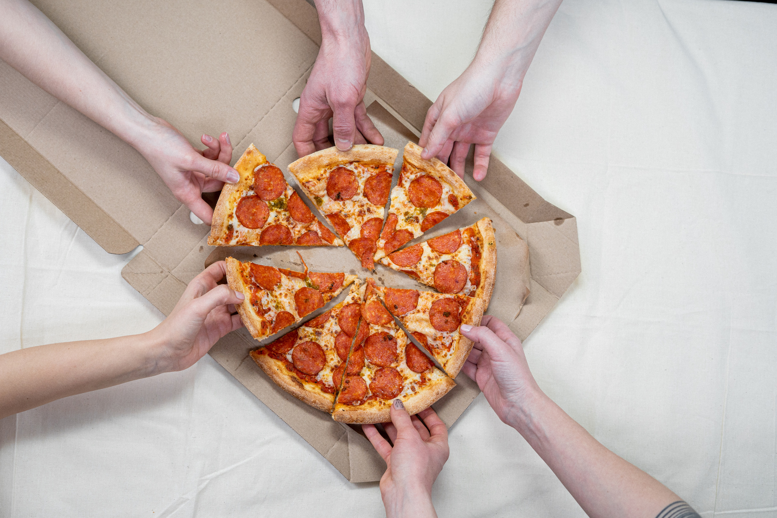
What is Justice?
Justice means treating everyone fairly and with respect, making sure we share what we have so that everyone gets what they need, because there is enough for everyone if we all do our part.
Little Acts of Love for Len
Notes:
Notes:
N/A
_______________________________
Script:
Who will read the definition of justice on the screen?
[Student reads]
How does the virtue of justice relate to the chocolate cake I made?
Who can share a story of someone they have seen show justice (or kindness)?
_______________________________
Citation:
- Photo by cottonbro from Pexels.

Slide 35
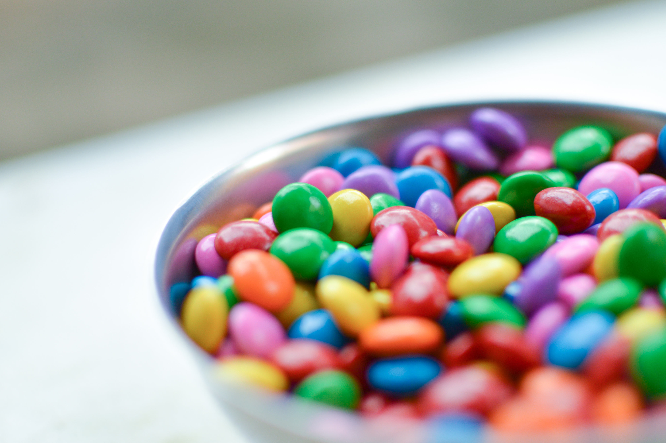
Candy for Everyone
Instructions:
  Line up.
  Take a piece of paper from the jar.
  Go back to your seats.
  Wait to receive your candies.
  Don’t eat the candies when you get them.
Little Acts of Love for Len
Notes:
Notes:
-Write numbers on small pieces of paper and put them in a cup.
-Have a bag of M&Ms (or another small candy).
-Each student draws a number from the cup.
-Go around and give each student M&Ms based on the number they drew.
Ask the students if they think the distribution of candy was fair or kind. Ask students what they could do to make it more fair.
Have everyone share their candy with their neighbors until everyone has the same amount (add more M&Ms if needed).
Guide the discussion around the topic of kindness and justice.
_______________________________
Script:
We’re going to try an experiment to learn more about justice.
Everyone please line up and take a number out of the cup, then go back to your seats.
[Pass out the M&Ms according to the number each child has]
Now that you have your M&Ms, do you think you got a fair number?
How can we make this more fair?
When we see something around us that is not fair, what can we do about it?
_______________________________
Citation:
- Photo by Caio from Pexels.

Slide 36
Elijah visits the Widow
of Zarephath
(1 Kings 17:7-16)
“For the Lord, the God of Israel, says: The jar of flour shall not go empty, nor the jug of oil run dry, until the day when the Lord sends rain upon the earth.”
Click to View Video
Little Acts of Love for Len
Notes:
Notes:
If you don’t want to show the video, you could share a quick summary of the story.
Online Bible resource: https://www.biblegateway.com/passage/?search=1%20Kings%2017&version=NABRE
_____________________________
Script:
Let’s learn about a story in the Bible that shows the virtue of Justice.
[Students watch clip]
How did the widow show justice? What did you learn about how we can show justice?
_________________________
Citation:
- Niños del Rio James. (Jul 20, 2021). ELIJAH AND THE WIDOW | James River Kids. Youtube. https://www.youtube.com/watch?v=VzulJuvfyW0

Slide 37
Magnus Starts Mary’s Meals
Click to View Video
How can we help people in other parts of the word get the things they need?
Little Acts of Love for Len
Notes:
Notes:
The video exemplifies making sure we share what we have so that everyone gets what they need, because there is enough for everyone if we all do our part.
_____________________________
Script:
Let’s learn more about Justice as we watch a video on how Mary’s Meals started. As you watch the video, look for ideas of ways you can help others and be just.
[Students watch clip]
How did Magnus show the virtue of Justice? What are some ways we can help others receive the things they need?
_____________________________
Citation:
- Mary's Meals. (Apr 25, 2017). Generation Hope. Youtube.

Slide 38

Role Playing Game!
Instructions:
  Get into groups of 3 to 4 students.
  Pick a paper out of the jar.
  Get ready to act out your scenario in front of the class.
  While your classmates are acting, think of how you could make the situation more fair.
Little Acts of Love for Len
Notes:
Notes:
Instructions
-Divide the class into groups.
-Have each group get a paper and act the scenario on paper.
-After the students act out the scenario, the rest of the class gives ideas of how you could make the situation fair or what they would do differently.
Example situations you could write on the paper:
* One student always gets picked first for games, but others never get chosen.
* Some students get extra time on assignments, while others don’t.
* One student gets all the best supplies, but others have to use broken or old ones.
* A student gets to sit in the best spot in the classroom, but others don’t have a choice about where to sit.
* One student is always called on to answer questions, while others never get a turn.
_____________________________
Script:
We’re going to play a role-playing game!
Get in groups of 3-4 and pick a paper out of the jar.
Your team will now need to act out what’s on your paper for the rest of the class.
As the team acts, everyone will give ideas of how that situation can be made more fair.
_______________________________
Citation:
- nisara / Adobe Stock

Slide 39
Lent Calendar
When your name is chosen, be ready to share your Little Acts of Love
Complete your Lent Calendar
Perform Little Acts of Love for people this week
Little Acts of Love for Len
Notes:
Notes:
N/A
_____________________________
Script:
Remember to complete your Lent calendar and do Little Acts of Love for someone this week.
Let's draw the names to know which three of you will share your Little Acts of Love next week.
_______________________________
Citation:
- ST.art / Adobe Stock
- tannikart / Adobe Stock

Slide 40
Love our Neighbor
Notes:
Notes:
You can choose to teach all the content in one class or break it up over several days.
Total lesson time: 50 min.
_____________________________
Script:
N/A
_____________________________
Citation:
N/A

Slide 41
Acts of Love
Instructions:
Share what you did to show love and kindness during the week.
Little Acts of Love for Len
Notes:
Notes:
N/A
_____________________________
Script:
Okay, class! Let’s hear about some Acts of Love you did this week. [Student 1, Student 2, and Student 3], please share one of your experiences doing a little act of love.
* Student 1
* Student 2
* Student 3
Thank you for sharing!
_____________________________
Citation:
N/A

Slide 42
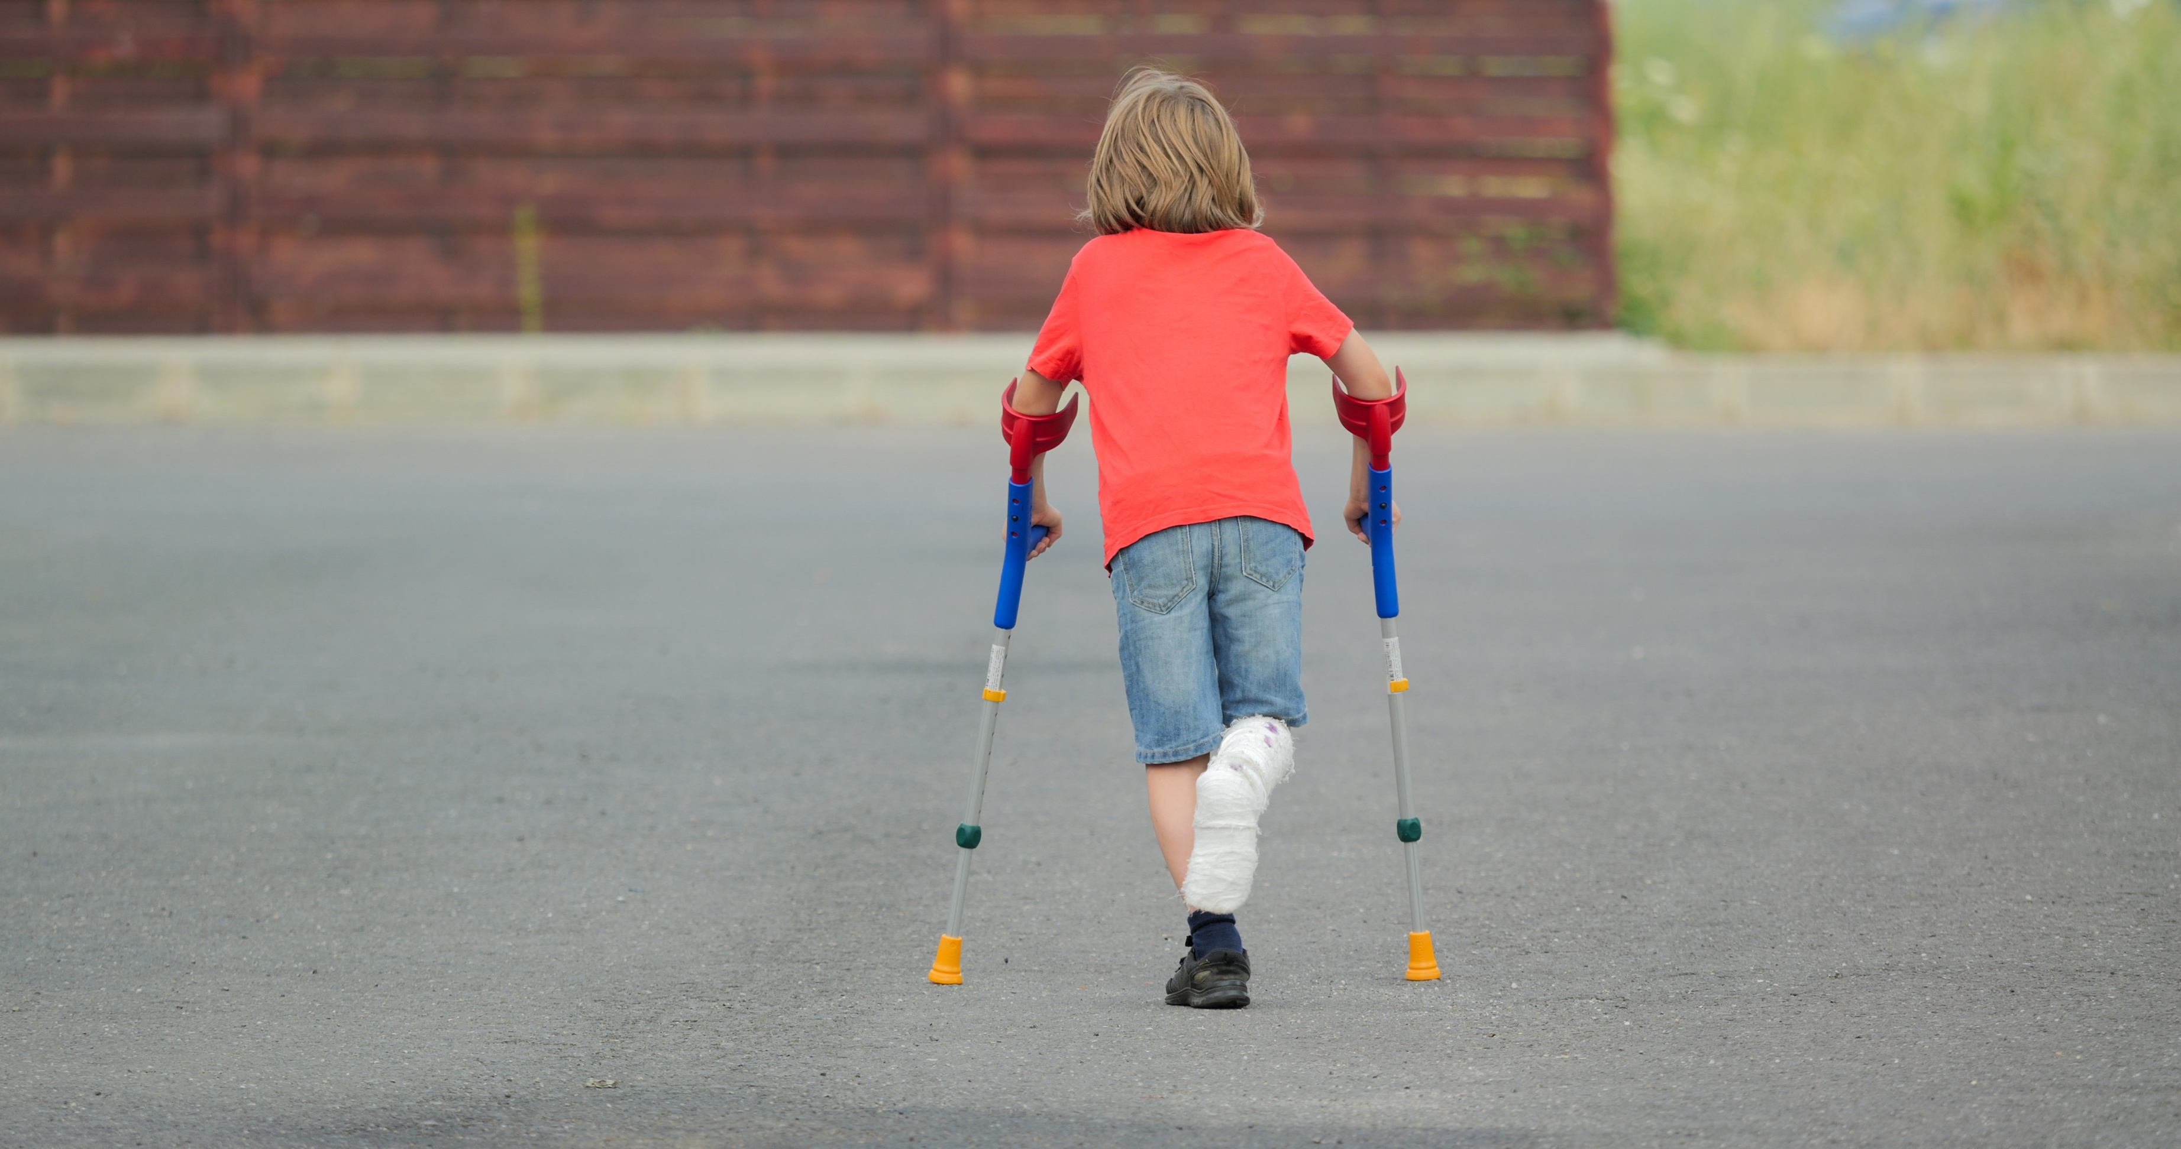
What should I do?
Little Acts of Love for Len
Notes:
Notes:
N/A
_____________________________
Script:
I have a problem I hope you can help me with.
I have a friend who broke his leg. I offered to help him mow his lawn or make him food, but he said he didn’t need any help.
I still feel I should help him somehow. Do you think he needs help? What can I do to help him feel better?
_____________________________
Citation:
- AndreyPopov via Getty Images.

Slide 43
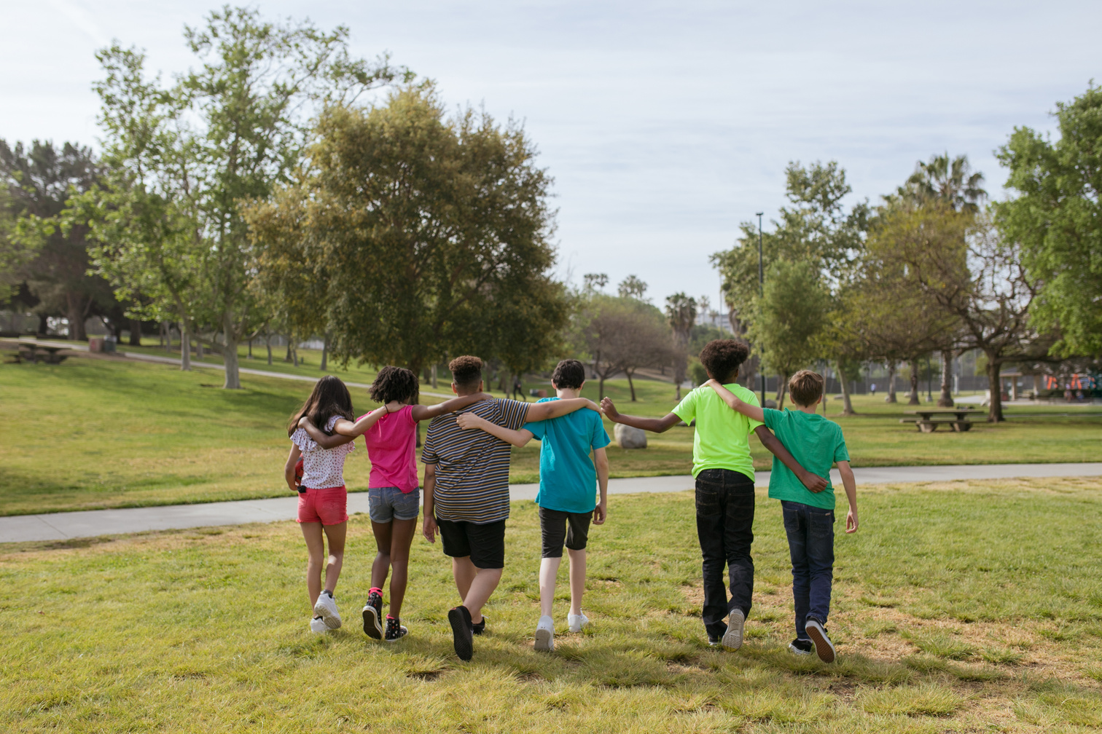
What does it mean to Love your neighbor?
Love your Neighbor means you see all people as your neighbors or as members of your family connected together. You look out for them and try to help them. You treat them as your friends.
Little Acts of Love for Len
Notes:
Notes:
N/A
_____________________________
Script:
Who can read the definition of Love of Neighbor on the screen?
[Student reads]
How does helping my friend relate to the virtue of Love of Neighbor?
Who can share a story of someone they have seen show Love of Neighbor?
_____________________________
Citation:
- Photo by RDNE Stock Project from Pexels.

Slide 44

Good Deep Ripple!
Instructions:
  Everyone will stand around the table.
  One person will be chosen to drop a toy into the tray filled with water.
  Another person will be chosen to drop another toy into the tray.
  Watch as the water moves when the toys are dropped.
Little Acts of Love for Len
Notes:
Notes:
Guide students through an activity to help them understand how their actions can create change in the community.
Get a large, shallow baking sheet. Fill with water. Have students take turns dropping small objects.
Guide the discussion around the reflection questions.
_____________________________
Script:
Let’s try an experiment to learn about good deeds.
Look at this baking sheet full of water. Do you see any movement in the water?
Let’s have someone come and help.
What happens when [student name] drops this toy into the water?
Let’s have someone else have a turn.
What happens to the waves in the water when the toys are dropped?
How would you compare the waves or ripples to doing something nice for those around you?
_____________________________
Citation:
- Canva AI Studio / Canva

Slide 45
The Prodigal Son
(Luke 15:11-32)
“But now we must celebrate and rejoice, because your brother was dead and has come to life again; he was lost and has been found.”
Click to View Video
Little Acts of Love for Len
Notes:
Notes:
Online Bible resource: https://www.biblegateway.com/passage/?search=Luke%2015&version=NABRE
If you don’t want to show the video, you could share a quick summary of the story.
_____________________________
Script:
Let’s learn about a story in the Bible that shows the virtue of Love our Neighbor.
[Students watch clip]
How does this story show Love our Neighbor? What does this story teach us about loving our neighbor?
_________________________
Citation:
- Gateway Kids. (Oct 17, 2024). THE PRODIGAL SON - A Gateway Kids Animation. Youtube. https://www.youtube.com/watch?v=zginPWgj7Ho

Slide 46
Mary’s Meals Examples of Loving your Neighbor
Click to View Video
How can we show love to our neighbors in other parts of he world?
Little Acts of Love for Len
Notes:
Notes:
The video shows the sacrifices of many of the village women to walk (at times) 3 hours uphill with bags of meals on their heads to be able to supply food to the school there.
_____________________________
Script:
Let’s learn about some of the sacrifices women in a village make to ensure children receive their food supplies from Mary’s Meals.
[After the video]
How do these women show Love our Neighbor?
_________________________
Citation:
- Mary's Meals. (Apr 25, 2017). Generation Hope. Youtube.

Slide 47

Let’s build a puzzle
Instructions:
  Make groups of 4 to 5.
  Pick a puzzle from the table.
  Complete the puzzle and have fun!
Little Acts of Love for Len
Notes:
Notes:
Help the children see that everyone is important and needs to be included to be whole.
Setup:
Have students work in groups.
Give each group a small puzzle (e.g. 10 piece puzzle), but keep one piece hidden.
Have students work together to put the puzzle together.
When they notice one piece is missing, bring out the last piece and talk to them.
Just like a puzzle needs all its pieces to be complete, we miss people when they’re not with us. We’re complete when everyone is together. Every person matters just like every puzzle piece matters.
_____________________________
Script:
Let’s do a puzzle together.
[Children work on the puzzle]
What happened? Why can’t you complete the puzzle?
Here’s the last piece. How does it feel to have all the pieces of a puzzle?
Just like the puzzle isn’t complete, we miss others when they are not with us. We’re complete when we’re all together. Everyone is important.
How can we make sure we include everyone?
_______________________________
Citation:
- Photo by Sharon Snider from Pexels.

Slide 48
Lent Calendar
When your name is chosen, be ready to share your Little Acts of Love
Complete your Lent Calendar
Perform Little Acts of Love for people this week
Little Acts of Love for Len
Notes:
Notes:
N/A
_____________________________
Script:
Remember to complete your Lent calendar and do Little Acts of Love for someone this week.
Let's draw the names to know which three of you will share your Little Acts of Love next week.
_______________________________
Citation:
- ST.art / Adobe Stock
- tannikart / Adobe Stock

Slide 49
Wisdom
Notes:
Notes:
You can choose to teach all the content in one class or break it up over several days.
Total lesson time: 45 min.
_____________________________
Script:
N/A
_____________________________
Citation:

Slide 50
Acts of Love
Instructions:
Share what you did to show love and kindness during the week.
Little Acts of Love for Len
Notes:
Notes:
N/A
_____________________________
Script:
Okay, class! Let’s hear about some Acts of Love you did this week. [Student 1, Student 2, and Student 3], please share one of your experiences doing a little act of love.
* Student 1
* Student 2
* Student 3
Thank you for sharing!
_____________________________
Citation:
N/A

Slide 51

What should I do?
Little Acts of Love for Len
Notes:
Notes:
If possible, bring a box to class.
_____________________________
Script:
Imagine that you find a beautiful box on your doorstep with no name. Inside, you discover a large bag of food and a note that says, ‘This is yours to keep, or you can share it with someone in need. What would you do?’
[Students share ideas]
Who would like to share what you discussed with your partner?
This scenario shows us how important sharing is. These are just the kind of decisions that reflect wisdom.
_____________________________
Citation:
- STOATPHOTO / Adobe Stock

Slide 52

What is Wisdom?
Wisdom means using what you know and have learned from God and His teachings to make good choices and decisions.
Little Acts of Love for Len
Notes:
Notes:
N/A
_____________________________
Script:
Who would like to read the definition?
[Student reads]
Wisdom is more than just knowing things; it’s about using what you know to make good choices.
Let's connect this to our discussion about sharing. How do you think your ideas about sharing from the mysterious gift scenario relate to wisdom?
_____________________________
Citation:
- mantinov / Adobe Stock

Slide 53

Wisdom Word Wall: Wise or Foolish?
Instructions:
  Think of one word that represents wisdom and one word that represents foolishness
  Write your words on a sticky note
  Place them on the wall
Little Acts of Love for Len
Notes:
Notes:
Materials:
- Sticky notes for every student
- Space for a Wisdom Word Wall
Wisdom related words: sharing, smart, learning, intelligence, thoughtful, careful
Foolish related words: silly, impulsive, careless, giddy, unwise
_____________________________
Script:
Let’s play Wisdom Word Wall. Think of one word that represents wisdom and one word that represents foolishness.
Write each word on a sticky note in big letters. Then, place your notes on the wall—wisdom words on one side, foolish words on the other.
_________________________
Citation:
- Imagentive / Adobe Stock

Slide 54
The Wise Man and the
Foolish Man
(Matthew 7:24-27)
https://www.youtube.com/watch?v=zginPWgj7Ho
“And everyone who listens to these words of mine but does not act on them will be like a fool who built his house on sand.”
https://www.youtube.com/watch?v=CStm71p8g_I
Little Acts of Love for Len
Notes:
Notes:
Video 1 (3th graders): https://www.youtube.com/watch?v=I6S3cRVLMFQ
Video 2 (4th and 5th graders) / (00:35 - 3:15): https://www.youtube.com/watch?v=CStm71p8g_I
You could also have the students read the parable (Matthew 7:24-27).
Bible Online Resource: https://www.biblegateway.com/passage/?search=Matthew%207&version=NIV
_____________________________
Script:
Let's see how we can connect some of the words from our word wall to the characters in the story. Pay attention to the following video about the parable of The Wise Man and the Foolish Man.
[Students watch the video]
What do you think makes someone wise? How can we apply wisdom in our own lives?
_____________________________
Citation:
- Saddleback Kids. (Mar 5, 2018). The Parable of the Two Builders [Video file]. YouTube. https://www.youtube.com/watch?v=I6S3cRVLMFQ
- Crossroads Kids' Club. (Feb 12, 2024). God's Story: Parable of the Two Builders Video file]. YouTube. https://www.youtube.com/watch?v=CStm71p8g_I

Slide 55
Mary’s Meals: how a simple acts leads to a great future
Click to View Video
How did Mary’s Meals have an impact on Veronica’s life? Is there anything we can do to help people around the world?
Little Acts of Love for Len
Notes:
Notes:
If there’s another example that you think would relate more to your class, you could use that example/story.
_____________________________
Script:
Pay attention to the following video about Veronica, a girl that has benefited from Mary’s Meals organization.
[Students watch clip]
Can we think of some words from our Wisdom Word Wall that relate to her? How can helping a group like Mary’s Meals make us wise?
_____________________________
Citation:
- Mary's Meals. (Nov 10, 2013). Child 31 - The Story of Mary's Meals [Video file].

Slide 56

Charades: wise or unwise?
Instructions:
  One pair of students will act out a scenario in front of the class.
  After they act for one minute, guess what they are acting out.
  Decide if they are made a wise or unwise decision and why.
Little Acts of Love for Len
Notes:
Notes:
Scenario 1: A student sees a classmate struggling with homework and offers to help them.
Scenario 2: A child chooses to eat only candy and skip any healthy snacks during lunchtime.
Scenario 3: A student sees someone being bullied and tells the teacher about it.
Scenario 4: A child refuses to share their toy and tells their friend to leave them alone.
_____________________________
Script:
Let’s play charades, focusing on wisdom. I will need 4 pairs of students to act out different scenarios. The rest will guess what they are acting out, and we will decide whether the students made a wise choice or not.
Let’s start with [student A, B, C, D].
After the game: This was a fantastic way to see how our choices, whether wise or unwise, can affect ourselves and others.
_______________________________
Citation:
- Coetzee/peopleimages.com / Adobe Stock

Slide 57
Lent Calendar
When your name is chosen, be ready to share your Little Acts of Love
Complete your Lent Calendar
Perform Little Acts of Love for people this week
Little Acts of Love for Len
Notes:
Notes:
N/A
_____________________________
Script:
Remember to complete your Lent calendar and do Little Acts of Love for someone this week.
Let's draw the names to know which three of you will share your Little Acts of Love next week.
_______________________________
Citation:
- ST.art / Adobe Stock
- tannikart / Adobe Stock

Slide 58
Charity
Notes:
Notes:
You can choose to teach all the content in one class or break it up over several days.
Total lesson time: 50 min.
_____________________________
Script:
N/A
_____________________________
Citation:

Slide 59
Acts of Love
Instructions:
Share what you did to show love and kindness during the week.
Little Acts of Love for Len
Notes:
Notes:
N/A
_____________________________
Script:
Okay, class! Let’s hear about some Acts of Love you did this week. [Student 1, Student 2, and Student 3], please share one of your experiences doing a little act of love.
* Student 1
* Student 2
* Student 3
Thank you for sharing!
_____________________________
Citation:

Slide 60
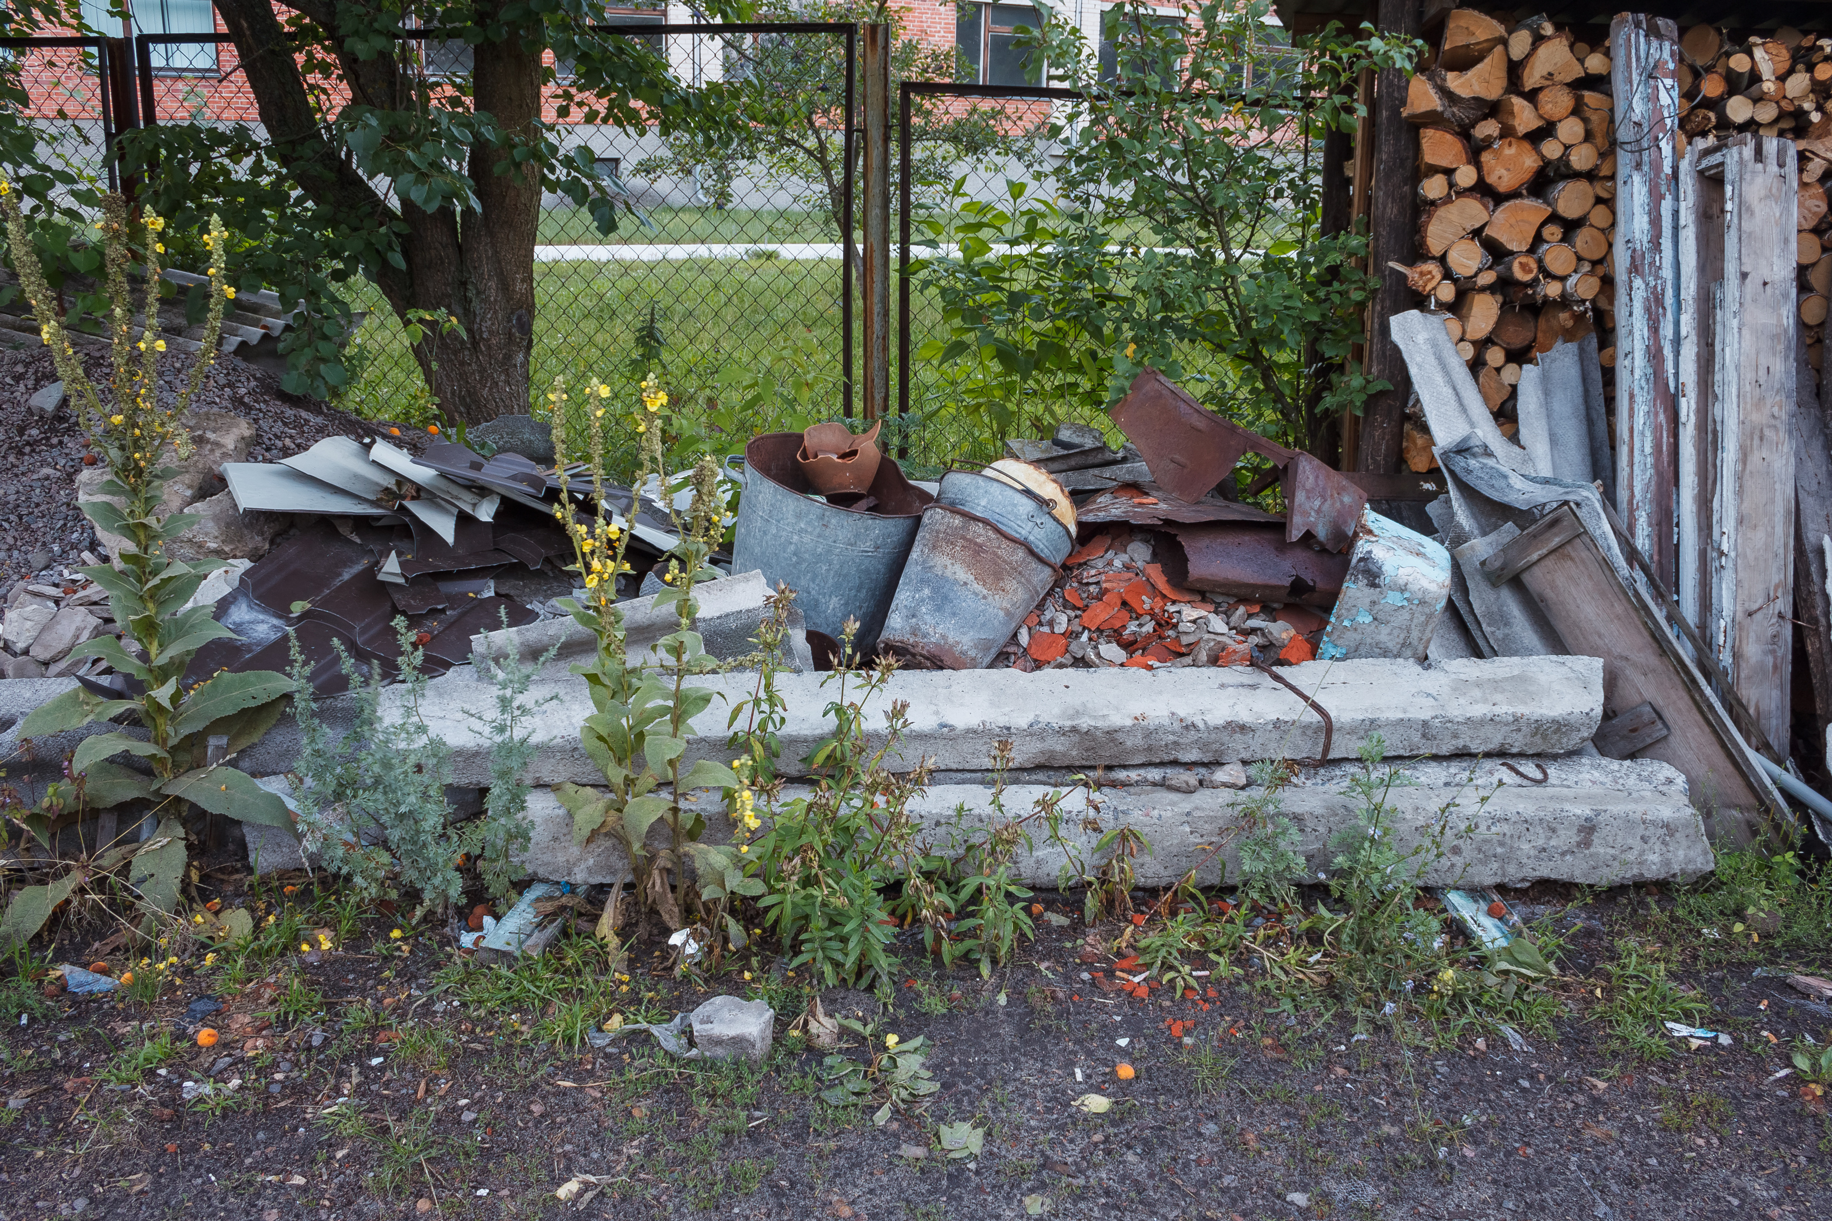
What should I do?
Little Acts of Love for Len
Notes:
Notes:
Pretend you have this dilemma. Help students get engaged with the story.
You can choose to tell that you were planning to do your favorite activity next Saturday.
_____________________________
Script:
Class, I need your help. My neighbor, Mrs. Nelson, is often alone and struggling with her garden since she’s old and sick.
This Saturday is my day to relax, but I feel like I should help her. I could spend the day reading my book, or I could go over and help Mrs. Nelson with her garden.
What would you do if you were in my place? Should I enjoy my Saturday, or should I help Mrs. Nelson who is in need?
[Students share their ideas]
Thank you for your ideas. Let’s learn how this story can relate to charity.
_____________________________
Citation:
- Roman / Adobe Stock

Slide 61
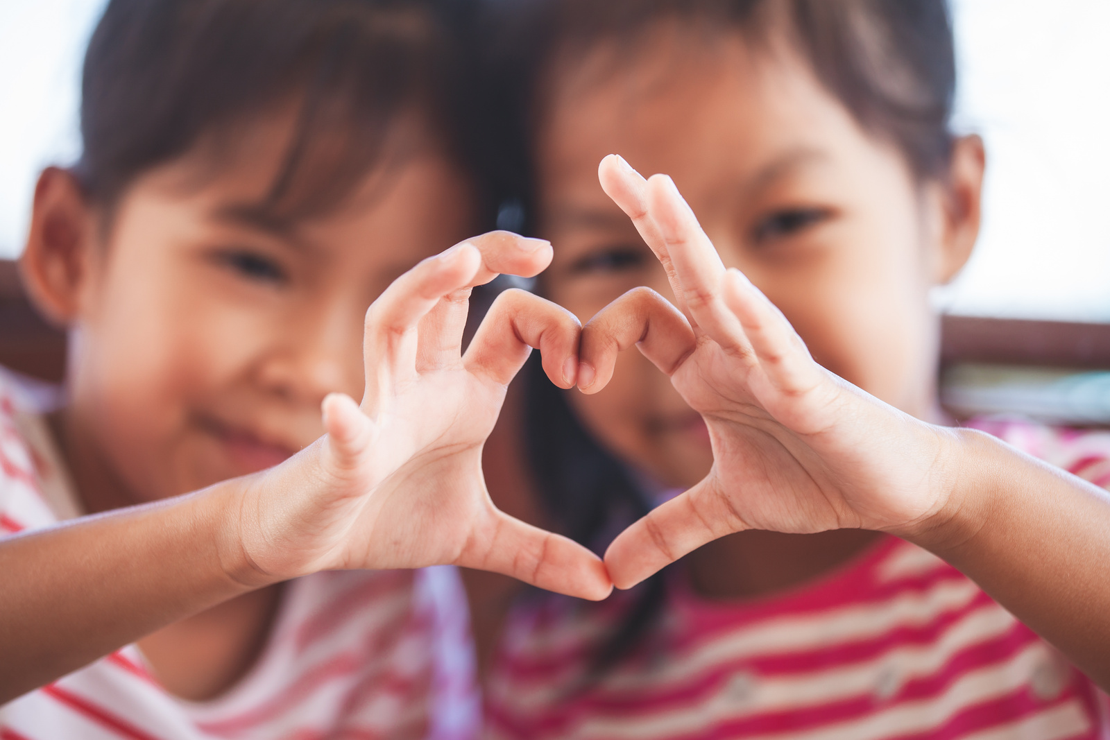
What is Charity?
Charity means loving God above all and loving ourselves and our neighbors for the sake of God.
Little Acts of Love for Len
Notes:
Notes:
N/A
_____________________________
Script:
Who would like to read the definition?
[Student reads]
Charity means loving God above all and loving ourselves and our neighbors for the sake of God.
Let's connect this to our discussion about my neighbors garden. How do you think your ideas about helping my neighbor relate to charity?
_____________________________
Citation:
- pingpao / Adobe Stock

Slide 62

How can I show charity?
Instructions:
  With a classmate, think of three ways you can show charity in your life every day.
  Write down your ideas.
Little Acts of Love for Len
Notes:
Notes:
N/A
_____________________________
Script:
With your classmate next to you, think of three ways you can show charity in your life every day. Write your ideas in your notebook.
[Activity time]
Who would like to share their ideas?
_____________________________
Citation:
- ajayptp / Adobe Stock

Slide 63
The good Samaritan
(Luke 10:25-37)
“Which of these three, in your opinion, was neighbor to the robbers’ victim?”
“He answered, “The one who treated him with mercy.” Jesus said to him, “Go and do likewise.”
Watch Video: 01:06 - 03:08)
Little Acts of Love for Len
Notes:
Notes:
On video watch time stamp (01:06 - 03:08)
Online Bible Resource: https://www.biblegateway.com/passage/?search=Luke%2010&version=NIV
If you don’t want to show the video, you could share a quick summary of the story.
_____________________________
Script:
Let’s connect these ideas to a powerful story from the Bible about helping others. As you watch this video, make sure to look out for examples of showing charity.
[Students watch clip]
What examples did you find? What does the story of the Good Samaritan teach us about helping others, even if they are different from us?
_____________________________
Citation:
- Saddleback Kids. (Jul 22, 2016). The Good Samaritan (Luke 10:25-37) [Video file]. YouTube. https://www.youtube.com/watch?v=osfQg4yKtq8

Slide 64
Charlie Doherty’s charity example
Click to View Video
Can you think of a small way we can help make sure everyone in the world has enough food to eat?
Little Acts of Love for Len
Notes:
Notes:
N/A
_____________________________
Script:
Let’s learn a little more about charity in today’s world from the story of Charlie Doherty, a young man close to your age who has helped kids around the world through Mary’s Meals.
[Students watch clip]
How did Charlie’s actions show that anyone can make a difference, no matter their age?
_____________________________
Citation:
- Mary's Meals. (Nov 10, 2013). Child 31 - The Story of Mary's Meals [Video file].

Slide 65
Charity Action Plan
With a classmate, create an action plan for one of your charity ideas.
Instructions:
Use 4 different colored sticky notes or a piece of paper to answer each of the following questions
What is your charity idea?
How are you going to do it?
Who are you going to do it for?
What do you need help with?
Little Acts of Love for Len
Notes:
Notes:
Materials:
Option 1: Sticky notes. 4 different colors for each group of two students.
Optional 2: Template. Print one for each student.
Template:
(https://docs.google.com/document/d/1FgO_iCMI7Cxl3pdM0PvKONOG5ko5cP5qAgayCkxmQGM/edit?tab=t.0)
_____________________________
Script:
With a classmate, create a simple plan of how you can show charity in your life today.
Answer the following questions on each sticky note or on a paper:
- What is your charity idea?
- How you are going to do it?
- Who you are going to do it for?
- What do you need help with?
Once you’re ready, bring your sticky notes or paper up to the front and share what you are going to do.
__________________________
Citation:
- N/A

Slide 66

Congratulations
on finishing Little Acts of Love for Lent!
Little Acts of Love for Len
Notes:
Notes:
N/A
_____________________________
Script:
Congratulations on all of the Little Acts of Love for Lent you have done!
_____________________________
Citation:
-Colorful fireworks background
By radenmas / Adobe Stock

Slide 67
Reflection
What did you learn during lent this year?
How can you make a difference:
  In the classroom?
  At home?
  In the world?
Little Acts of Love for Len
Notes:
Notes:
Have a discussion on how Little Acts of Love for Lent went in your class.
_____________________________
Script:
-What did you learn during lent this year?
-Which stories from Mary’s Meals did you like the best? Why?
-What did you learn from Mary’s Meals that could help you help others?
-Do you remember what virtues we talked about? Can we list them?
-What else did you learn this year during Lent?
How can you make a difference?
-In the classroom?
-At home?
-In the world?
_____________________________
Citation:
- ananaline / Adobe Stock

Slide 68
365 days of Acts of Love
Continue doing Little Acts of Love every day!
Little Acts of Love for Len
Notes:
Notes:
N/A
_____________________________
Script:
How many days are there in a year? 365!
Let's try to keep doing little acts of love for 365 days a year.
_____________________________
Citation:
- Imagentive / Adobe Stock

